Slide 1
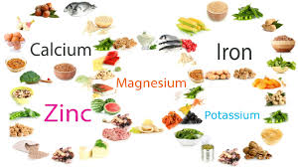
MINERALS
There are about 90 naturally occurring elements known on Earth.
It is known that 25 of these (24 or 27 in some sources) are essential and are found in foods.
The necessity of some elements is not fully known (Br, Sn, As, Cr, Mo, Rb, Sr, Ni, Ge).
When minerals are mentioned in nutrition, the elements found in foods other than C, H, O, N are understood. These four are found in organic molecules and water (H and O) and make up 99% of the number of atoms in living systems. Therefore, the amount of minerals in foods is relatively low, but they have important roles in living systems and foods.
The level (g / kg) of macro (major) elements in the human body is given below:
Ca: 10-20, P: 6-12, K: 2-2.5, Na: 1-1.5, Cl: 1-1.2, Mg: 0.4-0.5

Slide 2
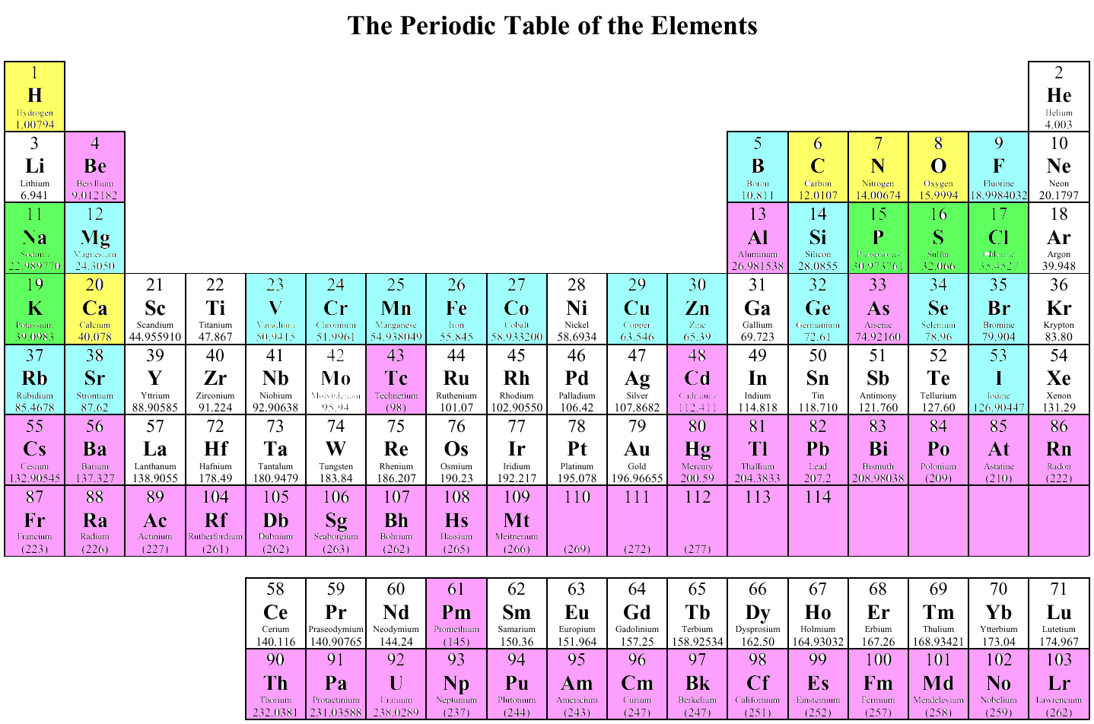
The main micro (trace) elements are Fe, I, Zn, Se, Cr, Cu, F.
Elements in foods can be in the form of a compound, complex or free ion.
The availability of these elements in living organisms generally depends on their water solubility. In the periodic table, groups 1 and 17 are generally found as free ions in foods. These are the elements Na, K, Cl and F. Many other elements are in the form of complex, chelated, or oxygen-containing anions.
The properties of the minerals can change according to the form in which they are found. Ex. Iron chloride (FeCl₃) precipitates as iron hydroxide when dissolved in water, but dissolves very well if it is chelated with citric acid. Conversely, while Ca dissolves well in CaCl2 form, it becomes insoluble when chelated with oxalate.
Yellow Boxes = Top 5 Elements present in the human body Green Boxes = Second 5 Top Elements present in the human body Blue Boxes = Trace elements that are required by the human body Violet Boxes =Elements that are deleterious to the human body.

Slide 3
Trace Elements in the Human Body and Average Daily Intake Amounts
ELEMENT | AMOUNT (mg/kg.bw) | DAILY INTAKE (mg/day)
Essential
Fe | 60 | 15
F | 37 | 2,5
Zn | 33 | 6-22
Si | 14 | 33
Cu | 1,5 | 3,2
B | 0,7 | 1,3-4,3
V | 0,3 | 0,02
As | 0,3 | 0,02-0,03
Se | 0,2 | 0,0007
Mn | 0,2 | 2-48
I | 0,2 | 0,2
Ni | 0,1 | 0,4
Mo | 0,1 | 0,3
Cr | 0,1 | 0,005-0,2
Co | 0,02 | 0,002-0,1
Non-Essential
Rb | 4,6 | 1-2
Br | 2,9 | 7,5
Al | 0,9 | 5-35
Ba | 0,3 | 1,3
Sn | 0,2 | 4
Ti | 0,1 | 0,9
Au | 0,1
Sb | 0,1
Te | 0,1 | 0,2
Li | 0,03 | 2,0
Cs | 0,02
U | 0,001
Bi | 0,0004

Slide 4
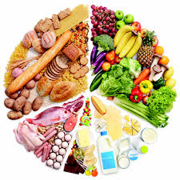
Essential Elements:
Essential means; If that substance is removed from the diet (does not exist), it means that there is a permanent and reproducible deficiency in a physiological function.
People's requirement for essential elements varies from 1-2 μg to 1 g. If the amount taken is less than necessary for a certain period of time, symptoms of deficiency occur.
The intake amounts of essential elements are considered in 3 different categories:
Those with certain RDA values: These are 7 elements: Ca, P, Mg, Fe, Zn, I, Se
Those whose estimated minimum requirements have been determined: Na, Cl, K
Those whose estimated safe and adeqaute intake amounts have been determined: Cu, Mn, F, Cr, Mo
Sometimes toxicity can be seen in the case of excessive intake, but this is very rare. Because in higher organisms, the complex mechanism called homeostasis controls absorption, metabolism and storage phenomena, but this mechanism may be insufficient in case of constant low or excessive intake. Low intake is common, especially in populations with malnutrition (especially iron deficiency and thus anemia).

Slide 5
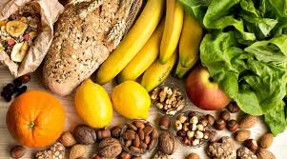
Those with certain RDA value (7) have precise scientific data and the determined values ​​are usually 2 standard deviations higher than the need. Therefore, intake below RDA does not always mean insufficient intake, but problems may occur in case of long-term insufficient intake.
For some elements with uncertain RDA value, there is an "estimated minimum requirements" value (Na, Cl, K). For another group, the data is more limited (estimated safe and adequate intake).
Deficiency in human nutrition is rare in developed societies. The most important problem in minerals is excessive Na intake and in societies whose daily salt consumption exceeds 6 g / day, the blood pressure problem increases with the advancement of age. (Daily intake in our country is 15 g)
Since 40% of NaCl is sodium, 6 grams of salt means 2400 mg sodium, which is about 5 times the minimum daily dose.
Bioavailability: It means the usability of a consumed nutrient in metabolic processes. In minerals, this is defined by absorption from the intestine and mixing into the blood. In some cases, the compound that has been absorbed may be in an unusable form. Ex. Iron forms a very strong chelate with some compounds and even if this chelate is absorbed, it cannot be used for hemoglobin production. Bioavailability depends on the form of the mineral. While it is <1% in some forms of iron, it is> 90% in Na and K.

Slide 6
ELEMENTS WITH AN RDA VALUE (for 25-50 age group) *
 | Ca (mg) | P (mg) | Mg (mg) | Fe (mg) | Zn (mg) | I (µg) | Se (µg)
MALE | 800 | 800 | 350 | 10 | 15 | 150 | 55
FEMALE | 800 | 800 | 280 | 15 | 12 | 150 | 55
ESTIMATED MINIMUM REQUIREMENT (> 18 years old, mg / day)
Na: 500 Cl: 50 K: 2000
ESTIMATED SAFE AND ADEQAUTE INTAKE AMOUNTS (for adults, per day)
Cu: 1.5-3.0 mg Mn: 2-5mg F: 1.5-4,0 mg
Cr: 50-200 µg Mo: 75-250 µg

Slide 7
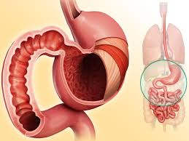
USE OF MINERALS
The digestion process starts with starch in the mouth. There is no change in minerals here. When the food goes into the stomach (where the pH is 2.0), the minerals begin to change.
The structure of the mineral complexes changes as a result of decreasing pH and resulting protein denaturation and hydrolysis.
Minerals can be separated from the structure and complex with other compounds. At low pH, ascorbic acid reduces Fe (+2) to Fe (+3). This reduction increases the release of iron in the complexes in the food and therefore its availability.
In the next stage, partially digested food passes to the small intestine. Here, pancreatic fluid containing sodium bicarbonate and digestive enzymes raises the pH. Protein and starch digestion continues. In addition, lipases come into play. Meanwhile, new bonds are formed, previous ones are broken down, so the availability of minerals changes.

Slide 8
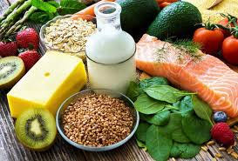
Factors Determining the Bioavailability of Minerals in Foods
(1) The Chemical Form of the Mineral in Food
- If the solubility is low, the mineral is less absorbed
- Soluble chelates are very stable and poorly absorbed
- Heme iron is better absorbed than none-heme iron
(2) Ligands
Soluble chelate-forming bonds (ligand-compound) with metals can increase absorption (EDTA increases iron absorption).
High molecular weight and less absorbable ligands may reduce absorption (e.g. dietary fiber, some proteins)
Ligands that form insoluble chelates with minerals can reduce absorption.
Oxzalate reduces the absorption Ca; Phytic acid reduces the absorption of Fe, Zn, Ca.

Slide 9
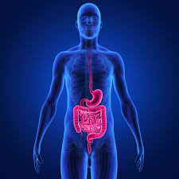
(3) Redox Activity of Food Ingredients
- Reducers (eg ascorbic acid) increase iron absorption, but have little effect on others.
- Oxidants inhibit iron absorption.
(4) Mineral- Mineral interaction
A mineral with a high concentration can affect the absorption of the other. For example: Ca….. Fe; Fe….. Zn, Pb.….. Fe.
(5) Physiology of the Consumer
For example, Fe and Ca absorption may be reduced in achlorhydria (decreased gastric acid secretion) disease.
Absorption may be reduced in the elderly. Soluble chelate-forming bonds (ligand-compound) with metals can increase absorption (EDTA increases iron absorption).

Slide 10
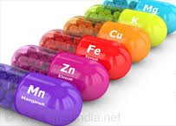
Mineral Deficiency in Nutrition:
Ca and Fe are two elements that are mostly lacking in nutrition in the world. These are also problematic elements in terms of absorption.
Other elements that may be lacking are Co, Cr, Se and Zn. Ca, Cr, Fe and Zn are in bound form and their bioavailability may vary according to the nature of the food (meal). Therefore, the problem may arise from insufficient intake or insufficient absorption.
Another element taken insufficiently is iodine. Iodine in water and food is generally in free ionic form and its absorption is high. Deficiency is caused by insufficient consumption. However, by requiring the addition of iodine to table salts, the problem was solved to a great extent.
Se is in the form of selenomethionine (chelate) in foods, but is well absorbed. Deficiency is due to insufficient consumption.
Co (ie vitamin B12-cyanocobalamin-deficiency) is found in vegetarians, as it is not found in plant foods. In addition, there may be a deficiency in elderly individuals.

Slide 11
Mineral level in plant foods; depends on the content of the soil with these minerals the genetic characteristics of the plant and the environment. The importance of what the animal eats in the mineral content of animal-based foods is limited, because the homeostatic balance of the animals determines the level of that element.
The composition of animal tissues is similar to that of humans, so these foods are good sources of minerals. Especially Fe, Zn, P and Co are rich in animal foods. On the other hand, animal foods other than milk are not good sources since Ca is collected in the bone in animals. Iodine is also low in animal foods other than seafood.
Minerals can be added to foods from outside (fortification). The most common application is adding iron (Fe-sulfate, Fe-lactate) and iodine. Thus, significant progress has been achieved in the solution of anemia and goiter problem.
Unlike vitamins and amino acids, minerals are not destroyed by factors such as heat, oxidants, light, pH. It can be removed from food by washing and physical separation. For example, with grain milling, Fe in wheat decreases by 76% and Mn by 86%. Ca loss increases if the pH is low in cheese processing. The loss is high in boiling water. Although the iron loss is very low in boiling pasta, the K loss is> 50%. Because K is in free ion form and Fe is bound to proteins or other high molecular compounds.

Slide 12
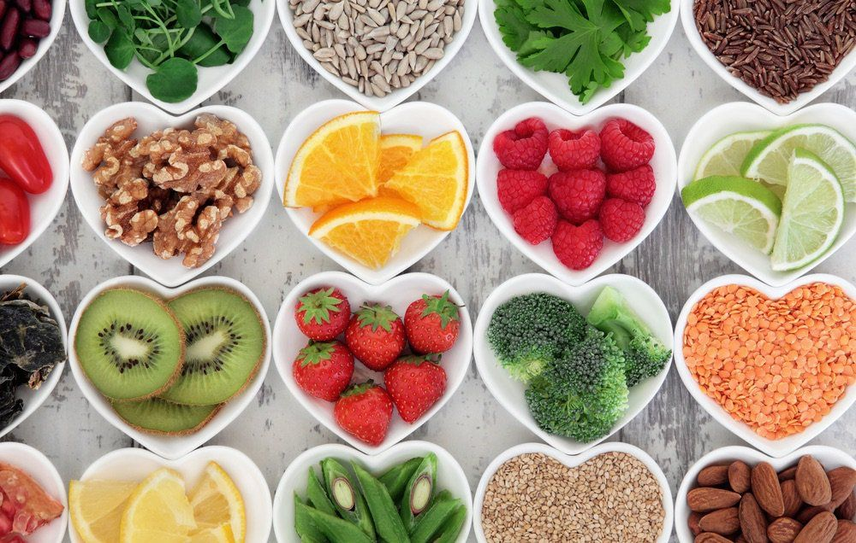
The main sources of some elements and their functions in the body are as follows, briefly:
Al: Enriched flour. Probably essential. Its deficiency is unknown.
Br: Enriched flour. Its essentiality is unknown.
Ca: Milk and products, leafy vegetables. Deficiency leads to Osteoporosis in elderly.
Cu: Organ meat/offal, seafood, almond. Its deficiency is rare. Catalyst/ cofactor in enzymes.
I: Salt, seafood. Deficiency: Goiter.
Fe: Meat, grain, legumes. Catalyst. building block of hemoglobin. Def.: Anemia, lack of immunity, loss of strength
Mg: Whole grains, nuts, legumes, green leafy vegetables. Its deficiency is rare.
Mn: Cereals, fruits and vegetables. Enzyme cofactor. Its deficiency is rare.
Ni: Plants. Essential. Its deficiency is unknown.
P: Animal foods. In the structure of ATP. Its deficiency is rare.
K: Fruits-vegetables-meat. Electron transfer in cells. Its deficiency is rare. KCl is used instead of NaCl.
Se: Seafood, organ meats/offals, some cereals depending on the soil Se level. Antioxidant
Na: Salt, food additives, Its deficiency is rare. High amounts: Hypertension.
S: Common in food. In the structure of methionine and cysteine. These are essential amino acids.
Zn: Meats, cereals. Def.: Loss of appetite, growth retardation, skin disorder.
Co: Meats, fish, chicken.

Slide 13
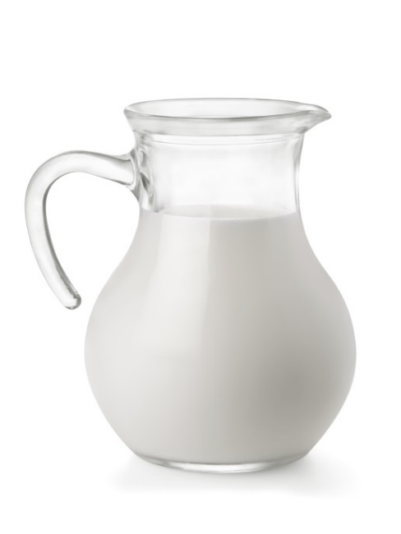
Minerals
The body requires minerals in small amounts for a number of different functions.
Each mineral is required in different amounts.
Some are required in larger amounts, while others are required in very small amounts and are known as ‘trace elements’.
22 minerals are needed by the body
Two categories:
Major
Include calcium, chloride, magnesium, phosphorus, potassium, sodium, and sulfur
Trace
Include iron, zinc, iodine, selenium, copper, manganese, fluoride, chromium, molybdenum, arsenic, nickel, silicon, boron and cobalt

Slide 14
Macro/Micro Minerals
Micro/Trace means you need a small amount of these minerals
Macro-Minerals
Calcium
Micro/Trace-Minerals
Iron
Macro means you need a large amount of these minerals

Slide 15
Some important minerals

Slide 16
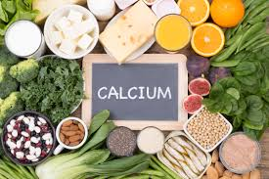
Calcium
It has an important structural role in plants and animals.
It has a role in many biochemical and physiological functions. (photosynthesis, oxidative phosphorylation, muscles, cell division, nervous system, enzyme activity, cell membrane function, hormone secretion).
Its main importance in cells is based on its complex formation with proteins, carbohydrates and lipids. This is important in physiology.
Ca in milk is found in the form of colloidal Ca-phosphate in serum (30%) and casein micelles.
Cheese with high Ca content is more elastic. The presence of vitamin D increases the absorption of Ca.

Slide 17
Calcium
The skeleton contains about 99% of the body’s calcium with approximately 1kg present in adult bones.
Function:
Develop and maintain healthy bones and teeth;
Normal muscle contraction (including the heart);
Normal blood clotting.
Calcium levels in the blood are carefully regulated by hormones such as vitamin D to keep it within narrow limits.

Slide 18
Calcium & Foods
Sources:
Dairy products, bread as most bread flour (except wholemeal) is fortified with calcium by law in the UK, green leafy vegetables such as broccoli, cabbage, fortified soya products, fish eaten with the bones e.g. sardines, tinned salmon.
fortified juices
Food | Calcium
Yogurt, plain (low-fat) Yogurt, flavored (low-fat) | 1 cup - 415 mg 1 cup – 345 mg
Milk, skim Milk, 1-2% | 1 cup – 302 mg 1 cup – 300 mg
Ice cream | ½ cup – 88 mg
Broccoli, cooked | ½ cup – 68 mg
Salmon, canned | 3 oz – 165 mg
Fortified orange juice | 8 oz – 300 mg
How much do you need?
Males 19-50 years old: 1,000 mg / day
Females 19-50 years old: 1,000 mg / day

Slide 19
Calcium
Deficiency:
If calcium intake is too low, calcium is withdrawn from bones to maintain blood levels. This means a diet low in calcium can lead to low bone density which, over time, can lead to osteoporosis. Osteoporosis is characterised by weak and brittle bones
Insufficient calcium in bones can be a result of an inadequate supply of vitamin D, as it is essential for the absorption of vitamin D; In children this can result in rickets, and osteomalacia in adults.

Slide 20
Ca absorption
It is related to the Ca content of food and the compounds that decrease-increase Ca absorption.
Calcium absorption is influenced by a number of factors.
Inhibitory factors include phytates (e.g. in wholegrain cereals, pulses) and oxalate (e.g. in spinach, beetroot).
Promoting factors include vitamin D, lactose and dietary protein.
The most important source is milk and dairy products. It is difficult to ensure adequate Ca intake without consuming these. Absorption rate is 32% in milk, 30-70% in vegetables (68.6% in cauliflower). (Non-absorbable forms of Ca in milk are quite high). Absorption rate is very low in foods with high oxalate and phytate content (eg 5% in spinach).

Slide 21
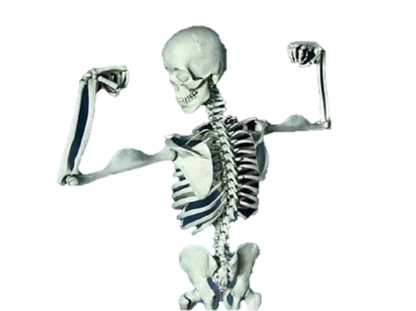
Calcium
Function: | Strengthens bones and teeth
Food Source: | Milk/Dairy Products, Whole Grains, Dark Green Leafy Vegetables
Deficiency: | Osteoporosis (Bones become weak and brittle due to mineral loss)
Toxicity: | -Kidney stones

Slide 22
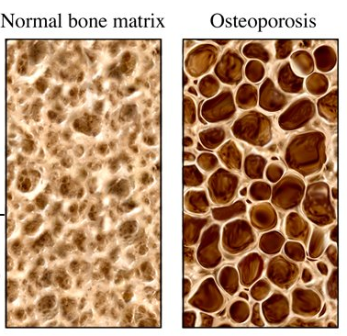
Osteoporosis

Slide 23
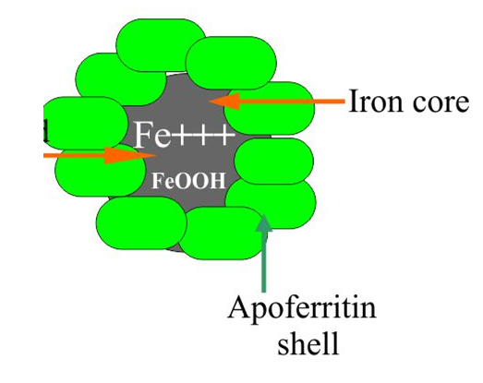
IRON
It is essential for all living things. Its role in the biological system (hemoglobin-myoglobin) is very important.
It plays a role in oxygen transport, storage, ATP production, DNA synthesis, chlorophyll synthesis.
Almost all iron in the body is found in chelated form. Free iron is toxic in cells because it leads to the production of active oxygen species, which in turn causes lipid oxidation and subsequent DNA destruction.
Almost every living thing stores iron in non-toxic form to avoid free iron toxicity. This form is apoferritin combined with protein. The protein surrounds the iron like a shell. Up to 4500 atoms of iron can be stored in a ferritin shell. When hemoglobin or myoglobin is synthesized, iron is converted into free form.

Slide 24
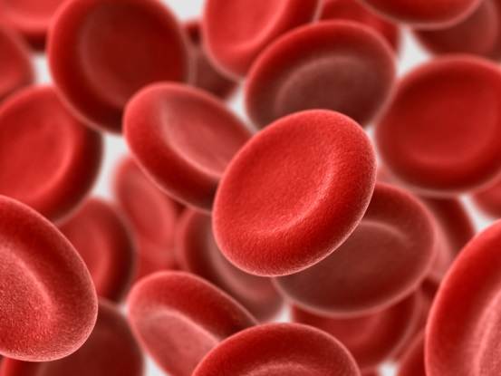
Iron
Functions:
Formation of haemoglobin in red blood cells;
Binding of oxygen and transporting around the body;
Function of the immune system;
Normal energy metabolism;
Metabolism of foreign substances that need to be removed from the body.

Slide 25
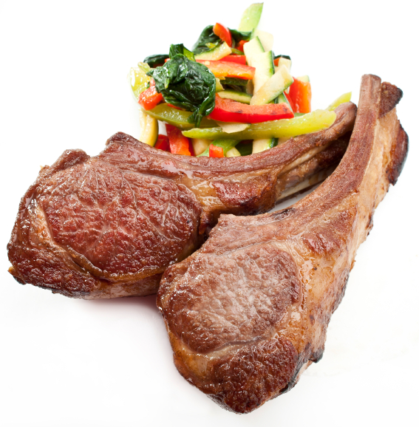
Iron & Foods
Heme iron:
Found in animal products
Red meats, liver, poultry and eggs
Non-heme iron:
Found in plant products
Beans, nuts, seeds, dried fruits, fortified breads and cereals

Slide 26
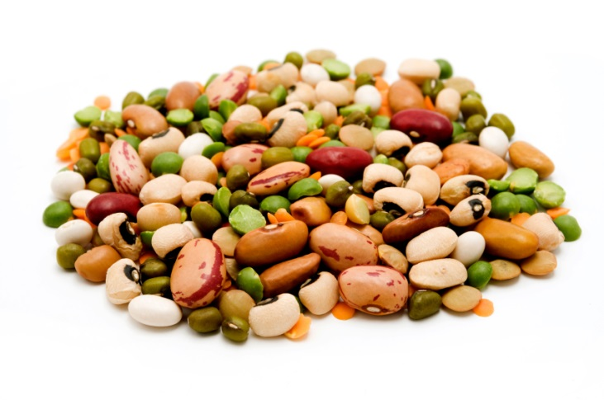
Iron
Haem iron (from animals) is the most bioavailable form or easily absorbed form of iron, but the most common form of iron in our diet is from plants (non-haem iron).
Non-haem iron can be found in cereals, vegetables, pulses, beans, nuts and fruit.
Absorption of non-haem iron is affected by phytates (found in plant seeds), fibre, tannins and calcium, by binding non-haem iron in the intestine, reducing absorption.
The absorption of non-heme iron in increased by, Meat, fish, chicken, ascorbic acid and EDTA. In those who consume enough meat and ascorbic acid, 2 mg of iron is absorbed daily and this amount is sufficient for healthy individuals.

Slide 27
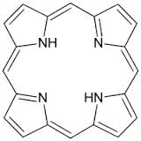
Fe absorption
The amount of Fe absorbed from the intestine is related to the composition of the diet and the form of Fe. Heme iron is tightly bound to the porphyrin ring, it does not dissociate until it is absorbed in the intestinal mucosa. It is mainly found in hemoglobin and myoglobin - hence meat-fish-chicken. All of the iron in plants and 40-60% of that in animal tissues is non-heme. Heme iron absorption is generally independent of diet and is higher than non-heme iron.
porphyrin ring
Fe

Slide 28
Iron
Deficiency:
A lack of dietary iron depletes the body’s iron stores and can eventually lead to iron deficiency anaemia.
Teenage girls and women of childbearing age need more iron than males of the same age.
It is estimated that 2/3 of children and women of childbearing age in underdeveloped countries have iron deficiency.
The average iron intake of teenage girls is 57% of the Recommended Nutrient Intake.
Intakes are also low in a large proportion of young women.
Did you know?
More than 2 billion people worldwide suffer from iron deficiency anaemia, making it the most common nutritional deficiency.

Slide 29
Iron supplements
Iron deficiency is the most widespread vitamin or mineral deficiency in the world.
70% of your body’s iron is in your hemoglobin
Too little iron = too little oxygen
High risk groups:
Strict vegetarians
Those who do not eat a balanced diet
Those who are over 60
Those who suffer from food allergies, intolerances

Slide 30
Iron
Function: | Helps make red blood cells, helps muscles store and use oxygen
Food Source: | Animal products, meat, dark green leafy vegetables
Deficiency: | Anemia (Low red blood cell formation)
Toxicity: | Heart disease, elevated LDLs

Slide 31
Electrolytes
Electrolytes helps maintain fluid balance in the body
Electrolytes
Sodium
&
Potassium

Slide 32
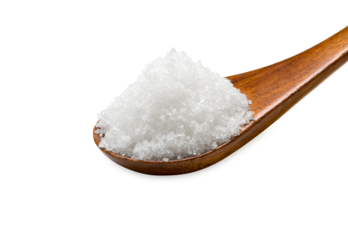
Sodium
Sodium is a component of table salt, also known as sodium chloride (NaCl). The mass percent composition of sodium in sodium chloride is 39%.
To convert sodium to salt, multiply by 2.5:
Amount of salt = Amount of sodium x 2.5
Functions:
Regulating body water content (Helps maintain fluid balance) and electrolyte balance;
The absorption of certain nutrients and water from the gut.
Helps transmit nerve impulses
Influences contraction and relaxation of muscles
Sodium levels are under homeostatic control, regulated by the kidneys.
When supply is excessive, sodium is excreted in urine.

Slide 33
Sodium & Health
The human body requires about 500 mg of sodium per day, while the average American usually ingests between 2,300-6,900 mg each day.
It is recommended to stay in a range of 1,500 to 2,400 mg / day.
Sources:
Most raw foods contain sodium chloride (NaCl) in small amounts, yet salt is commonly added to food during processing, preparation and serving.
Too much sodium
Causes high blood pressure
May lead to fluid retention

Slide 34
Where are you getting sodium?
On food labels:
Monosodium glutamate (MSG)
Baking soda
Baking powder
Disodium phosphate
Sodium alginate
Sodium nitrate or nitrite
www.mayoclinic.com

Slide 35
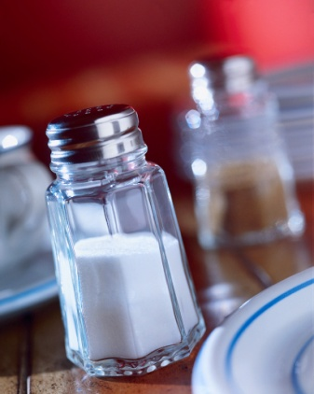
Reducing sodium in your diet
Eat more fresh foods
Eat less processed foods
Look for low-sodium products
Limit the salt you add to foods
Experiment with other seasonings
Use salt substitutes with caution

Slide 36
Sodium
Deficiency:
As intakes of sodium are considered to be high, deficiency is unlikely to occur, however losses can occur in some circumstances:
Excess sweating
Diarrhea
Kidney failure

Slide 37
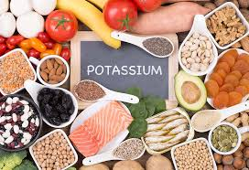
Potassium
It is found in the body at the level of 2 g / kg.
It regulates the intracellular osmotic pressure.
It plays a role in cell membrane transport, activation of some glycolytic and respiratory enzymes.
It is calculated that 2-5.9 g of potassium is taken per day with a normal diet.
No deficiency is encountered, except for a diet with a very poor potassium content.
The main source is fruits and vegetables, and meat and grains are also important sources.

Slide 38
Sodium & Potassium
Function: | Maintains fluid balance in the body
Food Source: | Salt, fruits and vegetables
Deficiency: | Muscle cramps, irregular heart beat, seizures
Toxicity: | High blood pressure

Slide 39
other minerals

Slide 40
Phosphate: It is frequently found in foods as part of biological molecules or as an additive. It plays an important role in living systems (eg ATP). Phosphoproteins are important in the storage of iron. Phospholipids are components of the cell membrane. It is one of the main components of bone. Its main source is meat, oil seeds, seafood, dairy products, legumes. Its salts are often used as food additives.
Magnesium: Activator of many enzymes, stabilizer of membranes of plasma and intra-plasma organelles and nucleic acids. Its deficiency causes serious problems, but it is not common in humans because it is abundant in green leafy vegetables, unprocessed grains, nuts, meat and milk.
Chlorine: It is usually taken as table salt. It is found in extracellular fluids and in gastric fluid. Absorption and removal is fast. Excessive salt consumption is a serious problem all over the world.
According to the Turkish Food Codex, the maximum % salt ratio is approximately (depending on the dry matter except for ayran): Tomato paste is 1.4, white cheese 2.5, ayran 1.0, bread 0.9.
Copper: It is involved in the structure of many autoreductase enzymes, which catalyze the autooxidation of iron from the +2 to the +3 form. These reactions are very important as Fe +3 is the only form that can be stored in the liver. The daily requirement is 1-2 mg and this is met with a normal diet. It is an undesirable element in food processes and storage. Its main sources are organ meats, seafood, seeds, nuts, cocoa and unprocessed grains.

Slide 41
Manganese: Daily requirement is met through diet. It is the building block of enzymes. No toxicity has been reported even at high doses. Nuts, legumes, tea, unprocessed grains are their main sources.
Zinc: Daily requirement is met with a normal diet. It is a component of many enzymes. It is required for the activation of some enzymes. Deficiency creates a problem in animals. High doses are toxic to humans. Red meat, cereals, nuts, seafood are their main sources.
Nickel: Deficiency has not been reported in humans. Essential for some animal species. It is an activator of some important enzymes. It increases the activity of insulin. It is estimated that 150-170µg is taken daily. The requirement is an estimated 35-500µg / day. Their sources are nuts, legumes, grains and chocolate.
Cobalt: After it was understood that Vitamin B12 contains cobalt, its importance has emerged. It is taken enough with normal diet except vegetarians. Its main sources are organ meats, meat, fish, chicken and fortified cereals.
Vanadium: It is known to stimulate growth in poultry. Its role in humans is unknown. It is estimated that 12-30µg is taken daily. Mushrooms, oysters, black pepper and parsley are their main sources.
Chromium: Daily intake is 5-200µg. It activates the phosphoglucomutase enzyme, which is important in the use of glucose, and increases insulin activity. Chromium deficiency decreases glucose tolerance and increases the risk of cardiovascular disease. It is found in some grains, poultry, fish, meat and beer.

Slide 42
Selenium: Daily intake is 0.05-0.1 mg. It can be in different amounts in crops depending on the Se content of the soil. It is an antioxidant and is involved in the structure of glutathione peroxidase (GSH-Px) enzyme, one of the most important enzymes in antioxidative metabolism, which protects membranes from oxidative destruction. It is effective in the activity of thyroid hormone and the functions of vitamin C. Excessive intake has been shown to be toxic in animals. It is found in organ meats and plant foods depending on the Se level of the soil.
Molybdenum: Daily intake is 0.3 mg. Major component of some enzymes. Cofactor of enzymes involved in the metabolism of sulfurous amino acids, purines and pyridines. Excessive intake has been shown to be toxic in animals. Legumes, grains, and nuts are their main sources.
Boron: Effective in mineral metabolism. Its function in humans is not fully understood, but it is thought to have an effect on Ca attachment in teeth and bones. WHO has increased its daily intake recommendation from 1 mg to 10 mg. The main sources are fruits, especially grapes, quince and sour cherry, pistachio and dried nuts.
Fluorine: It is added to toothpastes because it prevents tooth decay. It stimulates bone formation. In some countries it is added in drinking water. The main sources are water and tea.
Iodine: There is 10 mg iodine in the body and 70-80% of it is in the thyroid gland. Daily requirement is 100-200µg. It is very low in many foods and is added to salt as KI. Goiter disease is common in countries with low iodine in drinking water. Excessive intake is toxic. Sources are seafood, salt and water.

Slide 43
Arsenic: Known to be essential in animals. (May play a role in methionine metabolism). There is no exact information for humans, but it is thought that an intake of 15-25 µg / day may be required (estimated at 20-30 µg / day). High doses are toxic. Main sources are fish, meats, dairy products and cereals).
Tin: Not essential in humans, but present in every organ. It has a role in promoting growth in animals. Inorganic tin has very little absorption, so its toxicity is not encountered. Organic salts are toxic.
Aluminum: There is 50-150 mg in the body. It increases with age. Its absorption is very low. Recent studies show that it is harmful to the nervous system.
Silicon: It is soluble silicic acid. Its main source is grains. Its biological function in humans is unknown. It has a role in bone growth in animals. A dose of > 100 mg / day is known to be toxic. Daily intake is 21-26 mg. There is a total of 1 g Si in the body.

