Slide 1
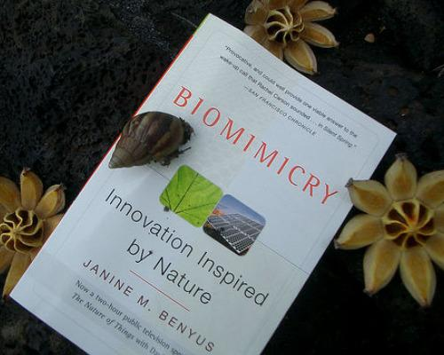
Biomimicry: Learning From Nature
Nature as Model, Measure, and Mentor

Slide 2
Agenda
Introduction to Biomimicry
Key Elements: EMULATE (RE)CONNECT ETHOS
Systems Thinking
Biomimicry for Creative Thinking
Life's Principles
Inspiration from birds
Inspiration from trees
Inspiration from beetles & other animals
Influence of biomimicry on economy
Connection between Architecture and Nature
Biomimicry Design Challenges
Case Studies

Slide 3
What is biomimicry?
(From the Greek bios, life, and mimesis, imitation)
Bio= Life, living things
Mimicry= Copying, emulating
Biomimicry is a design tool based on emulating the strategies used by living things.
The interdisciplinary field where technology, science, art, design and architecture influence each other and use biology for innovative solutions and products is called biomimicry.

Slide 4
Inspiration from nature

Slide 5
Jenine Benyus
is defined in her book as a "new science that studies nature's models and then imitates or takes inspiration from these designs and processes to solve human problems". Benyus suggests looking to Nature as a "Model, Measure, and Mentor" and emphasizes sustainability as an objective of biomimicry.

Slide 6
What we learn today about mimicry???
The first flying machine heavier than the air from the Wright brothers, in 1903, was inspired by flying pigeons.
The aerodynamics of the famous Japanese Bullet train was inspired by the shape of a bird’s beak.
The study of shark skin is at the origin of particularly effective swimming suits.
Architecture is inspired by termite mounds to design passive cooling structures.
Velcro is born from the observation of the hooks implemented by some plants for the propagation of their seeds via animal’s coat.
Climbing pads capable of supporting human weight are a mimic of the biomechanics of gecko feet.

Slide 7
Main Website http://biomimicry.net

Slide 8
Main Books

Slide 9
Inspirational Books

