Slide 1
COM101B Lecture 12: poınters – Part1
ASST. Prof. Dr. Hacer Yalım Keleş

Slide 2
PoInters
The most sophisticated feature of C
They lead to more efficient and compact code
Pointers enable us to,
achieve parameter passing by reference
deal concisely and effectively with arrays
represent complex data structures
work with dynamically allocated memory

Slide 3
BASICS
Memory is an oredered sequence of consecutively numbered storage locations
A data item is tored in one or more adjacent locations in memory
Every data item has a starting address
the address of a data item is the address of its first storage locations
The address can be stored in pointers and can be used to access data
for reading
for writing
The address of an item is considered as a pointer to that item

Slide 4
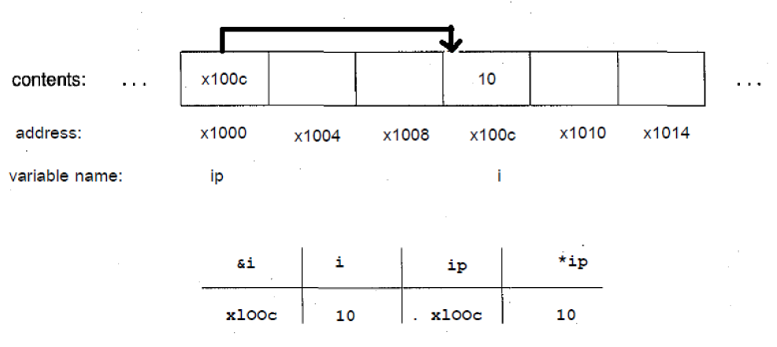
ip is a pointer, which contains the address of the variable i:

Slide 5
address and dereferencıng operators
C provides two unary operators:
&: address of operator
*: dereferencing operator
& operator returns the address of an item
* operator returns the content of the data item that is pointed to by a pointer
it fetches the value of the item that is pointed by an address

Slide 6
dereferencıng
Accessing an object through a pointer is called dereferencing
& operator can be applied to only lvalues.
&10 &’C’ &(x+4) : invalid
if type of an item is T, &T has a pointer to T type.
int i; &i : pointer to int
* operator can only be applied to pointes
j = *ip + 10; //ip is a pointer to an integer

Slide 7
poınter type declaratıon
type *identifier;
declares the identifier as a pointer to type
Example: char* cp; // pointer to char
int* p; // pointer to integer
double * dp; // pointer to double

Slide 8
poınter assıgnment
A pointer may be assigned to another pointer of the same type
Example: int i=1, j, *ip;
ip = &i;
j = *ip;
*ip = 0; // assigns 0 to i

Slide 9
poInter ınıtıalızatıon
type *identifier = initializer;
initializer needs to be an address of a previously defined data of appropriate type or NULL , i.e. 0.
Example: #include <stdio.h>
float* fp;
short s;
short *sp = &s;
char c[20];
char* cp = &c[4];

Slide 10
Example:
#include <stdio.h>
int main(){
int i,j=1;
int *jp1, *jp2 = &j;
jp1 = jp2;
i = *jp1;
*jp2 = *jp1 + i;
printf(«i=%d, j=%d, *jp1=%d, *jp2=%d\n»,i,j,*jp1,*jp2);
return 0;
}

Slide 11
Result:
i=1, j=2, *jp1=2, *jp2=2

