Slide 1
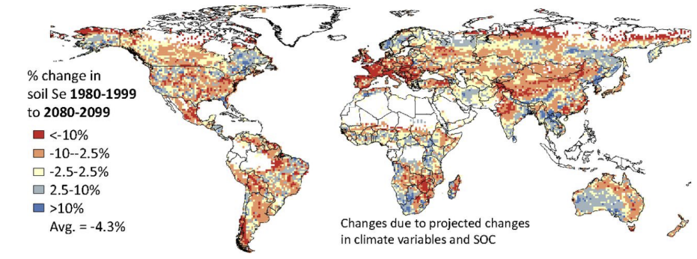
Toprak- Selenyum

