Slide 1
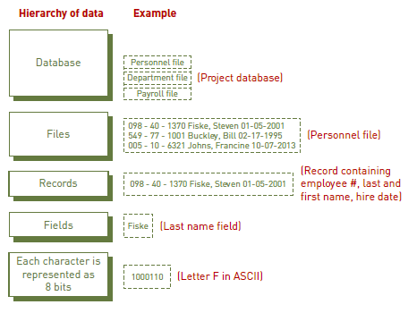
Database Systems & Big Data
Notes:
A database is a well-designed, organized, and carefully managed collection of data.
A database management system (DBMS) consists of a group of programs used to access and manage a database
It also provides an interface between the database and its users and other application programs.
Here is the hierarchy that begins with bits through database.

Slide 2
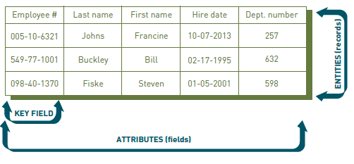
Database Systems & Big Data
Notes:
An entity is a person, place, or thing (object) for which data is collected, stored, and maintained.
An attribute is a characteristic of an entity.
A primary key is a field or set of fields that uniquely identifies the record.

Slide 3
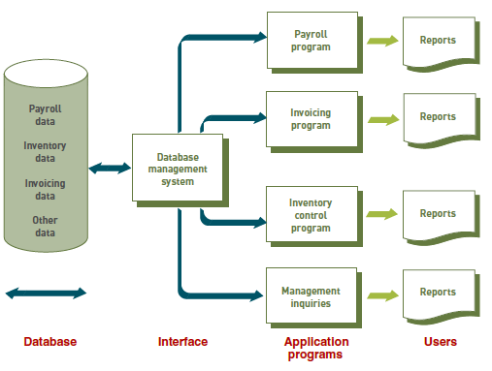
Database Systems & Big Data
Notes:
database approach to data management: multiple information systems share a pool of related data

Slide 4
Database Systems & Big Data
● Content
● Access
● Logical structure
● Physical organization
● Archiving
● Security
Notes:
When building a database, the following questions must be considered:
● Content. What data should be collected and at what cost?
● Access. What data should be provided to which users and when?
● Logical structure. How should data be arranged so that it makes sense to a given user?
● Physical organization. Where should data be physically located?
● Archiving. How long must this data be stored?
● Security. How can this data be protected from unauthorized access?

Slide 5
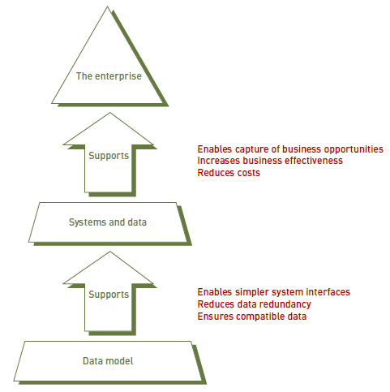
Database Systems & Big Data
Notes:
One of the tools database designers use to show the logical relationships among data is a data model.
A data model is a diagram of entities and their relationships.
Data modeling usually involves developing an understanding of a specific business problem and then analyzing the data and needed to deliver a solution.
When done at the level of the entire organization, it is called enterprise data modeling.
An enterprise data model involves analyzing the data and information needs of an entire organization.
It provides a roadmap for building database and information systems.

Slide 6
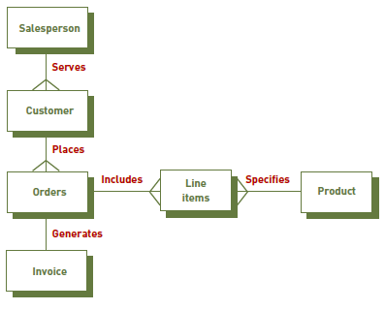
Database Systems & Big Data
Notes:
One such data model is an entity-relationship (ER) diagram.
ER diagrams show data items in tables (entities) and the ways they are related.
There are 3 types of relations here; one-to-many, many-to-one, one-to-one

Slide 7
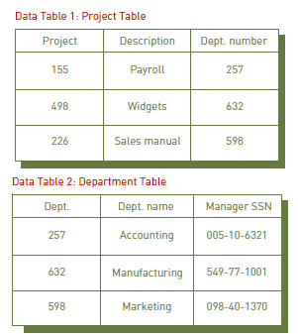
Database Systems & Big Data
Notes:
The relational database model is a simple but highly useful way to organize data into collections of two-dimensional tables (or relations).
Each row in the table represents an entity.
Each column represents an attribute of that entity.
As long as the tables share at least one common attribute, these tables can be linked.
The relationship between tables can be set via the use of foreign keys -- a field in a table that links to the primary key of another table.

Slide 8
Database Systems & Big Data
● Selecting
● Projecting
● Joining
● Linking
Notes:
After entering data into a relational database, users can make inquiries and analyze the data.
selecting: Manipulating data to eliminate rows according to certain criteria.
projecting: Manipulating data to eliminate columns in a table.
joining: Manipulating data to combine two or more tables.
linking: the ability to combine two or more tables through common data attributes to form a new table with only the unique data attributes.

Slide 9
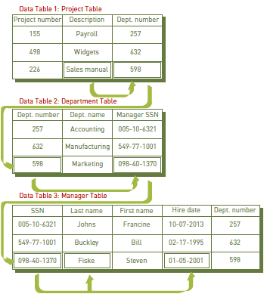
Database Systems & Big Data
Notes:
We have 3 tables: Project, Dept., and Manager.
We want to find out the name of the manager of the “sales manual” project and the length of time the manager has been with the company.
Search the Project table to find out the project’s department number.
Use the department number to search the Department table for the manager’s Social Security number.
The department number is also in the Department table and is the common element that links the Project table to the Department table.
The DBMS uses the manager’s Social Security number to search the Manager table for the manager’s hire date.
The manager’s Social Security number is the common element between the Department table and the Manager table.
One of the primary advantages of a relational database is that it allows tables to be linked.
This linkage reduces data redundancy and allows data to be organized more logically.

Slide 10
Database Systems & Big Data
Quality of information → Quality of decision
Accessible
Accurate
Complete
Economical
Flexible
Relevant
Reliable
Secure
Simple
Timely
Verifiable
Notes:
As it is mentioned on the 1st week, data used in decision making should have the characteristics listed on the slide.
Data cleansing (data cleaning or data scrubbing) is the process of detecting and then correcting or deleting incomplete, incorrect, inaccurate, or irrelevant
records that reside in a database.

Slide 11
Database Systems & Big Data
Cleansing ≠ Validation
Crosschecking
Standardization
St., St, st., st → Street
Notes:
Data cleansing is different from data validation.
Validation is the identification of “bad data” and its rejection at the time of data entry.
One data cleansing solution is to identify and correct data by crosschecking it against a validated data set.
For example, street number, street name, city, state, and zip code entries in a database may be cross-checked against the formal (state) Postal Zip Code database.
Data cleansing may also involve standardization of data, such as the conversion of various possible abbreviations (St., St, st., st) to one standard name (Street).

Slide 12
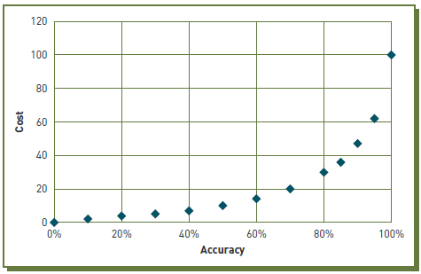
Database Systems & Big Data
Notes:
The cost of performing data cleansing can be quite high.
As it can be seen, achieving 100% accuracy of data in a DB may cause an exponential increase in cost.

Slide 13
Database Systems & Big Data
SQL
ACID (atomicity, consistency, isolation, durability)
Schema
Notes:
a DBMS is a group of programs used as an interface between a database and application programs or between a database and the user.
A few concepts about DBMS.
SQL: A special-purpose programming language for accessing and manipulating data stored in a relational database.
ACID properties (atomicity, consistency, isolation, durability) that guarantee relational database transactions are processed reliably.
They ensure the integrity of data in the database.
Basically, these principles mean that data is broken down to atomic values—that is, values that have no component parts—such as employee_ID, last_name, first_name, address_line_1, address_line_2, and city.
The data in these atomic values remains consistent across the database.
The data is isolated from other transactions until the current transaction is finished,
and it is durable in the sense that the data should never be lost.
Schema: A description that defines the logical and physical structure of the database.
It identifies the tables, the fields in each table, and the relationships between fields and tables.

Slide 14
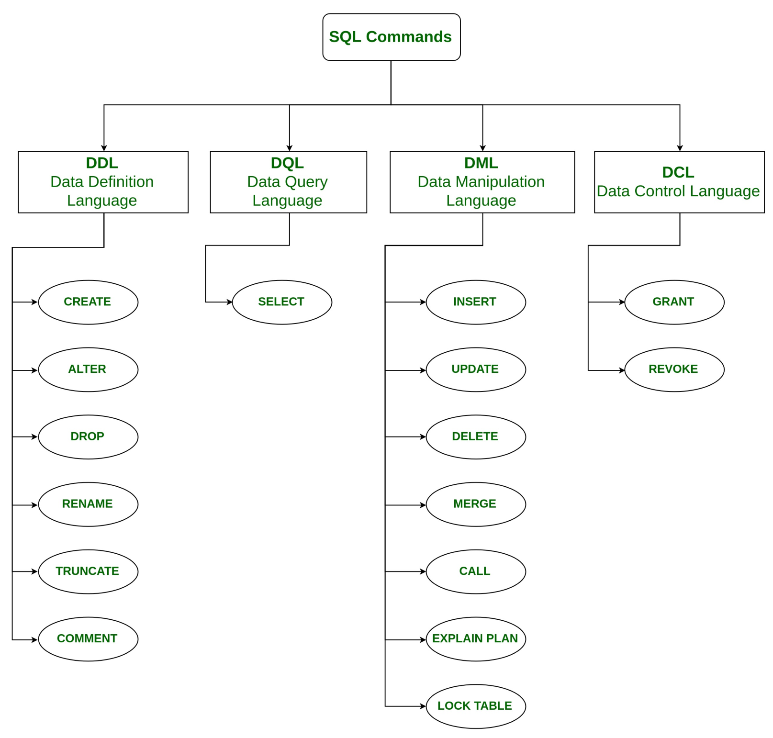
Database Systems & Big Data
Notes:
DDL(Data Definition Language): DDL or Data Definition Language actually consists of the SQL commands that can be used to define the database schema.
CREATE – is used to create the database or its objects (like table, index, function, views, store procedure and triggers).
DROP – is used to delete objects from the database.
ALTER-is used to alter the structure of the database.
TRUNCATE–is used to remove all records from a table, including all spaces allocated for the records are removed.
COMMENT –is used to add comments to the data dictionary.
RENAME –is used to rename an object existing in the database.
DQL (Data Query Language): DML statements are used for performing queries on the data within schema objects.
SELECT – is used to retrieve data from the a database.
DML(Data Manipulation Language): The SQL commands that deals with the manipulation of data present in the database.
INSERT – is used to insert data into a table.
UPDATE – is used to update existing data within a table.
DELETE – is used to delete records from a database table.
DCL(Data Control Language): DCL includes commands such as GRANT and REVOKE
It mainly deals with the rights, permissions and other controls of the database system.
-GRANT-gives user’s access privileges to database.
-REVOKE-withdraw user’s access privileges given by using the GRANT command.
TCL(Transaction Control Language) : TCL commands deals with the transaction within the database.
-COMMIT– commits a Transaction.
-ROLLBACK– rollbacks a transaction in case of any error occurs.
-SAVEPOINT–sets a savepoint within a transaction.
-SET TRANSACTION–specify characteristics for the transaction.

Slide 15
Database Systems & Big Data
SQL
PL/SQL
T-SQL
Notes:
SQL is the standard language to query a database.
SQL is a single query that is used to perform DML and DDL operations.
PL SQL stands for "Procedural Language extensions to SQL."
This is the extension of Structured Query Language (SQL) that is used in Oracle.
PL/SQL is a block of codes that used to write the entire program blocks/ procedure/ function, etc.
T-SQL stands for " Transact-SQL."
This is the extension of Structured Query Language (SQL) that is used in Microsoft.
includes special functions like the converted date () which are not part of the regular SQL.

Slide 16
Database Systems & Big Data
Enormous
Complex
DBMS are incapable of dealing
Volume, velocity, and variety
Notes:
Big data is the term used to describe data collections that are so enormous (terabytes or more)
and complex (from sensor data to social media data)
traditional data management software, hardware, and analysis processes are incapable of dealing with them.
volume, velocity, and variety are three characteristics of big data.

Slide 17
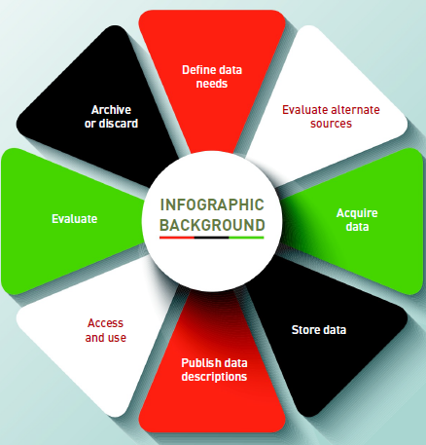
Database Systems & Big Data
Notes:
The big data life cycle
A policy-based approach to managing the flow of an enterprise’s data, from its initial acquisition or creation to the time when it becomes outdated and is
deleted.

Slide 18
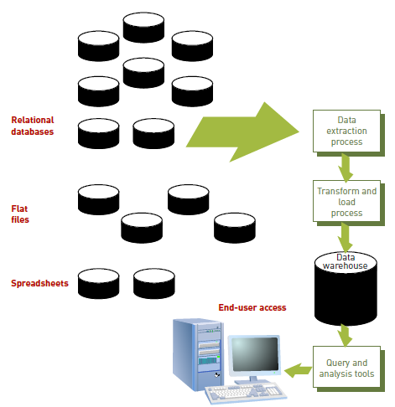
Database Systems & Big Data
Notes:
Technologies Used to Process Big Data
A data warehouse is a database that holds business information from many sources in the enterprise.
It covers all aspects of the company’s processes, products, and customers.
A data warehouse stores historical data that has been extracted from operational systems and external data sources.
The ETL (extract, transform, load) process takes data from a variety of sources,
edits and transforms it into the format used in the data warehouse,
and then loads this data into the warehouse.
software tools to support these ETL tasks:
Ab Initio, IBM InfoSphereDatastage, Oracle Data Integrator, and the SAP Data Integrator.
Several open-source ETL tools are also available, including Apatar, Clover ETL, Pentaho, and Talend.
Unfortunately, much of the ETL work must be done by low-level proprietary programs that are difficult to write and maintain.

Slide 19
Database Systems & Big Data
Data Marts
Data Lakes
Notes:
data mart: A subset of a data warehouse.
It is used by small- and medium-sized businesses and departments within large companies to support decision making.
data lake (enterprise data hub): A “store everything” approach to big data that saves all the data in its raw and unaltered form.
ETL process of traditional data warehouse can be lengthy and computer intensive, taking days to complete.
In Data Lake concept, only when the data is accessed for a specific analysis is it extracted from the data lake, classified, organized, edited, or transformed.

Slide 20
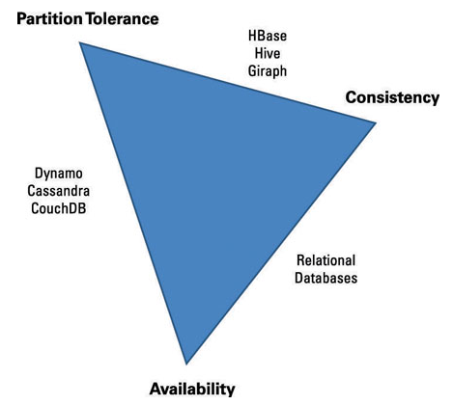
Database Systems & Big Data
ACID again & CAP
NoSQL
NoSQL
RDBMS
Notes:
The ACID properties of a relational database are Atomicity, Consistency, Isolation and Durability.
The ACID properties aren’t flexible.
it is impossible for a distributed data store to simultaneously provide more than two out of the following three
Consistency: Like the C in ACID. Consistency means that data is the same across the cluster, so you can read or write from/to any node and get the same data.
Availability: ‌Resources should be always available. There should be a non error response.
Partition tolerance: No single point (or node) of failure.
It means that the cluster continues to function even if there is a "partition" (communication break) between two nodes (both nodes are up, but can't communicate).

Slide 21
Database Systems & Big Data
NoSQL
BASE
NoSQL DB Types
Key value Stores — Riak, Voldemort, and Redis
Wide Column Stores — Cassandra and HBase.
Document databases — MongoDB
Graph databases — Neo4J and HyperGraphDB.
Notes:
NoSQL databases are being used to deal with the variety of data found in big data and Web applications.
NoSQL relies upon a softer model known as the BASE model.
BASE (Basically Available, Soft state, Eventual consistency).
Basically Available: Guarantees the availability of the data . There will be a response to any request (can be failure too).
Soft state: The state of the system could change over time.
(they do not require a predefined schema; data entities can have attributes edited or assigned to them at any time.)
Eventual consistency: The system will eventually become consistent once it stops receiving input.
NoSQL databases give up the A, C and/or D requirements, and in return they improve scalability.
A major advantage of NoSQL databases is the ability to spread data over multiple servers so that each server contains only a subset of the total data.
NoSQL databases fall into four main categories:
Key value Stores — Riak, Voldemort, and Redis
Wide Column Stores — Cassandra and HBase
Document databases — MongoDB
Graph databases — Neo4J and HyperGraphDB

Slide 22
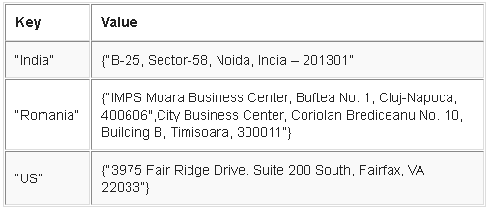
Database Systems & Big Data
Notes:
Key-value databases store data in unique key-value pairs, meaning each key is associated only with one value in a collection, like in a dictionary.
This makes querying a key-value data store fast because of its simple model.
There’s no query language needed.
Data retrieval is a simple matter of using get, put, and delete commands.

Slide 23
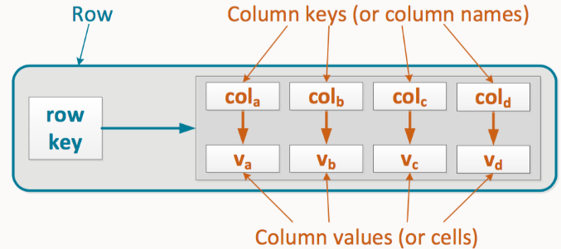
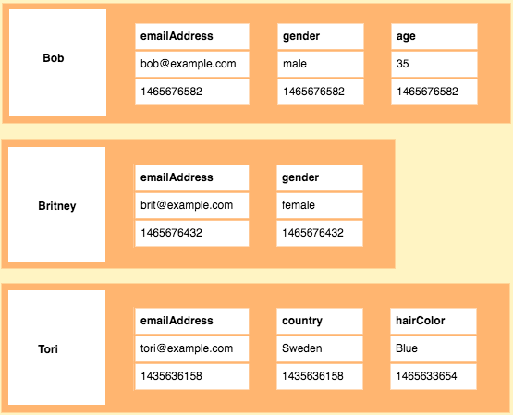
Database Systems & Big Data
Notes:
As the name suggests, wide-column stores use columns to store data.
Individual rows constitute a column family.
A typical column family contains a row key as the first column, which uniquely identifies that row within the column family.
The following columns then contain a column key, which uniquely identifies that column within the row,
so that you can query their corresponding column values.
Rows do not need to have the same number of columns.
Columns can be added to any row at any time without having to add it to other rows.

Slide 24
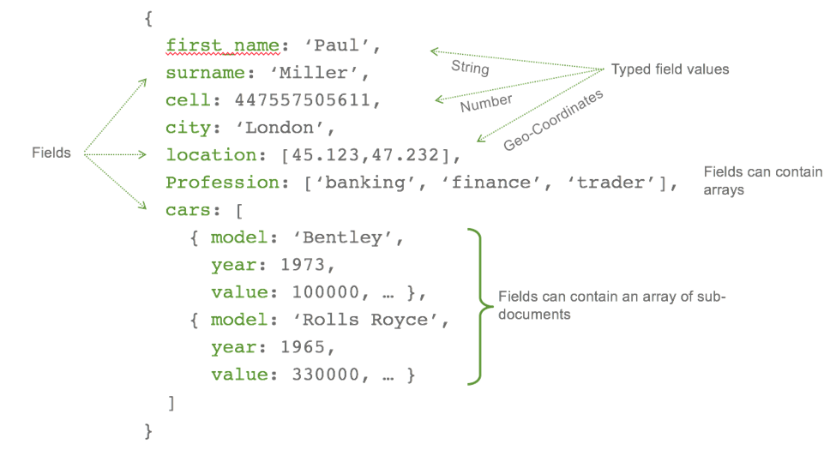
Database Systems & Big Data
Notes:
Document store databases use JSON, XML, or BSON documents to store data.
You can pretty much fill in a document with whatever data you want.
Documents can have different structures, but you can index common fields for faster performance.
In the slide a document in Mongo DB is seen.

Slide 25
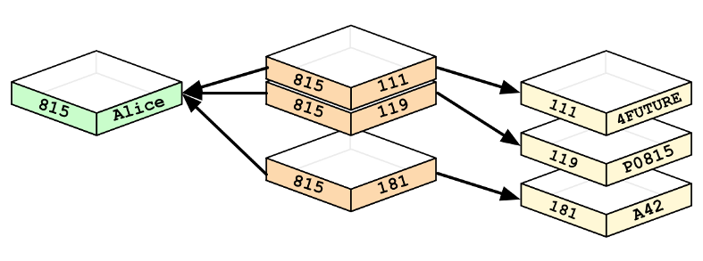
Database Systems & Big Data
Notes:
Nodes and relationships are the bases of graph databases.
A node represents an entity, like a user, category, or a piece of data.
A relationship represents how two nodes are associated.
Graph database requires only storing data once (nodes). The different types of relationships (edges) are specified to the stored data.
The relationships between the nodes are predetermined, that is, it is not determined at query time.

Slide 26
Database Systems & Big Data
Hadoop
Open-source framework
Stores & processes large data sets
MapReduce & HDFS
Hadoop cluster may have 1000s of servers
Notes:
Hadoop is an open-source software framework
it includes several software modules for storing and processing extremely large data sets
has two primary components:
a data processing component (a Java-based system called MapReduce)
a distributed file system (Hadoop Distributed File System, HDFS) for data storage.
A Hadoop cluster may consist of thousands of servers.

Slide 27
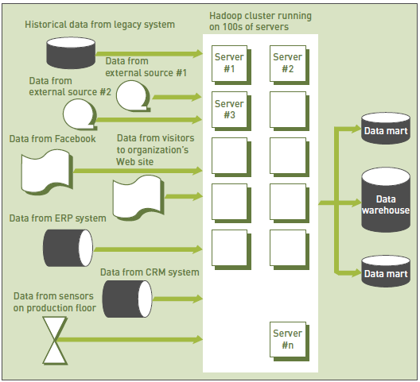
Database Systems & Big Data
Notes:
Here is the environment of Hadoop.

Slide 28
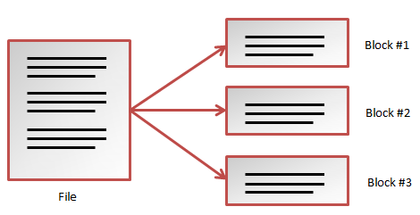
Database Systems & Big Data
Notes:
How Hadoop stored data in HDFS?
Hadoop divides data into subsets.

Slide 29
Database Systems & Big Data
Notes:
distributes the subsets onto different servers (or nodes) for processing.
a subset of the data within the HDFS and the MapReduce system are housed on every server in the cluster.
This approach creates a highly redundant computing environment
the application keeps on running even if individual servers fail.

Slide 30
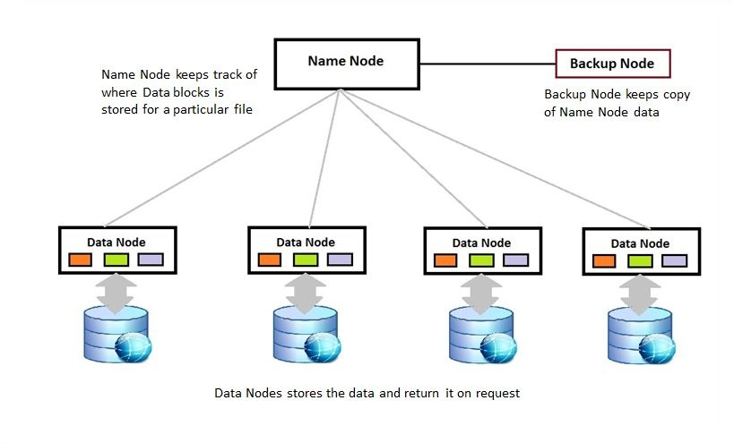
Database Systems & Big Data
Notes:
In Hadoop, i mean HDFS there are two types of servers (or nodes):
Name node: it keeps track of where data blocks are stored for a particular file since it is stored in pieces.
Data node: It stores data and returm it on request.
And the backup node is a copy of name node.

Slide 31
Database Systems & Big Data
Hadoop MapReduce
Java based program & tech.
Map & reduce tasks
Split, map, shuffle, and reduce phases
Notes:
How Hadoop process data?
MapReduce is a processing technique and a program based on java.
It is parallel in nature, thus are very useful for performing data analysis using multiple nodes in the cluster.
contains two tasks, namely Map and Reduce.
Actually the whole process has four phases: splitting, mapping, shuffling, and reducing.
Splitting: Dividing the input into the chunks
Mapping: Each split is passed to a mapping function to produce output values
Shuffling: Consolidating the relevant records from Mapping phase output
Reducing: combining values from Shuffling phase and returning a single output value.

Slide 32
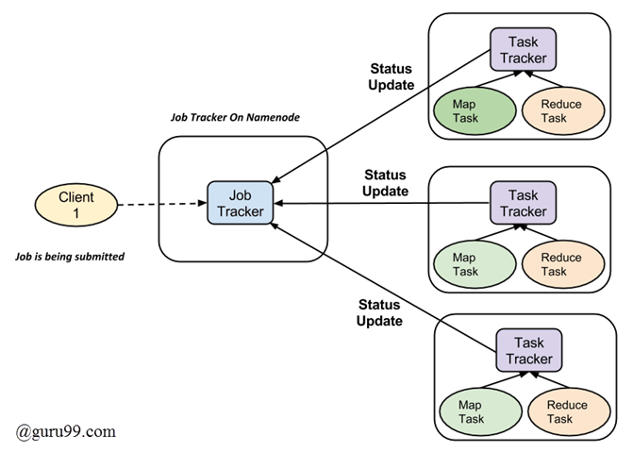
Database Systems & Big Data
Notes:
Here mapping is the job.
Job tracker manages this job.
Job tracker is the “name node”.
Since we will use multiple nodes to process input data,
one “map task” is created for each split and then it executes map function for each record in the split.
Data nodes are the task trackers those complete the “map and reduce tasks”.

Slide 33
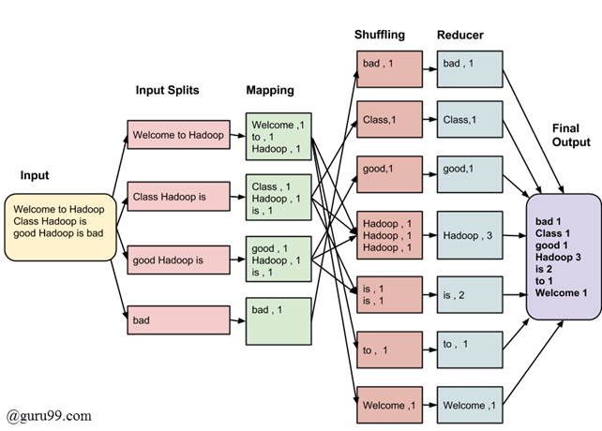
Database Systems & Big Data
Notes:
Here is a sample for MapReduce process for “word counting”.
In the splitting phase, input data is divided into the fixed-size chunks, three-word chunks.
In the mapping phase, a list in the form of <word, frequency> is prepared.
Results of this phase is written on the local disk of the nodes not on the HDFS.
In the shuffling phase, the same words are grouped together along with their respective frequency.
In the reducing phase, total occurrences of each word is calculated.
Shuffling and reducing is done on one of the data nodes and the final result is saved on HDFS.

Slide 34
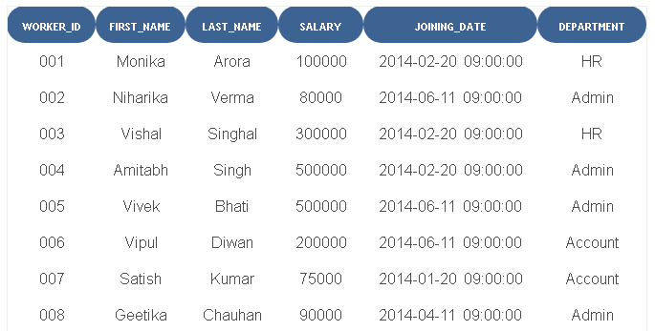
Database Systems & Big Data
Notes:
- Write An SQL Query To Print Details Of Workers Excluding First Names, “Vipul” And “Satish” From Worker Table.
Select * from Worker where FIRST_NAME not in ('Vipul','Satish');
- Write An SQL Query To Print Details Of The Workers Who Have Joined In Feb’2014.
Select * from Worker where year(JOINING_DATE) = 2014 and month(JOINING_DATE) = 2;
- Write An SQL Query To Fetch Worker Names With Salaries >= 50000 And <= 100000.
SELECT CONCAT(FIRST_NAME, ' ', LAST_NAME) As Worker_Name, Salary FROM worker WHERE WORKER_ID IN (SELECT WORKER_ID FROM worker WHERE Salary BETWEEN 50000 AND 100000);

