Slide 1
REPRODUCTIVE HERD HEALTH
Prof.Dr. Şükrü Küplülü

Slide 2
Feed and Water hygiene
(Anonim, 2017)

Slide 3
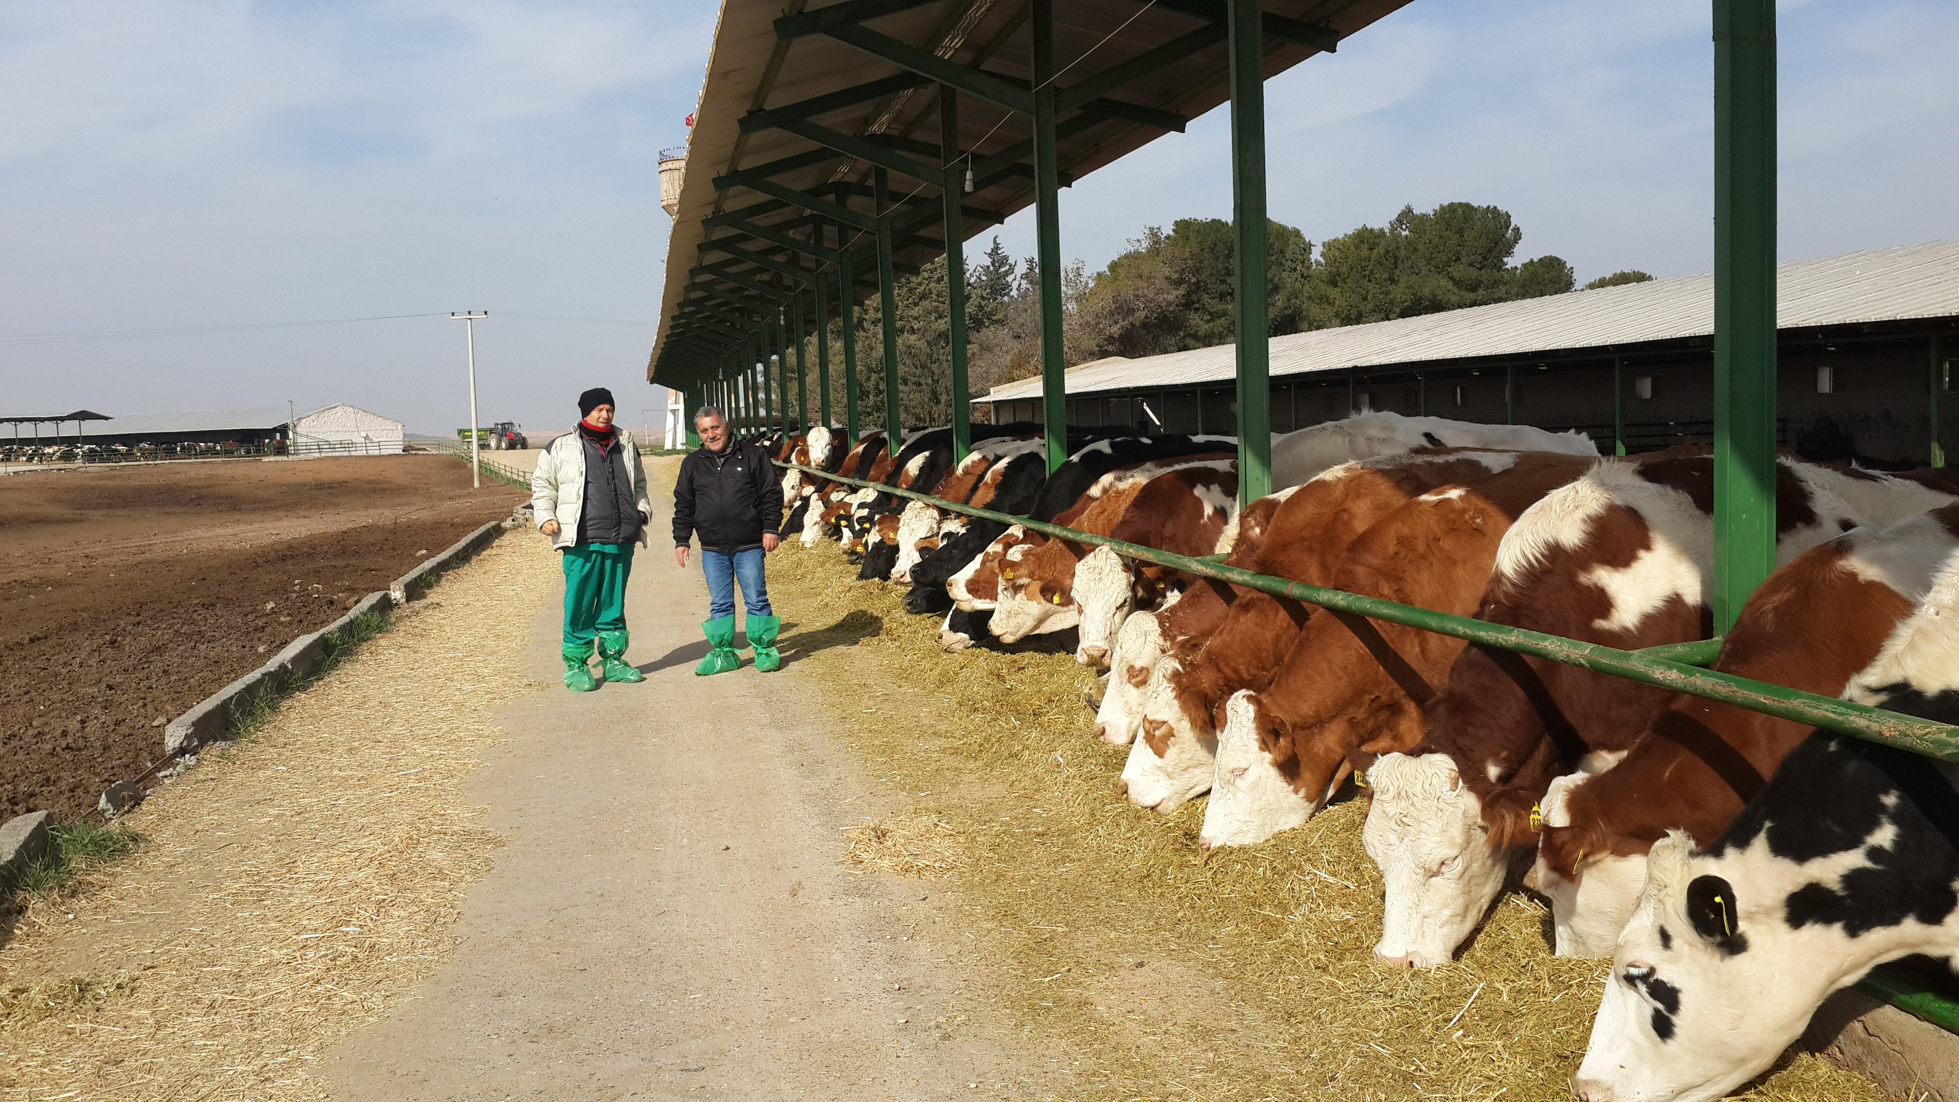
Feed and Water hygiene
a cow at the peak of milk production
Dry matter 3-4% of body weight
Consumes up to 150 - 160 liters of water
(Küplülü ve Vural, 2015 TİGEM)

Slide 4
Factors affecting water consumption
Walking distance
Quality of water
Degree of water
Contamination of water
Hierarchical order
Number of drinkers per animal
milk yield

Slide 5
Factors affecting water consumption / property of water
Parameters | Risk Factors (Mg/L) | Mean con (mg/L)
PH | < 6,0 - 8,5 > | 7,6
Whole dissolved solids | 1000 < | 190
Nitrate - Nitrogen | 20 < | 0,9
Cu | 1,0 < | 0,02
Fe | 0,30 < | 0,20
Manganase | 0,05 < | 0,01
Chloride | 250 < | 10,1
Sulfate | 1000 < | 11,4
Coliforms (E.coli) | 1 < (100 ml/koloni*) | < 1 (100 ml/koloni*)
Hardness |  | 89,6
(Swistock, 2017)

Slide 6
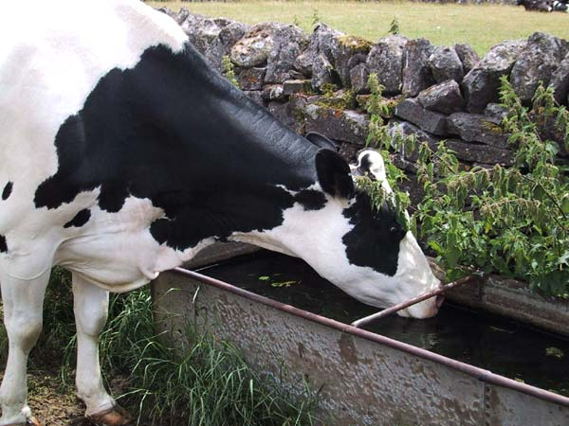
Water Consumption

Slide 7
Water Consumption
(Huzzey ve ark., 2007)

Slide 8
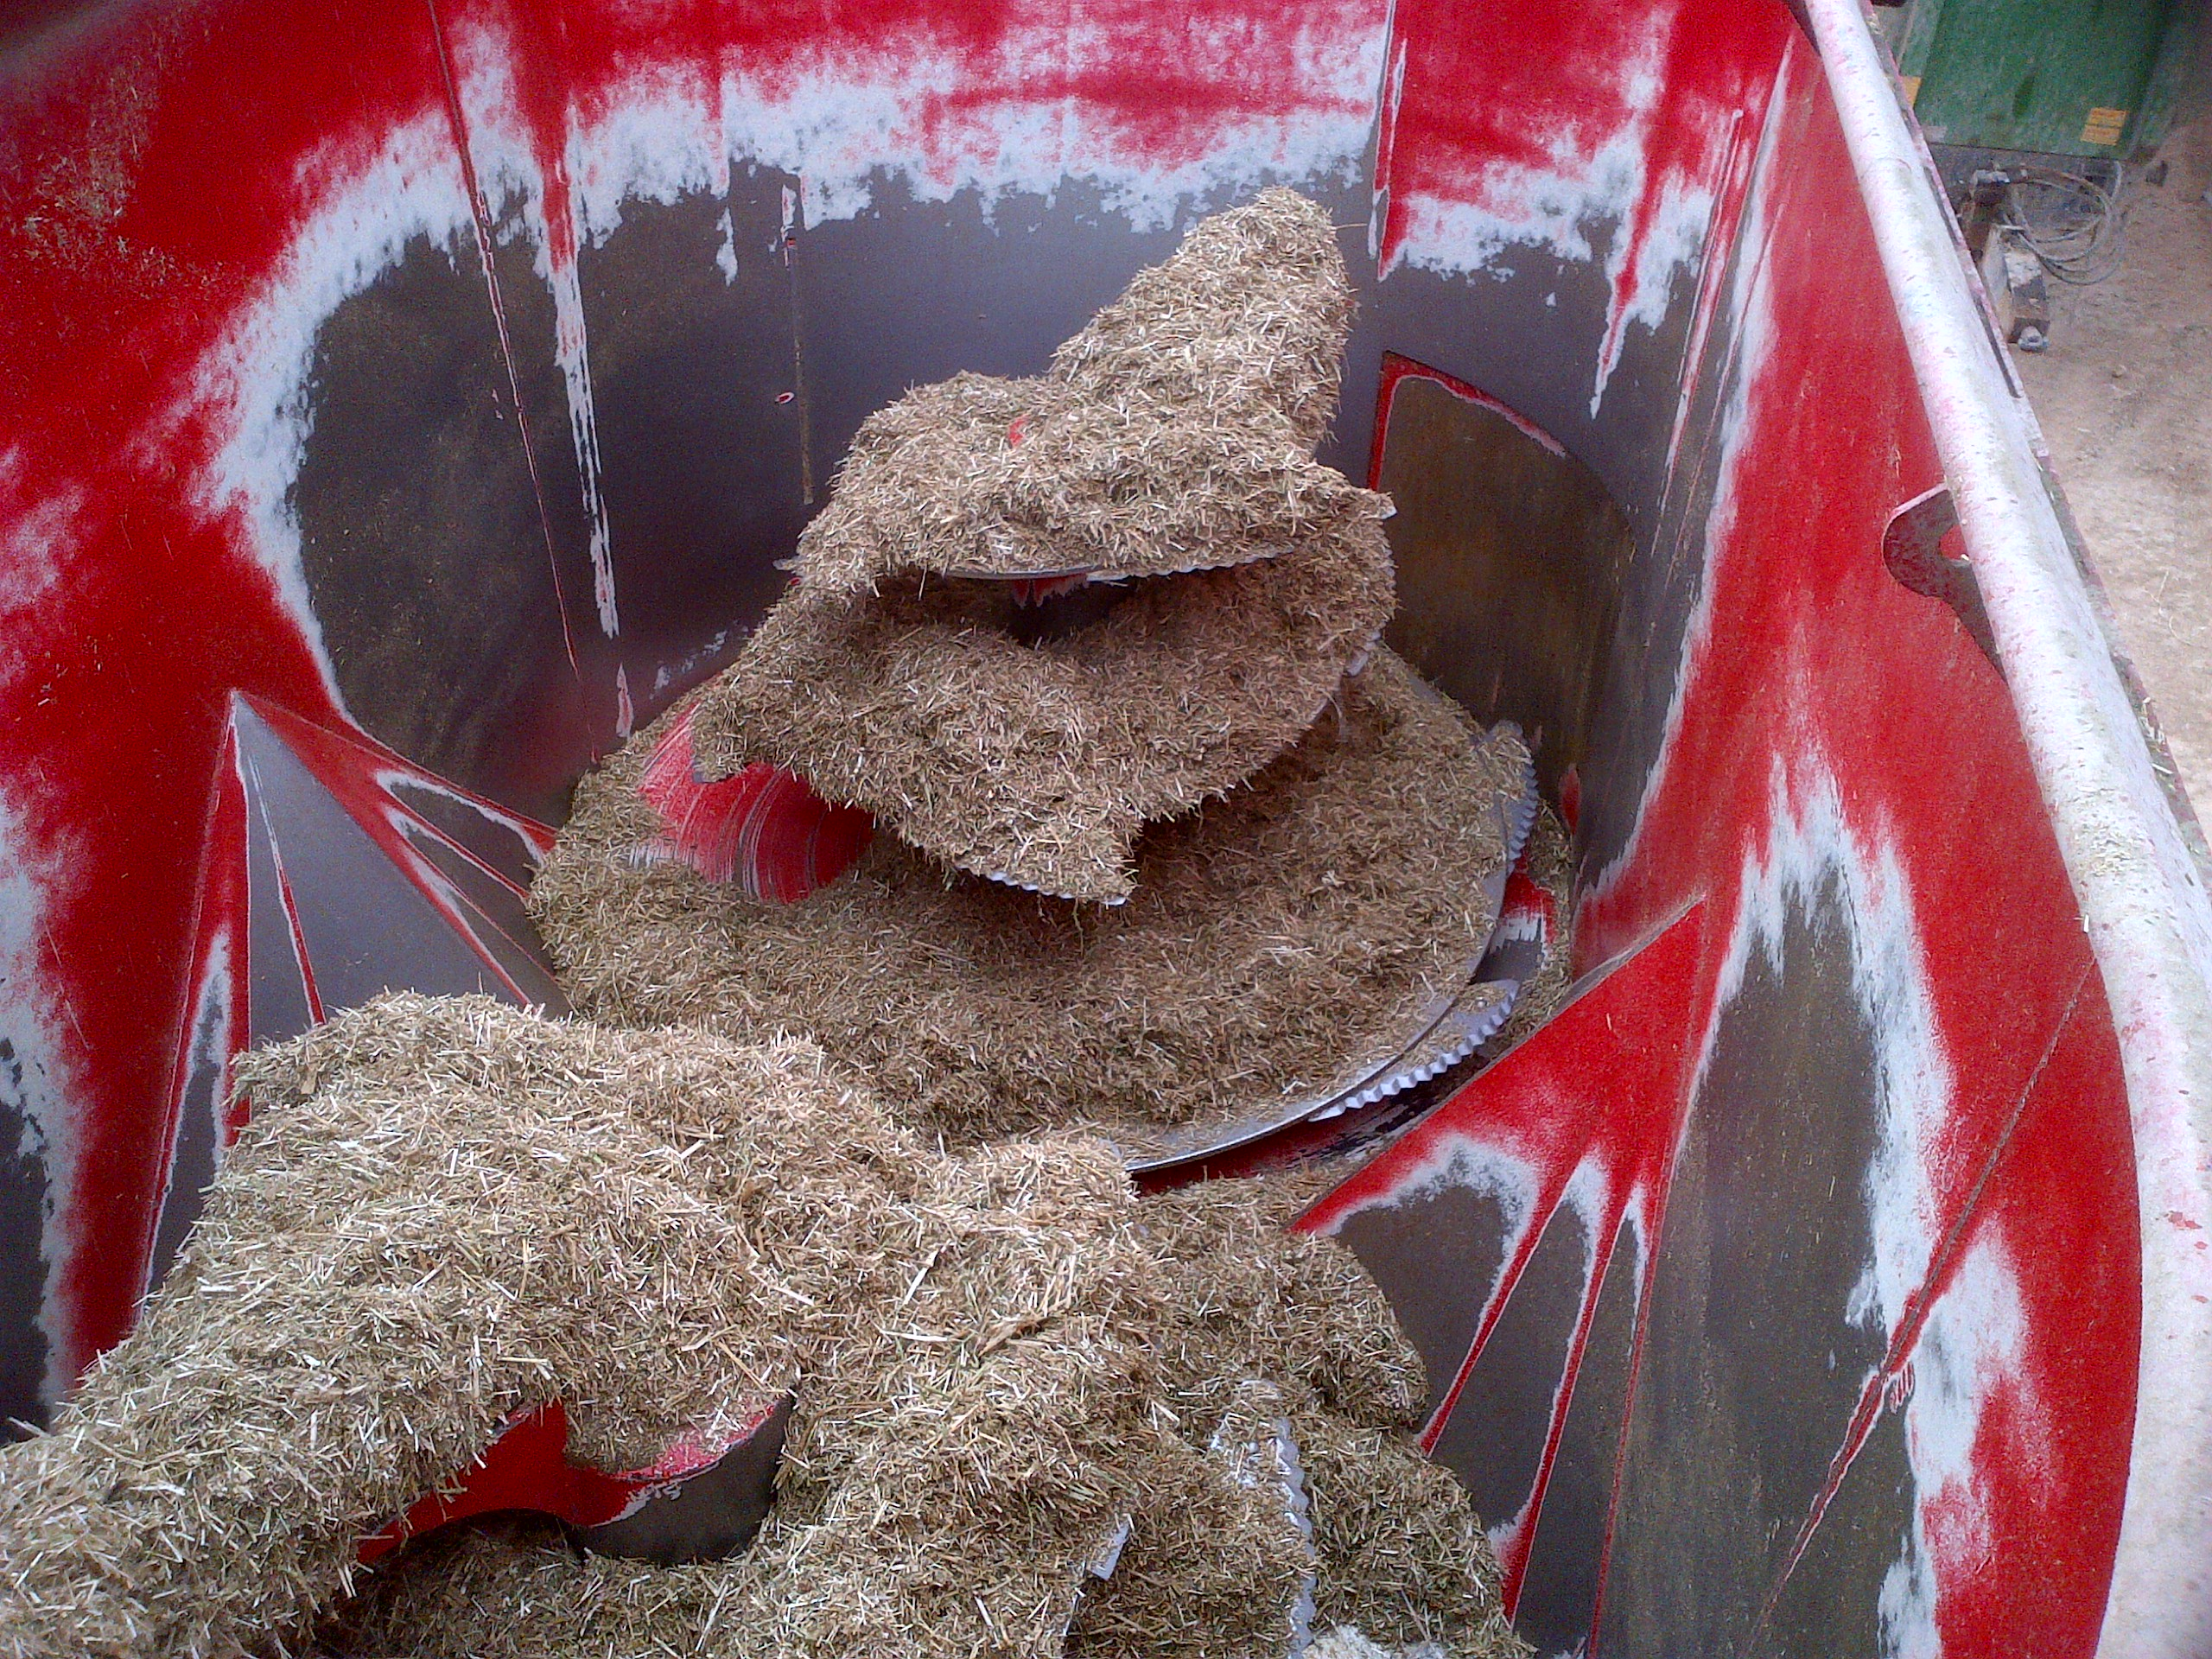
Factors Affecting Feed Consumption
Quality of ration
Hierarchical order
Enough space for each animal
Milk yield
Contamination of ration
(Küplülü ve Vural, 2005 TİGEM)

Slide 9
Relationship between prepartum dry matter consumption and uterine infections
(Huzzey ve ark., 2007)

Slide 10
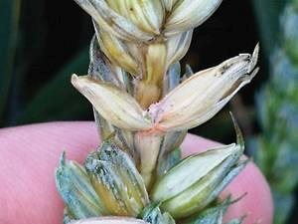
Feed Hygiene / Mycotoxins
Growth between 0-60 ° C and 2 - 7 pH
(Zain, 2011; Nahrer ve Rodrigues, 2017)

Slide 11
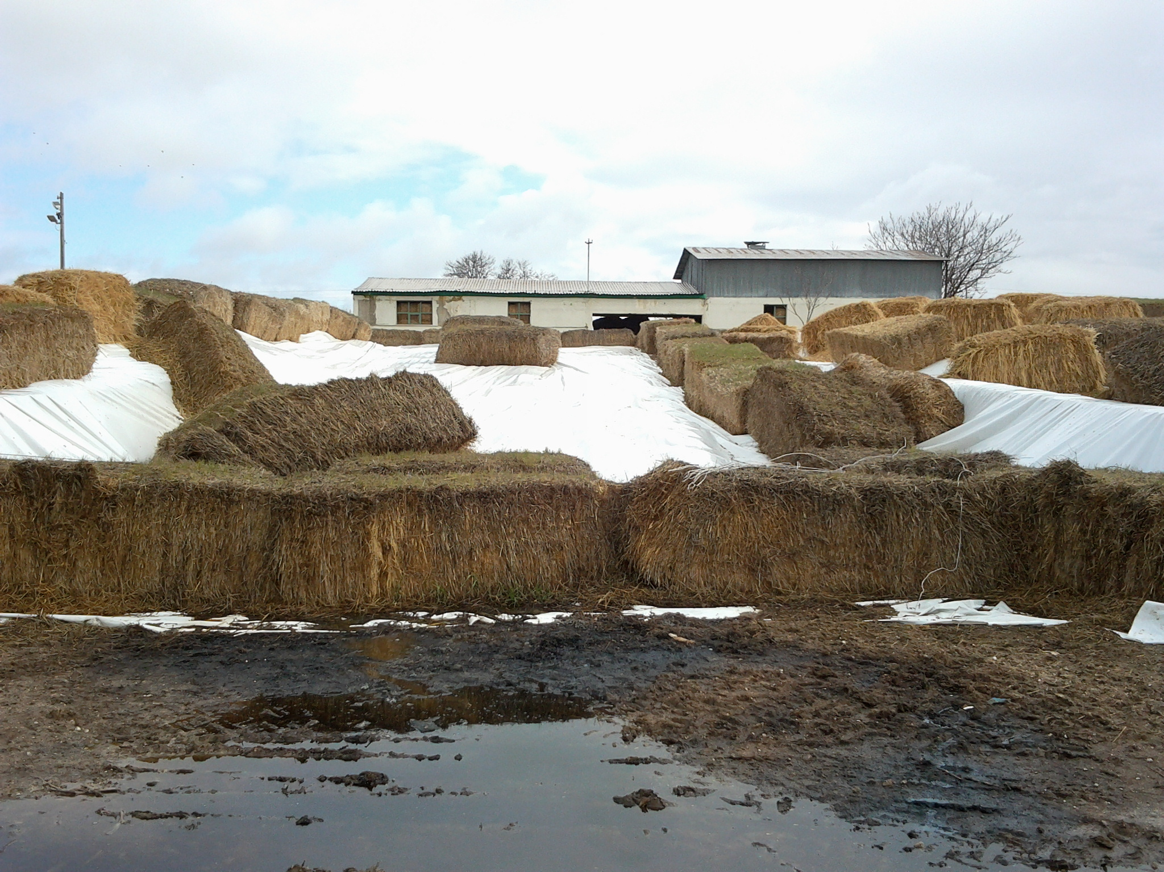
Feed Hygiene / Mycotoxins
The term mycotoxin mykes (Greek, fungus) and toxicum (Latin, poison)
Reproduction in general
Temperature: 0-60 ° C
PH: 2-10
water activity: 0.74-0.99
(Küplülü ve Vural, 2005 TİGEM)

Slide 12
Feed Hygiene / Mycotoxins
There are around 400 species but the most common ones
Fusarium; before or after harvest
Penicillium and Aspergillus species; during drying and in warehouses
It was determined that they can produce toxin by infecting food.

Slide 13
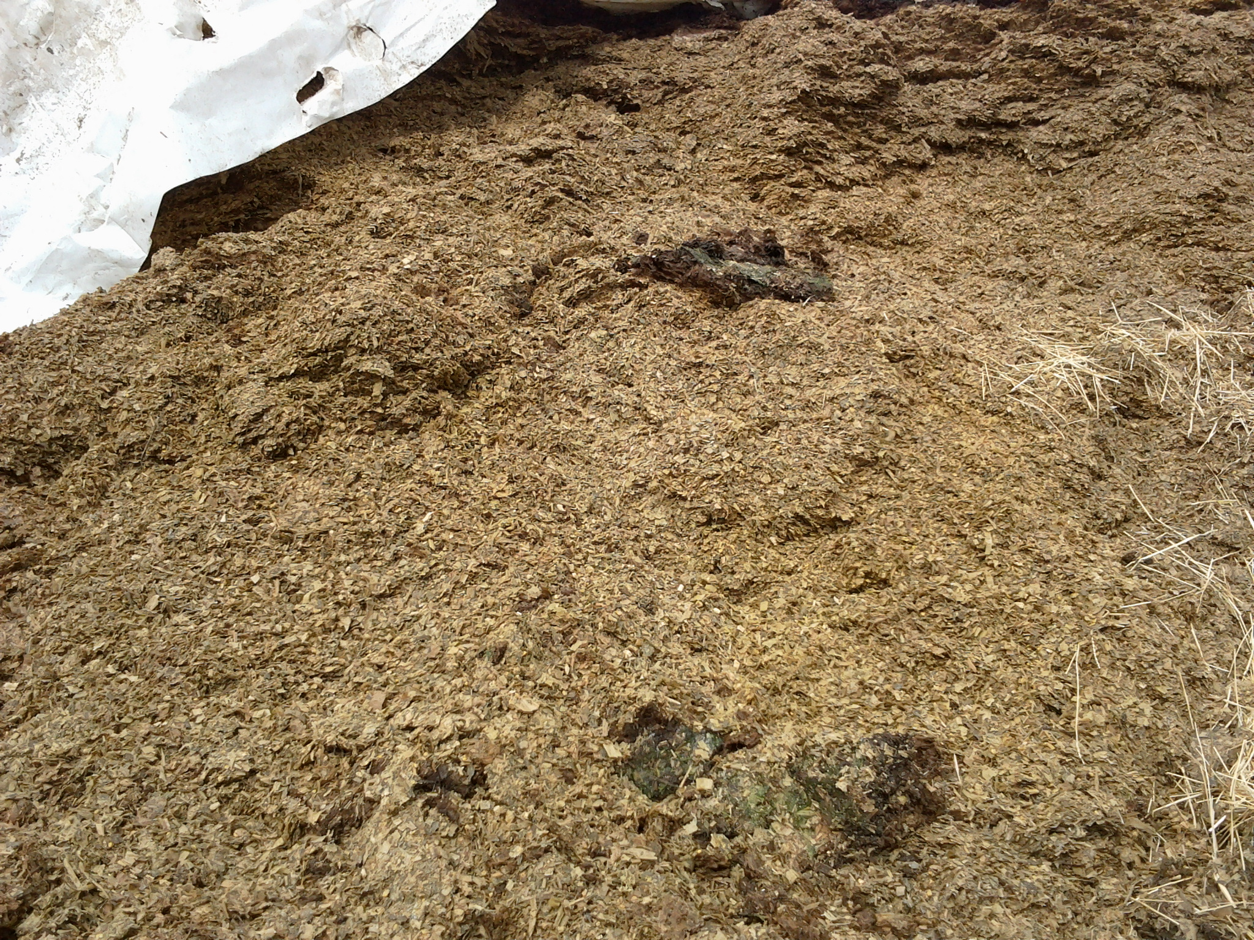
Feed Hygiene / Mycotoxins
Effects 1
Immune system collapse
Gastrointestinal problems
Decrease in dry matter intake
Rumen dysfunction
Intestinal hemorrhage
(Küplülü ve Vural, 20015 TİGEM)

Slide 14
Feed Hygiene / Mycotoxins
Effects 2
milk contamination
fertility problems
liver problems
decline in milk production
growth retardation
metabolism problems
(Küplülü ve Vural, 20015 TİGEM)

Slide 15
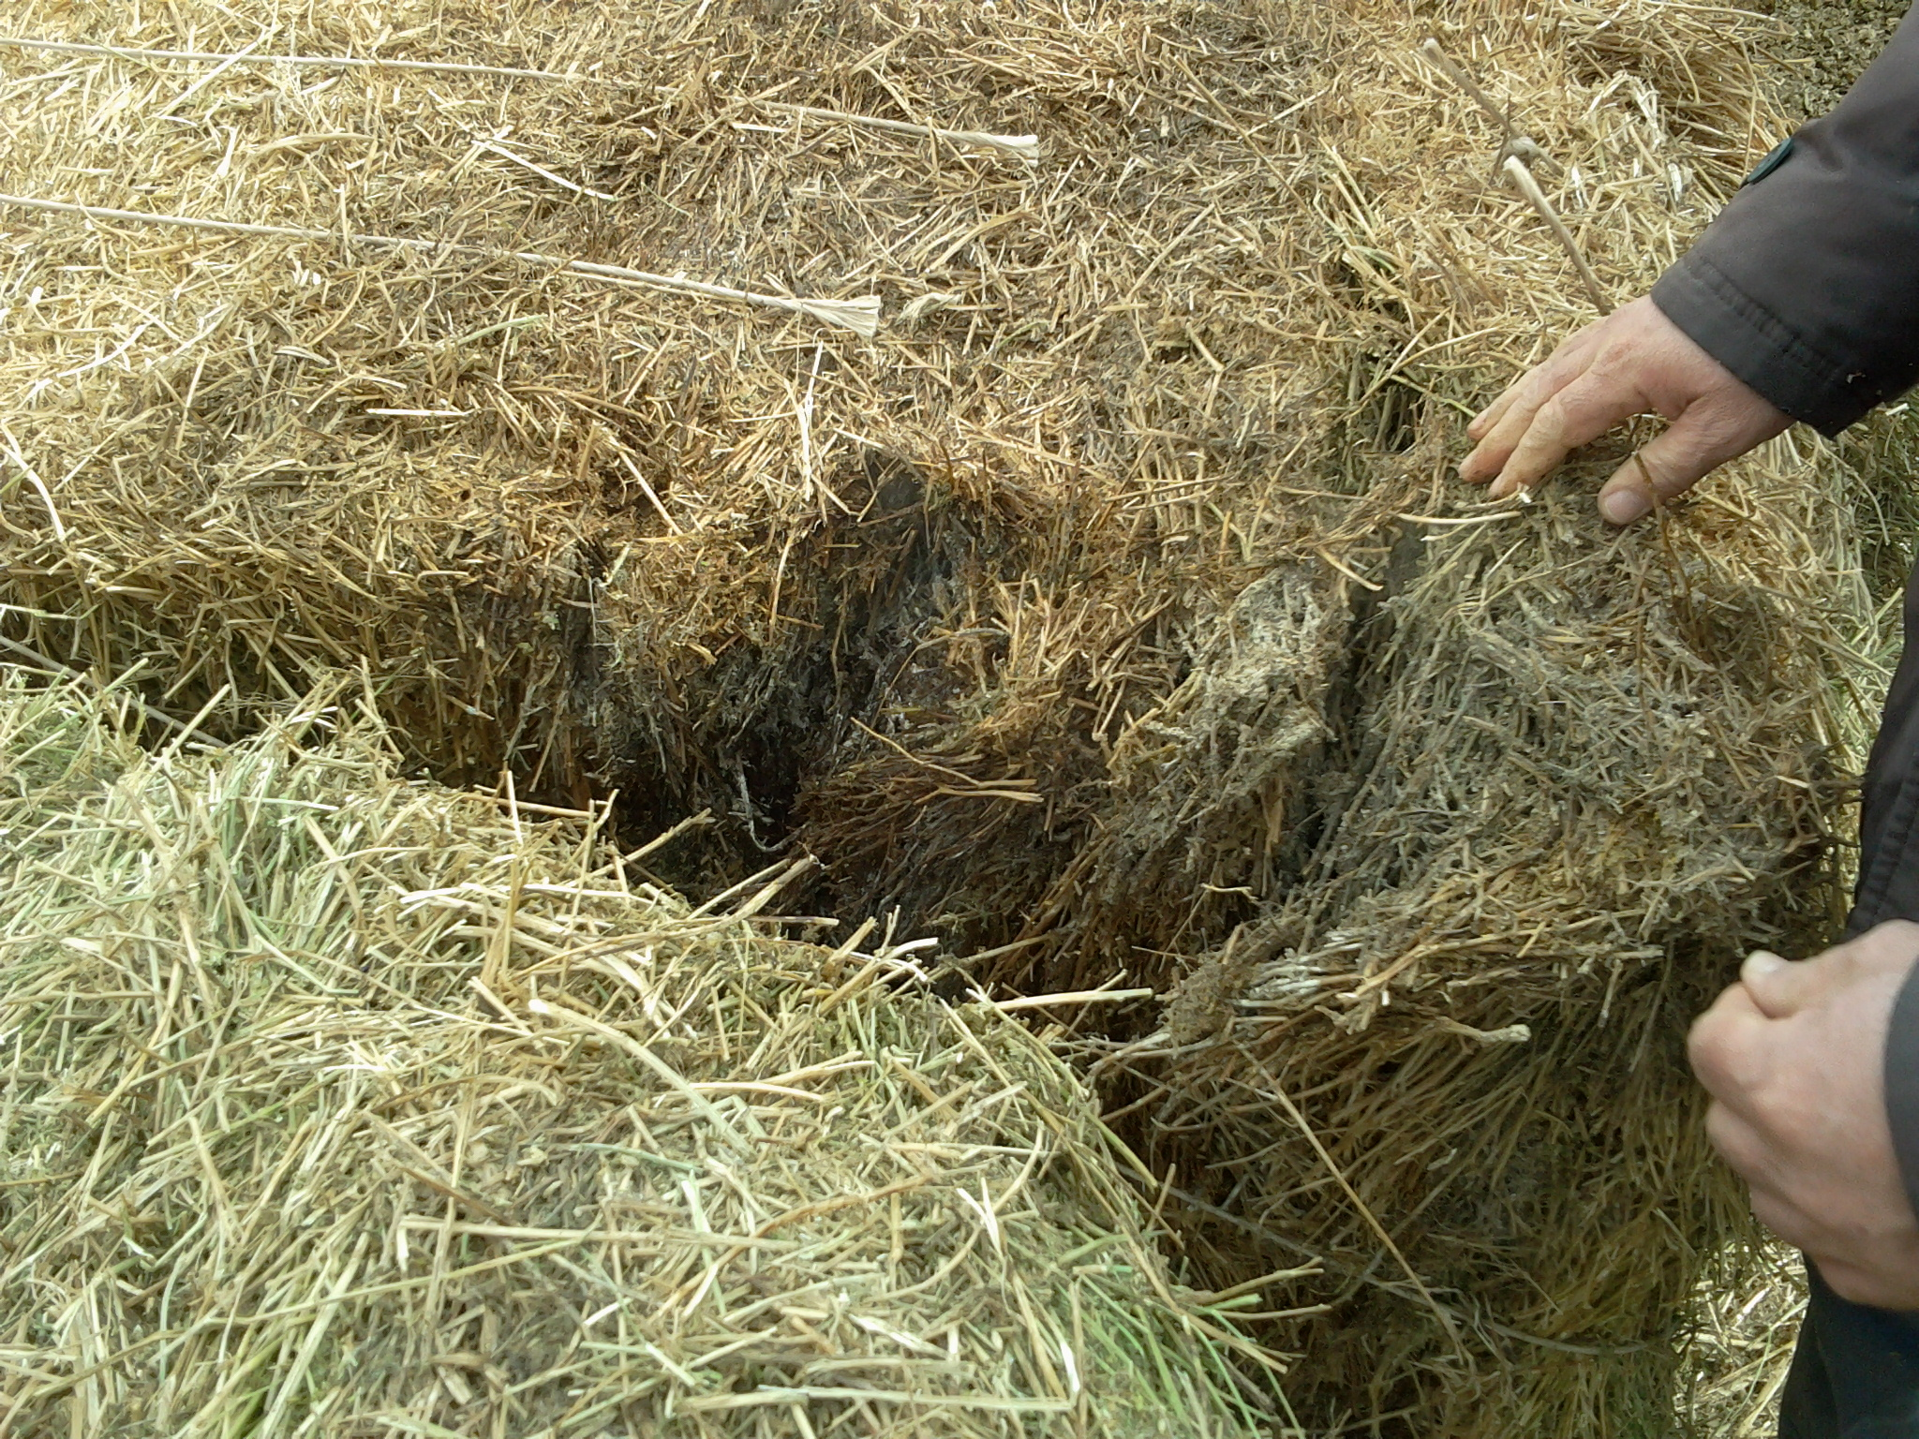
Feed Hygiene / Mycotoxins
Dairy cows
Zearalenone problem
When feeding> 1.3 mg / kg
Irregular oestrus
Low concept rate
Ovarian cyst
Embryonic death
pasteurization and boiling
ineffective
(Küplülü ve Vural, 2005 TİGEM)

Slide 16
Feed Hygiene / Mycotoxins
(Küplülü ve Vural, 20015 TİGEM)

Slide 17
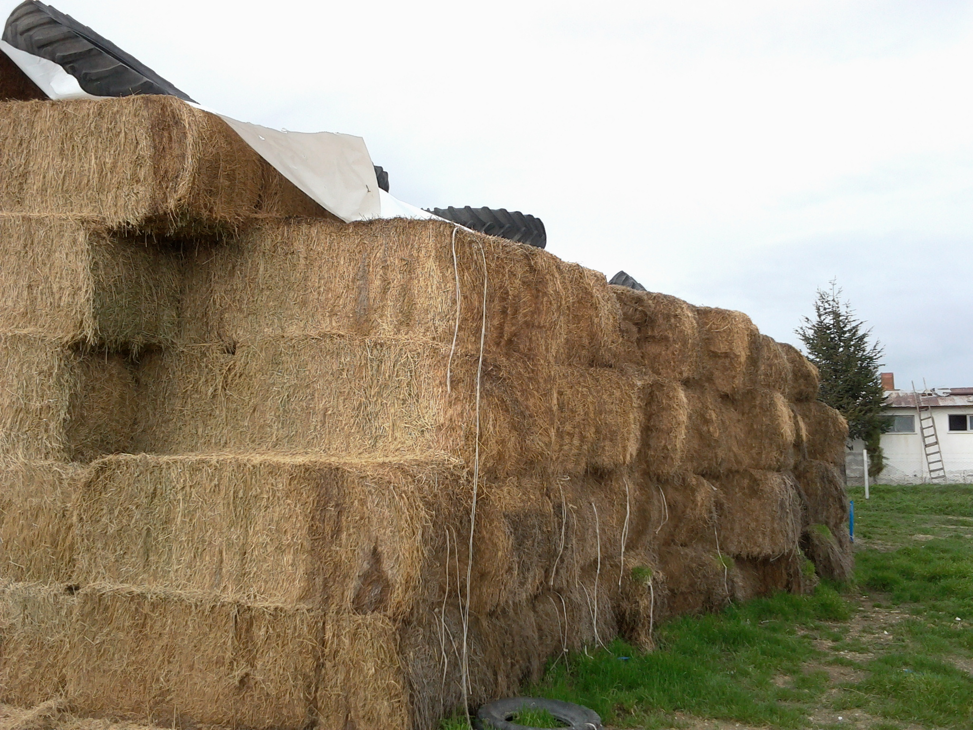
Feed Hygiene / Mycotoxins
(Küplülü ve Vural, 20015 TİGEM)

