Slide 1
Interactions of NSAIDs (Aspirin and Ibuprofen)
Amirarsalan SHIRIPOOR
16030198

Slide 2
Aspirin
Aspirin is a salicylate used to treat pain, fever, inflammation, migraines, and reducing the risk of major adverse cardiovascular events.
Also known as Aspirin, acetylsalicylic acid (ASA) is a commonly used drug for the treatment of pain and fever due to various causes. Acetylsalicylic acid has both anti-inflammatory and antipyretic effects. This drug also inhibits platelet aggregation and is used in the prevention of blood clots stroke, and myocardial infarction (MI)
Acetylsalicylic acid (ASA) blocks prostaglandin synthesis. It is non-selective for COX-1 and COX-2 enzymes. Inhibition of COX-1 results in the inhibition of platelet aggregation for about 7-10 days (average platelet lifespan). The acetyl group of acetylsalicylic acid binds with a serine residue of the cyclooxygenase-1 (COX-1) enzyme, leading to irreversible inhibition. This prevents the production of pain-causing prostaglandins. This process also stops the conversion of arachidonic acid to thromboxane A2 (TXA2), which is a potent inducer of platelet aggregation. Platelet aggregation can result in clots and harmful venous and arterial thromboembolism, leading to conditions such as pulmonary embolism and stroke.

Slide 3
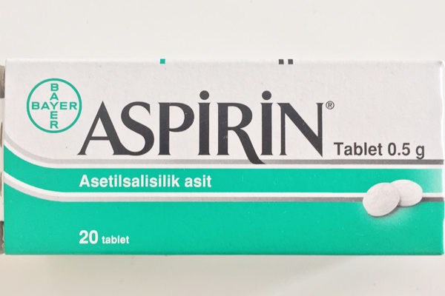
It is important to note that there is 60% homology between the protein structures of COX-1 and COX-2. ASA binds to serine 516 residue on the active site of COX-2 in the same fashion as its binding to the serine 530 residue located on the active site of COX-1. The active site of COX-2 is, however, slightly larger than the active site of COX-1, so that arachidonic acid (which later becomes prostaglandins) manages to bypass the aspirin molecule inactivating COX-2 ^{11,12}. ASA, therefore, exerts more action on the COX-1 receptor rather than on the COX-2 receptor ¹⁴. A higher dose of acetylsalicylic acid is required for COX-2 inhibition

Slide 4
Ibuprofen
Ibuprofen is an NSAID and non-selective COX inhibitor used to treat mild-moderate pain, fever, and inflammation.
Ibuprofen is a non-steroidal anti-inflammatory drug (NSAID) derived from propionic acid and it is considered the first of the propionics. The formula of ibuprofen is 2-(4-isobutylphenyl) propionic acid and its initial development was in 1960 while researching for a safer alternative for aspirin. Ibuprofen was finally patented in 1961 and this drug was first launched against rheumatoid arthritis in the UK in 1969 and USA in 1974. It was the first available over-the-counter NSAID

Slide 5
The exact mechanism of action of ibuprofen is unknown. However, ibuprofen is considered an NSAID and thus it is a non-selective inhibitor of cyclooxygenase, which is an enzyme involved in prostaglandin (mediators of pain and fever) and thromboxane (stimulators of blood clotting) synthesis via the arachidonic acid pathway.²⁷
Ibuprofen is a non-selective COX inhibitor and hence, it inhibits the activity of both COX-1 and COX-2. The inhibition of COX-2 activity decreases the synthesis of prostaglandins involved in mediating inflammation, pain, fever, and swelling while the inhibition of COX-1 is thought to cause some of the side effects of ibuprofen including GI ulceration.

Slide 6
Both aspirin and ibuprofen belong to a drug class called nonsteroidal anti-inflammatory drugs (NSAIDs). They have similar side effects, and taking them together increases your risk of these side effects.
Aspirin and ibuprofen can cause stomach bleeding, especially if you take too much. That means taking them together increases your risk. The risk of stomach bleeding from these drugs continues to increase if you:
are older than 60 years
have or have had stomach ulcers or bleeding
take blood thinners or steroids
drink three or more alcoholic beverages per day
take more of either drug than recommended
take either drug for longer than directed
Aspirin or ibuprofen may also cause allergic reactions, with symptoms such as hives, rash, blisters, facial swelling, and wheezing. Taking them together increases this risk as well. If you experience any redness or swelling from aspirin or ibuprofen, contact your doctor.
Both aspirin and ibuprofen may also cause hearing problems. You may notice ringing in your ears or a decrease in your hearing. If you do, you should contact your doctor.

Slide 7
References
https://www.healthline.com/health/chronic-pain/treating-pain-with-heat-and-cold#_noHeaderPrefixedContent
https://go.drugbank.com/drugs/DB01050
https://go.drugbank.com/drugs/DB00945

