Slide 1
CREATININE CLEARANCE

Slide 2
Creatinine clearance is one of the renal function tests.
Creatinine clearance is the most commonly used test for the regulation of glomerular filtration rate (GFR).
GFR: It is a measure of the amount of fluid that is filtered from the glomerulus into the Bowman’s capsule per unit of time. It is determined by measuring the excretion of a substance which is a filter from the grommets and which is not absorbed back from the tubules.

Slide 3
In the organism, nitrogen-containing and biologically important compounds are synthesized which do not possess protein properties by utilizing amino acids. One of them is creatine. Creatine is a nitrogenous compound synthesized from arginine, glycine and methionine amino acids.
Creatine is a high-energy phosphate carrier that provides ATP synthesis from ADP. Phosphocreatine, if necessary, is converted to creatinine, which is a cyclic compound giving phosphoric acid.

Slide 4
Creatinine is formed as a result of muscle metabolism and is proportional to muscle mass, and is excreted in the urine 20-26 mg / kg daily in men and 14-22 mg / kg daily in women. The contractile properties of the muscles depend on the phosphocreatine content and the contraction force is proportional to the degree of phosphocreatine degradation.
Creatinine and a small amount of creatine are excreted in the urine

Slide 5
In one day, creatinine in mg is thrown out per kilogram of body, called creatinine coefficient.

Slide 6
Plasma creatinine levels are quite stable in people having normal kidney and in patients with mild renal impairment, so it is used for clearance and GFR measurement.

Slide 7
The determination of creatinin in serum (Alkali picrate method)
Principle: The creatinin in the protein-free filtrate forms the red tautomer with picric acid in the alkaline solution.

Slide 8
Experimental procedure
6 ml of water and 2 ml of serum are transferred to the test tube
Add 1 ml sodium tungstate +1 ml sulfuric acid
Take 5 ml of the prepared solution which is serum filtrate
Standards are set up for the calibration chart

Slide 9
The Calibration Chart
Tube | Dilute standard solution (ml) | Filtrate (ml) | D. Water (ml)
Blind | - | - | 5
STD 1 (2 mg/dl) | 1 | - | 4
STD 2 (4 mg/dl) | 2 | - | 3
STD 3 (6 mg/dl) | 3 | - | 2
STD 4 (8 mg/dl) | 4 | - | 1
STD 5 (10 mg/dl) | 5 | - | -
Sample | - | 5 | -

Slide 10
3 ml of picric acid and 1 ml of 10% sodium hydroxide are added to all prepared tubes.
After standing at room temperature for 10 min, the transmittance values (% T) are measured at 520 nm.
Unknown Pkr value is calculated by entering concentration values against % T on semi-logarithmic paper

Slide 11
Transmittance
The ratio of the light intensity from the solution to the light intensity entering the solution (I / Io) is defined as transmittance (T). Transmittance is usually defined as (% T)
A = 2-logT
A T%
0 100
1 10
2 1

Slide 12
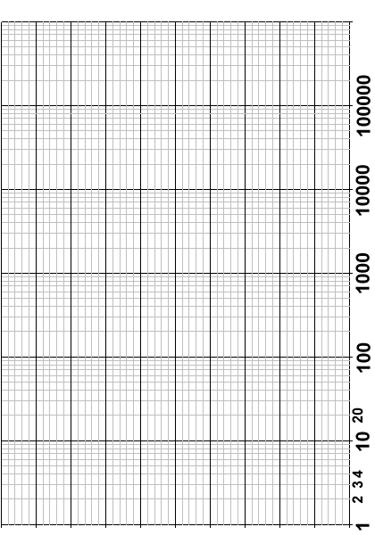
Semi-logarithmic scale

Slide 13
Calculation of creatinine clearance
=(Ukr/Pkr) x V x A
Ukr= Creatinin concentration in urine ( 100 mg/dl)
Pkr=Creatinin concentration in plasma
V= Urine flow rate (1.5 ml/min)
A= Surface area in square meters (1.73)

Slide 14
Standard Values
The standard range for a 70-80 year old male individual is 55-113 ml / min / 1.73 m2.

Slide 15
The cases; Creatinine clearance is high
- The body is dehydrated
- Muscle injuries
- Overweight exercises
- Carbon monoxide poisoning, hypothyroidism
The cases; Creatinine clearance is low
- Renal insufficiency
- Too little blood flow in the kidneys
- Damage to the kidneys

Slide 16
References
Biochemistry practice book (2004)
Shahbaz H, Gupta M. Creatinine Clearance. [Updated 2019 Jul 5]. In: StatPearls [Internet]. Treasure Island (FL): StatPearls Publishing; 2020 Jan-. Available from: https://www.ncbi.nlm.nih.gov/books/NBK544228/

