Slide 1
COM 412
Information Technology and Security Governance

Slide 2
IT & Security Governance
Project Management Principles
* Distinct start and finish
* Distinct phases
• Mobilization
• Analysis and Design
• Build
• Post-implementation support (which may or may not be part of O&M)
• Closure
• Monitoring and Control

Slide 3
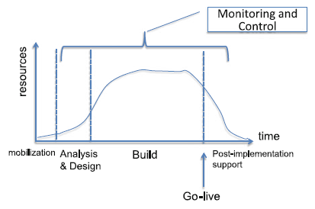
IT & Security Governance
Project Management Principles
* The phases have distinct tasks but may typically overlap

Slide 4
IT & Security Governance
Project Management Principles
* Mobilization Phase:
Preparation activities for the project:
• Preparation and signing of contract
• Mobilization and readying of the resources
• Procurement of necessary software and hardware
• Preparation & on-boarding of team members
• Provisioning of resources

Slide 5
IT & Security Governance
Project Management Principles
* Analysis and Design Phase:
A detailed analysis of the user requirements is initiated
• The idea: no configuration or coding work should start until concurrence (consensus) from the users is received
• Concurrence → signed-off design documents

Slide 6
IT & Security Governance
Project Management Principles
* Analysis and Design Phase:
Actions:
• Project kickoff presentation is given. This includes:
- Table of organization: roles and responsibilities are defined
- Project plan: timeline & tasks
- Project scope
- Deliverables and acceptance criteria
- Communication plan: when, how, and who will be communicated what

Slide 7
IT & Security Governance
Project Management Principles
* Analysis and Design Phase:
Actions:
• On-boarding session between project managers (customer’s and vendor’s side) and the lead personnel from the vendor’s side. Discussed issues here:
- Review of policies and guidelines
- Deliverable checklist
- Documentation format
- Authorized signatories
- Escalation procedure
- Change request procedure

Slide 8
IT & Security Governance
Project Management Principles
* Analysis and Design Phase:
Actions:
• Requirement gathering meetings with end users:
- Gathering specific requirements from end users
- Defining and refining the specifications
- Preparing design documents
• Design sign-off: approval

Slide 9
IT & Security Governance
Project Management Principles
* Build Phase:
Sub-phases:
• Build: configuration of the systems and programming:
• Testing
- Unit
- Integration
- System
- User acceptance

Slide 10
IT & Security Governance
Project Management Principles
* Build Phase:
Sub-phases:
• Go live: transfer of the application from the project environment (development and testing) into production.
Proper cutover is required.

Slide 11
IT & Security Governance
Project Management Principles
* Post-Implementation Support Phase:
Project team and O&M responsibility
* Monitoring and Control Phase (mind the timeline graph):
- Ensures that the project is within scope, time, cost, and quality
- PMs responsibility
* Closure Phase:
- Formal project end
- Done after incidences have been resolved, all
deliverables submitted and accepted, training and documentation submitted

Slide 12
IT & Security Governance
Scope Management
* For IT projects the scope is not 100 % clear during the project start (intangible stuff)
* Scope is defined during the progress of the project
- the deliverable may not be acceptable,
- mismatch between the deliverable and customer desires

Slide 13
IT & Security Governance
Scope Management
* The more detailed the scope at the start of the project, the better!
* Things that may be done:
- Have a clear-cut understanding of what the project is to deliver
- Research and vendor presentations
- Gap analysis: define current state versus to-be state
- Contracting of design specifications separate from “build” phase of the project

Slide 14
IT & Security Governance
Procurement Management and Contracting
* Requirements must be defined before tendering
* The most important document here is Terms of Reference (TOR)
* TOR
- specifies what is required from the vendor,
- asks that they comply with them, or if unable to comply, to indicate the approach they will take in addressing the requirement.
* Good TORs take time and effort to build
* RFIs may be applied to build effective TORs
Notes:
Request for Information (RFI): is used to get nonbinding proposals from vendors given some very generic requirements. This can be followed
up by presentations from these vendors.

Slide 15
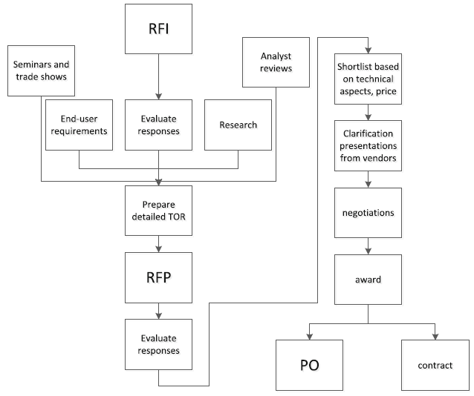
IT & Security Governance
Procurement Management and Contracting
Notes:
Typical tendering process.
Other sources of information except for RFIs are the Internet, research, analyst reviews, as well as by means of attending seminars,
workshops, and presentations on the topic.

Slide 16
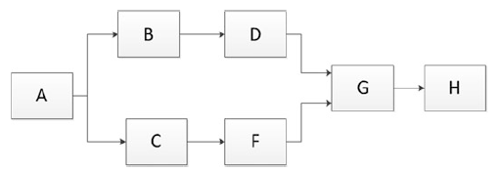
IT & Security Governance
Time Management
* A PDM (Precedence Diagramming Method) is a graphical representation of project tasks
* Activities are represented by a Node in the form of a RECTANGLE
* Dependency is represented by an ARROW

Slide 17
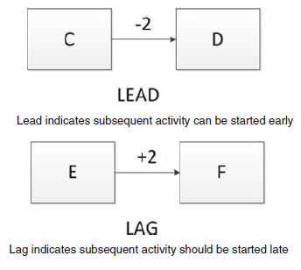
IT & Security Governance
Time Management
* Though a task is dependent on a previous one, it may not be necessary for the previous task to finish completely before starting the new task
* Or it may be the opposite

Slide 18
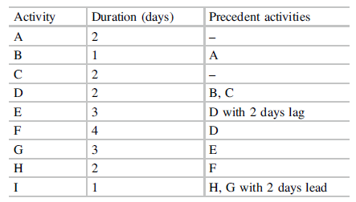
IT & Security Governance
Time Management

Slide 19
IT & Security Governance
Risk Management
* Ability to foresee how events or circumstances can affect a project before they actually occur
* Positive risks exist
* We mitigate, accept, or transfer the negative risks
* We enhance and promote its probability of occurrence for positive risks

Slide 20
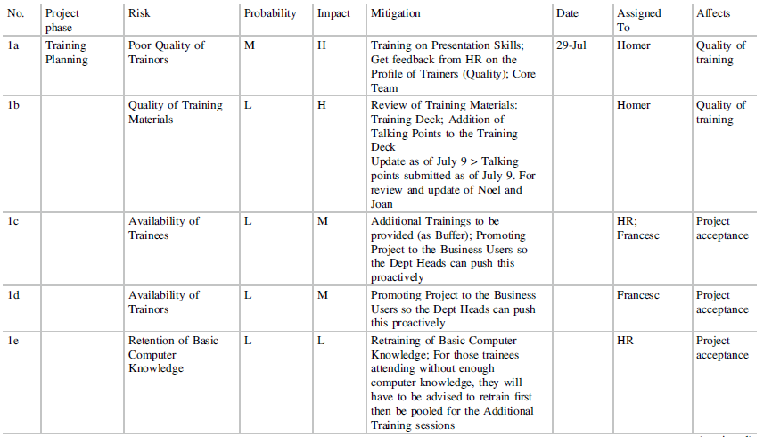
IT & Security Governance
Risk Management – Sample risk registry for a project
Generally, only low-low risks (probability, impact) can be accepted, all others should warrant action
in order to deal with them, and definitely high-high risks need mitigation action, or
a transfer.

Slide 21
IT & Security Governance
Project Documentation
* Type of documentation depends on the type of project and software
* Purely technical projects are simpler to document and manage:
- No business process design
- Users are restricted to IT personnel

Slide 22
IT & Security Governance
Project Documentation
* Docs of phases
- Analysis phase: vendor is getting sufficient information from the customer organization’s users and IT
Minutes of meetings
User requirements document
- Design phase:
Flowcharts
flow of the process through different departments and users
flowcharts may be defined at differing levels of detail (0, 1, 2, 3, and 4)

Slide 23
IT & Security Governance
Project Documentation
- Design phase:
Flowcharts (detail levels; processes→ tasks → transactions)
• Level 0: a list of involved processes with a brief description
• Level 1: a diagram showing the highest level process interaction between different types of users
• Level 2: process flowchart describing the tasks involved for each particular process
• Level 3: each task is broken down into transactions
• Level 4: Work Instruction level, is a step-by-step depiction of how a user is to transact. Typically includes screenshots and an explanation of the parameters and selections the user is to make in transacting

Slide 24
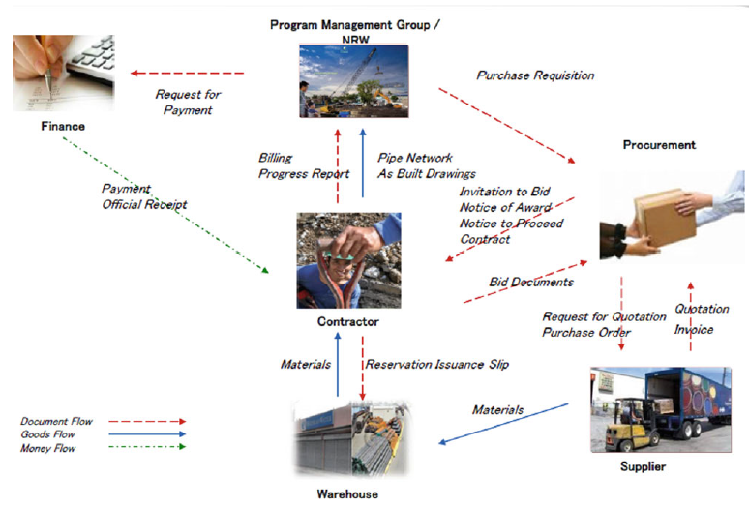
IT & Security Governance
Notes:
Level 1: showing the highest level process interaction between different types of users

Slide 25
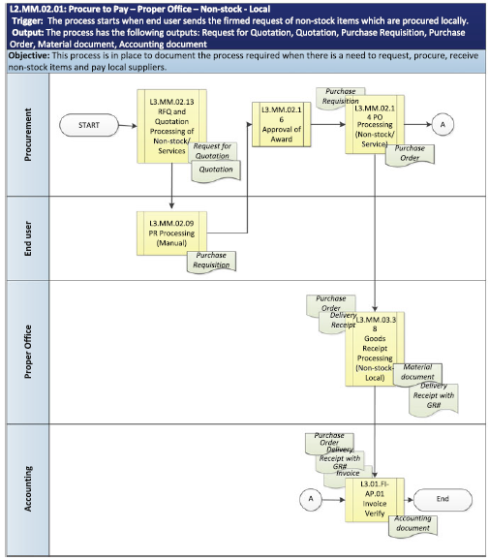
IT & Security Governance
Notes:
Level 2: process flowchart the tasks involved for each particular process

Slide 26
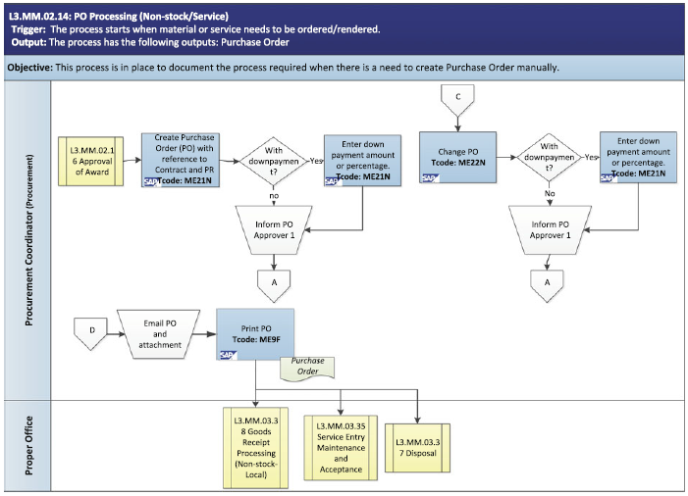
IT & Security Governance
Notes:
Level 3: each task is broken down into transactions

Slide 27
IT & Security Governance
Project Documentation
- Design phase:
Designing and documenting the processes is typically iterative
Each successive level is signed off before proceeding to a more detailed level
Some softwares may not be so heavy in terms of process (document management systems, portals, …) but other functionalities (search criteria, metadata, fields to be stored, selection menus) are there.
A functional design document is used for this purpose.

Slide 28
IT & Security Governance
Project Documentation
- Design phase:
A functional design document typically includes:
• Overall functional architecture
• Functions, attributes, and forms to be used
• Process flowchart: if process is simple enough, it may already be included into this functional design document
• Layout of user screens
• High-level description of interfaces used
• Roles and permissions

Slide 29
IT & Security Governance
Project Documentation
- Design phase:
A technical design document typically includes:
• Overall technical architecture: a diagram showing the different software components, servers, network components etc.
• Description of the different environments to be used

Slide 30
IT & Security Governance
Project Documentation
- Cutover and Go Live phase:
Once the solution has been built, the focus now is on the different steps leading to the go live.
Cutover special documentation includes:
• Data migration plan: describing how data will be migrated into the new system from the legacy system
• Test plan: describing in high level how the new system will
be tested, by whom
• Test scripts: these are the details on the test plan, and indicate work instruction level of scenarios to be tested
• User manuals
• Operations manuals: necessary by the IT team that is to operate and run the system

Slide 31
IT & Security Governance
FRICEW (RICEFW or RICEF)
* Common definition used in SAP methodology
* Refer to customized components in an application, these are the typical components which are customized using code
* Stands for:
- Forms: input screens for users
- Reports
- Interfaces
- Conversion
- Enhancements: modifications over standard code
- Workflows

Slide 32
IT & Security Governance
FRICEW (RICEFW or RICEF)
* FRICEW needs to be monitored and minimized for an application. Since:
- Coding is error-prone
- Customizations are not supported during application upgrades
- No product support on custom coding
* Any program FRICEW should be reported by the customer PM to the portfolio manager and even the CIO (if required by the company IT policy) to seek approval for their undertaking

Slide 33
IT & Security Governance
Implementation Strategy
* Big bang approach
- the solution is released into production for the general populace
* It is a hardware or software migration method that involves getting rid of the existing system and transferring all users to the new system simultaneously.
* Big bang approach→ riskiest way
WHY?

Slide 34
IT & Security Governance
Implementation Strategy
* Big bang approach
- The most difficult (if not impossible) to rollback - There is no substitute for good, exhaustive testing
- Incidences discovered after the go live need to be expedited, much faster than if the users would have an
alternative environment
* Instead other approaches: pilot, phased

Slide 35
IT & Security Governance
Testing
* Cost of a bug increases exponentially over time, so that the later in time it is detected, the more expensive it is to fix (IT projects)
* Ability to detect a bug is more difficult at the beginning
* So, the earlier the testing and the more exhaustive, the better for the project and the least costly

Slide 36
IT & Security Governance
Test types
* Unit testing:
A software module is tested to determine that the function for which it was designed for is performed correctly
* Regression testing:
Is done to verify that a code change in the software does not impact the existing functionality of the product
* Integration testing:
A module is tested in conjunction with the other modules of the software to verify that it functions correctly as a whole
* System testing:
Validates the complete and fully integrated software product.
* User Acceptance Testing (UAT)
Performed by the end user or the client to verify/accept the software system before moving the software application to the production environment

Slide 37
IT & Security Governance
Test types
* Other two types of tests exist based on expected results:
• Positive testing: the most common, in which inputs are given to each module and the outputs are checked (for expected results)
preparation of a purchase order scenario
- purchase order proceeds in its generation under different scenarios
- Purchase Request approval actually proceeds to the generation of the PO
• Negative testing: testing a scenario in which the module is not to proceed normally
preparation of a purchase order scenario
- person has no permission to generate the purchase order
- there is no Purchase Request approved for the PO
- there is insufficient budget

Slide 38
IT & Security Governance
People Change Management
* An approach to transitioning individuals, teams, and organizations to a desired future state
* People resist to change (natural defense mechanism to minimize risk)
* Change means the unknown
• More work
• More effort to learn the new processes
• No work (being laid off)

Slide 39
IT & Security Governance
People Change Management
As change is difficult, it needs to be explained well:
• What are the benefits of the change?
• Why do we need the change?
• What does the change mean for each and every employee?
• When and how will the change take effect?
• Elicit the support that you need from the users (make no secret).

