Slide 1
COM258
Chapter 4: Basic SQL

Slide 2
Outline
SQL Data Definition and Data Types
Specifying Constraints in SQL
Basic Retrieval Queries in SQL
Insert, Delete and Update Statements in SQL

Slide 3
Basic SQL
Structured Query Language (SQL)
SQL language is one of the important reasons for the commercial success of relational databases
Table, row and column will be used for relational model terms relation, tuple and attribute respectively

Slide 4
Create Table Command in SQL
CREATE TABLE command specify a new relation
It provides table name
This command also specify attributes and initial constraints
CREATE TABLE EMPLOYEE ...
CREATE TABLE command creates base tables. They are actually created and stored as a file.
Virtual relations are created using CREATE VIEW statement

Slide 5
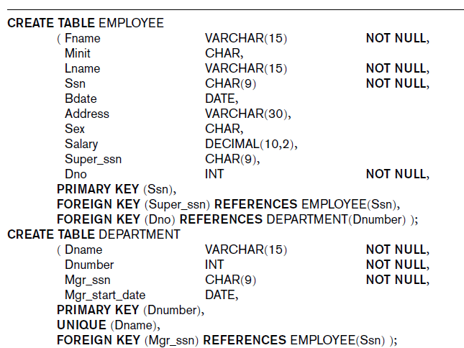
Create Table Command in SQL

Slide 6
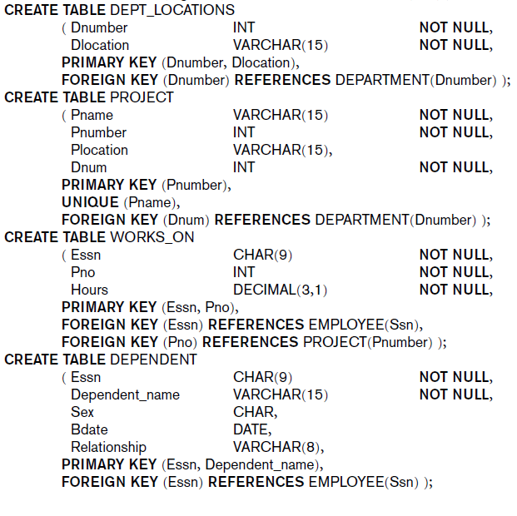
Create Table Command in SQL

Slide 7
Specifying Attribute Constraints and Attribute Defaults
NOT NULL
NULL is not allowed for a particular attribute
Default value
DEFAULT <value>
CHECK clause
Pnumber INT NOT NULL CHECK (Pnumber>0 AND Pnumber<10);

Slide 8
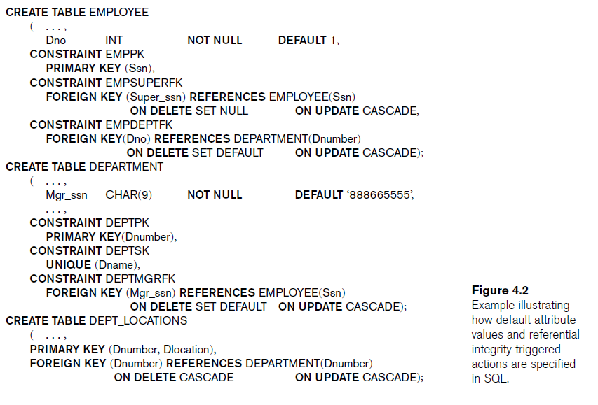
Specifying Attribute Constraints and Attribute Defaults

Slide 9
Basic Retrieval Queries in SQL
SELECT statement is used to retrieve information from a database
SELECT (attribute list)
FROM (table list)
WHERE (condition);
Logical comparison operators can be used in condition.

Slide 10
Basic Retrieval Queries in SQL
Retrieve the name and address of all employees who work for the Research department.
SELECT Fname, Lname, Address
FROM EMPLOYEE, DEPARTMENT
WHERE Dname=‘Research’ AND Dnumber=Dno;
Same name can be used for two attributes.
Attributes should be in different relations.
Relation name is used to prevent ambiguity.

Slide 11
Basic Retrieval Queries in SQL
Missing WHERE clause: No condition on tuple selection
ALL possible tuple combinations (CROSS PRODUCT)
SELECT Ssn, Dname
FROM EMPLOYEE, DEPARTMENT;

Slide 12
Basic Retrieval Queries in SQL
Asterisk (*)
Retrieve all the attribute values of the selected tuples.
SELECT *
FROM EMPLOYEE
WHERE Dno=5;

Slide 13
Basic Retrieval Queries in SQL
Substring Pattern Matching and Arithmetic Operators
LIKE operator
Used for pattern matching
% replaces one ore more characters
_ replaces a single character
Arithmetic Operators
Addition (+), subtraction(-), multiplication (*), and division(/)

Slide 14
Basic Retrieval Queries in SQL
ORDER BY
DESC is used for descending order of values
ASC is used for ascending order of values
ORDER BY Dname DESC, Ssn ASC

Slide 15
INSERT, DELETE and UPDATE Statements in SQL
INSERT
INSERT INTO DEPARTMENT VALUES (‘NewDep’, 12, ’123456789’);
DELETE
DELETE FROM EMPLOYEE WHERE Ssn=‘123456789’;
UPDATE
UPDATE EMPLOYEE SET Dno=5 WHERE Ssn=‘123456789’;

