Slide 1
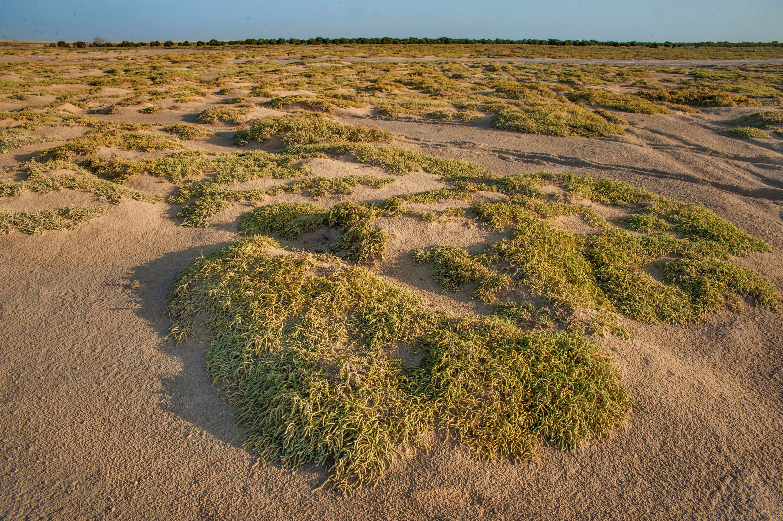
Halochnemum strobilaceum- Çuvan, Acıot

Slide 2
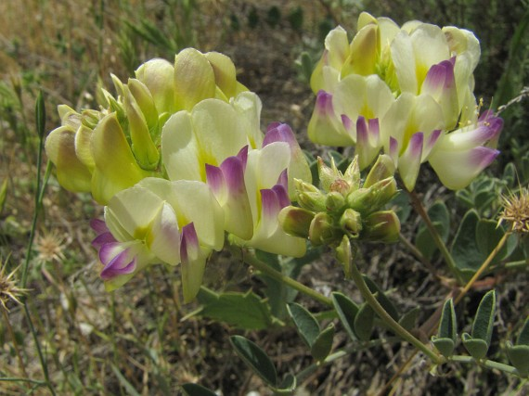
Hedysarum varium

Slide 3
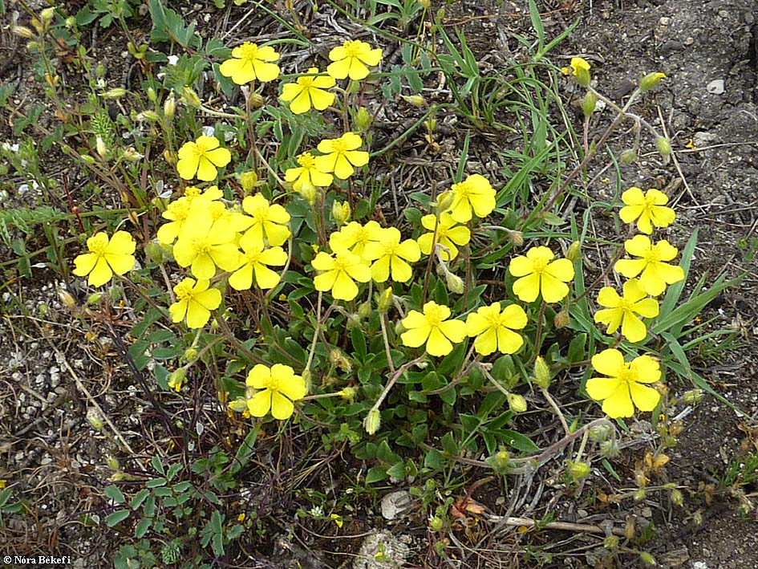
Helianthemum canum

Slide 4
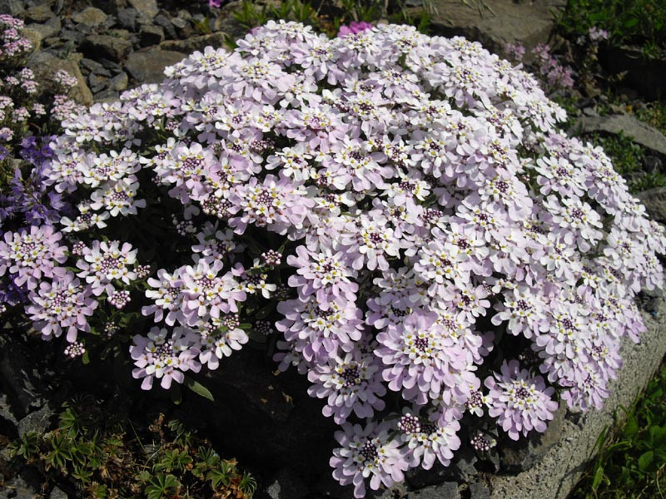
Iberis taurica

Slide 5
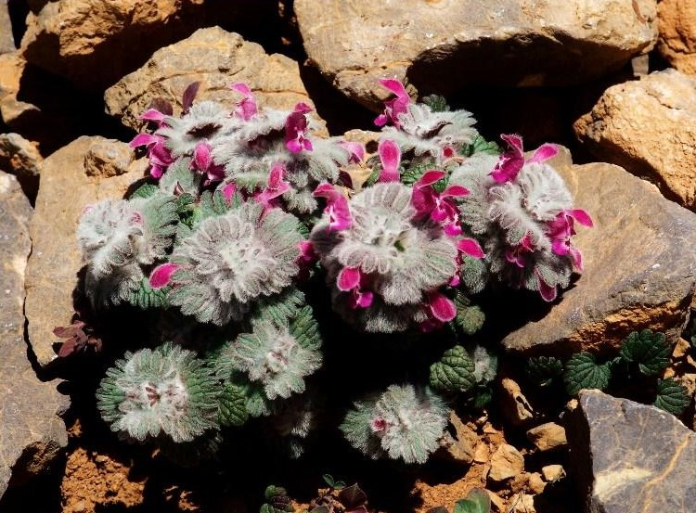
lamium_eriocephalum_2

Slide 6
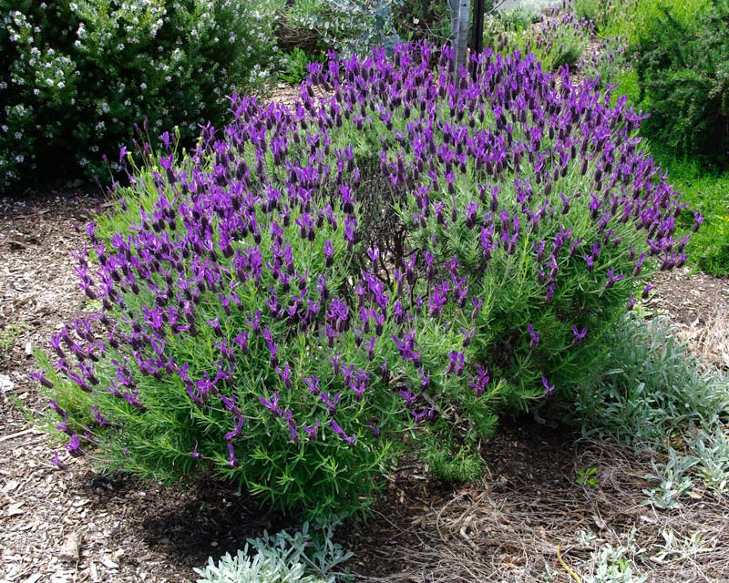
Lavandula stoeachas- Karabaş

Slide 7
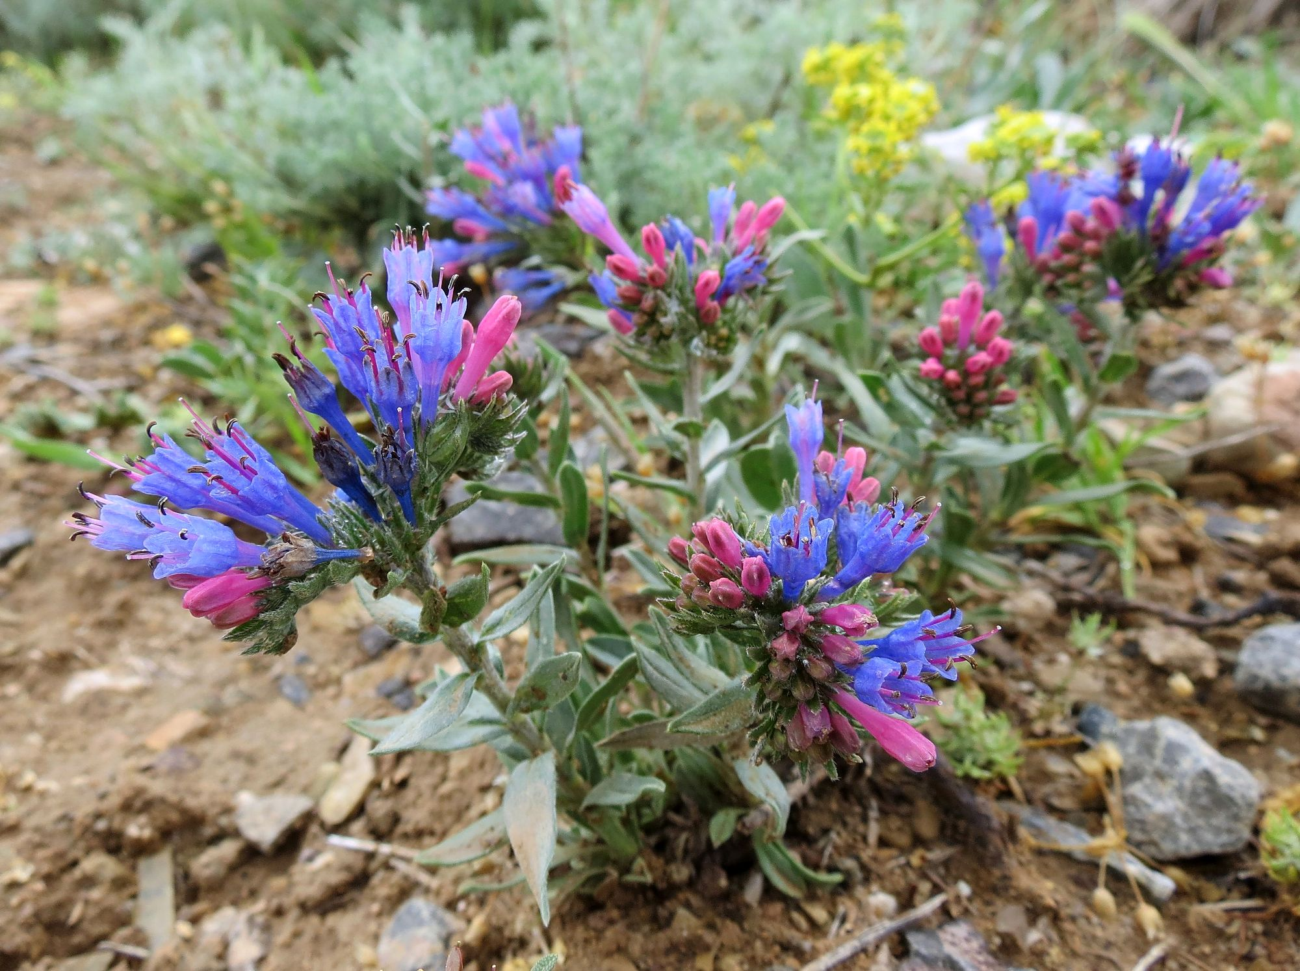
Moltkia coerulea

Slide 8
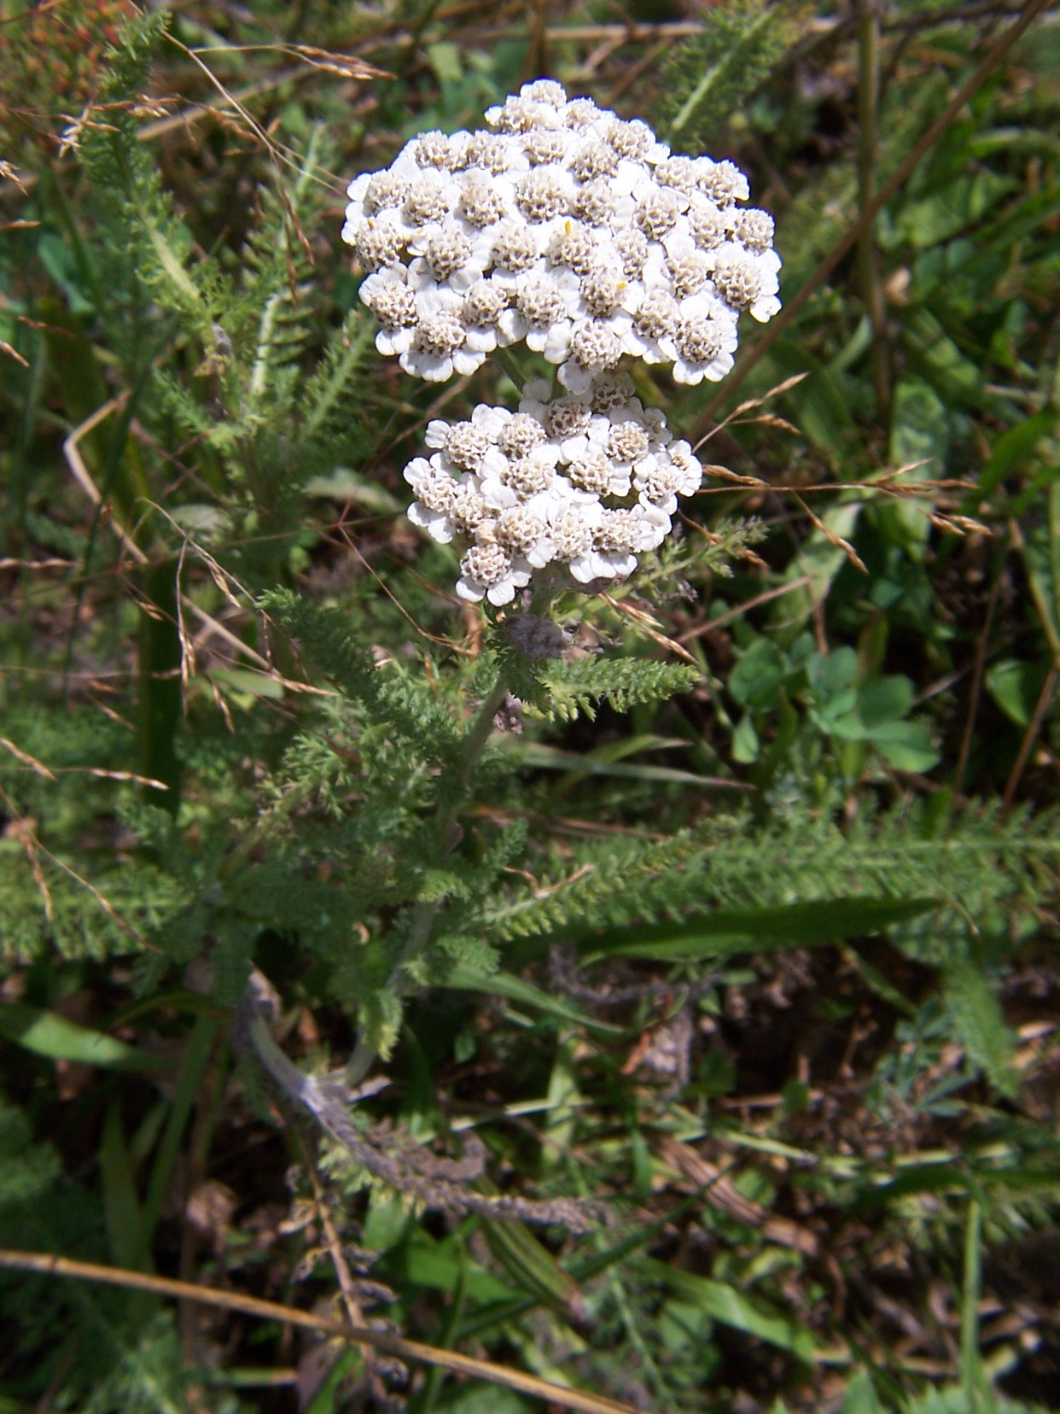
Achillea millefolium subsp. millefolium

Slide 9
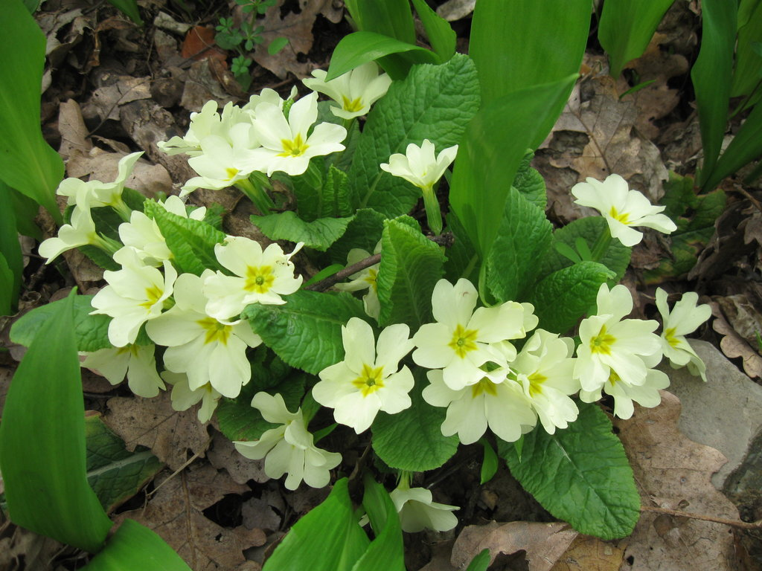
Primula vulgaris

Slide 10
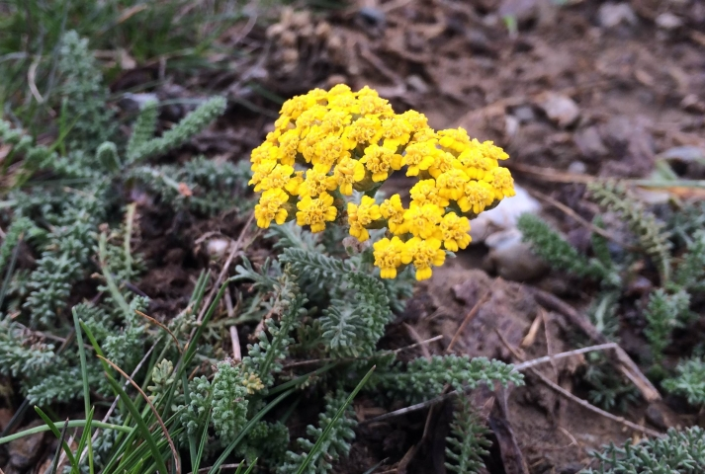
Achillea gypsicola

Slide 11
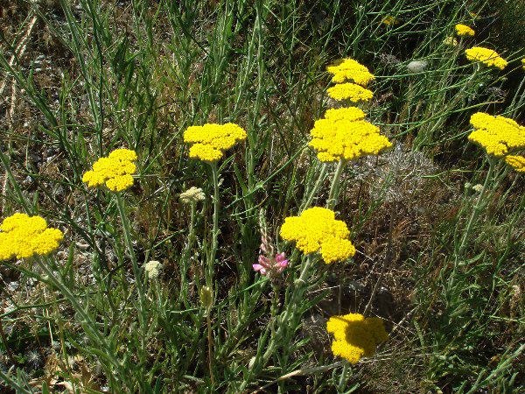
Achillea_wilhelmsii

Slide 12
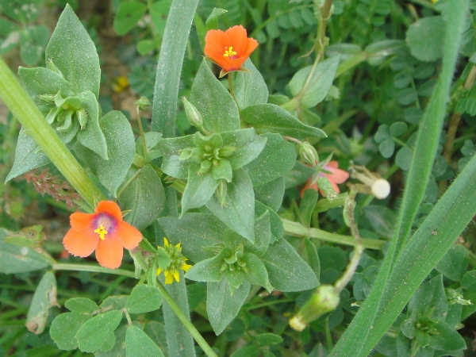
Anagallis arvensis ssp. arvensis

Slide 13
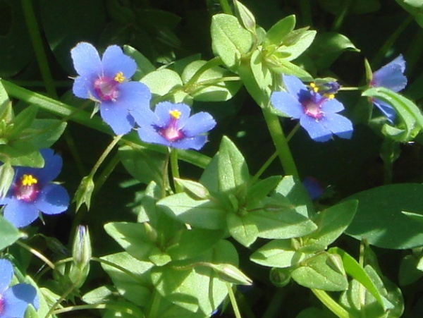
Anagallis arvensis var. caerulea

Slide 14
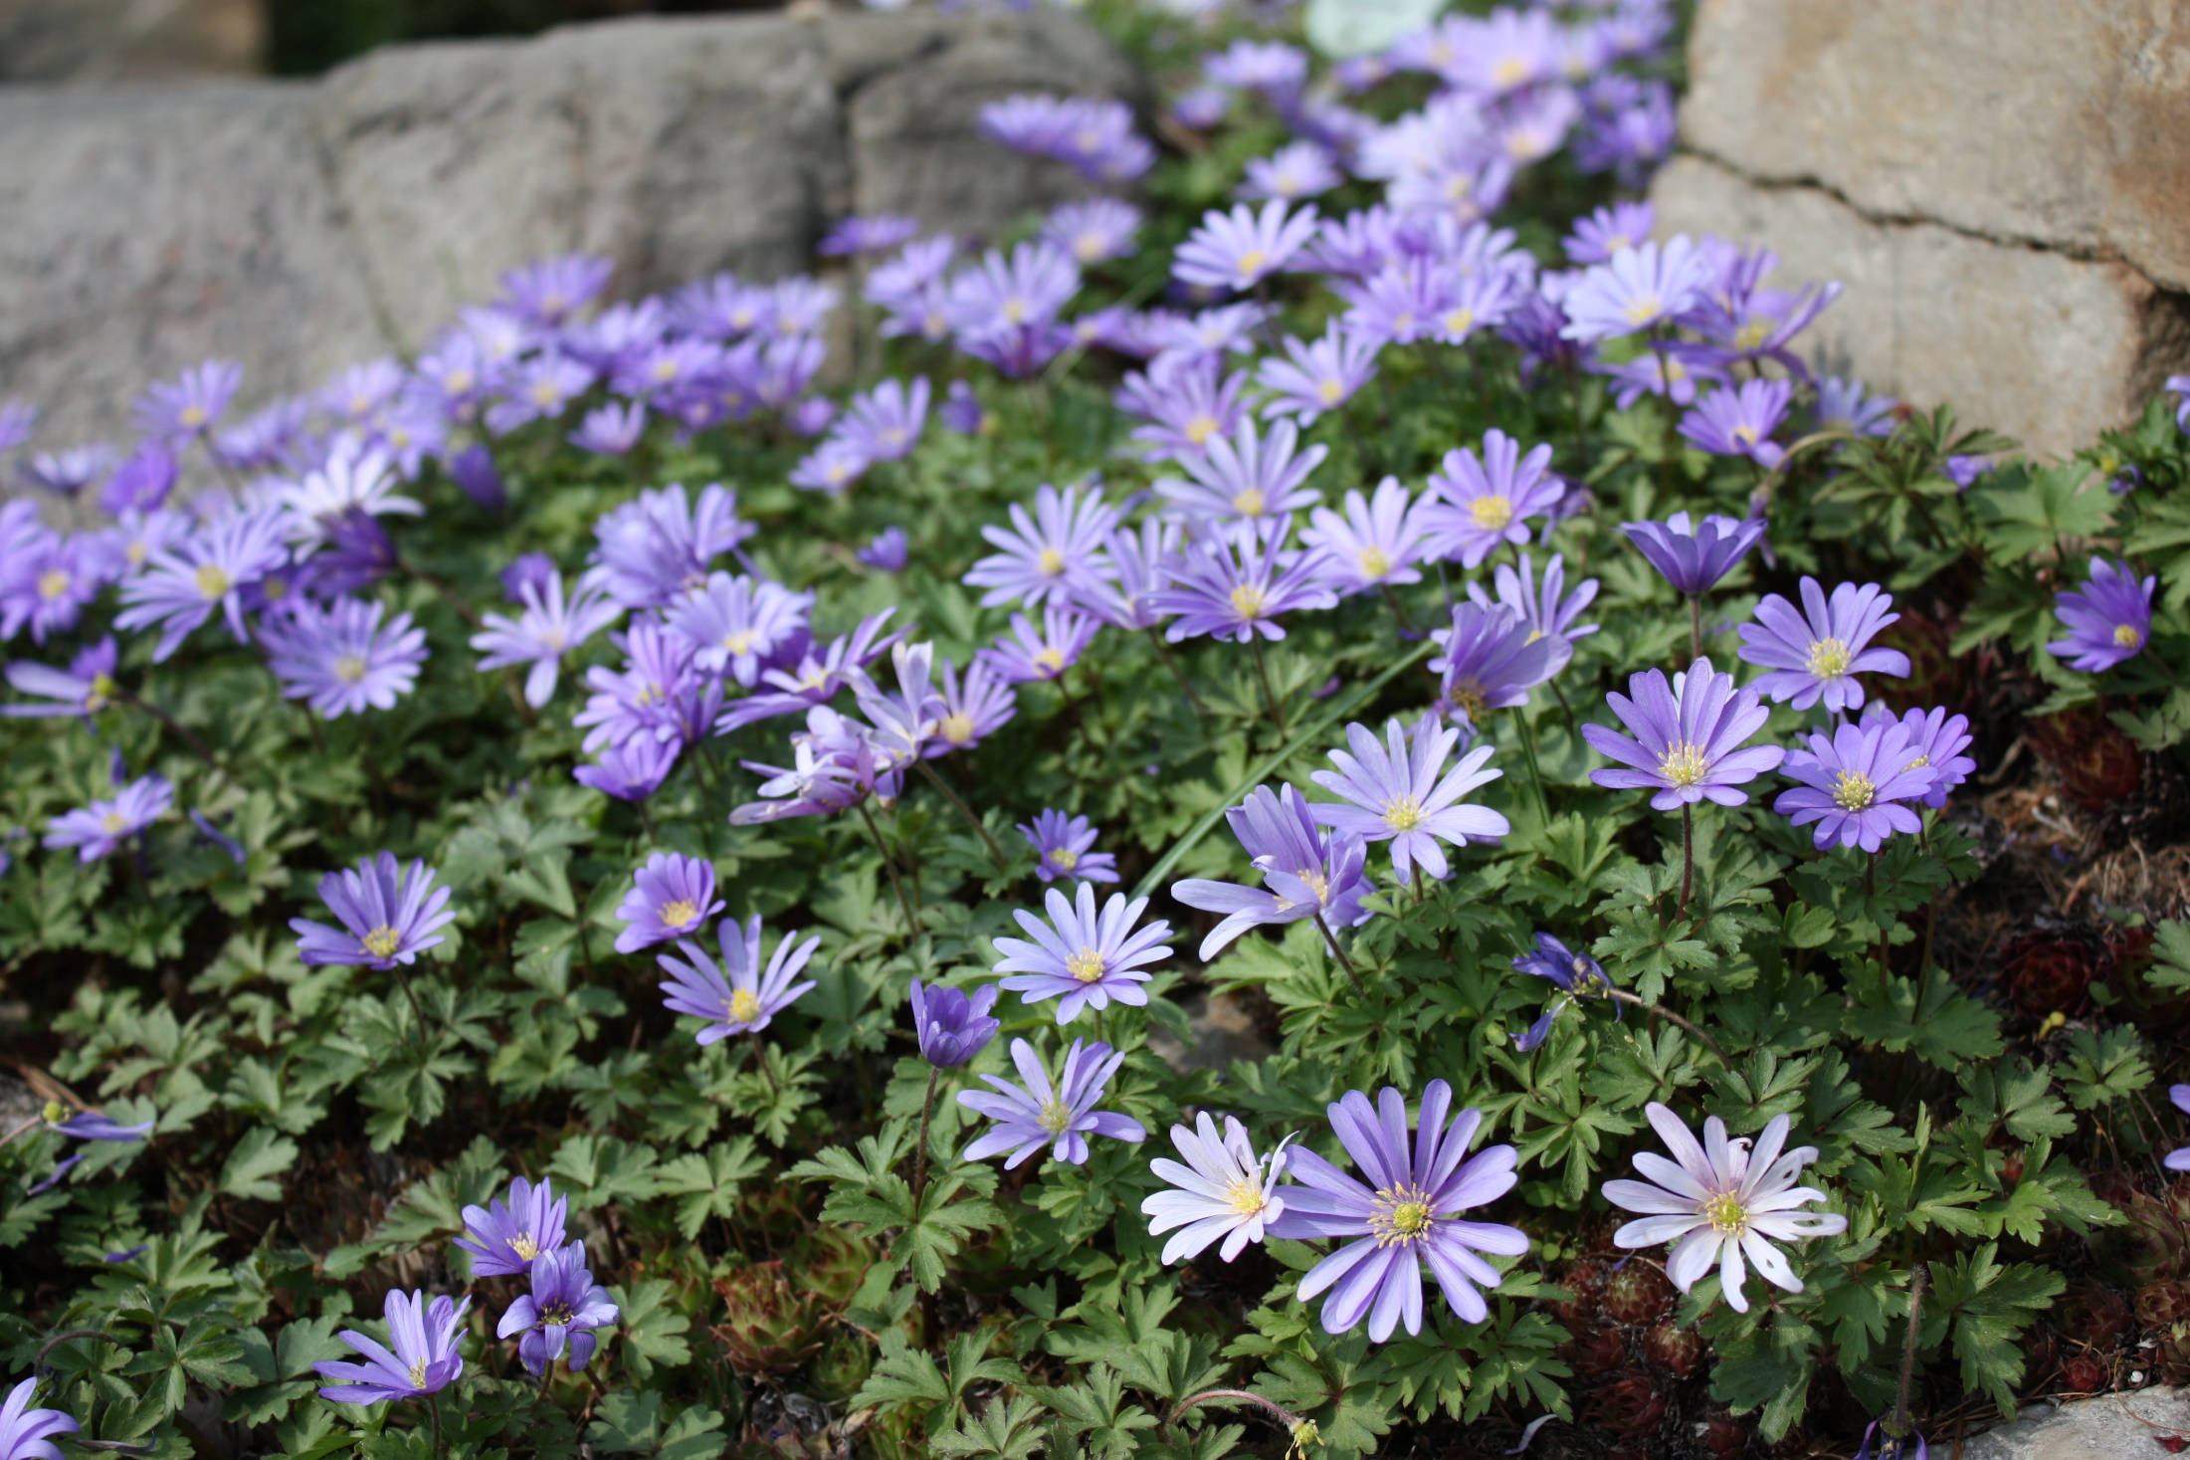
Anemone blanda

Slide 15
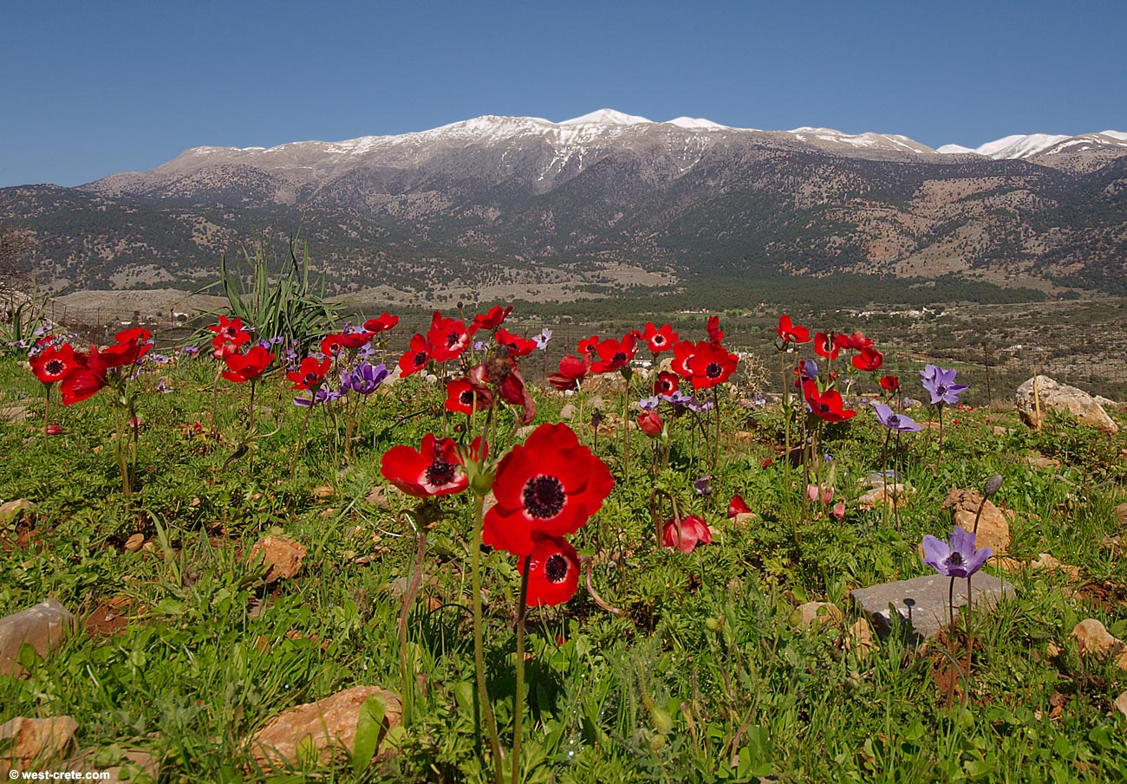
Anemone coronaria

Slide 16
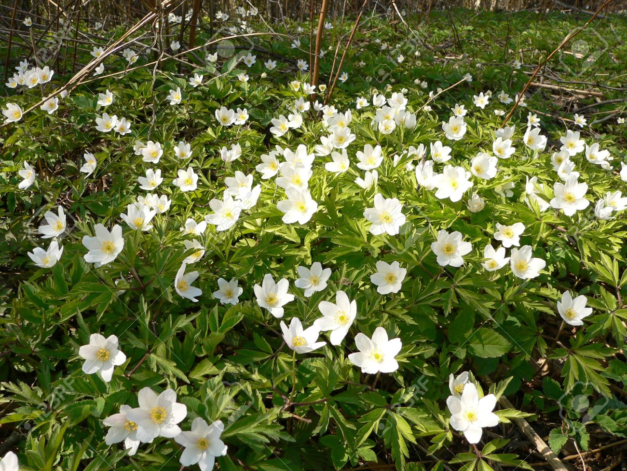
Anemone nemorosa

Slide 17
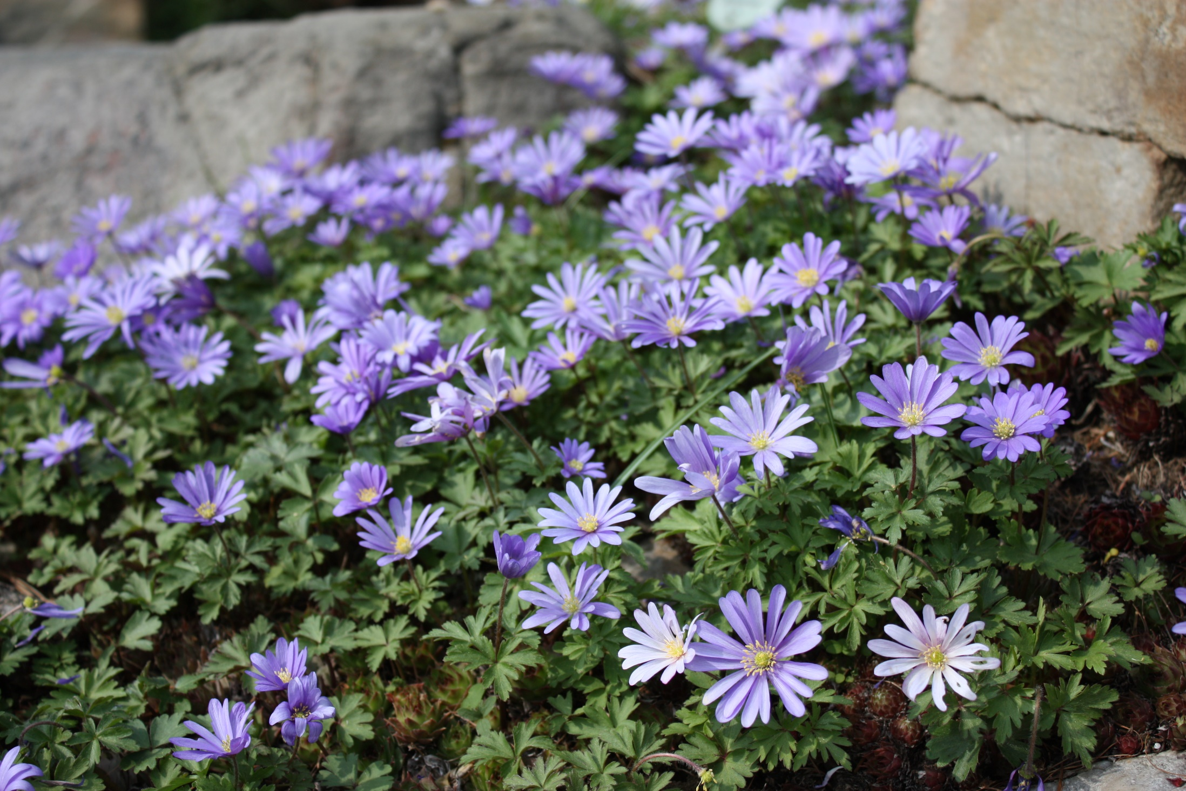
Anemone blanda

Slide 18
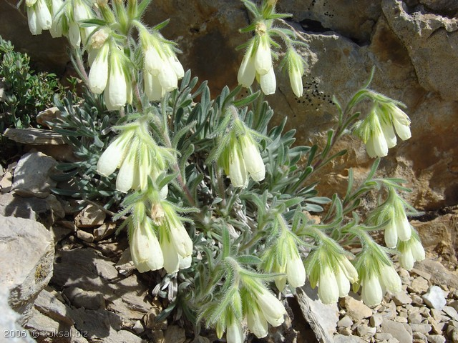
Onosma armenum

Slide 19
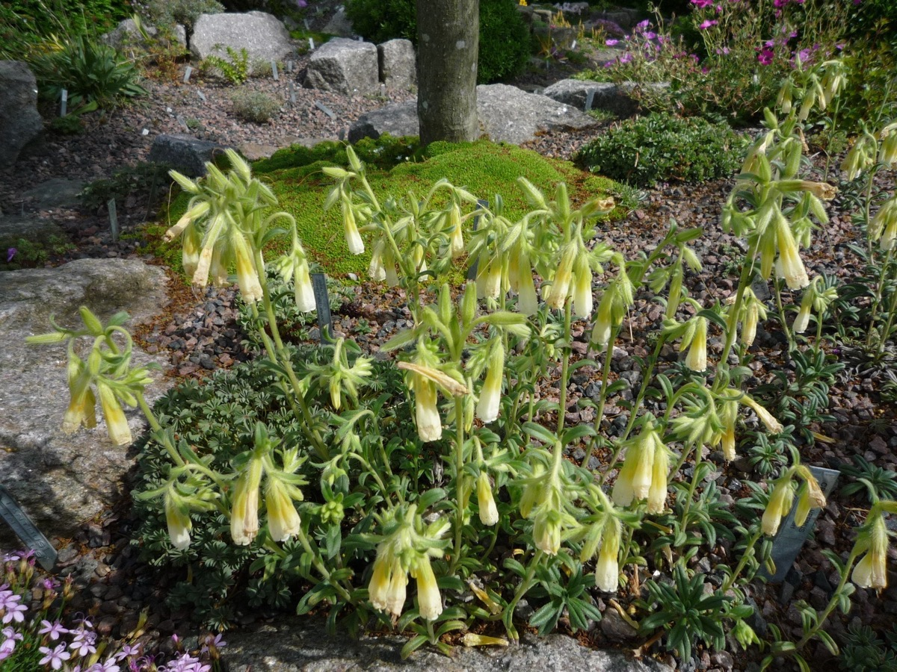
Onosma taurica

Slide 20
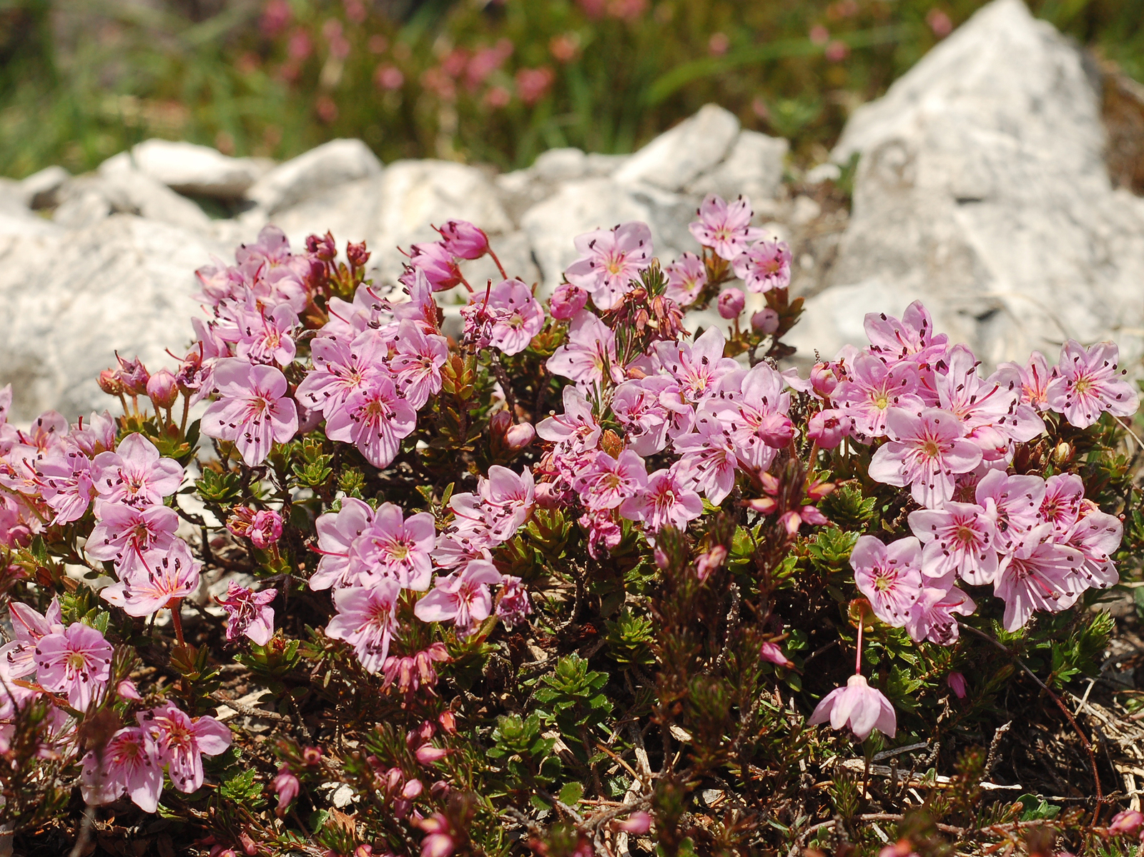
Rhodothamnus_chamaecistus

Slide 21
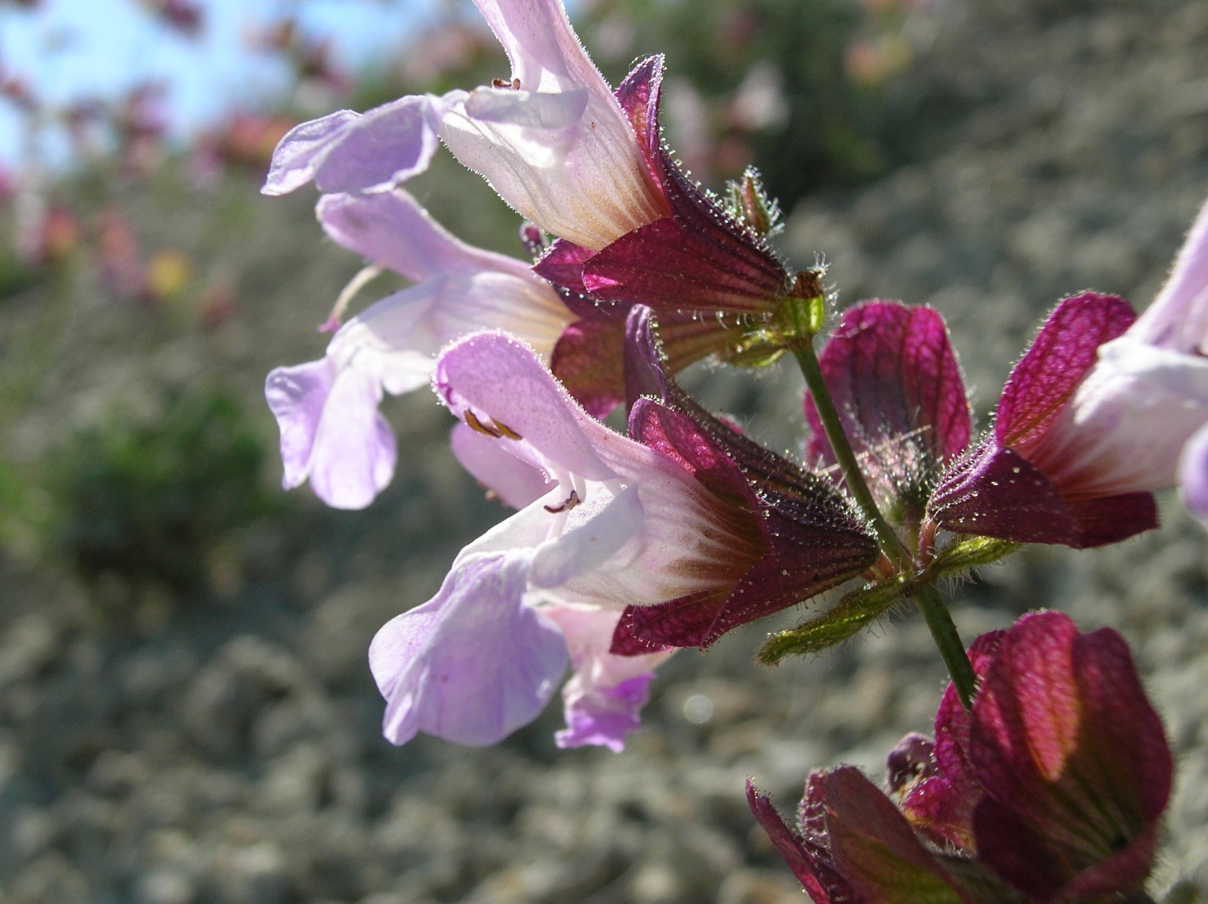
Salvia aytachii- Beypazarı adaçayı

