Slide 1
Diversity And Classification of Flowering Plants: Amborellales, Nymphaeales, Austrobaileyales, Magnoliids, Ceratophyllales

Slide 3
Angiosperm Phylogeny Group (APG III) system - 2009

Slide 5
Floral Formulas

Slide 6
Floral Diagrams Cross-sectional representation of a flower

Slide 7
Amborellales - the most basal, extant angiosperm lineage

Slide 8
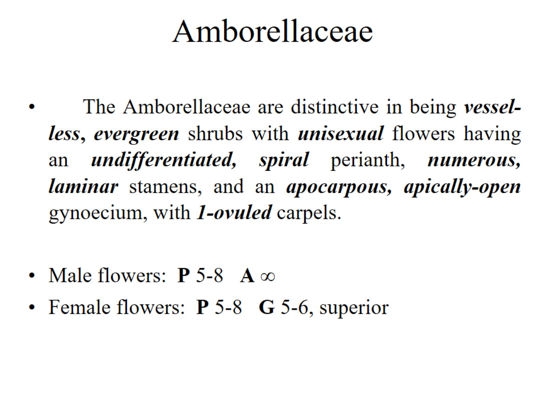
Amborellaceae

Slide 9
Amborella, if it represents a “primitive” angiosperm:

Slide 10
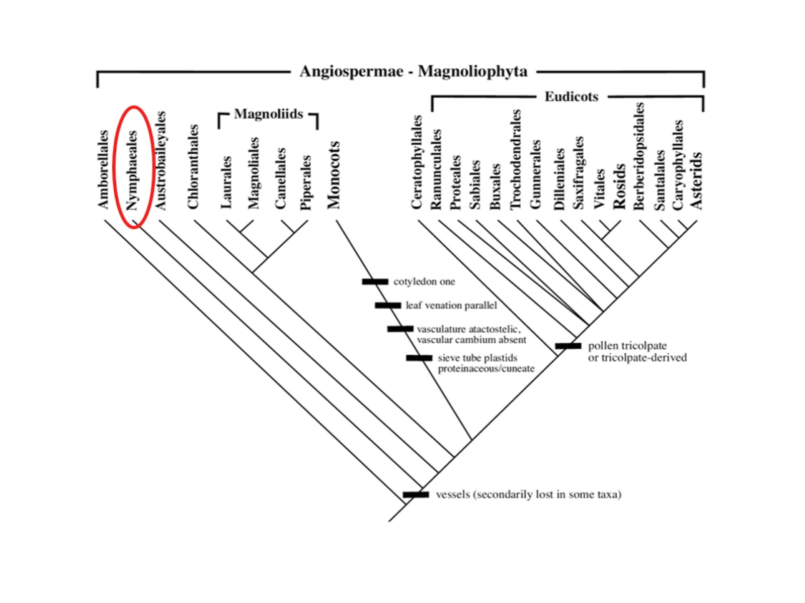

Slide 11
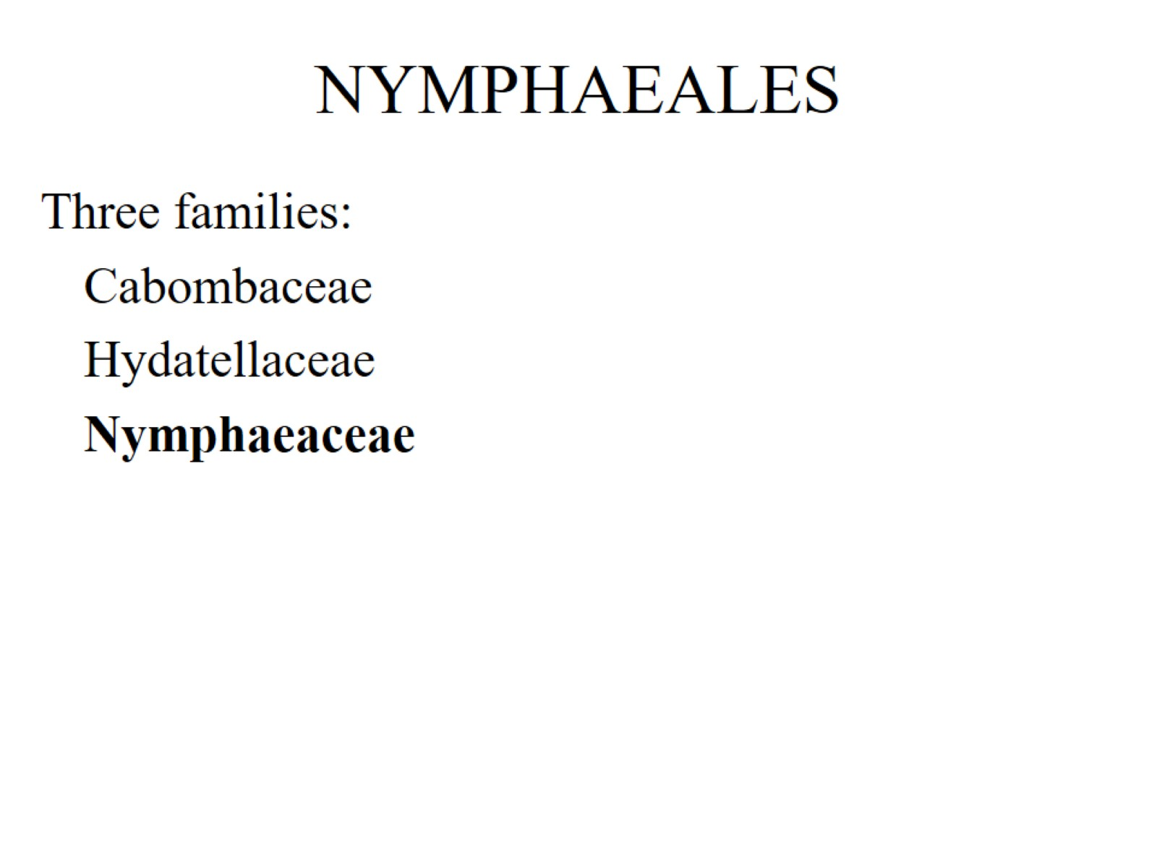
NYMPHAEALES

Slide 12
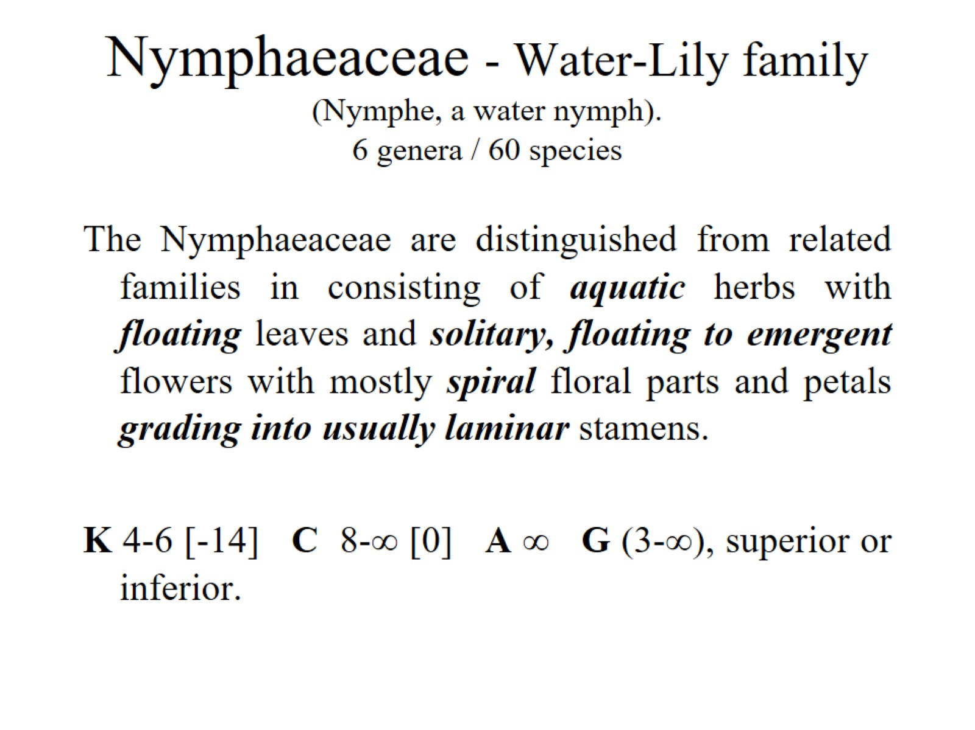
Nymphaeaceae - Water-Lily family (Nymphe, a water nymph). 6 genera / 60 species

Slide 13
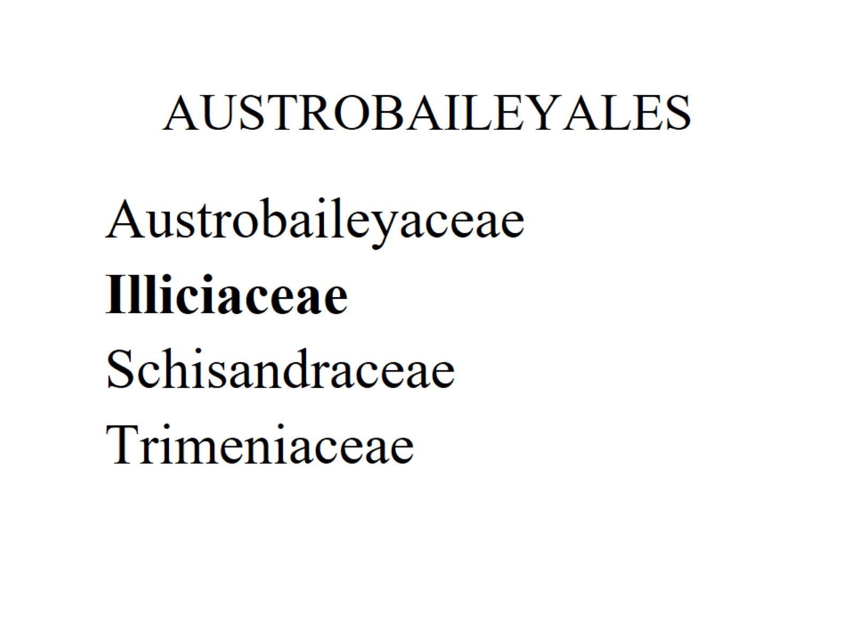
AUSTROBAILEYALES

Slide 14
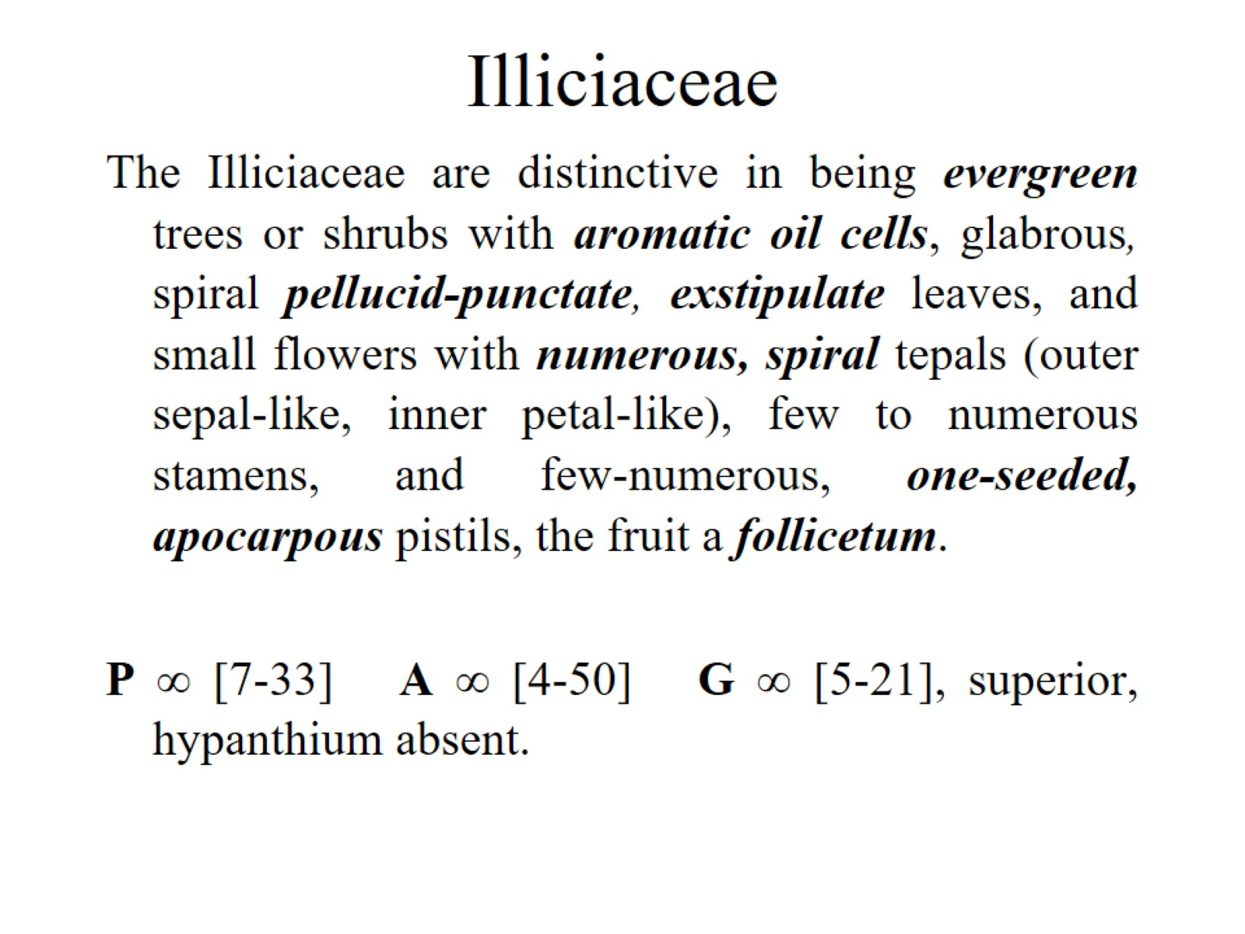
Illiciaceae

Slide 15
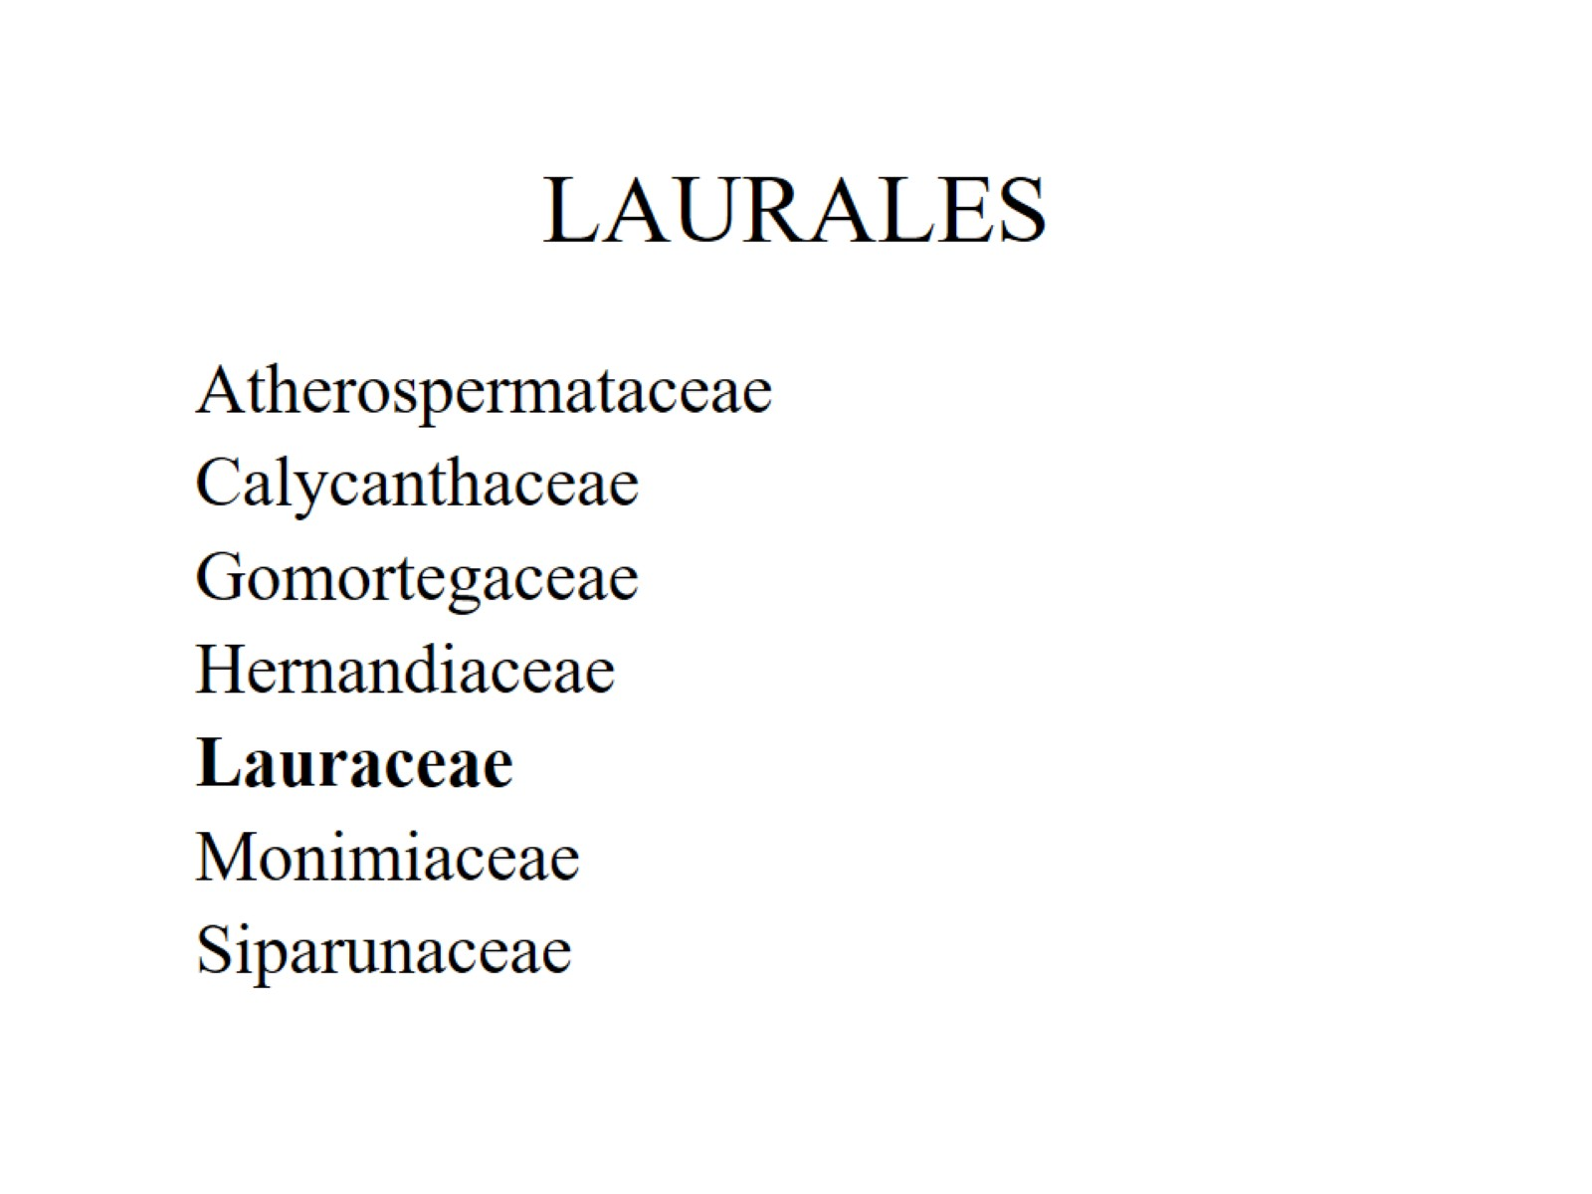
LAURALES

Slide 16
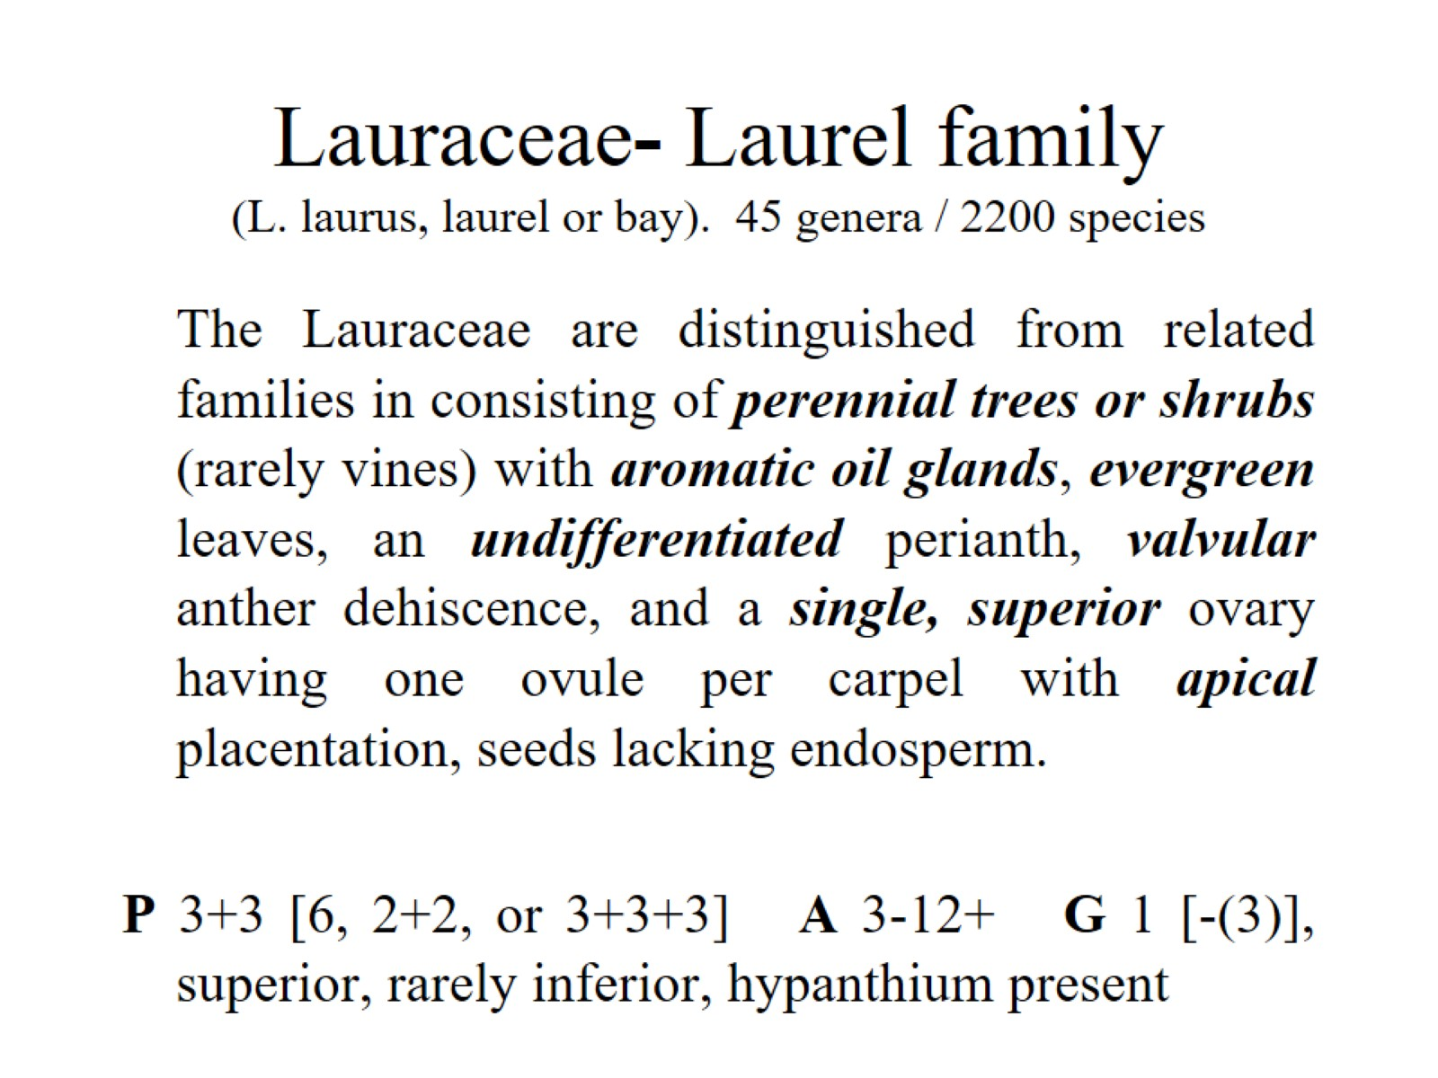
Lauraceae- Laurel family (L. laurus, laurel or bay). 45 genera / 2200 species

Slide 17
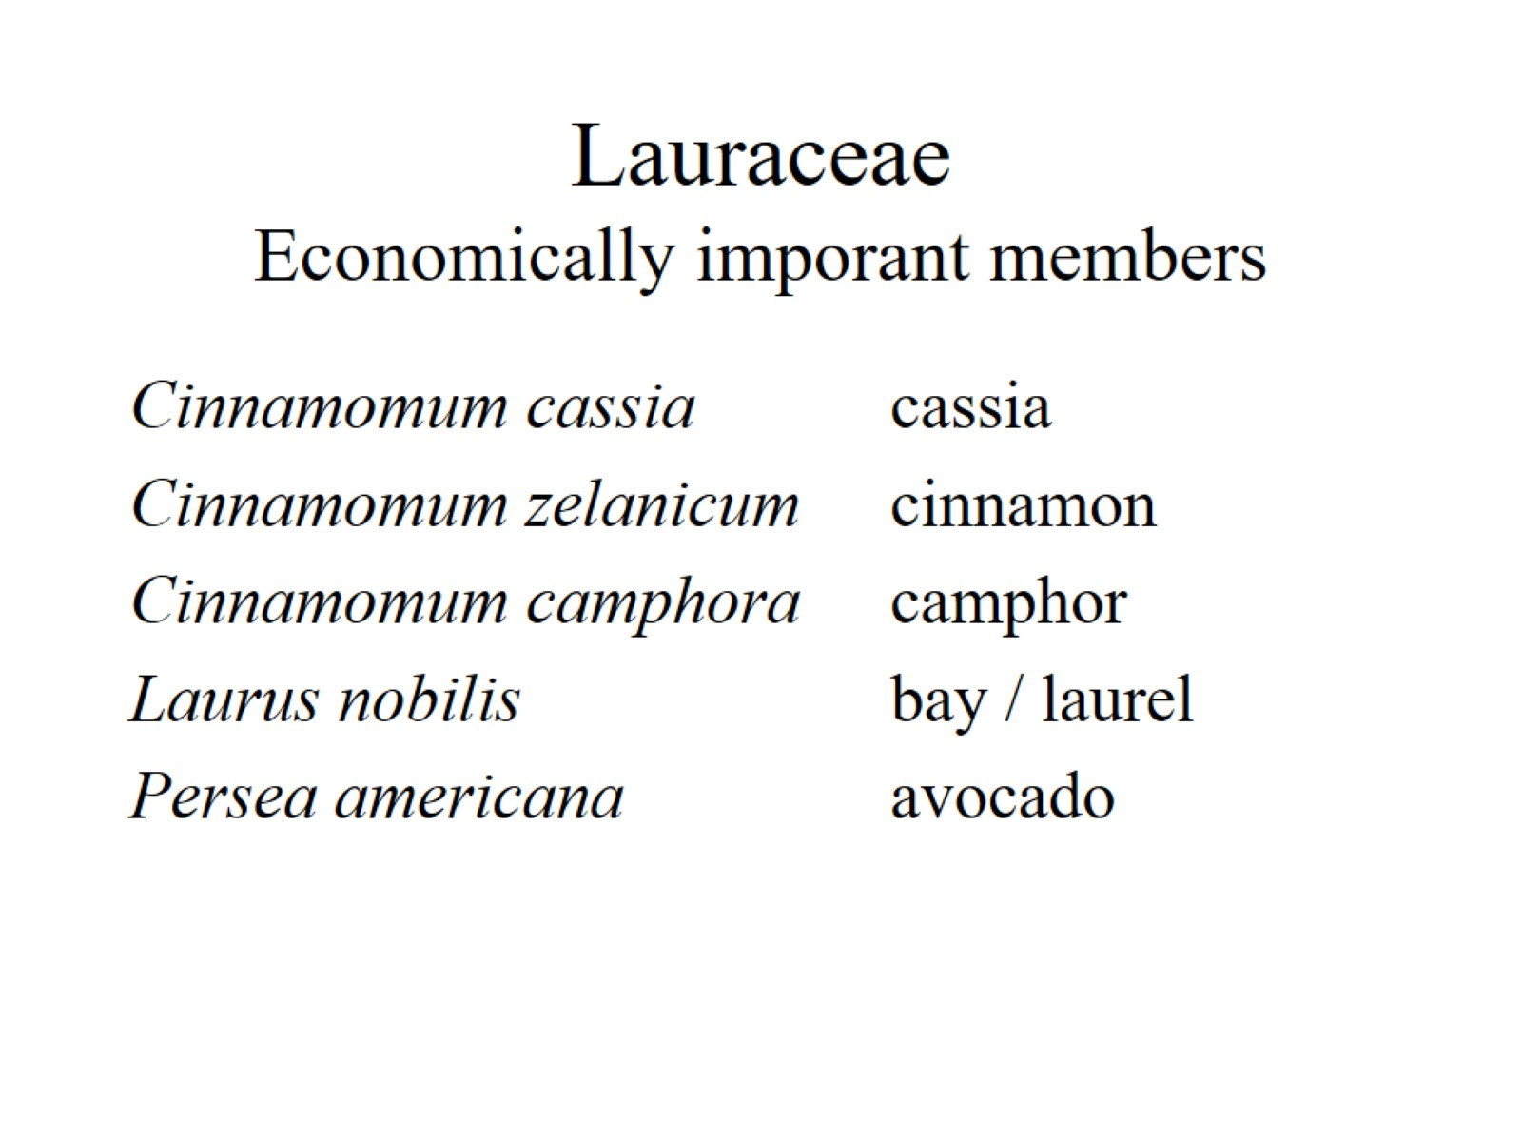
Lauraceae Economically imporant members

Slide 18
MAGNOLIALES

Slide 19
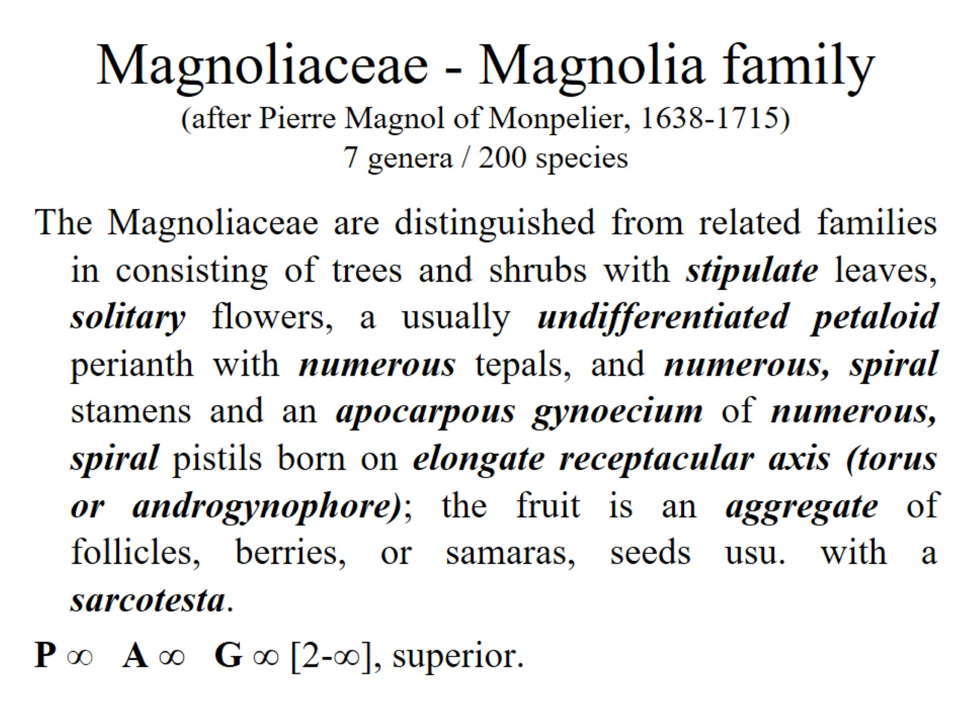
Magnoliaceae - Magnolia family (after Pierre Magnol of Monpelier, 1638-1715) 7 genera / 200 species

Slide 20
PIPERALES

Slide 21
Aristolochiaceae - Birthwort family (Gr. aristos, best + lochia, childbirth, from resemblance of a species of Aristolochia to the correct fetal position). 5-8 genera / 465-480 species

Slide 22
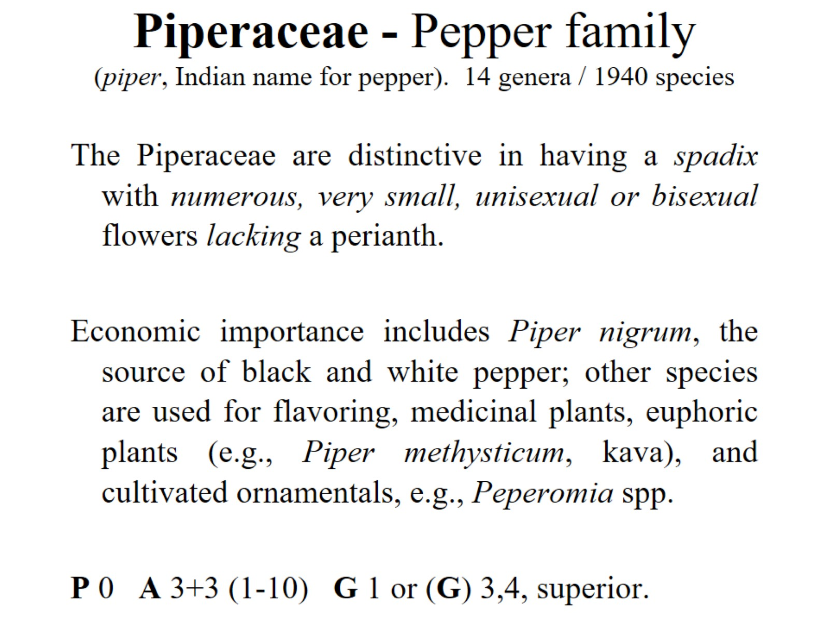
Piperaceae - Pepper family (piper, Indian name for pepper). 14 genera / 1940 species

Slide 23
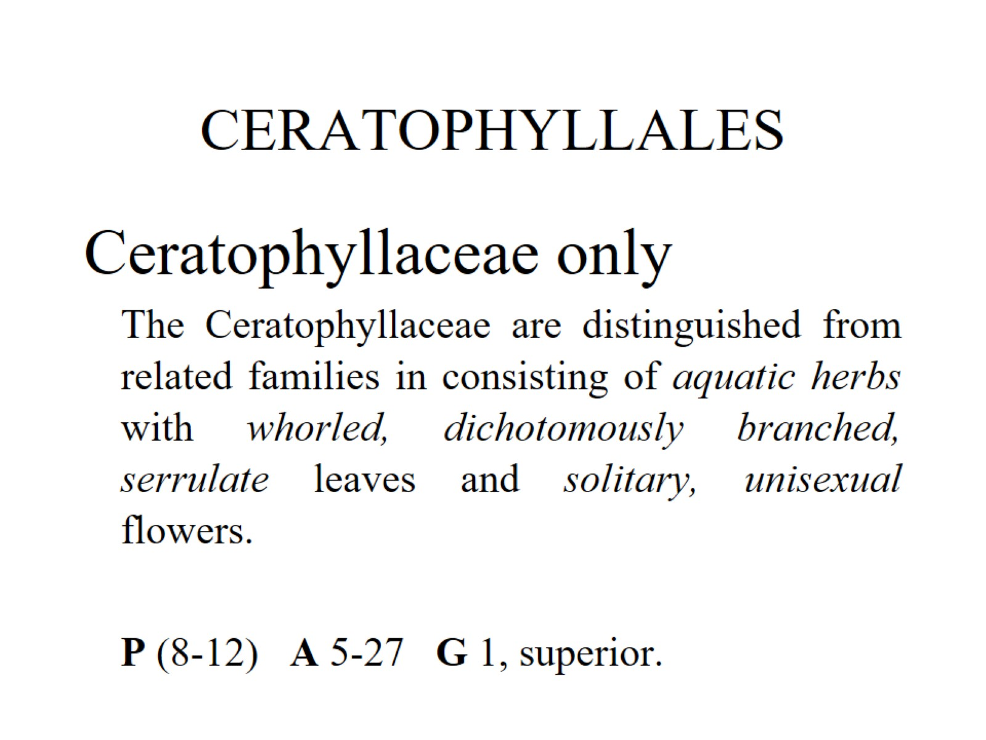
CERATOPHYLLALES

Slide 24
Diversity And Classification of Flowering Plants: Monocots

Slide 25
Monocotyledons (Monocotyledonae, Monocots)

Slide 26
Apomorphies of the Monocots

Slide 27
ALISMATALES Araceae - Arum family (Arum, a name used by Theophrastus). 111 genera / 2980 species

Slide 28
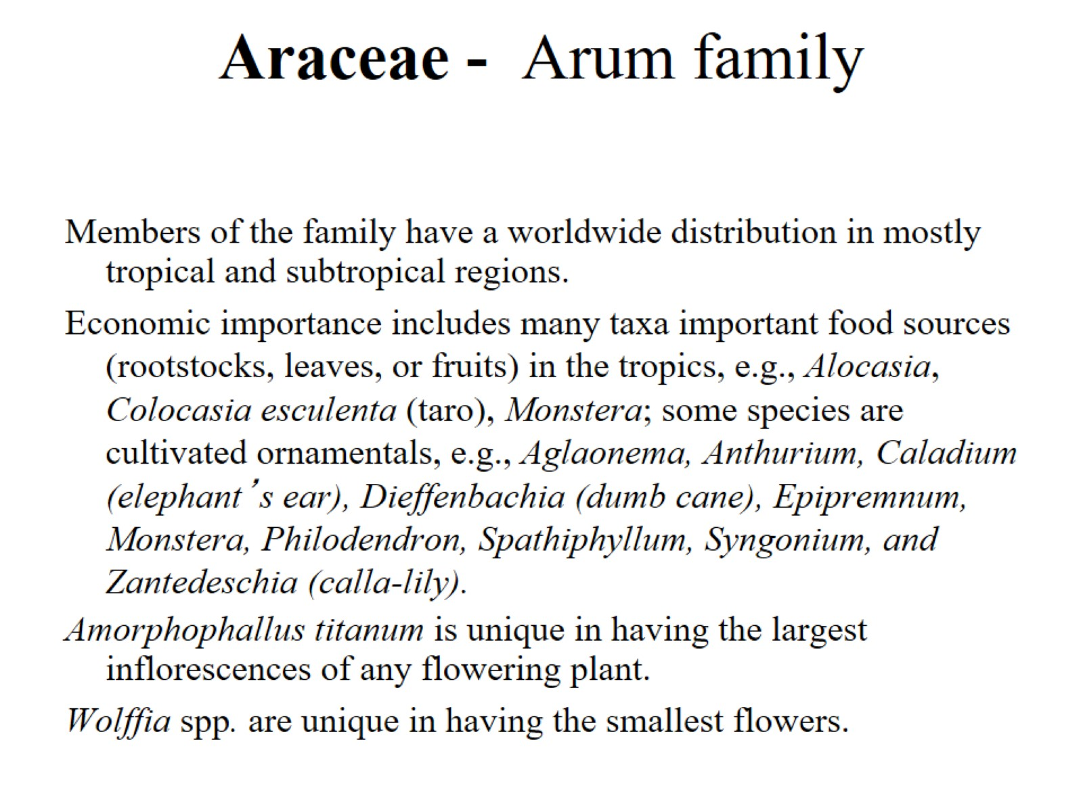
Araceae - Arum family

Slide 29
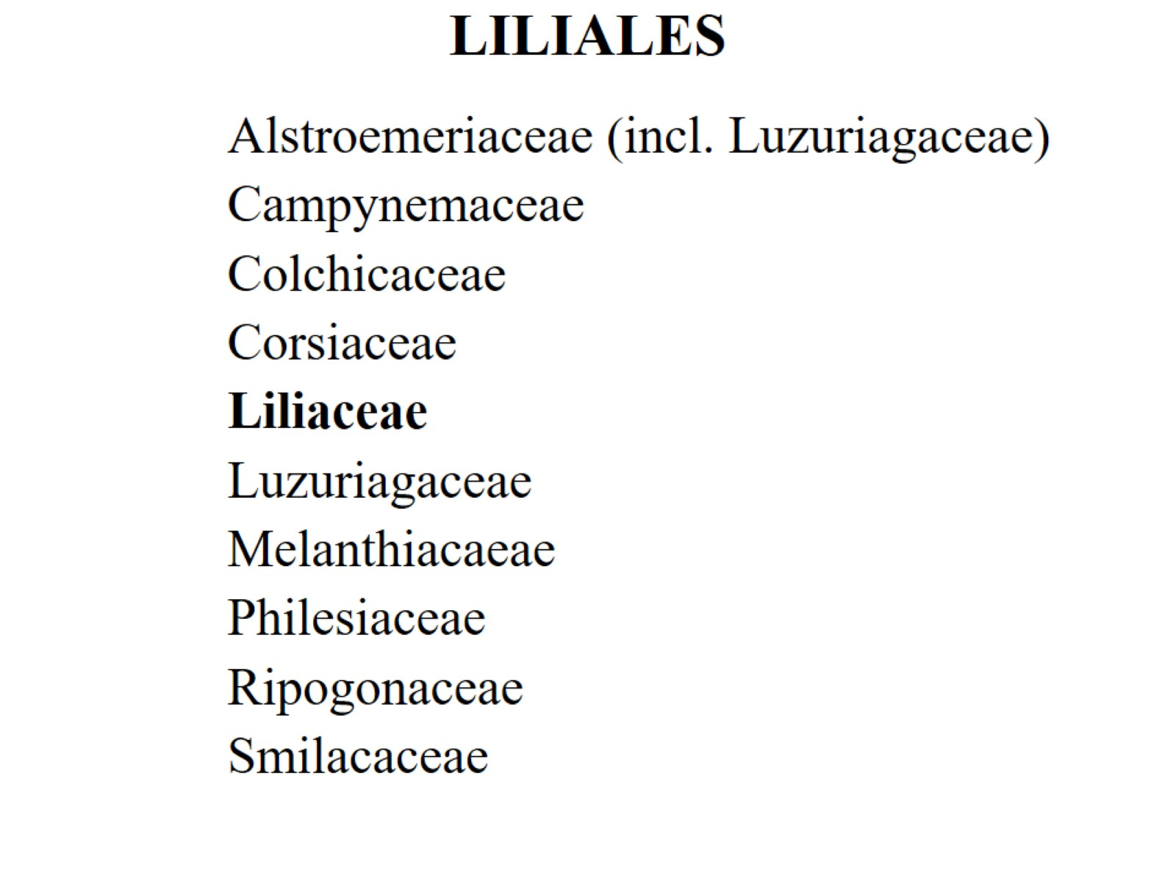
LILIALES

Slide 30
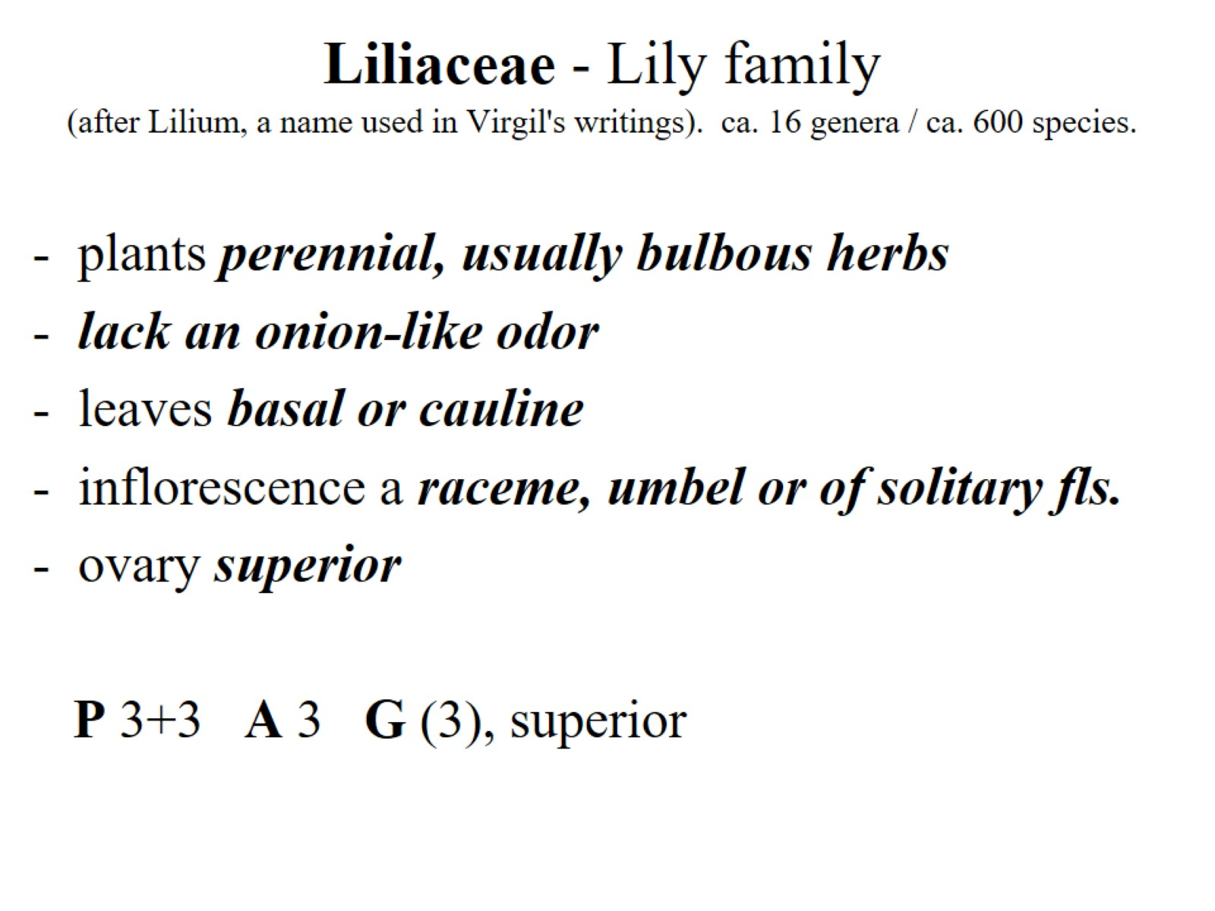
Liliaceae - Lily family (after Lilium, a name used in Virgil's writings). ca. 16 genera / ca. 600 species.

Slide 31
ASPARAGALES

Slide 32
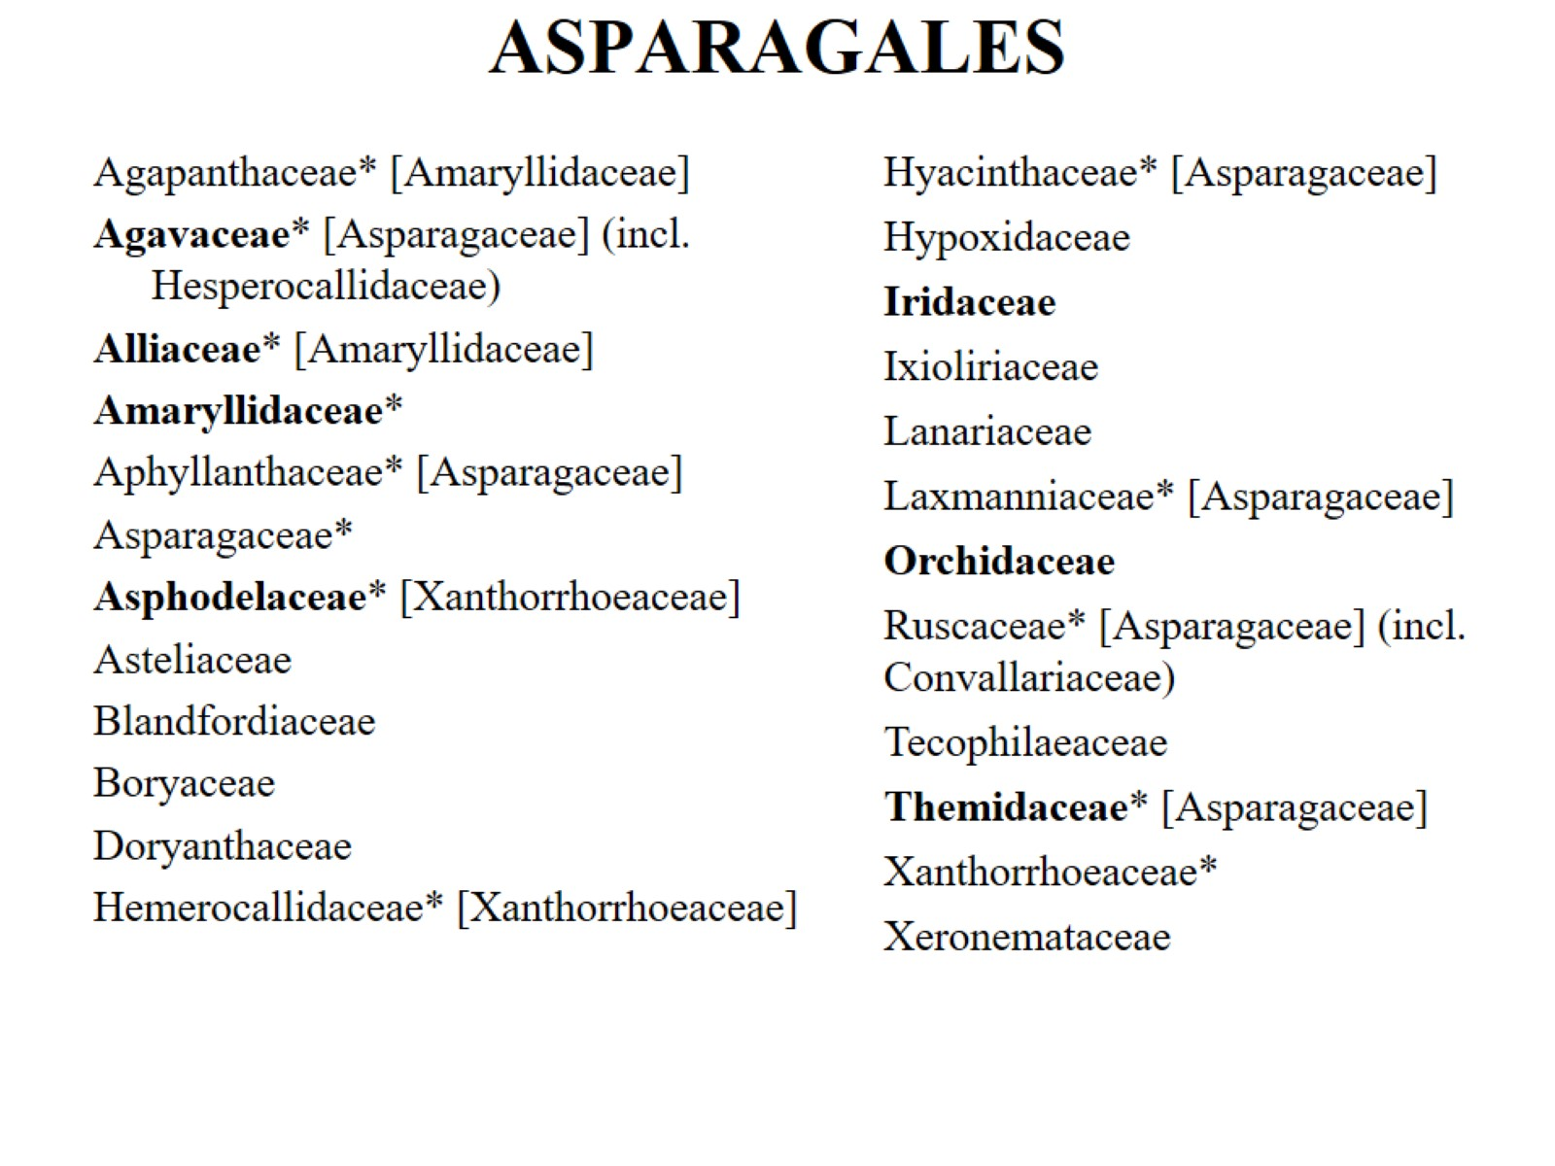
ASPARAGALES

Slide 33
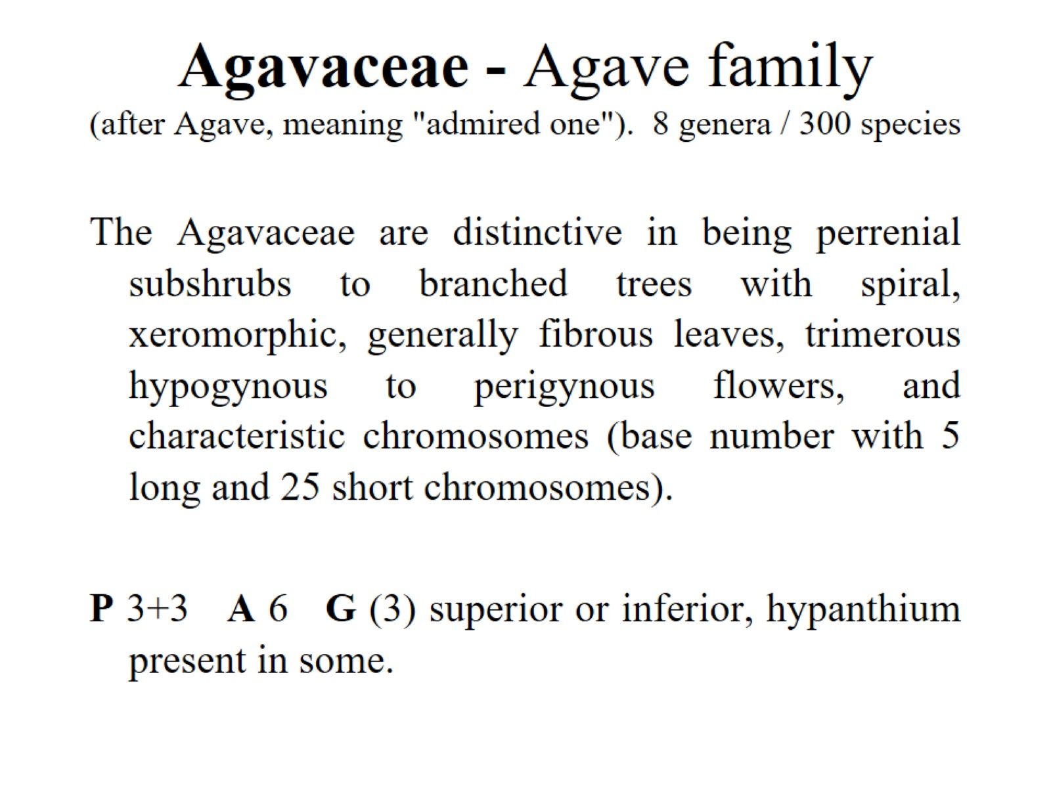
Agavaceae - Agave family (after Agave, meaning "admired one"). 8 genera / 300 species

Slide 34
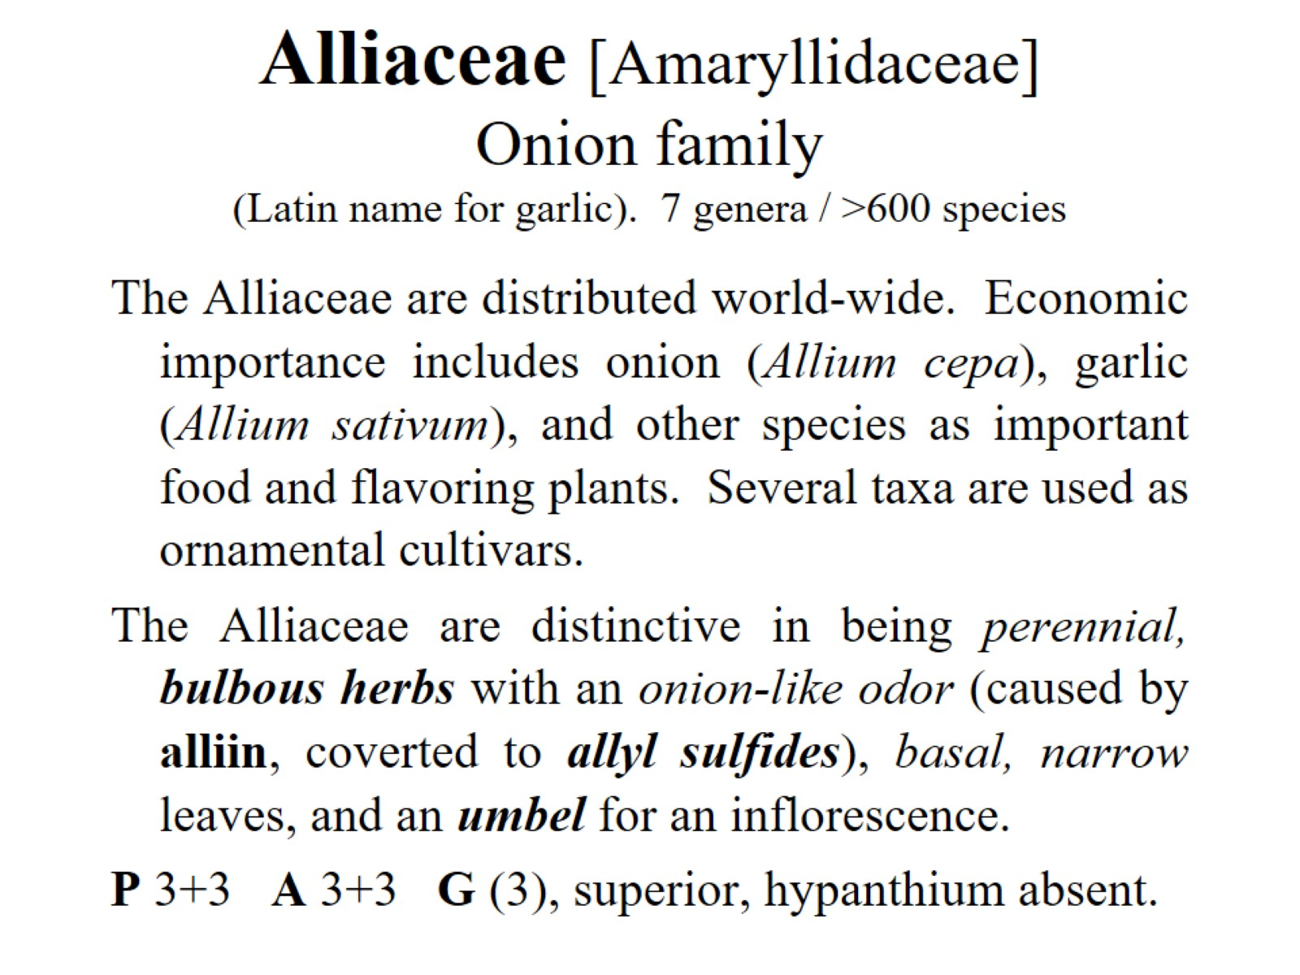
Alliaceae [Amaryllidaceae] Onion family (Latin name for garlic). 7 genera / >600 species

Slide 35
Asphodelaceae [Xanthorrhoeaceae s.l.] Asphodel or Alöe family 15 genera/780 species

Slide 36
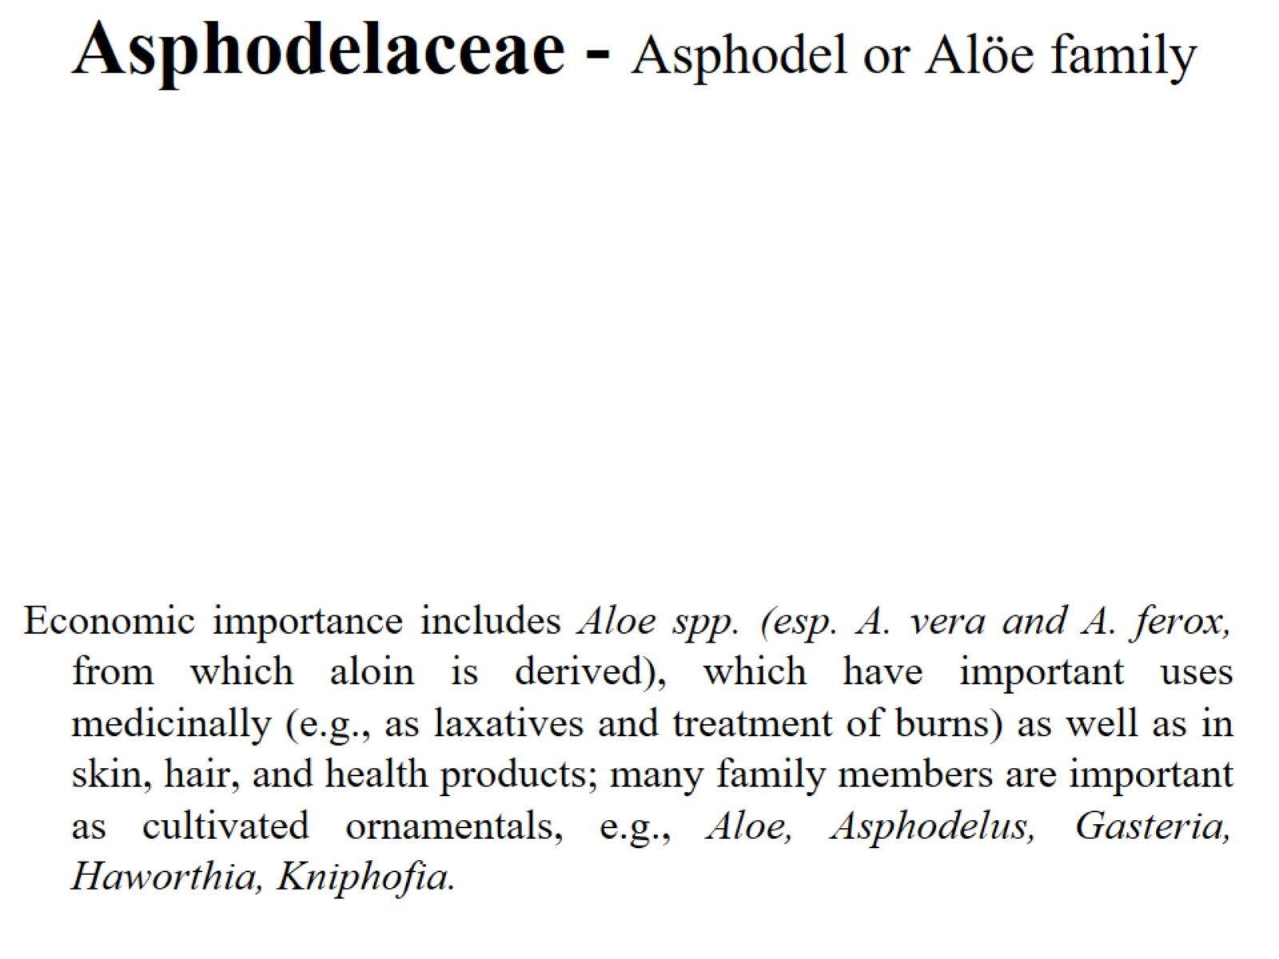
Asphodelaceae - Asphodel or Alöe family

Slide 37
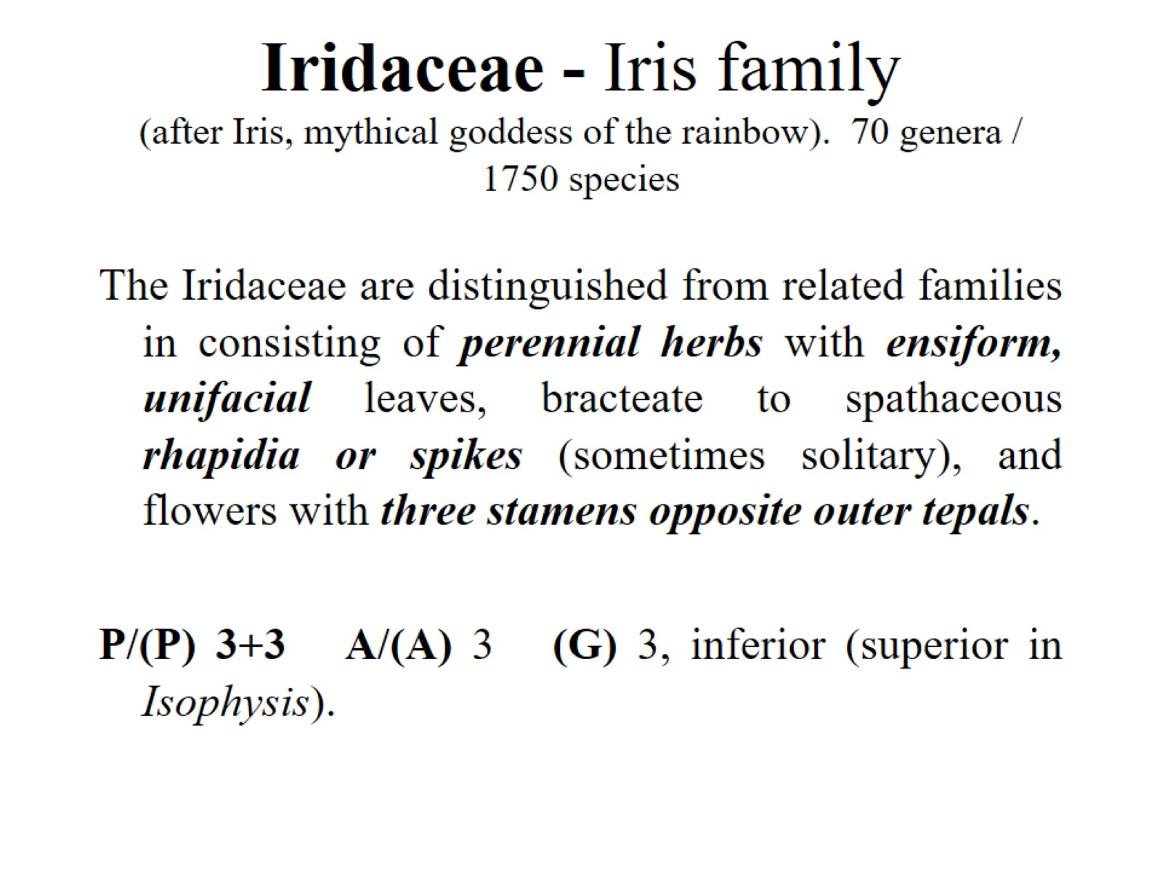
Iridaceae - Iris family (after Iris, mythical goddess of the rainbow). 70 genera / 1750 species

Slide 38
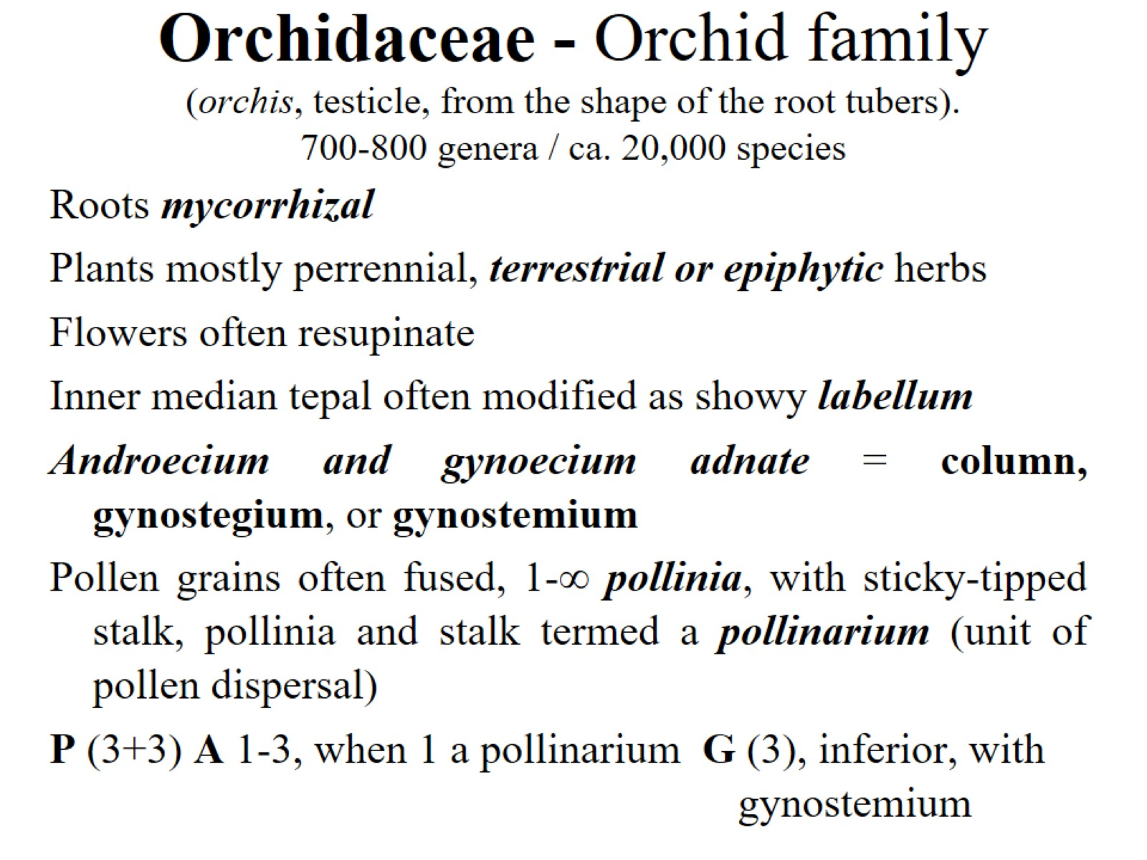
Orchidaceae - Orchid family (orchis, testicle, from the shape of the root tubers). 700-800 genera / ca. 20,000 species

Slide 39
Orchidaceae - Orchid family (orchis, testicle, from the shape of the root tubers). 700-800 genera / ca. 20,000 species

Slide 40
Vanilla: Vanilla planifolia

Slide 41
Orchidaceae - Orchid family (orchis, testicle, from the shape of the root tubers). 700-800 genera / ca. 20,000 species

