Slide 1
«AGRICULTURAL POLICY»
Prof. Dr. İlkay DELLAL
Assoc. Prof. Yener ATASEVEN
Ilkay.Dellal@ankara.edu.tr
yenerataseven@hotmail.com
Ankara University
Faculty of Agriculture
Deparment of Agricultural Economics

Slide 2
PRESENTATION CONTENT
Concepts Related to Agricultural Policy
Objectives of Agricultural Policy
Tools of Agricultural Policy
Executives of Agricultural Policy
Application Areas of Agricultural Policy
Agricultural Support Policy
Agricultural Products Foreign Trade

Slide 3
Concept of Policy
It is a choice between existing ways to achieve a goal.
Determining the policy to be implemented requires the existence of the decision body and the existence of a political power.
Elements that make up the policy:
AUTHORITY → POLITICAL POWER → PURPOSE → TOOL

Slide 4
General Aims of Policy
Economic well-fare
Providing Social-Political Welfare

Slide 5
WHY Agricultural Policy
Reasons Requiring State’s Intervention in Agricultural Sector ????

Slide 6
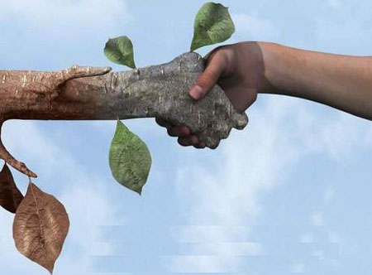
THANKS…
ANY QUESTIONS…

