Slide 1
How to search the literature for relevant sources?
Altug Yalcintas
Ankara University (faculty member) and TED University (visiting lecturer)
altug.yalcintas@politics.ankara.edu.tr

Slide 2
Objective of this session
Using JEL Codes, keywords, buzz words, and phrases to look for background information in a specific area of study.
Making a list of available sources on a subject of research.
Learn more about the techniques to access to:
Readings (physical books and articles, ebooks and earticles etc.)
Watchings (clips on YouTube, Vimeo etc.)
Listenings (podcasts, radio shows etc.)

Slide 3
JEL Codes of AEA
JEL: Journal of Economic Literature
AEA: American Economic Association
Website: https://www.aeaweb.org/econlit/jelCodes.php?view=jel
Or Google/Yandex/Bing: “JEL Codes”

Slide 4
From scarcity to abundance
Until the 2000s : scarcity of readings, watchings, and listenings
Constraint then : How can I get access to the most relevant sources?
Since the 2000s : abundance of readings, watchings, and listenings.
Constraint now : Where should I start?
Risks
Making unnecessary readings, watchings, and listenings
Relying on “predatory publications” (i.e. deceptive and exploitive sources that are easy and / or free to get access to on the Internet.)

Slide 5
Online Sources and Databases – Open Sources
(1. International)

Slide 6
The Church of Google (or Googlism)

Slide 11
Charles Darwin. 1859. On the Origin of Species.

Slide 14
Other Online Networks
Social Science Research Network (SSRN)
Provided by Elsevier, a for-profit company
Working papers, conference papers, or preprints
https://www.ssrn.com/en/
Research Papers in Economics (REPEC)
https://ideas.repec.org/
And numerous open archives: econlib.org, arxiv.org, socarxiv.org

Slide 15
Personal and institutional blogs
Greg Mankiw (Harvard): http://gregmankiw.blogspot.com/
Paul Krugman (MIT): http://krugman.blogs.nytimes.com/
Dani Rodrik (Princeton): https://rodrik.typepad.com
Real World Economics Review Blog: http://rwer.wordpress.com/
Institute for New Economic Thinking: http://ineteconomics.org/blog/institute

Slide 16
Email Lists
https://eh.net/mailing-lists/: an email list for economic historians
https://historyofeconomics.org/resources/shoe-list/: an email list for the historians of economic thought
https://www.econjobrumors.com: a forum for economists to discuss jobs, conferences, journals etc.
And many others.

Slide 17
Platforms of social media
Twitter.com: Lionnel Roubini, Deirdre McCloskey, Dani Rodrik, Daron Acemoğlu, Timur Kuran etc.
Research Ethics in Economics, Altuğ Yalçıntaş: https://twitter.com/EconResEthics
Youtube.com: “Sweet Talk” by Deirdre N. McCloskey, https://www.youtube.com/watch?v=gfgibbkIyco
A podcast: “Smith and Marx walk into a bar” by Carlos Eduardo Suprinyak, Gerardo Serra, and Scott Scheall, https://hetpodcast.libsyn.com
Facebook.com, Linkedin.com, Slideshare.com…

Slide 18
Online bookstores
Amazon.com, Kobo.com*
D&R, Idefix, Hepsiburada
Download ebooks and earticles in PDF or EPUB and read them on PCs, laptops, and mobile devices
Download audiobooks and listen to them on PCs, laptops, and mobile devices
* Some of the downloadable sources are free (like “free lunch”)

Slide 20
Maybe!!!

Slide 21
How to read esources
Download appropriate software!
For PDF files, download a commonly used PDF reader such as Adobe Acrobat Reader – open and free
For EPUB files, download a commonly used EPUB reader such as Calibre (PCs and laptops) or Lithium (mobile devices) – open and free
A suggestion of an open and free word processor: Open Office

Slide 22
Online Sources and Databases – Open Sources
(2. National)

Slide 23
TR Dizin - http://trdizin.gov.tr

Slide 24
Dergi Parkı -

Slide 25
YÖK Tez Merkezi - https://tez.yok.gov.tr/UlusalTezMerkezi/

Slide 26
Social media platforms
Vikipedi.com.tr
Eksisozluk.com
…

Slide 27
Social media platforms
Vikipedi.com.tr
Eksisozluk.com
…
Use them precautiously (in fact, do not let them appear in your written assignments, graduation projects, conference papers etc.)

Slide 28
Personal and institutional blogs
Kendime Yazılar, Mahfi Eğilmez: http://www.mahfiegilmez.com
Ekonomi alla Turca, Uğur Gürses: https://ugurses.net
On Twitter:
Mahfi Eğilmez, Uğur Gürses, Mustafa Sönmez, Aykut Kibritçioğlu, Serdar Sayan, Dani Rodrik, Daron Acemoğlu
Research Ethics in Economics, Altuğ Yalçıntaş: https://twitter.com/EconResEthics

Slide 29
Online Sources and Databases – Subscription-based sources
(International)

Slide 30
How can you get access to the databases that require subscription?
By paying them the fee!
Do NOT do it as long as you are affiliated with an academic institution
Free for TEDU students, academics, and support staff (Username and password may be required)
At TED University premises, including wireless areas such as the library, classrooms, cafeterias, and other public areas

Slide 31
EconLit (American Economic Association)
Provided by the American Economic Association, a non-profit scholarly organisation since 1969
Selected peer-review journal articles, books, PhD dissertations, and conference proceedings in economics
Content available here: https://www.aeaweb.org/econlit/content
JEL Codes
Coverage 1886 to date (1.3 million records)
https://www.aeaweb.org/econlit/

Slide 32
JSTOR (Andrew Mellon Foundation)
Provided by Andrew Mellon Foundation, a non-profit organisation, since 1995
“We collaborate with the academic community to help libraries connect students and faculty to vital content while lowering costs and increasing shelf space, provide independent researchers with free and low-cost access to scholarship, and help publishers reach new audiences and preserve their content for future generations.”
Keywords search among “12 million academic journal articles, books, and primary sources in 75 languages”
https://www.jstor.org
Source: https://about.jstor.org [Accessed July 2019]

Slide 33
Web of Science (Clarivate)
Publication analytics since 1997, detailed figures of citations (forward and backward)
Provided by Clarivate (formerly owned by Thomson Reuters), a for-profit company
Coverage: 1900s to date, selection of outlets: 100 million records (journal articles, conference proceedings, and books), 33000 journal articles (5200 social sciences)
Journal Impact Factor
Science Citation Index (SCI), Social Science Citation Index (SSCI), Arts and Humanities Index (AHI), Emerging Sources Citation Index (ESCI)
Source: Web of Science Fact Book: https://clarivate.com/wp-content/uploads/2017/05/d6b7faae-3cc2-4186-8985-a6ecc8cce1ee_Crv_WoS_Upsell_Factbook_A4_FA_LR_edits.pdf [Accessed July 2019]

Slide 34
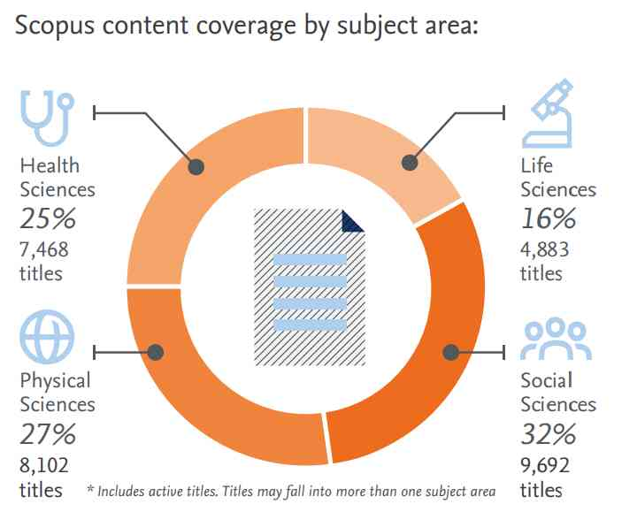
Scopus (Elsevier)
Since 2004
75+ million records (23,500+ peer-reviewed journals)
68 million post-1970 records, including references
6.5+ million pre-1970 records going back as far as 1788
https://www.scopus.com
Source: Scopus Global Research Fact Sheet 2019
https://www.elsevier.com/__data/assets/pdf_file/0017/114533/Scopus_GlobalResearch_Factsheet2019_FINAL_WEB.pdf [Accessed July 2019]

Slide 35
Offline Sources
Libraries and bookshops

Slide 36
Libraries in Ankara
TED University Library
Mülkiye Kütüphanesi
Milli Kütüphane
Bilkent University Library
METU Library
Goethe Institute
Institut Français Ankara
CerModern

Slide 37
Bookshops in Ankara
Dost Kitabevi
Arkadaş Kitabevi
İmge Kitabevi
D&R stores
…

