Slide 1
Information Technology in Business and Society II
IT Infrastructure and Costs

Slide 2
Managing IT infrastructure components
Capacity Planning and Scalability
Capacity planning:
predicting when a computer hardware system becomes saturated.
Enough computing power for the current and future business needs
Scalability:
Expanding/ degrading to the ability of a computer, product, or system.
Total Cost of Ownership

Slide 3
Total Cost of Ownership
The total cost of ownership for a PC in an organization is much more than its initial purchase price.
The other cost components are:
software development and documentation
purchase price
ongoing license and support fees
configuration, testing, deployment, maintenance
support, training,
security, backup
disaster recovery

Slide 4
Managing Hardware and Software Assets
Total Cost of Ownership
Includes both direct and indirect costs.
Purchase and maintenance costs for a technology resource.
Purchasing hardware and software accounts for only 20% of TCO. (Source: Laudon K. and P. Laudon (2017), Essentials of MIS, Pearson)
Hidden costs can make distributed systems more costly than mainframes.

Slide 5
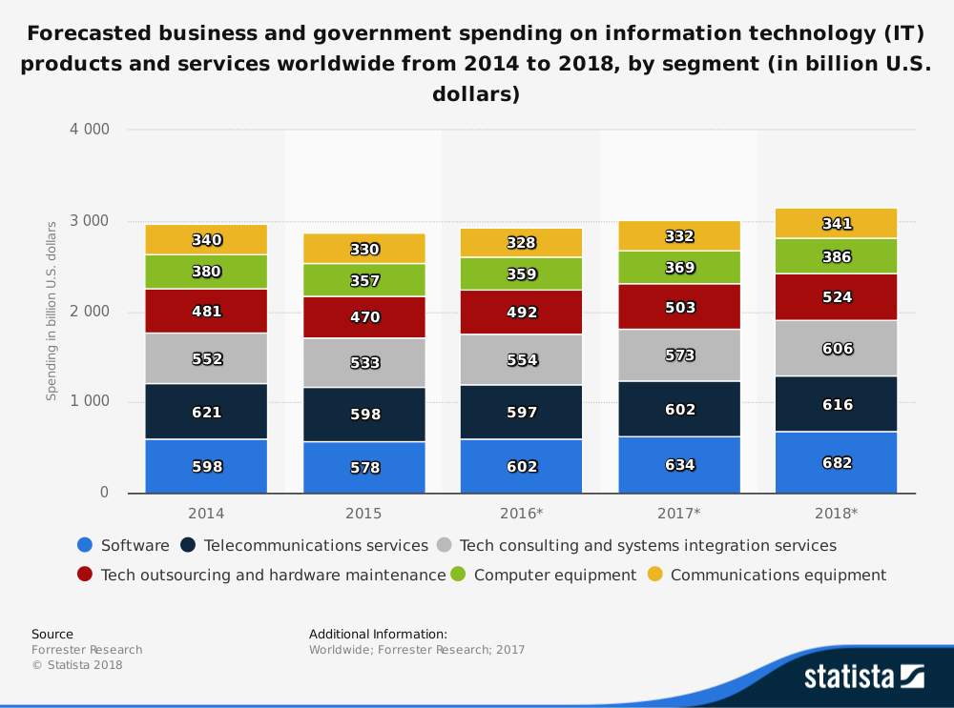
Total Cost of Ownership

Slide 6
Total Cost of Ownership
Reducing TCO
Making necessary complementary investments
(1) training people,
(2) streamlining processes and
(3) acquiring technologies that are easy to manage, service and support.

Slide 7
Total Cost of Ownership
Complementary assets are assets, infrastructure or capabilities which are necessary to support the production and marketing of an innovation/goods and service.
They are the assets or investments that are necessary to use the innovation or primary investment.

Slide 8
Total Cost of Ownership
Reducing TCO
Outsourcing
using a third party to complete business activities
Ex: hardware and software purchase and maintenance, application development and IT help-desk services (Chaffey and Wood, 2004).

Slide 9
Total Cost of Ownership
Reducing TCO
Using cloud computing or utility computing
per-hour or other per-use charge.
more appealing to SMEs.
Provides scalability

Slide 10
Total Cost of Ownership

Slide 11
Total Cost of Ownership
A large portion of capital spending to information system components
However, one in three technology development projects fails.
This failure rate is also a big part of TCO.
Sunk cost
Why are firms unsuccessful in the implemetation of such big investments?

Slide 12
References
Chaffey D. and S. Wood (2005), Business information management: improving performance using information systems, Prentice Hall.
Laudon K. and P. Laudon (2017), Essentials of MIS, Pearson.
Laudon K. and J. Laudon (2018), Managing Information Systems Managing the Digital Firm, Pearson, 15th Ed.
Gallaugher, J. (2012), Getting the Most Out of Information Systems: A Manager's Guide.

