Slide 1
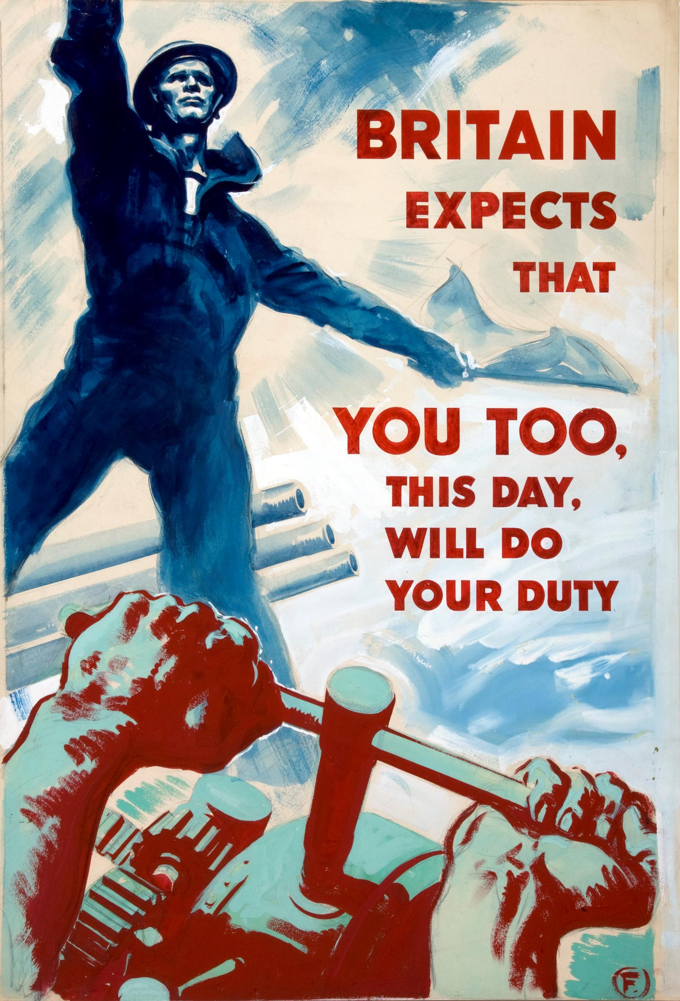
POST-WAR PERIOD
Dr. Funda Hay
fhay@ankara.edu.tr
Ankara University
From the website Wikipedia

Slide 2
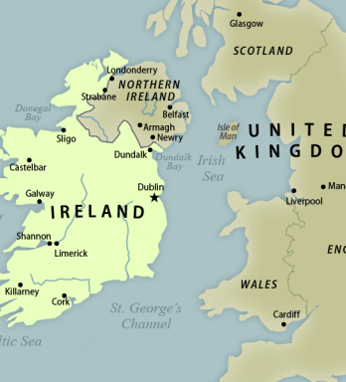
Northern Ireland
In 1969, both Catholics and Protestants, began to gather on the streets and demand a fairer system.
In 1972 the Northern Ireland government was removed and was replaced with direct rule from London.
From the website Every CRS Report

Slide 3
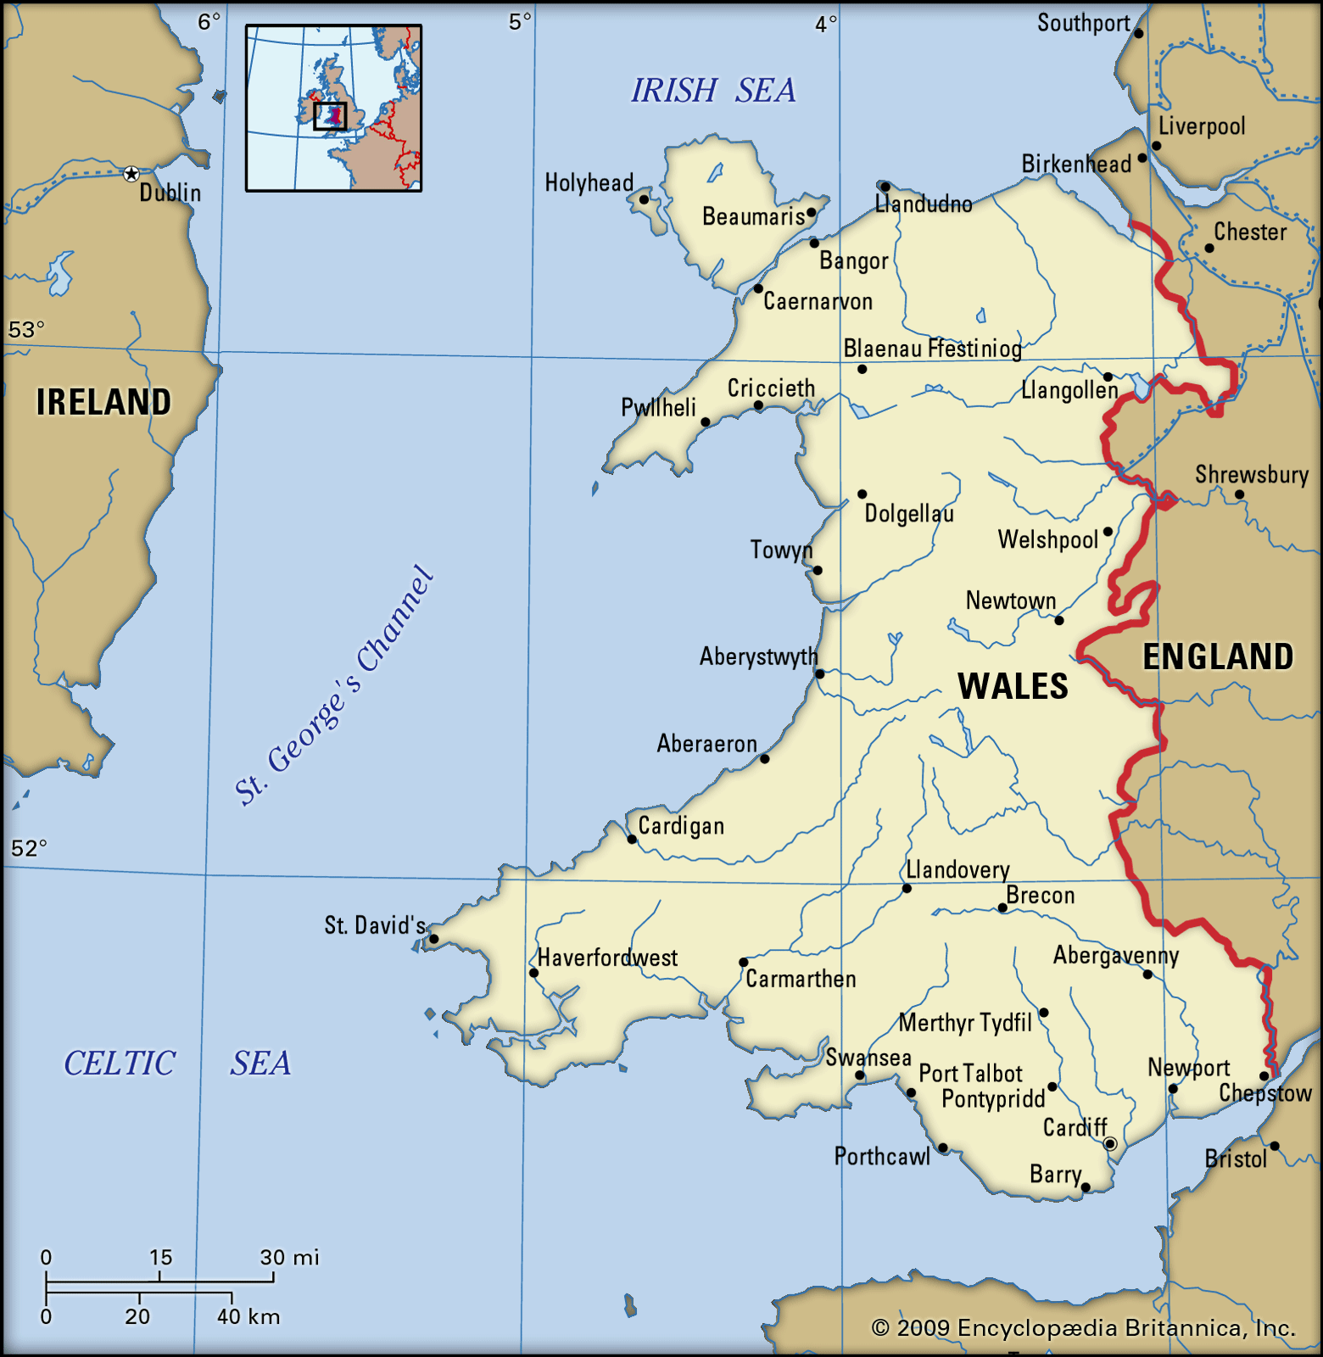
Wales
In Wales, a nationalist party, Plaid Cymru, the parry of "fellow countrymen," became an important political figure in Welsh nationalism, but they could not be successful.
From the website Britannica

Slide 4
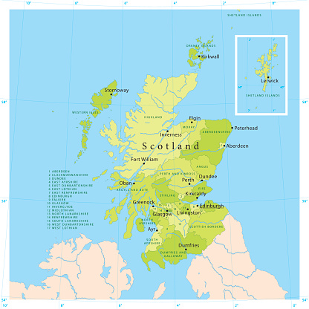
Scotland
The Scottish Nationalist Patty (SNP) showed its growing popularity in 1970s.
The English government decided that 54 per cent of those who voted was not a big enough majority, and to the anger of the SNP it abandoned the self-government offer.
From the website iStock

Slide 5
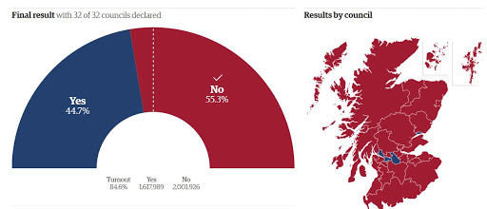
In 2014 they voted in a referendum on their independence; yet 55% of the population voted for “No.”
After this referendum Scottish nationalist asked another round; Scotland’s independence either in Autumn 2018 or Spring 2019 was declined by Westminster.
From the website Metapolis

Slide 6
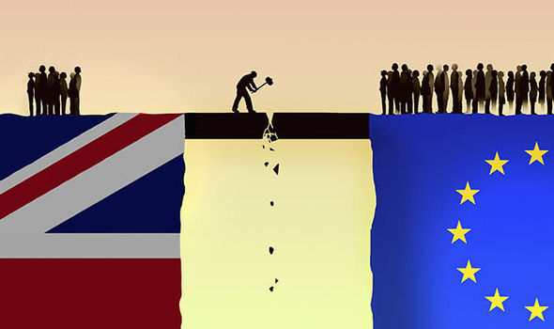
According to a poll published on August 5, 2019, 46 per cent of Scots indicated that they would support Scottish independence in a second referendum while 43 per cent stated otherwise.
The UK left the EU on 31 January 2020. Now SNP again asks another referendum.
From the website Londra Gazete

Slide 7
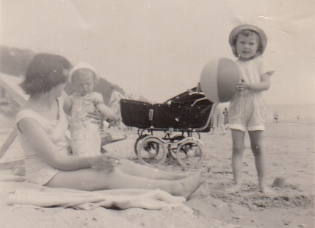
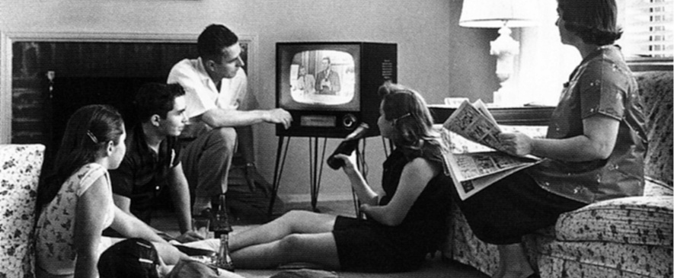
Social Life & Immigration
From the website Historic UK
From the website Newsela

Slide 8
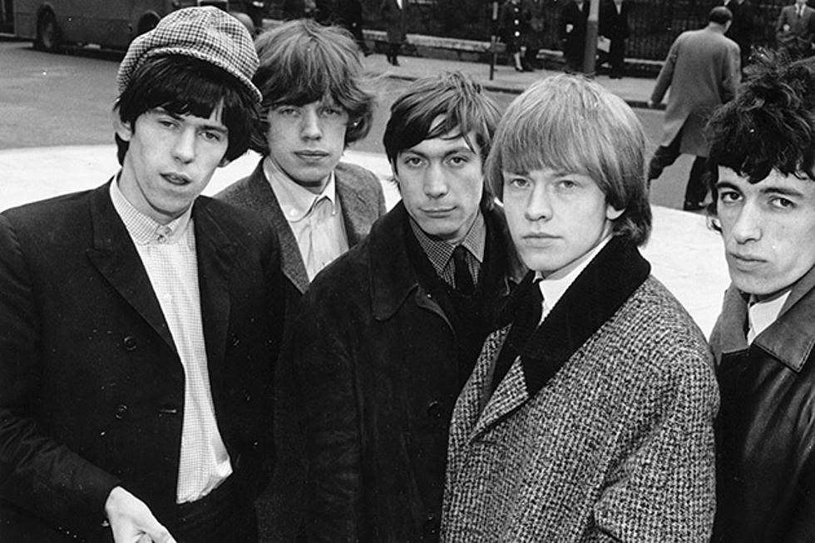
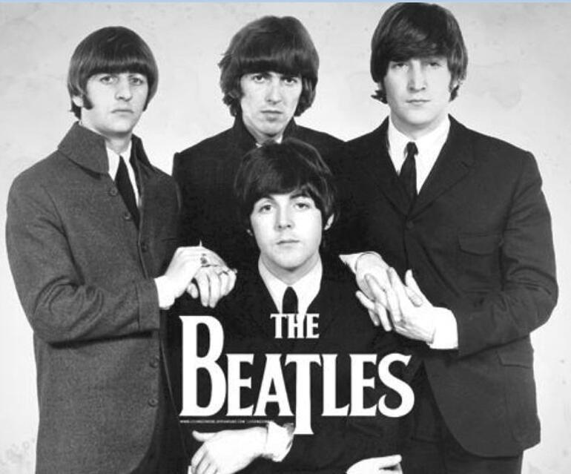
From the website Hürriyet
From the website Diffuser

Slide 9
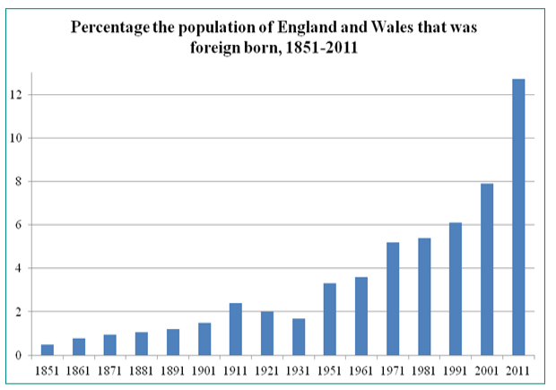
Britain also experienced new social problems, particularly after the arrival of immigrants in Britain.
In the fifties, however, the first black immigrants starred to arrive from the West Indies, looking for work.
By 1985 there were about five million recent immigrants.
From the website Migration Watch UK

Slide 10
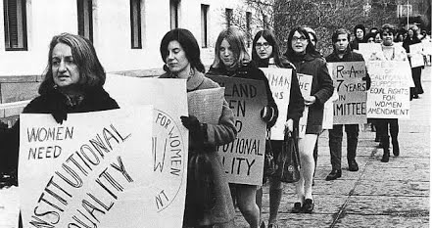
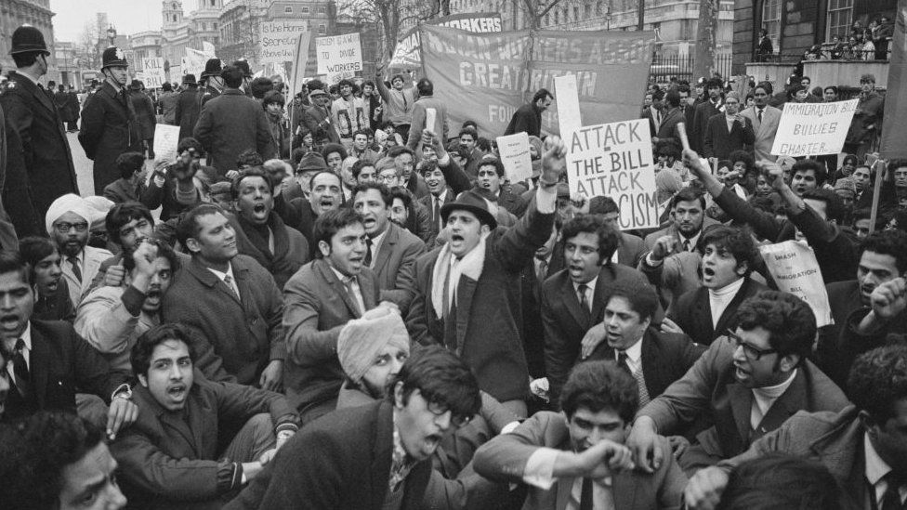
From the website Google Sites
Unemployment increased rapidly at the end of the 1970s.
Women protested about violence against women
From the website BBC

Slide 11
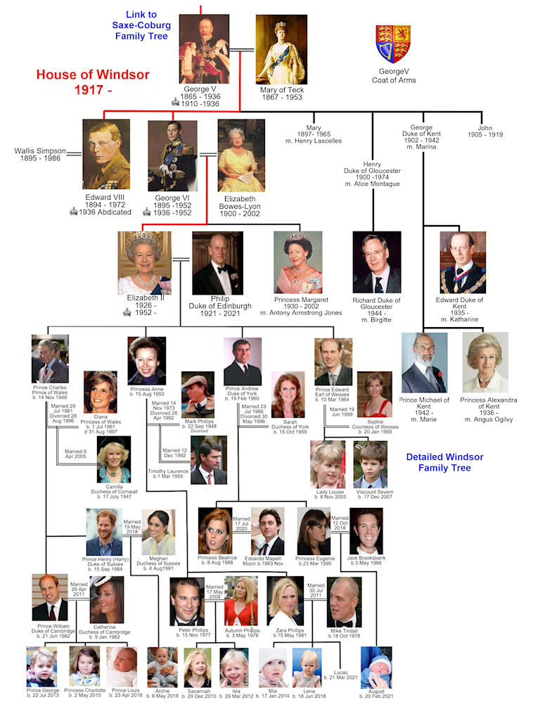
From the website the Royal Family
From the website British Royal History

Slide 12
Bibliography
Burns, William E. A Brief History of Great Britain. Facts on File, 2010.
McDowall, David. An Illustrated History of Britain. Longman, 1989.
Morgan, Kenneth O. Twentieth-Century Britain: A Very Short Introduction. Oxford UP, 2000.
Varal, Seçil. ‘Everendum’: National Identity and Scottish Independence in Contemporary Scottish Drama. Ankara University, 2019. PhD Dissertation. The CoHE Thesis Center.

