Slide 1
Evolution of Woody and Seed Plants

Slide 4
Secondary growth from lateral meristems: vascular cambium & cork cambium.

Slide 6
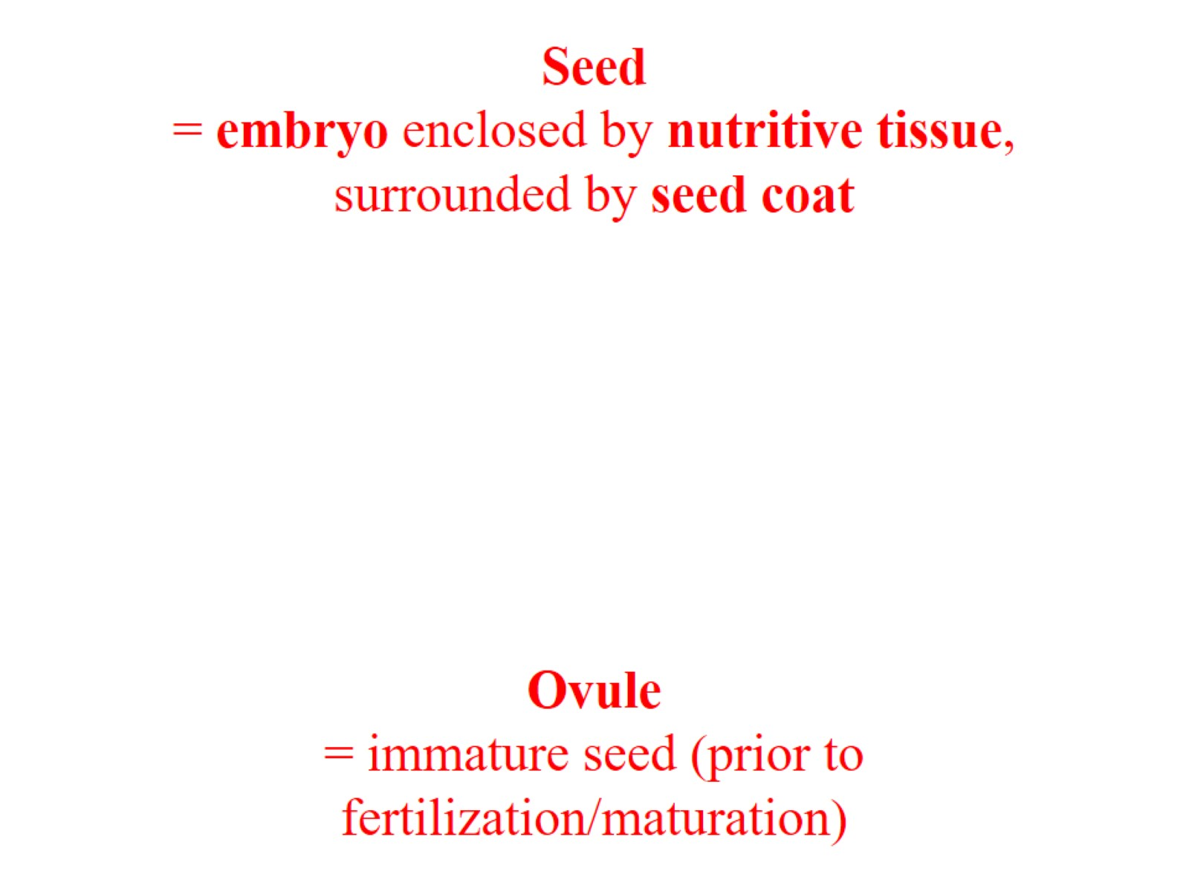
Seed = embryo enclosed by nutritive tissue, surrounded by seed coat

Slide 7
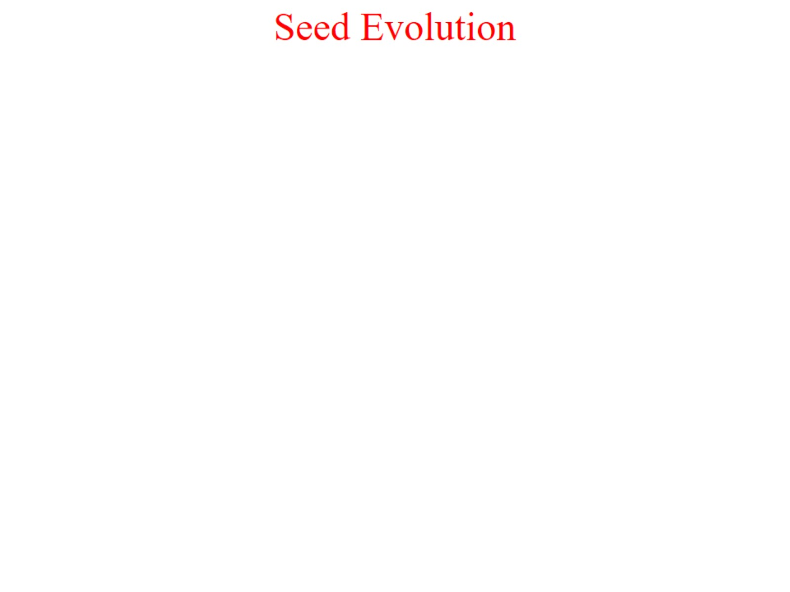
Seed Evolution

Slide 8
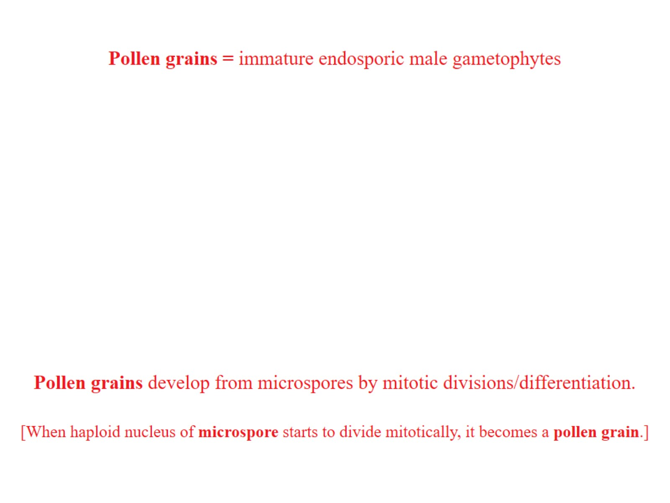

Slide 14
Adaptive significance of seeds

Slide 15
eustele – single ring of vascular bundles

Slide 16
ARCHEOPTERIS

Slide 17
“PTERIDOSPERMS” — “SEED FERNS”

Slide 18
Medullosa

Slide 20
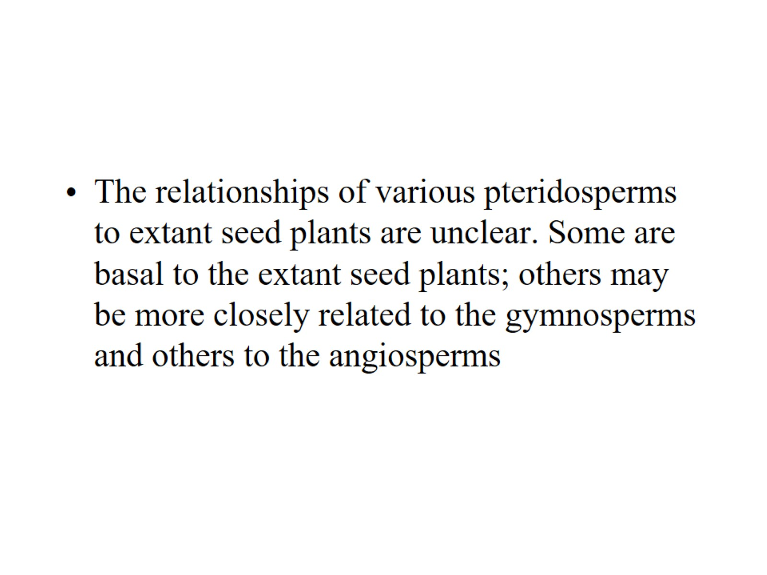

Slide 21
Cycadophyta – Cycads

Slide 22
Extant Cycads

Slide 23
Ginkgophyta—Ginkgo

Slide 24
Ginkgo

