Slide 1
WUTHERING HEIGHTS
by Emily Brontë

Slide 2
Timetable & Narrators
1801
1771-1801
1802
Mr Lockwood opens the story of Brontë
Nelly Dean narrates the past story of the two families
Mr Lockwood brings Brontë’s story to a close

Slide 3
Narrators
Lockwood
(The Frame Story)
Nelly Dean
(Story of the Earnshaws & Lintons)
Isabella
(Within Nelly’s Story)

Slide 4
The Characters at the Beginning
Heathcliff => a 19th century landowner
Mr Lockwood => a gentleman
Nelly Dean => the servant
Catherine Linton
Hareton Earnshaw

Slide 5
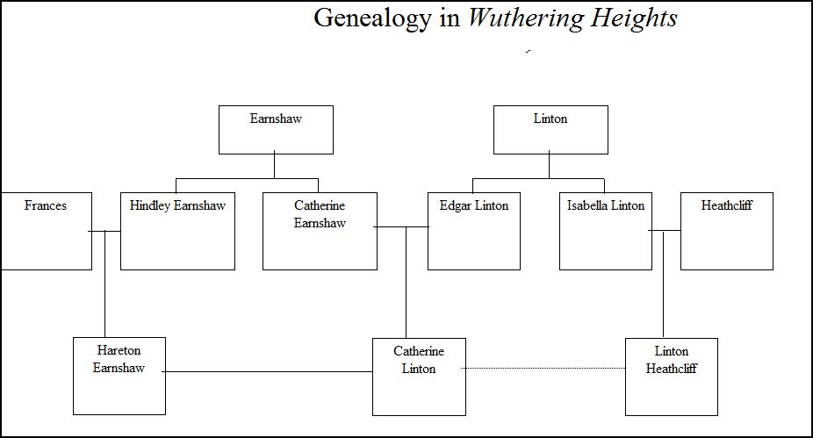
Wuthering Heights
Thrushcross Grange
(CATHY)

Slide 6
1801
1771-1801
1802
Lockwood came to Thrushcross Grange
Nelly tells the story
Lockwood’s second visit
Heathcliff
Hareton
Catherine
Everyone is alive
Hareton
Catherine

Slide 7
The Novel is about
the contrast between the two houses
the love story between Heathcliff and Cathy
Heathcliff’s desire for revenge
the contrast between the ordinary and the extraordinary

Slide 8
Social Issues
the rising bourgeoisie
laws
marriage
family relationships
parenthood
the nature of love

Slide 9
Important Scenes
Mr Lockwood’s stay at Wuthering Heights
Heathcliff’s arrival at Wuthering Heights as a small child
Hindley’s return to Wuthering Heights for Mr Earnshaw’s funeral
Cathy’s return from Thrushcross Grange after five weeks
Heathcliff saving Hareton’s life
The conversation between Cathy & Nelly after Edgar’s proposal
Heathcliff’s arrival after 3 years of absence
Cathy warning Isabella against Heathcliff

Slide 10
Isabella’s letter to Nelly
Nelly visiting Wuthering Heights to see Isabella
The last meeting of Heathcliff & Cathy before her death
Heathcliff’s reaction to her death
The first meeting of Catherine Linton & Linton Heathcliff
The degradation of Hareton
The difference between Catherine and Linton
Hareton & Catherine’s friendship & solidarity
Heathcliff’s speech of giving up

