Slide 1
VOLTAMMETRY AND POLAROGRAPHY
ANALYTICAL CHEMISTRY LABORATORY MANUAL 3
Instrumental Analyses

Slide 2
What Is the Electrochemistry?
Electrochemistry is the study of chemical processes that cause electrons to move.
This movement of electrons is called electricity, which can be generated by movements of electrons from one element to another in a reaction known as an oxidation-reduction ("redox") reaction.
An example is the oxidation of iron(II) ions by cerium(IV) ions. The reaction is described by the equation.
In this reaction, an electron is transferred from Fe⁺² to Ce⁺⁴ to form Ce⁺³ and Fe⁺³ ions. A substance that has a strong affinity for electrons, such as Ce⁺⁴, is called an oxidizing agent, or an oxidant. A reducing agent, or reductant, is a species, such as Fe⁺², that donates electrons to another species.
We say that Fe ⁺² is oxidized by Ce⁺⁴; similarly, Ce⁺⁴ is reduced by Fe⁺².

Slide 3
Electrochemıcal technıques
﻿Electrochemical techniques are a powerful and versatile analytical technique that offers high sensitivity, accuracy, and precision as well as a large linear dynamic range, with relatively low-cost instrumentation. ﻿
Voltammetry and polarography, as the name suggest, are a current-voltage technique; the recording of current vs. potential is termed a voltammogram and polarogram.
﻿﻿Voltammetric measurements and mechanistic probing of redox system of various electroactive samples of biological significance (drugs, metals, hormones, and vitamins) have been reported.

Slide 4
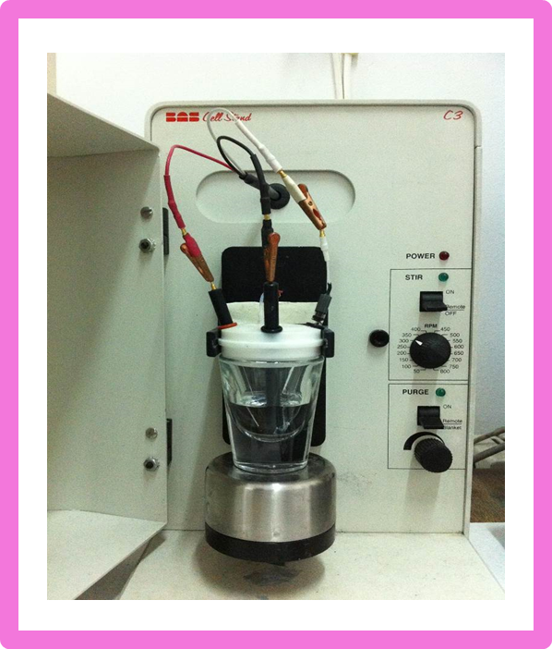
Voltammetry
It is an electrochemical method which the current is measured as a function of the potential applied to the electrode. The voltammetric experiments are realized in an electrochemical cell and generally three-electrode systems are used.
These electrodes are working electrode, reference electrode and auxiliary (counter) electrode.
In the voltammetric method, a potential, which changes over time, is applied between the working and reference electrodes and the current between the working and counter electrodes is measured.
﻿All types of electrodes employed in voltammetry such as solid electrode( Pt, Ru, Au, glassy carbon, diamond, carbon paste, wax-impregnated graphite electrodes, SPCE), and others.

Slide 5
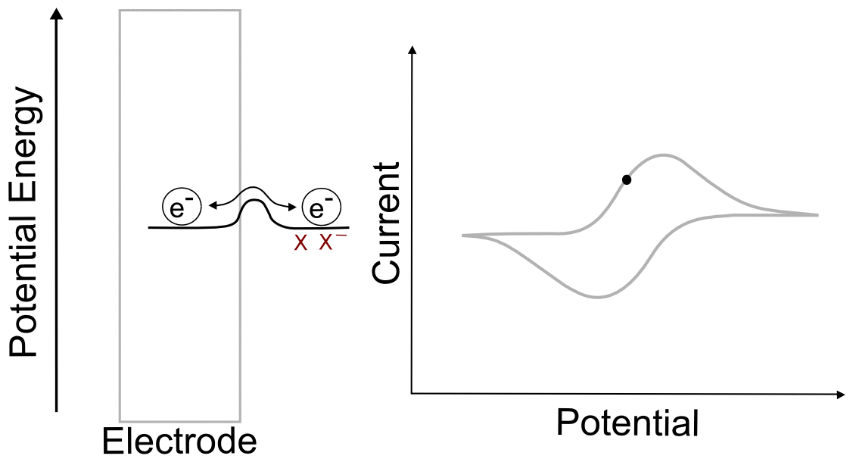
Voltammetry
The graph of the applied potential versus the measured current is called a voltammogram.
In voltammetry, the potential range, which can be applied to examine the electrochemical behavior of a sample, is dependent on the working electrode, the solvent and the type of the electrolyte.
﻿The commonly used voltammetric methods are linear sweep, cyclic, differential pulse, square wave, and stripping voltammetry, which involves a preconcentration step followed by voltammetric and polarographic measurements.
﻿The potential is scanned by anodic or cathodic direction depending on the redox properties of the investigated drug compounds.

Slide 6
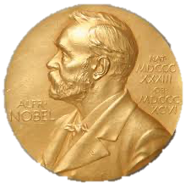
polarography
The first voltammetric method is polarography and it was discovered by the Czech chemist Jaroslav Heyrovsk in 1922, which made him, won the Nobel Chemistry Prize in 1959.
Different from voltammetry, in polarography, which is a significant field of electrochemistry, dropping mercury electrode is used as the working electrode.
In this method, the graph of the applied potential versus the measured current is called a polarogram.

Slide 7
polarogram
After the sample to be analyzed begins to enter into a reaction with the electrode, there will be a rapid increase in the current in line with the slightest change that can occur in the potential.
The magnitude of the current is limited to the speed of electroactive sample in reaching the electrode surface and therefore there will be no increase after a certain potential value. The magnitude of the current in the region where there is no more increase is called the limiting current (C-D).
Before the electroactive sample enters into a reaction, a small current is observed. This current emerges as a result of the loading of electrical double layer or the impurities in the solution and the magnitude of this current is called the residual current (A-B).
In the figure below, at the B-C region, a small increase in the potential results a large increase in the current. The magnitude of the current at this region is called the diffusion current (id). The potential versus the half of the diffusion current is called the half wave potential (E1/2).

Slide 8
Voltammograms and polarograms allow the researchers to analyze the sample both qualItatIvely and quantItatIvely:
Qualitatively
For each substance, there is a half wave potential under certain conditions. Half wave potentials are quite characteristic for electroactive substances and therefore they are used for qualitative analyses.
Quantitatively
They are also used in quantitative analysis since the diffusion current is proportional to the concentration. This relationship is given with the Ilkovic equation:

Slide 9
IlkovIc equatIon
For the Ilkovic equation, when the other parameters are held constant for the electrode used and the sample, there is a linear relationship between the id value and C (id = k × C).
Therefore, by using the calibration equation, which is obtained with the measured current values of the standard samples at different concentrations, the quantity of the substance at an unknown sample can be calculated.
i_{d} = 605 n D^{1/2} C m^{2/3} t ^{1/6}
id: diffusion current
n: the number of electrons taking place at the electrode reaction
D: the diffusion coefficient of the sample solved
C: the concentration of the sample solved
m: mass flow rate of mercury as mg/sec
t: dropping time as sec
605: a number including drop geometry and
Faraday constant
In quantitative analysis, quantity determination can also be made by proportioning the id values measured for the solutions with known and unknown concentration. 𝑖dstandard/𝑖dsample=𝐶standard/𝐶sample

Slide 10
Drug AnalysIs wIth the VoltammetrIc Method
In this experiment, the concentration of the given drug solution is determined with the voltammetric method. In order to do this, first of all, five solutions with different concentrations are prepared in line with the stock solution of the drug active ingredient; their current values are measured and the concentration versus current line is obtained.
The stock solution of the active ingredient standard contained by the drug sample is prepared (1×10⁻³ M). From this stock solution, solutions to be used in the analysis are prepared with the concentrations of 2×10⁻⁵ M, 4×10⁻⁵ M, 6×10⁻⁵ M, 8×10⁻⁵ M and 1×10⁻⁴ M at the H₂SO₄ supporting electrolyte media.
A linear equation is obtained by plotting the measured currents of each solution versus concentration values. The measured current of the given sample (with unknown concentration) is written on the exact place at this linear equation and the concentration of the sample is calculated.

Slide 11
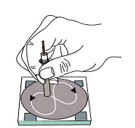
﻿Before each experiment the glassy carbon electrode was polished manually with alumina, in the presence of bidistilled water on ﻿on a smooth polishing cloth.
The voltammograms were recorded with BAS 100 W electrochemical analyzer (Bioanalytical System, USA).
Voltammetric measurements used a commercial glassy carbon working electrode, a platinum wire auxiliary electrode and Ag/AgCl (NaCl 3 M, BAS) reference electrode.

Slide 12
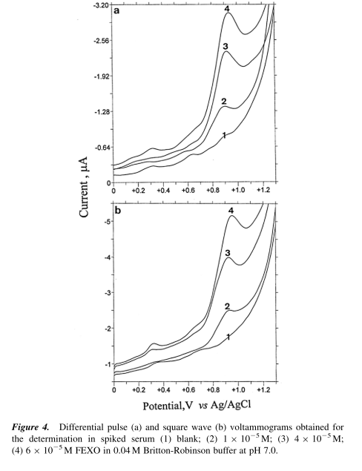
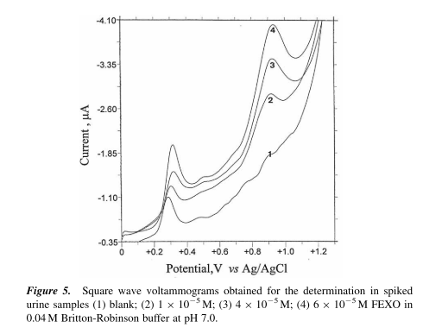
﻿﻿Anodic Voltammetric Behavior and Determination of Antihistaminic Agent: Fexofenadine HCl

Slide 13
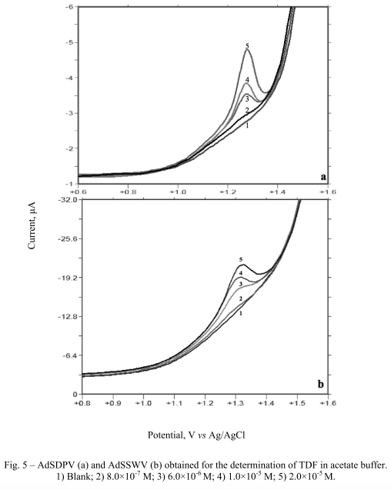
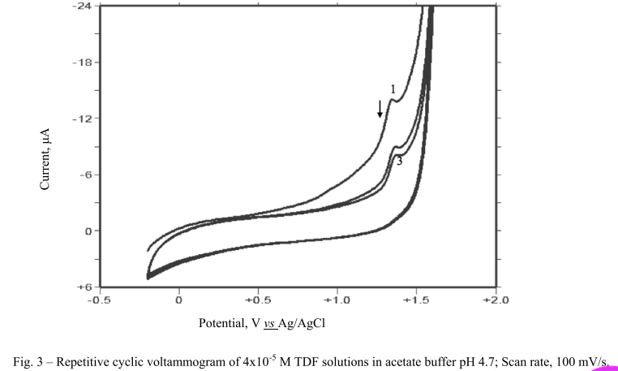
﻿ELECTROCHEMICAL CHARACTERISTICS OF TENOFOVIR

Slide 14
The calıbratıon curve based on Oxıdatıon-reductıon

Slide 15
references
Electroanalytical Methods in Pharmaceutical Analysis and Their Validation, S.A. Ozkan, HNB Pub., USA, ISBN: 978-09664286-7-4, 2012.
Electroanalysis in Biomedical and Pharmaceutical Sciences, S.A. Ozkan, J.M. Kauffmann, P. Zuman, (Voltammetry, Amperometry, Biosensors, Applications) ISBN 978-3-662-47137-1, Springer-Verlag Berlin Heidelberg, 2015
Analytical Electrochemistry, J. Wang, 3rd Ed. John Wiley and Sons, 2006
Practical Electrochemical Cells. In: Handbook of Electrochemistry, S. Chen, Ed.: Zoski, C. G., Amsterdam: Elsevier, 33–56, 2007
Fundamentals of Electroanalytical Chemistry, P. Monk, John Waley-Sons Inc., 2011.

