Slide 1
Artificial insemination in Dogs & Cats
Koray tekin
Ankara Üniversitesi, Veteriner Fakültesi
Reprodüksiyon ve Suni Tohumlama Anabilim Dalı
Notes:
değerli dinleyiciler, sizlere köpeklerde suni tohumlama ile ilgili bir seminer sunacağım.
Sunum sırasın

Slide 2
Goals to achieve
AI
1.1. İntroduction
2. Indications
3. Ethics
4. Andrological and Gynecological Evaluation
5. Semen Collection and Evaluation
5.1. Macroscobic Evaluation
5.2. Microscobic Evaluation
6. Semen Assesment
7. Success Rate for AI
7.1. Timing for ovulation
7.2. Timing for AI
8. Insemination Teqniques
9. Rules and Regulations for Semen exporting

Slide 3
What Artificial is ?
Made or produced by human beings rather than occurring naturally, especially as a copy of something natural.
What insemination is ?
introduce semen into female genital tract

Slide 4
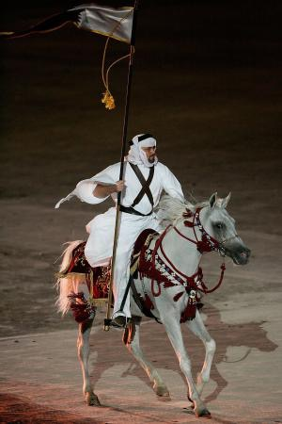
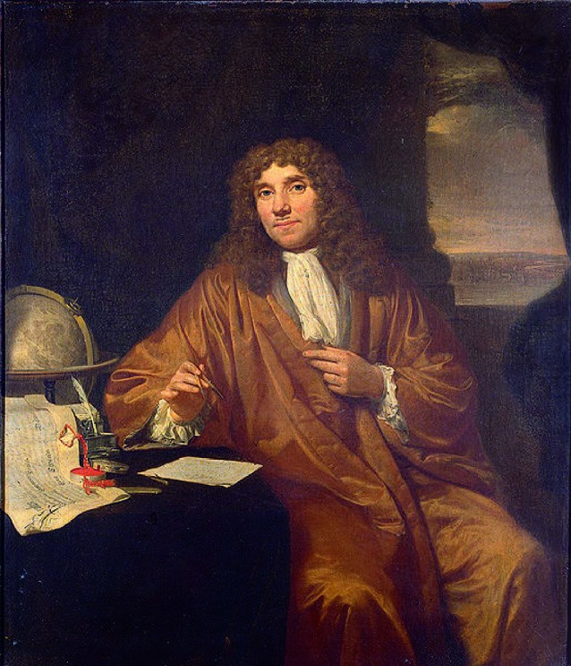
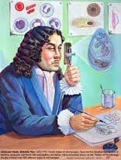
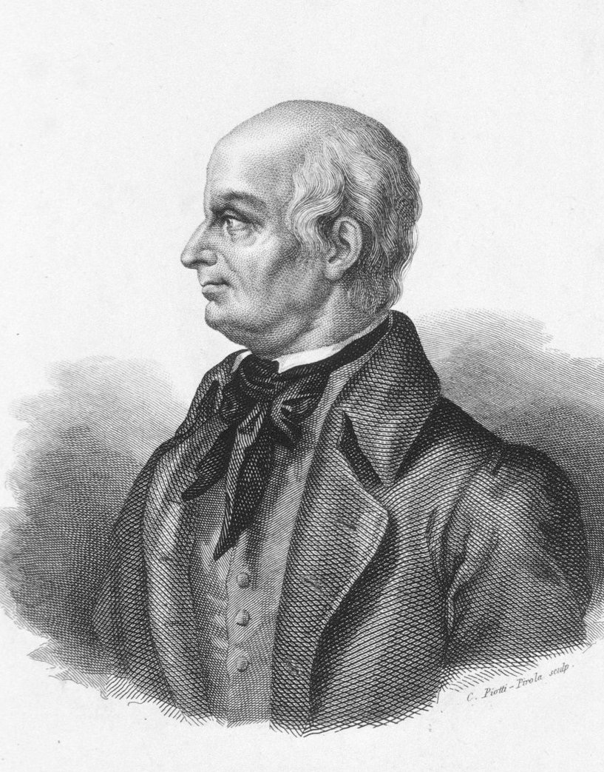
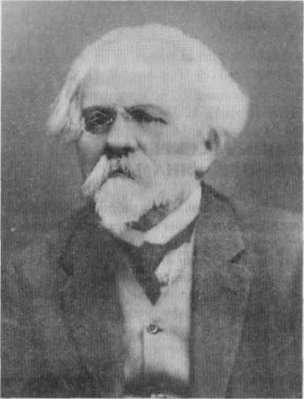
What Artificial insemination is ?
is the process of collecting sperm from a male animal and manually depositing them into the reproductive tract of a female
1300 Arabic tribe
1455, Impotent Henry the IV
1678, Lovenhook and Johannes Ham
1780, Spallanzani,
1900, Ivanov-humanzee
Notes:
Kısa

Slide 5
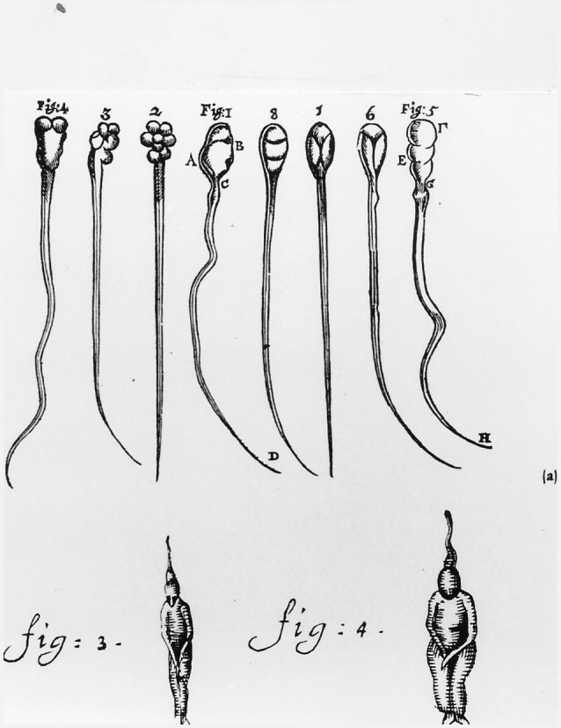
“zaaddiertjes” or “living animalcules in human semen ...
in 1784, the first artificial insemination in a dog Lazzaro Spallanzani
first to report the effects of cooling on human sperm, cooled by snow became motionless.
Notes:
Spermatozoa were first seen and described by Antoni van Leeuwenhoek and his assistant Johannes Hamin 1678 in the Netherlands. In a letter to William Bounker of the Royal Society of London (Phil.Trans. Vol.XII, nbr. 142, 1678) he showed a picture of sperm cells of the human and the dog. van Leeuwenhoek described the spermatozoa as “zaaddiertjes” or “living animalcules in human semen ... less than a millionth the size of a coarse grain of sand and with thin, undulating transparent tails”. He draws the conclusion that the tails must be operated by means of muscles, tendons and joints (Mol, 2006; Kremer, 1979). van Leeuwenhoek did not study Latin, the scientific language of the day. Nevertheless, his paper amazed and perhaps amused the reigning King of England.

Slide 6
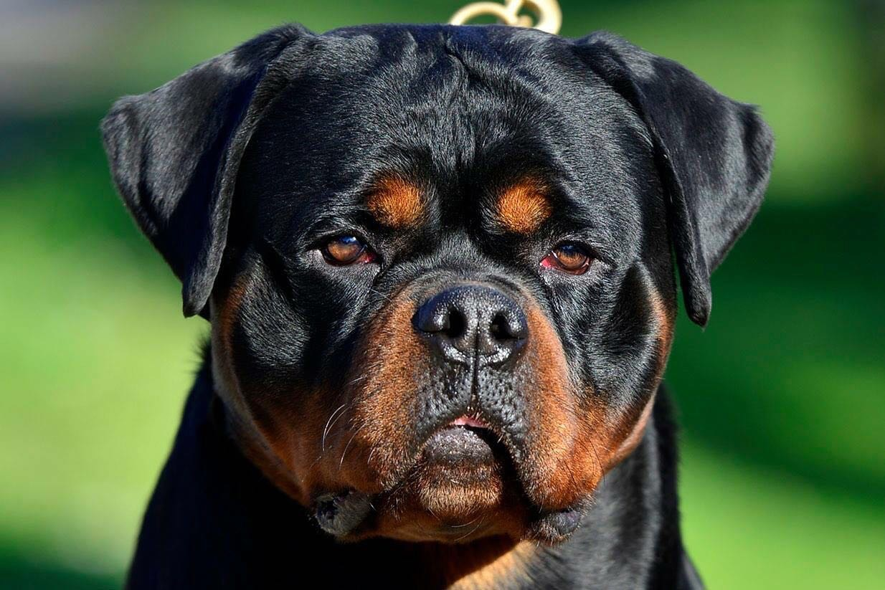
Why?
Superior genetic material,
Prevents the spread of sexually transmitted diseases
Sperm Mobilisation,
Increasing the Fertility
Reducing the breeding costs
Notes:
According to Linde-Forsberg (2001, 2005a), from all the AI in dogs performed by veterinarians today in Europe, about 50-55% is done with fresh semen, collected at the clinic,
10% with chilled semen and around 35-40% with frozen semen.
Akrabalı yetiştirmenin önüne geçilebilir, çiftleşme agresyonu problem yaşanmaz.
TVT, Brucella canis, Herpes virus gibi çiftleşme ile bulaşan hastalıklar kontrol altına alanabilir,
Erkek ve dişi hayvanın transferi yerine, sperma transferi gerçekleştirilebilir,
Erkek ve dişiye bağlı infertilite problemleri ortadan kaldırılarak, fertilite artırılabilir,
Eğer ırk standartları ortaya konulursa, bireysel farklılıklar gözetmeksizin uygun çiftleşme programları yaratılabilir.

Slide 7
Potential Benefits
Potential Weakness
Decrease stress, infectious deseases transmission, travel expenses,
Splitting of an ejaculate to bred more females
Reduction of the costs with maintenance of stud dogs in a colony,
Worldwide availability of the semen of a given dog,
Allow early castration of working dogs while maintaining availability of their genes,
Evaluation of semen quality prior to AI,
Early detection of male reproductive pathologies,
Semen preservation
Overcome problems associated with the refusal to breed (psychological or physical reasons, precocious ejaculation), inexperienced males
May overcome quarantine restrictions
Semen collection without interruption of the
male activity (show or training),
Induction of physical or psychological trauma during the AI process
Risk of performing AI for inappropriate reasons
Failure in careful clinical examination of the breeding animals
Potential risk for maintaining some disorders in a particular genetic line (hip dysplasia or anatomical abnormality of the reproductive tract)
Potential risk for introduction of inherited diseases or abnormalities
Potential overuse of a given male within a programme or breed
May allow confusion of parentage

Slide 8
Indications?
Factor | Cause
Female-dependent | Male Rejection
 | Aggression
 | Congenital Anomalies (Vaginal Septum, hymen)
Male-dependent | Reduced Libido
 | Pain
 | Physical deficiency (mount, erection, muscle or congenital problems
Both | Inexperience
 | Male tofemale disproportion
 | Social and Behavioral problems (Dominant female or social hierarchy)

Slide 9
Canine estrus cycle
Mono-estrus
4 stages
Pro-estrus 9 day (3-27)
Estrus 9 day (1-21 day)
Met-estrus/Diestrus
Anestrus

Slide 10
AI Stages
Estrus detection
Sperm Collection
Timing and Method of AI

Slide 11
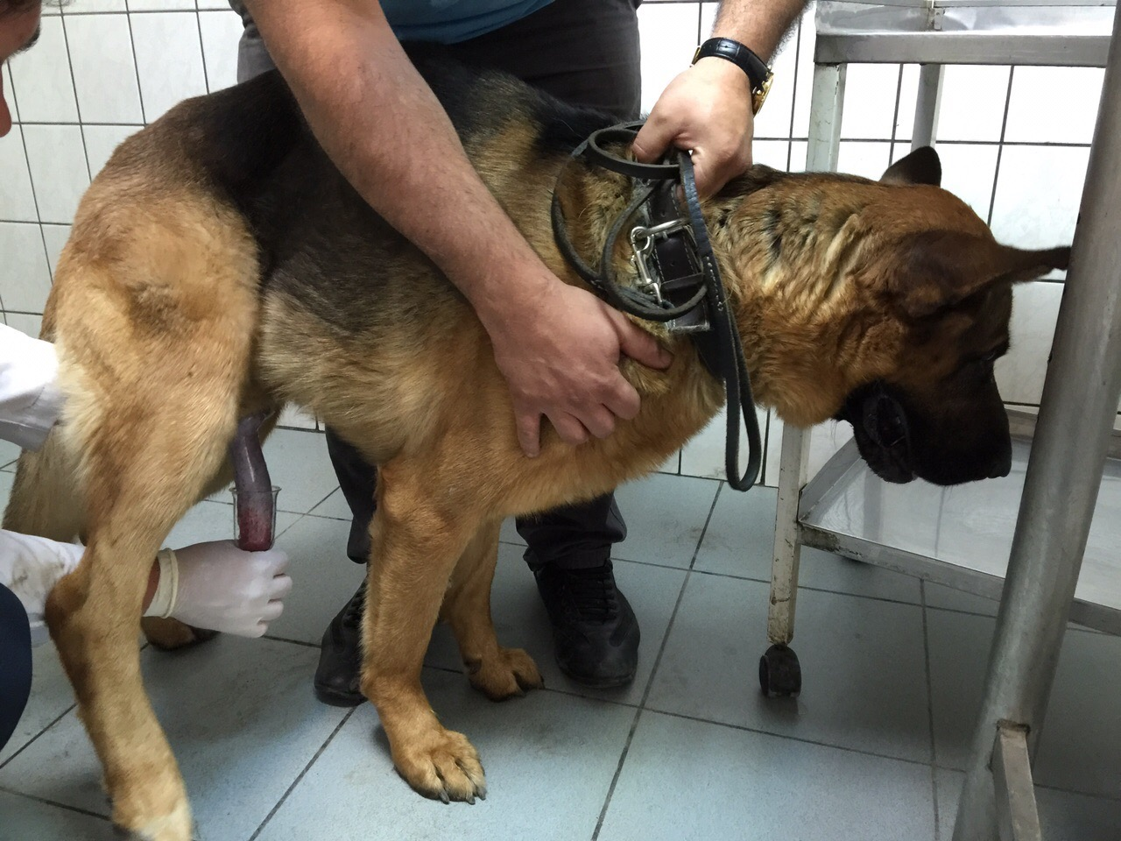
Sperm Collection
Digital Manipulation
Stimulation,
Erection,
Emission,
Ejaculation
Pudental Nerve (Somatic)
Pelvic Splanchnic Nerve (Parasympathetic)
S2-S4
Lumbar and Sacral (sympathetic)
Pudental Nerve (Somatic)
Notes:
Suni tohumlama bir yönetim işidir. ve bu yönetim belirli aşamların izlenmesini gerektirmektedir.
Kopekten spermanın alınması genellikle kolaydır, ancak kalitenin artırılması için deneyime ihtiyac duymaktadır.
Yüksek dölverimi almak in muayene şarttır.
Alınan her numune mutlaka motilite, yoğunluk, canlılık ve anormal spermatozoa yönünden muayane edilmelidir.
Tohumlama öncesinde sperma muayenesi erkeğin potansiyel dölverimini belirleyen en önemli kriterdir.
Ayrıca, spermanın dondurulması ve tohumlanması öncesinde mutlaka damızlık sertifikası aranmalıdır.
DMS mutlaka uygulanmalıdır.
Spermanın alınması sırasında östrustaki bir dişi, yada vaginadan alınan örnekler libidoyu artırmak için kullanılabilir,
Sperma alınırken gerçekleşen hatalı uygulamalar ileride davranışsal problemlere yol açabilmektedir.
Ideal intervals between collections are 2 to 5 days, whilst intervals longer than 10 days may result in an increased number of morphological abnormalities and decreased motility (Freshman, 2002; Johnston et al., 2001). In longer periods, it is advisable to perform one previous collection, if semen is to be chilled or frozen for shipment. If semen preservation is planned, semen extender should be prepared before the arrival of the animal (Freshman, 2002). The most common method for semen collection in the dog is by digital manipulation, in the presence of a female. However, bitch presence, although desirable as it facilitates procedures, is not essential to accomplish the collection (Farstad, 2010; Linde Forsberg, 2005a). It should be noticed that when the collection is achieved in the presence of the bitch ejaculates present higher concentration.
The use of manual massage is the most commonly used technique (Farstad, 2010; Johnston et al., 2001; Linde Forsberg, 2005a), although in the past semen was collected from dogs using an artificial vagina. Nowadays, semen collection into a tube is commonly accomplished by penile massage and the use of a cone or plastic sleeve, a funnel or a special collecting vial (Linde Forsberg, 2005a). Briefly, the process is started with a massage of the dog prepuce at the level of the bulbus glandis until developing partial erection, followed by the quick retraction of the prepuce and penile expose. If the collector is right-handed, semen must be collected from the dog’s left side, with the operator holding the dog’s penis with the right hand and the collection container in the left hand. During pelvic thrusting, rigid vials should be kept at a distance from the penis, to avoid trauma. When pelvic movements are finished and the dog lifts its rear leg, a 180o backward rotation of the penis should be obtained and the erectile penis should then be directed into the collection cone or the funnel.
www.intechopen.com
Artificial Insemination in Dogs 55
Some pressure may be applied with the thumb on the apex of the glans penis, at the level of the urethral process, to stimulate ejaculation. When a crystal clear fluid (prostatic fluid) begins to flow into the collection tube, you can gently slide the collection cone off the penis. Watch for semen to flow in the collection tube (Farstad, 2010; Linde Forsberg, 2005a).
Canine ejaculate consists of 3 fractions, with the first and third fraction consisting of prostatic fluid and the second being rich in spermatozoa (England et al., 1990) (Table 3). The first fraction, the presperm portion, is emitted in 0.5 to 1 minute and is colourless, with a volume range of 1-5 ml. It is expelled during first stage of erection, at the moment of the presence of evident copulatory movement of male. The second fraction, the sperm-rich portion, is also rapidly completed (1-2 minutes), and is grayish-white in colour, with a volume of 1-3 ml. It is expelled when thrusting movement of the male ceases and full erection is observed. The third fraction comes from the prostate and may be up to 30-40 ml; it may take up from 5 to 30 minutes to be completed (Günzel-Apel, 1994; Johnston et al., 2001).

Slide 12
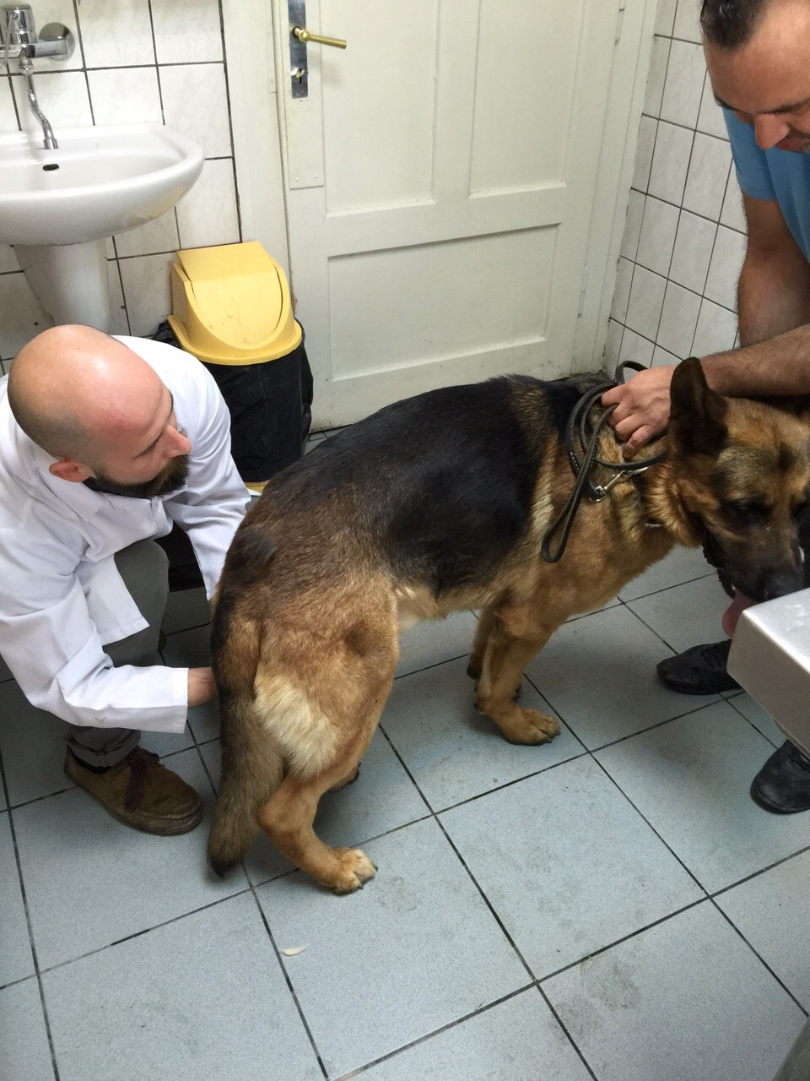
Semen Collection
2-5 days interval
Presence of Female animal
Fractions must be followed

Slide 13
Fresh Sperm Features
Parameter | 1. Fraction | 2. Fraction | 3. Fraction
Volume | 0.1-2 mL | 0.1-3 mL | 1-20 mL
Color | Clean-Opaque | Grey-white, White, milky white | Clean
Viscosity | viscose | Kıvamlı-Akışkan, | Viscose
Character | Prostat, urine, bacteria & sperm | Sperm | Prostate
pH | 6.37 | 6.1 | 7.2
Time | 5-90 sec | 5-300 sec | 60 sec- 30 min

Slide 14
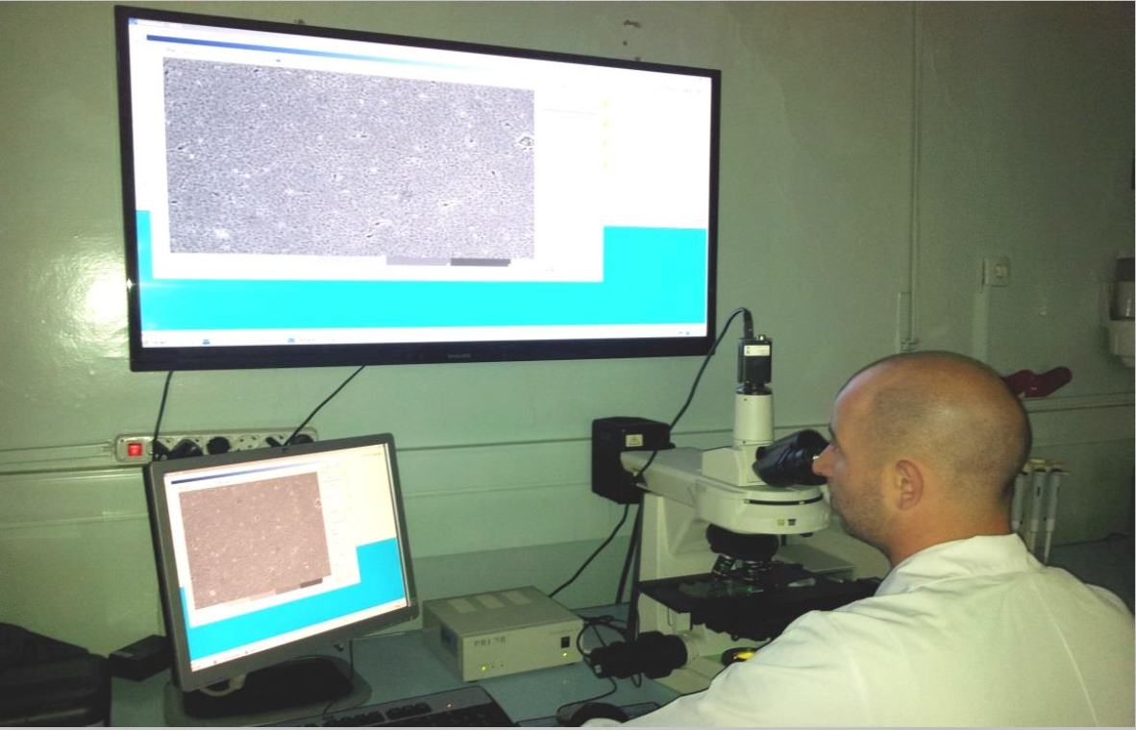
Sperm Examination
100 % Fertility ?
Must be repeated
Notes:
4.2 Semen assessment
Semen assessment is an important part of the evaluation of fertility in males and it should be performed as routine element of prebreeding examination. Furthermore, semen evaluation ought to be completed before artificial insemination or sperm preservation. Semen should be assessed immediately after collection and it has to be handled carefully during all the procedures. Rapid changes of environmental temperature may be deleterious for spermatozoal motility and structure, and may also artifactually influence the results of examination. Any delay in semen assessment may decrease the percentage of motile sperm and simultaneously increase the percentage of dead sperm. It is advisable to keep all equipment necessary for semen collection and evaluation at the temperature near 37oC (Christiansen, 1984; Feldman & Nelson, 1996; Linde-Forsberg, 1991).

Slide 15
Why semen Examination ?
Before AI,
Cryopreservation or Chilling
Early diagnosis for sperm related pathologies
İnfertility ?
New Male Stud animal,
Determination of Stud status before First breeding
Pathological Lesions
After Treatment

Slide 16
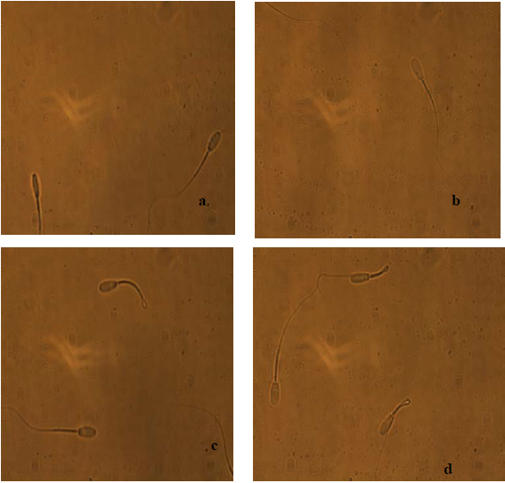
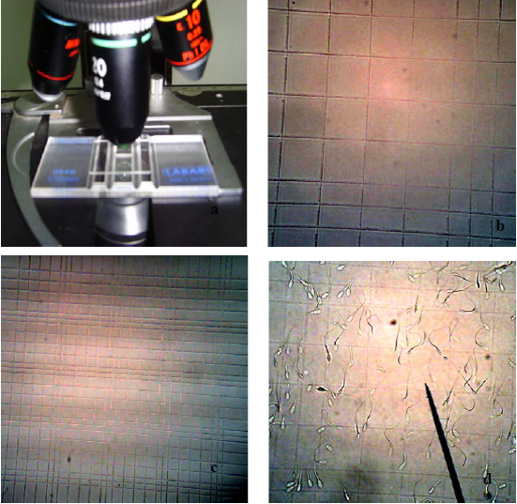
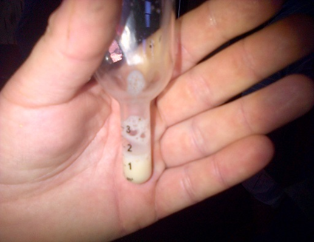
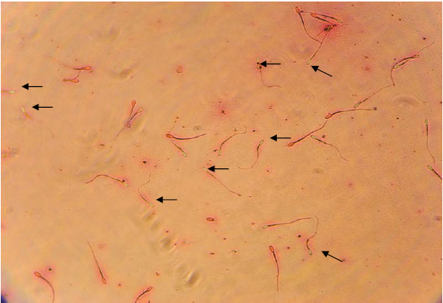
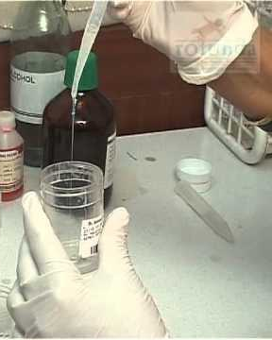
What Sperm Evaluation consist of ?
Volume;
Colour;
Motility;
Concentration;
Anormal;
Viability.
Notes:
Hacim; Genellikle hayvanın canlı ağırlığına, prostat büyüklüğüne, yaşına, sperm alım sıklığına, uyarıma ve alınan 3. fraksiyonun miktarına bağlıdır.
Azalan sperm hacmi; prostat hyperplazisi, kisti, yangı, epididymitis, vas deferns ve üretra tıkanmaları ve zayıf libidoya bağlı olabilir.

Slide 17
The Success of AI?
Timing,
Right amount of semen concentration,
Sperm selection and examination,
Deposition of sperm into right place,
Notes:
Bundan sonraki slaytlarda spermanın doğru zamanlama, canlılık, aktarım noktası hakkında ki konular üzerine olacaktır.

Slide 18
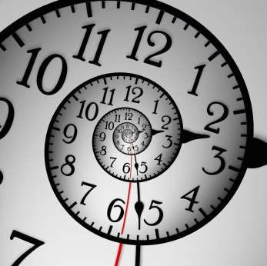
Timing
Mono-estrus.
Ovulation 24 to 72 hours after the LH peak
Ova may be released over 24 to 96 hours
Dog ovulates primary oocytes
The oviductal transit takes 5-10 days.
MII stage, 48-60 hours post ovulation
Fertilization
Mature canine ova may remain fertilizable for 2 to 4.5 days
Ovulate as early as day 3 to 4, late as day 26 or 27
Notes:
yılda bir ya da 2 kez kızgınlık geçirirler,
Hormonal, davranışsal ve fizyolojik olaylar siklus üzerine etki ederler,

Slide 19
Vaginal Cytology, PG₄, Vaginal endoscopy, USG
Vaginal cytology & PG₄
Must be repeated 2-3 days interval
Must be combined
Notes:
On the vaginal cytology, epithelial cells of the vagina change their form in response to estrogen impregnation, and passes from small round cells with a clearly visible cytoplasm in non-estrogenic stages, to larger, cornified, angular shaped-cells with small pyknotic nucleus, almost to the point of disappearing, under the influence of estrogens (Figure 1). At beginning of estrus, vaginal cytology presents its maximum cornification index (>70%). By that time, serial blood sampling for progesterone determination should start to detect the initial progesterone rise (2-3 ng/mL) which correlates with LH surge, which in turn triggers ovulation within 2 days. On the day of ovulation (day “0” of the cycle) progesterone concentrations may vary between 4 and 10 ng/mL. The sudden increase in the number of round-shaped cells and of neutrophils reflects the onset of diestrus (Fontbonne & Malandain, 2006).

Slide 20
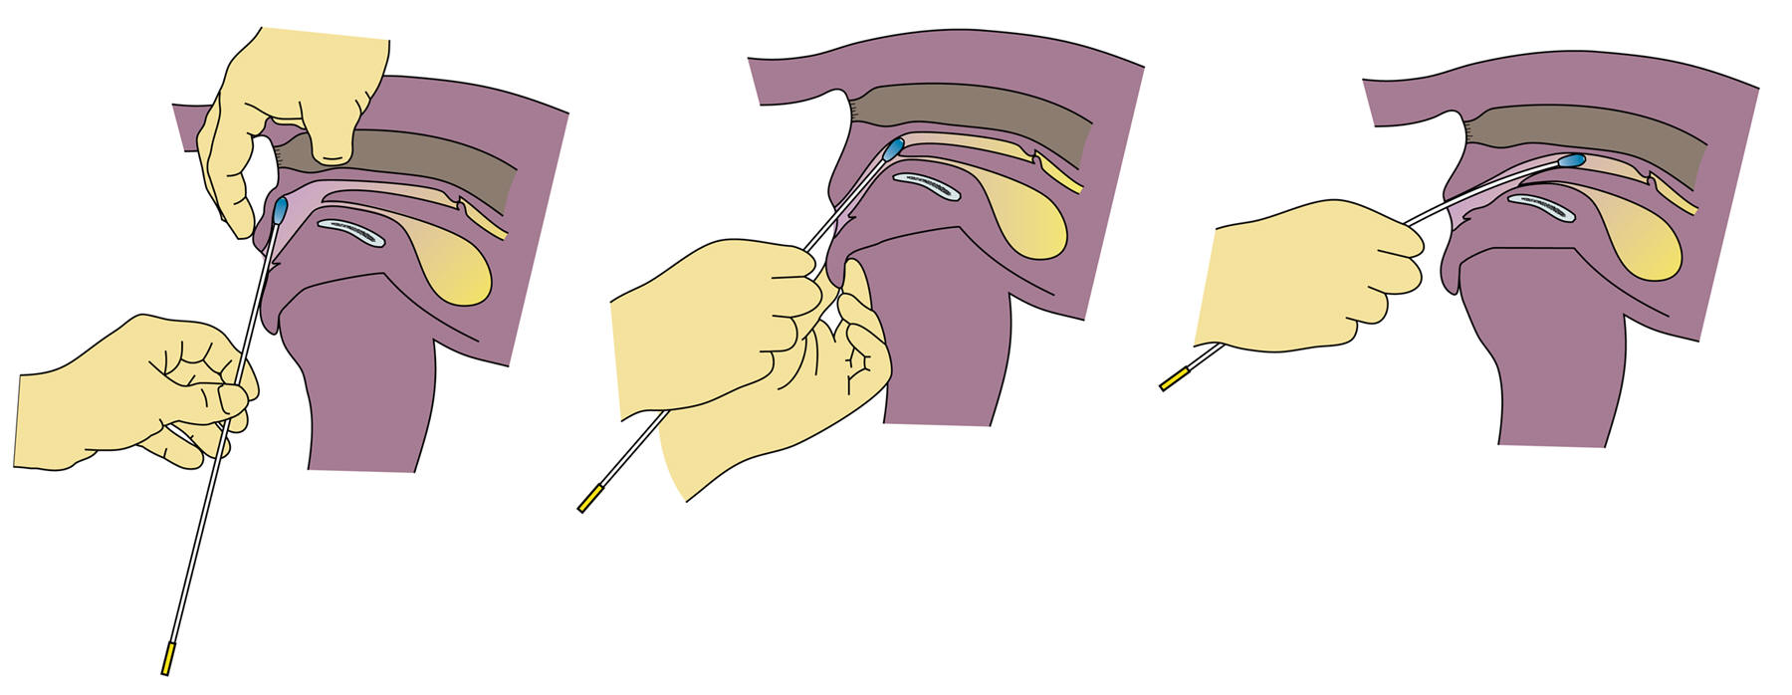
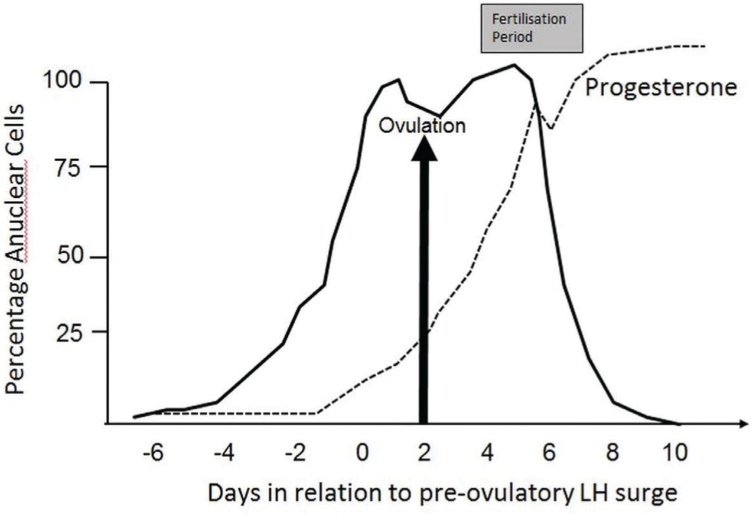
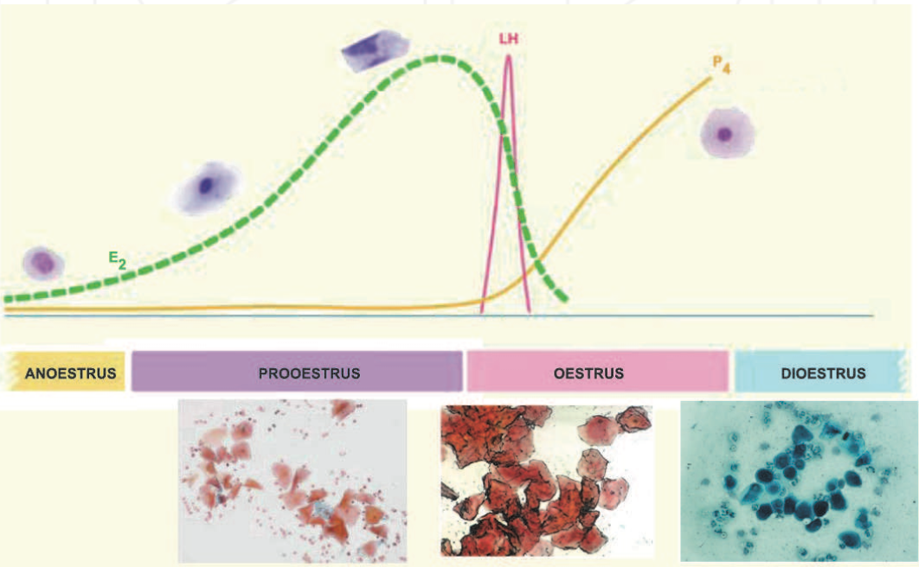
Vaginal cytology
Notes:
Progesterone semi-quantitative immunoenzymatic assays are available for clinical routines, but although rapids, these test lack accuracy. They give progesterone concentration according to a colorimetric scale for values corresponding to basal progesterone levels (0-1 ng/mL), intermediate levels corresponding to the LH surge (around 1-2.5ng/mL) and the ovulation periods (2.5 – 8ng/mL), and high progesterone levels (more than 8 or 10, depending on the kit). A recent study showed that, in dogs, semi-quantitative methods for progesterone determination are less accurate than the quantitative methods, in particular at intermediate plasma progesterone concentrations (Moxon et al., 2010). According to this study, the tested semi-quantitative assay estimated higher progesterone concentration than RIA (radioimmunoassay), which could suggest that the fertilization period had commenced earlier than it was actually the case. In addition to those assays, quantitative radio or chemiluminescent assays can also be used, even if not always available in the house lab, since cross-reactivity exist t

Slide 21
P₄ & USG
ovarian bursa
Notes:
Although ovarian ultrasound examination is a reliable and accurate method to determine ovulation in most domestic females, in the bitch fat accumulation in ovarian bursa that encloses the ovaries may difficult the value of the technique. In addition, several studies demonstrated that ultrasound images of the ovaries around ovulation are more difficult to analyze, due to the fact that ovarian follicles do not differ much in the immediate pre- and post-ovulatory period (England & Concannon, 2002), as not all dog follicles collapse at ovulation (Yeager & Concannon, 1996) and also because non-ovulated follicles frequently remain in the ovary (Wallace et al. 1992).
Consequently, follicular dynamics evaluation through ultrasonography (US) in dogs is still experimental and must follow a very precise protocol, which accuracy increase with the use of frequent examinations. In a recent study, Fontbonne (2008) reported that US was accurate enough to detect the occurrence of ovulation and obtain comparable numbers of ovarian structures between US examinations and macroscopic visual count on the surface of the ovaries after surgical removal, even if only one daily examination was performed. However, that author accepts that features of ovulation may be difficult to visualize in large breeds and in overweight animals. Pre-ovulatory follicles may present different aspects at US. Usually they appear as round to slightly triangular anechoic structures, sometimes slightly flattened, giving a honeycomb aspect to the ovary (Figure 2). At ovulation, different degrees of follicular collapse can be found in the US images, and usually a clear change of the ovarian echogenicity has been detected in a large number of bitches, giving the ovary a more homogeneous aspect (Fontbonne, 2008; Fontbonne & Malandain, 2006). Persistence of non-ovulatory follicular structures was perceived in US images after ovulation. Also, in the immediate post-ovulation period, until 24 hours after US changes of the ovaries at ovulation, hypoechoic structures were observed in most cases (Figure 2). These structures were very similar to the pre-ovulatory follicles, although slightly smaller, and tending to increase in echogenicity (from the border to the interior of the structure) with time (Fontbonne, 2008; Fontbonne & Malandain, 2006).

Slide 22
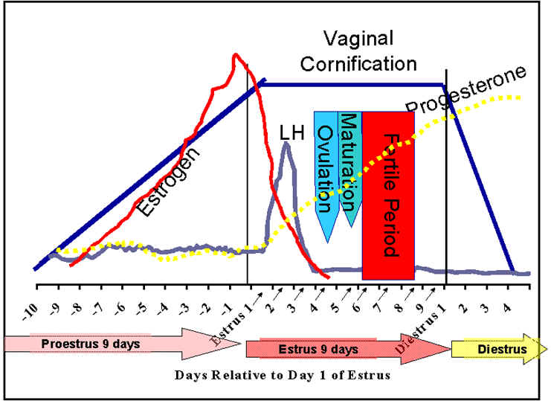
Relative progesterone concentrations during the proestrual/estrual period. P4 (ng/ml) Relative time points 1.1-1.9 Before LH surge 2.1-2.9 Day of LH surge 3.1-3.9 Days 1-2 after the LH surge 4.0-8.0 Day of ovulation 10-80 2-3 weeks post-ovulation

Slide 23
Vaginal endoscopy
Erken Pro-östrus
Pro-östrus
Östrus
Di-östrus
Notes:
It is possible to use vaginal endoscopy to determine the fertile period although it does not allow accurate timing of ovulation. However, this method requires expensive equipment. Nevertheless, it may give a huge contribution to the vaginal evaluation and detection of anatomical abnormalities that may impair proper reproductive performance.
The fluctuation of estrogen and progesterone concentrations in the blood at consecutive stages of estrous cycle in the bitch results in specific morphologic changes of the vaginal mucosa. Analysis of these changes allows for exact assessment of the stage of the estrous cycle and for determination of the optimal insemination time (Goodman, 2001; Jeffcoate & Lindsay, 1989; Lindsay 1983). The observation of the cranial part of the vagina is performed for this purpose. The deep introduction of the tip of endoscope into the narrow part of the vagina close to the cervix (dorsal median postcervical fold) or paracervix, is of less diagnostic value (Pineda et al., 1973).
Vaginoscopic examination is performed using a rigid endoscope 3-4 mm in diameter, with diagnostic sheath and a length of 30-33 cm or longer. The examination should be done on the standing animal. Usually there is no need of administration of sedatives. The tip of the endosope is introduced at the beginning at angle of 45-60o cranially and dorsally. When the tip of the optics reaches the vagina it should be repositioned at horizontal axis. During proestrus the increase of the estrogen concentration results in the oedema of the vaginal mucosa. Vaginoscopy reveals rounded folds in the vagina. The mucosa of the folds is turgid, pink in colour and with a smooth surface. Normally the bloody discharge is also visible in the vagina. Sometimes, periodic blood outflow from the cervix, through the paracervix may be observed. The lumen of the vagina is narrow, which can be appreciated when the endoscope is advanced cranially. At the last days of proestrus and at beginning of estrus, the decrease of estrogen concentration and increase of progesterone (P4) level is noted. It results in the collapse of vaginal folds. Formerly turgid and smooth, the mucosa, becomes wrinkled and shrunked. Vaginal folds become smaller. Maximal intensity of shrinkage of vaginal mucosa is observed between 3 and 7-8 days of estrous cycle. This time the loss of fluid from the tissue of vaginal mucosa and submucosa is great and the shape of vaginal folds become angulated with sharp angles at the top of folds. As the result, the lumen of the vagina is wider in comparison to proestrus. During diestrus vaginal folds become flat and round. The mucosa is red and small petechia may be visible at places touched by the tip of the endoscope. This is due to the fact that epithelium of the vagina is thin and consists of only 2-3 cell layers in diestrus and anestrus. An opaque, thick mucus is sometimes visible on the surface of epithelium (Figure 3).
Other methods has been proposed to monitor the bitch oestrous cycle, such as serial reading of the electrical resistance of the vaginal mucus around the time of ovulation, using probes inserted into the vagina during the heat period (Fontbonne, 2008), or the crystallization patterns in anterior vaginal fluids (England & Allen, 1989) or in saliva (Pardo-Carmona et al., 2010), which have been found up not to present an acceptable reliabily in the identification of the canine ovulation.

Slide 24
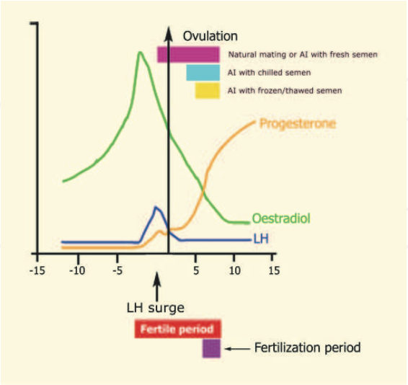
Timing of Insemination
Fresh, chilled or frozen semen ?
0 + 2 + 2,
+2 +2,
+2

Slide 25
Sperm type and Life span
Sperm | Dose | Expected life span | Schedule | % Fertility
Fresh | 150-200 x 10⁶ | 4-6 d | 4-18 ng/ml pg x 3 | Vaginal/80-90
Chilled | 150-200 x 10⁶ | 24-72 h | 8-18 ng/ml pg x 4 | Transcervikal/vaginal %70
Frozen | 50-300 x 10⁶ | 12-24 h | 10-18 ng/ml x 2 | %45 Transservikal/intrauterin

Slide 26
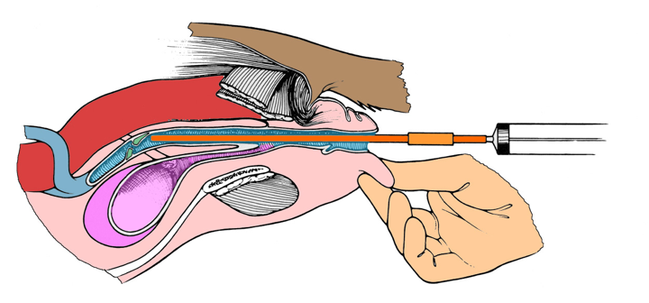
Insemination Techniques
Vaginal

Slide 27
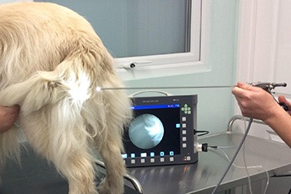
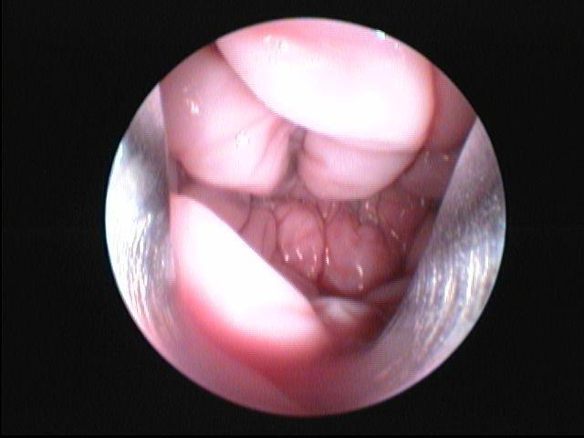
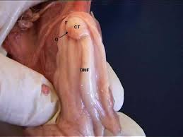
Insemination Techniques
Trans-Cervical

Slide 28
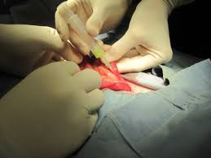
Insemination Techniques
Laparatomic

Slide 29
Goals to achieve
Indications
Challanges
Reproductive Physiology
Fertile Period
Deetermining the optimal time for AI
Semen Collection
AI Technique
Vaginal
Uterine
Surgical
Succes Rate with AI
?. Rules and Regulations for Semen exporting

Slide 30
Indications
Limited !!
Behavioral
Physical
Anatomical
Cryopreserved semen
when these do not relate to an inherited disease

Slide 31
Challenges
İnduced ovulator !!
Identification of the optimal time of mating
Long interoestrous interval
Reproductive anatomy
Semen collection and volume
the vestibule is narrow
vagina narrower, cervix sits at an angle protruding through the dorsal vaginal wall, making catheterisation very difficult

Slide 32
Reproductive Physiology
Long Day breeder!!
Domestication?
Female-Queen
Male - Tom
Puberty
6 - 9 months
Estrous Cycle
Seasonal
January to September
House cats may cycle year round
14 h light

Slide 33
Reproductive Physiology
Pro-estrus
1 - 2 days
Attracted to males
Rubs head and neck on objects
Vocalization, posturing and rolling
Estrus
Accepts male
4 - 6 days if male present, 10 days if no male
Ovulation 27 hours after mating (induced)
Affectionate to aggressive towards owners

Slide 34
Reproductive Physiology
Proestrus if queen did not ovulate
8 - 10 days
Diestrus after ovulation
psuedopregnancy - 40 days
pregnancy - 60 days
Anestrus 3 - 4 months

Slide 35
Reproductive Physiology
Long Day breeder!!
Proestrus, 0 - 2 d
+
Estrus, 2-19 d
Diestrus,
Pregnant
~60 d
Proestrus,
8-10 d
Diestrus
Pseudopregnant, ~40 d
Anestrus,
~30-90 d

Slide 36
Hormonal Changes in the Queen
Queen in Estrus (no mating)
Mating
Estrus
(9 days)
Parturition
E₂
E₂
Pregnancy
Lactation
P₄
Proestrus
P₄
4
8
12
16
4
8
12
16
20
Weeks

Slide 37
Hormonal Changes in the Queen
Proestrus
Estrogen increases due to follicular development
Estrus
Estrogen high until ovulation
Ovulation 27 hr after mating (vaginal stimulation)
Diestrus
No Cl if mating does not occur, so no diestrus
Cl produces progesterone (63 days, peak day 20)
If pregnancy does not occur or fails, CL life only 1/2 that seen in pregnancy.

Slide 38
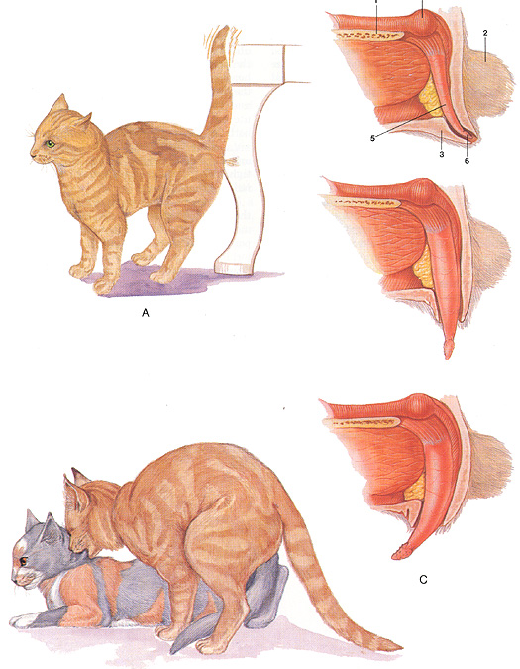
Erection and Mating

Slide 39
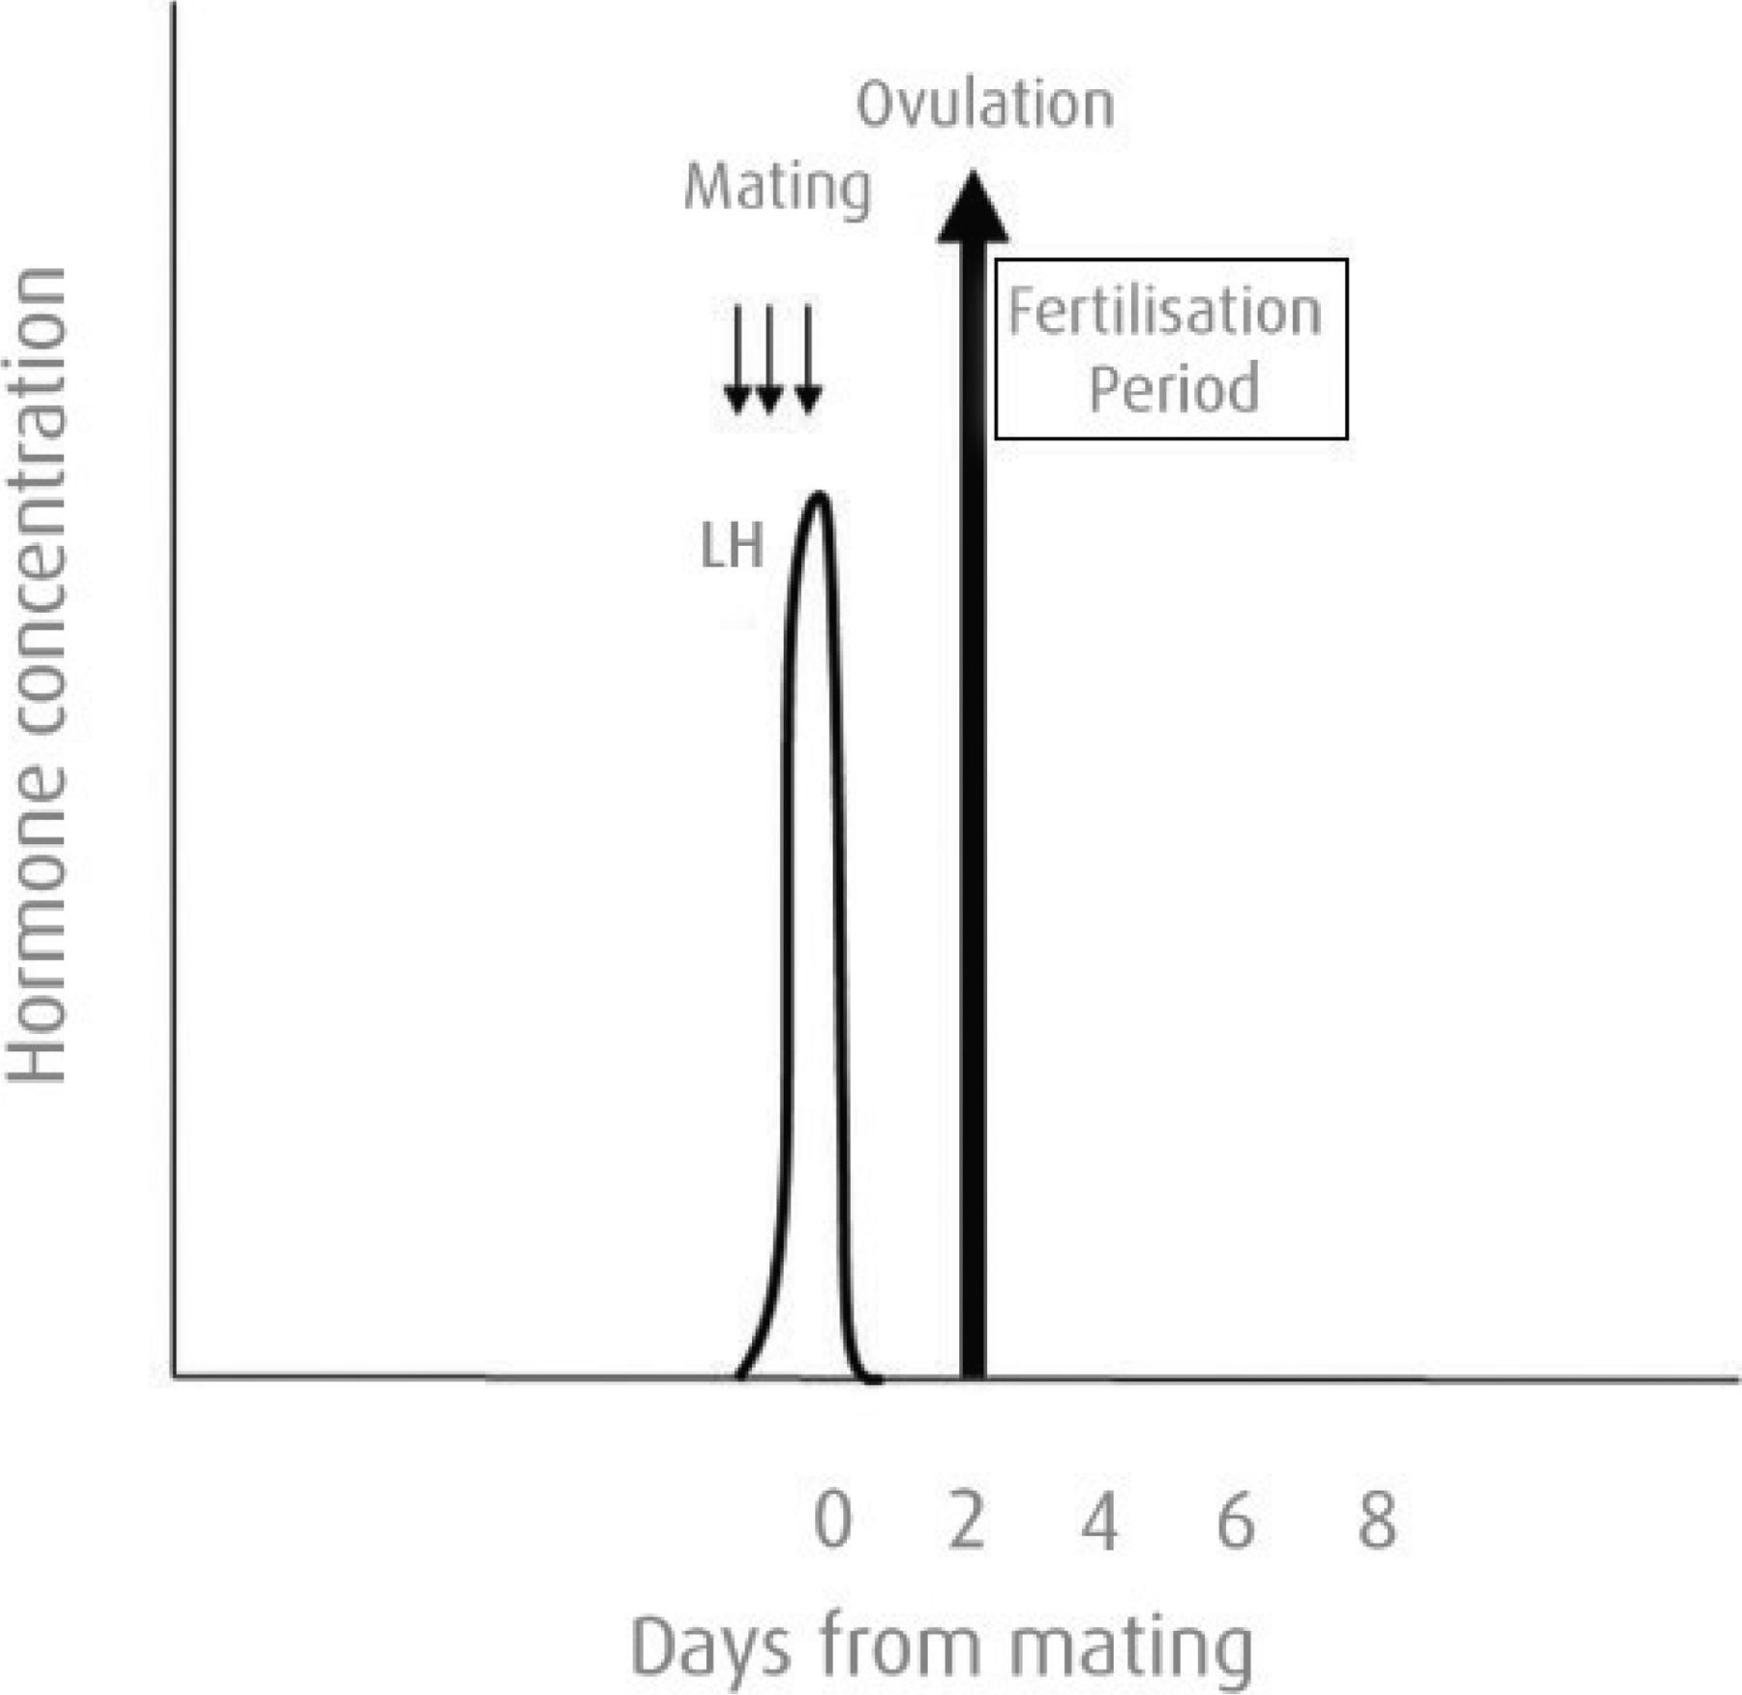

Slide 40
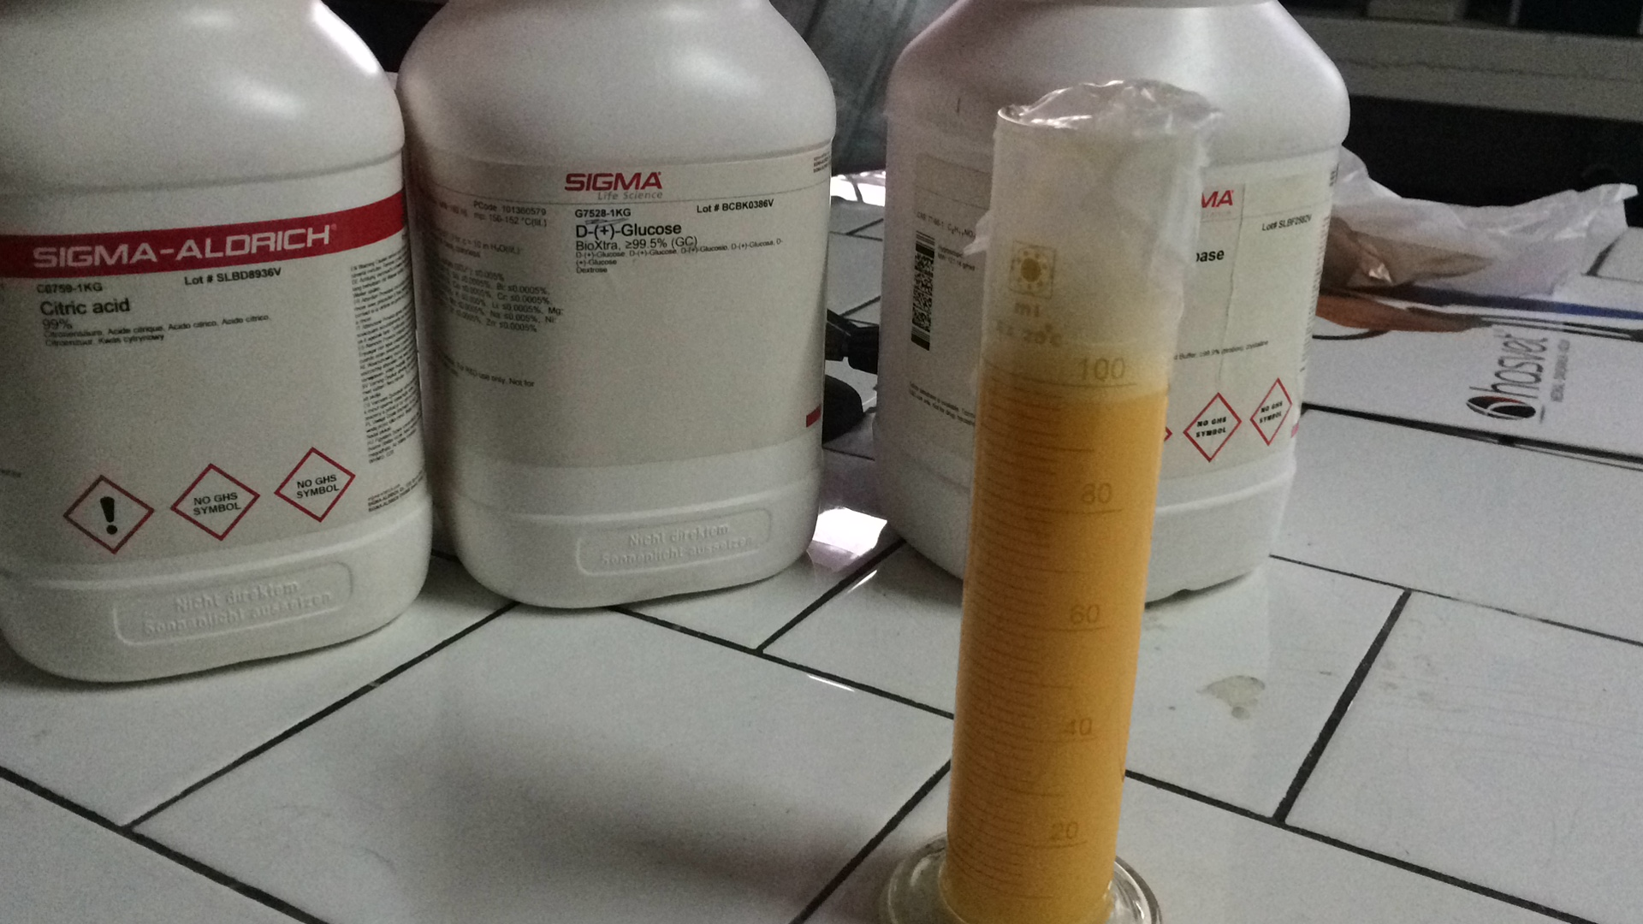
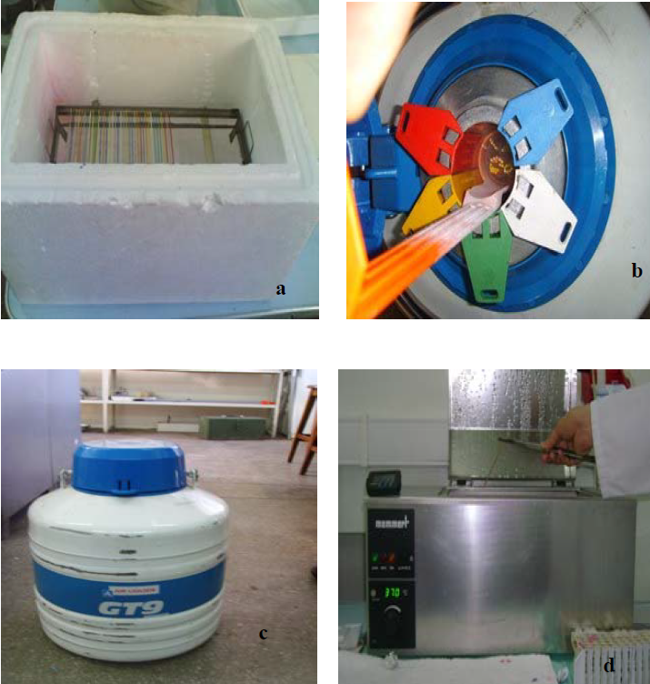
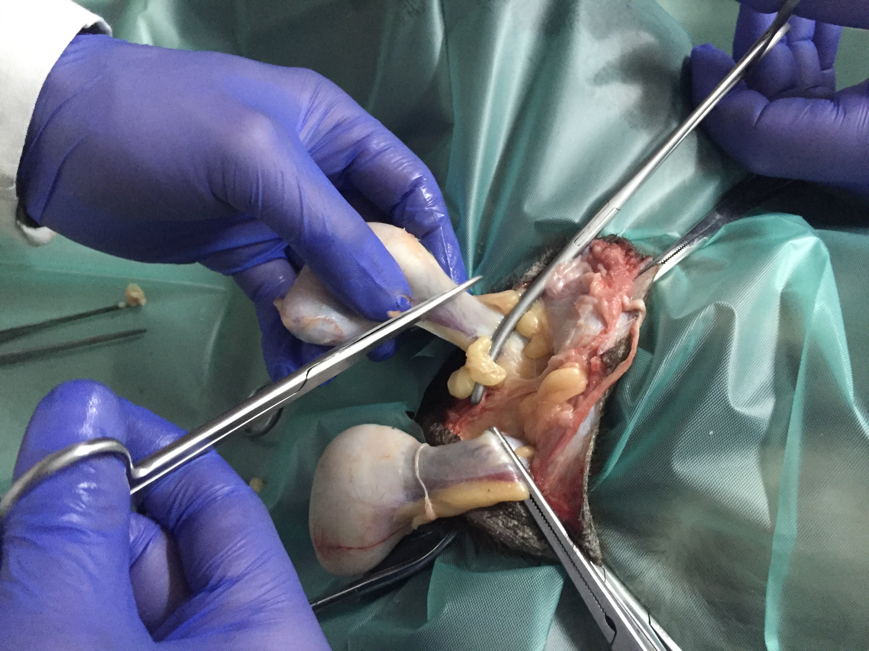
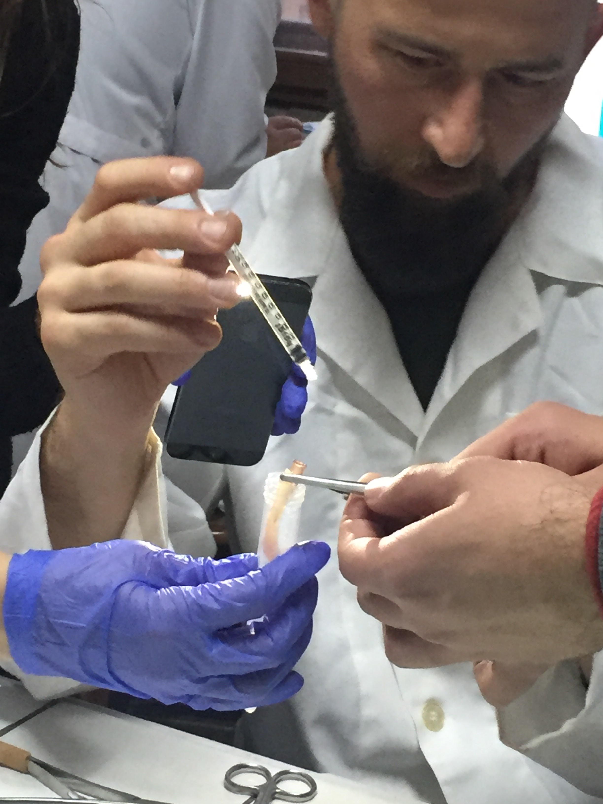
Spermanın Prezervasyonu
Kısa Süreli Saklama (Soğutma)
Uzun Süreli Saklama (Dondurma)
Post Mortem Sperm Dondurma

Slide 41
Sonuç ?
Damızlık Köpek kimdir?
Damızlık yetiştirici sertifika programı,
Üreme standartlarının belirlenmesi,
Yardımcı üreme teknikleri entegrasyonu,
İş birliği.
Notes:
Damızlık köpekler ırk standartları ve yardım üreme teknikleri ile belirlenmelidir,
Bu hayvan sahiplerine damızlık yetiştirici sertifikası verilmelidir,
Rott-weiler ırkına ait üreme standartların belirlenmesi gerekir,
Yetiştirme programlarında YÜT (USG, TG, Hormon analizi, spermanın dondurulması, ) kullanımı artırılmalıdır,

Slide 44
Strateji?
Çiftleşme davranışları
Süperİyor genetik
Kızgınlık siklusu ?
Spermanın Dondurulması
Nasıl tespit edilir?
Post-Mortem Sperm
Suni Tohumlama?
Sperm transportu
Yüzleşme

Slide 45
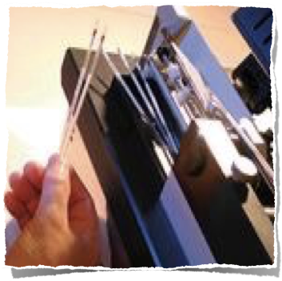
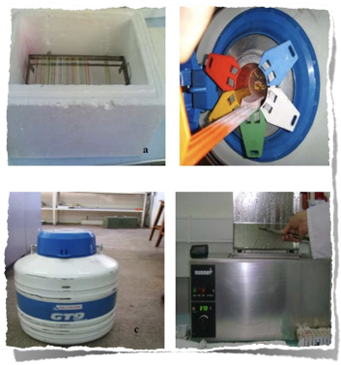
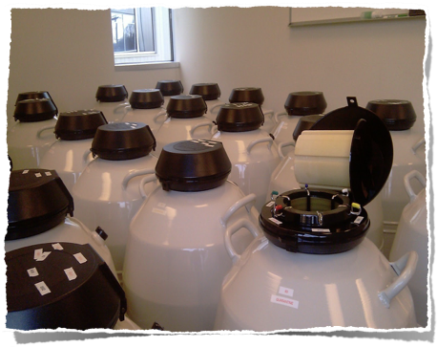
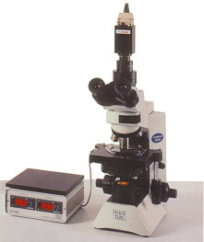
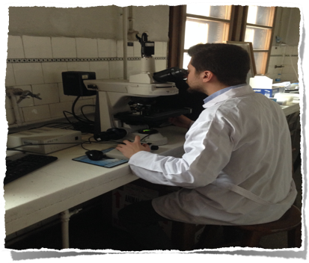
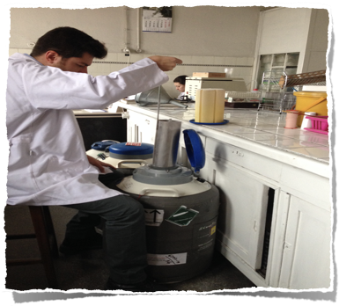
Spermanın Dondurulması ve Saklanması
Motilite
Yoğunluk
Canlılık
abnormalite
Renk
Koku
vizkozite
Hacim
Temel aşamada
7
Spermanın alınması
Ön değerlendirme
Sulandırma
paketleme
Soğutma ve Dondurma
Çözüm sonu değerlendirme
Depolama

