Slide 1
POLONYA SANATINDA USTALAR

Slide 2
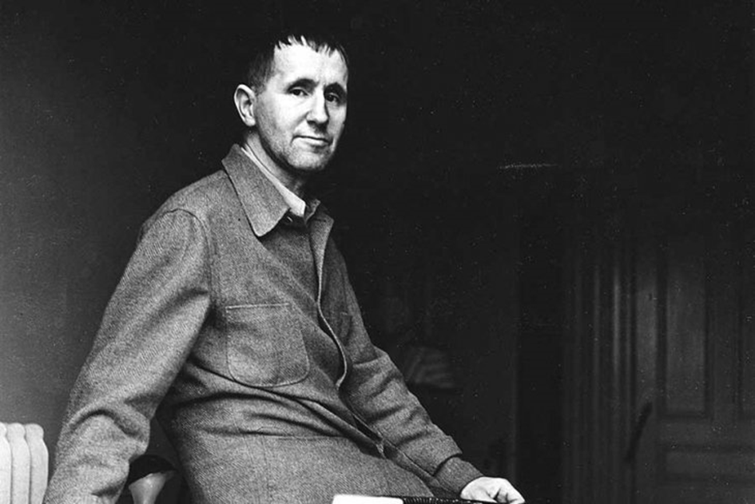
Bertold Brecht
brehtyan yöntem:
https://www.youtube.com/watch?v=JQpi7mw0pMs

Slide 3
Epik tiyatro ve Brecht
https://www.youtube.com/watch?v=SRW1OqOdruM
https://www.youtube.com/watch?v=XyvXIyLbV6w

Slide 4
Cesaret Ana oyunu izlenecek.
https://www.youtube.com/watch?v=8wosbrb5aHc

Slide 5
Kaynaklar
https://www.youtube.com/watch?v=8wosbrb5aHc
https://www.youtube.com/watch?v=SRW1OqOdruM
https://www.youtube.com/watch?v=XyvXIyLbV6w
https://www.youtube.com/watch?v=JQpi7mw0pMs

