Slide 1
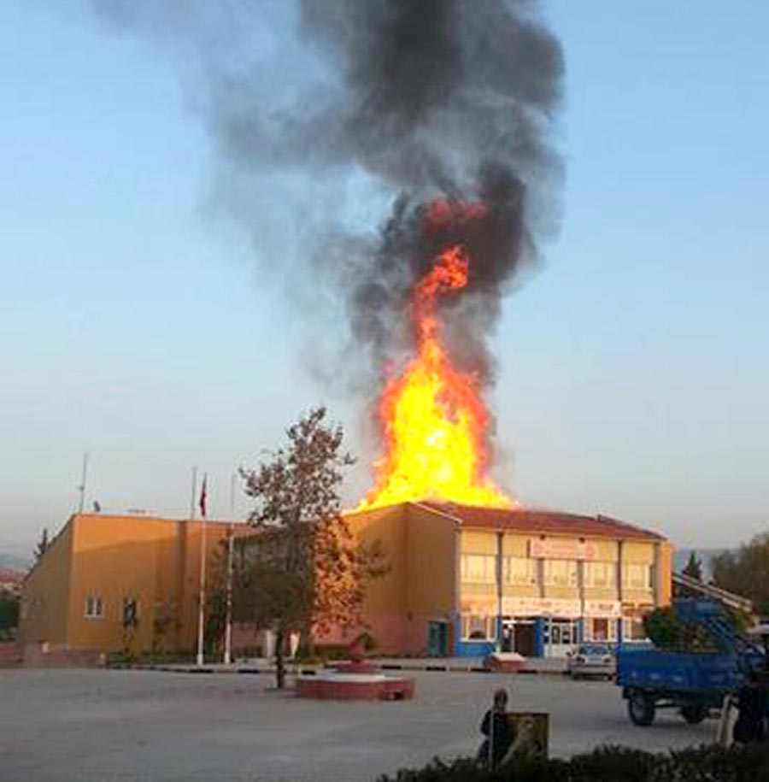
FIRE and FIRE HAZARDS

Slide 2
Character of fire
Reaction of a substance with oxygen is called "burning or fire" in the event that it is ignited and bringing it to an endothermic state. Three factors are needed to start the combustion process. 1-Flammable material (fuel) 2-Oxidising agent 3-Sources of ignition. If any one of these three factors is missing, it will not come to you.

Slide 3
Fire classes
Class A: fires originating from wood, fabric, etc. Temperature may be lowered with water below the fire point.
Class B: Fires of flammable liquids and liquefiable solids (solvents, oils, greases etc.) and which the temperature can not drop below the extinguishing point. In this case the oxygen should be depleted or reduced in concentration. The fire is covered with CO2, dry chemicals, foam or other liquid that can evaporate

Slide 4
Class C: Fires in electrical appliances. Materials such as flammable insulating materials or transformer oils cause this kind of fire. Extinguishing is carried out with CO2, dry chemical substances and some liquids that can evaporate. If electrical current can be switched off during the fire, measures for Class A or Class B are taken for the ongoing fire. Class D: Reactive metal fires such as Mg, K, Na and powdered Al, Zn and Ti. In order to extinguish,burning object covered with special dry chemical powders to avoid air contact.
Class K: Kitchen fires

Slide 6
Some general information about fire
In the first 5 minutes, the temperature rises above 500 oC in the fires. Approximately 900 oC is reached within 1 hour.
- At high temperature proteins start decomposing, blood pressure may increase and internal bleeding may occur, heart rythm breaks down, excessive water loss, breathing difficulty occurs.
-Human body and respiratory systems can withstand limited time at temperature of 65 oC 15 minutes at 120 oC temperature 5 minutes at 143 oC temperature only 1 minute at 177 oC temperature

Slide 7
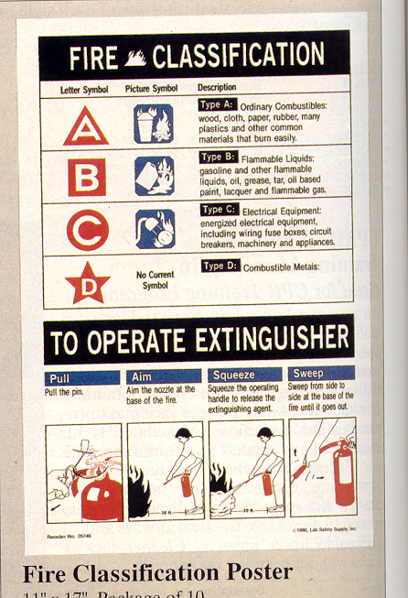

Slide 8
