Slide 1
Source
This Photo by Unknown Author is licensed under CC BY

Slide 2
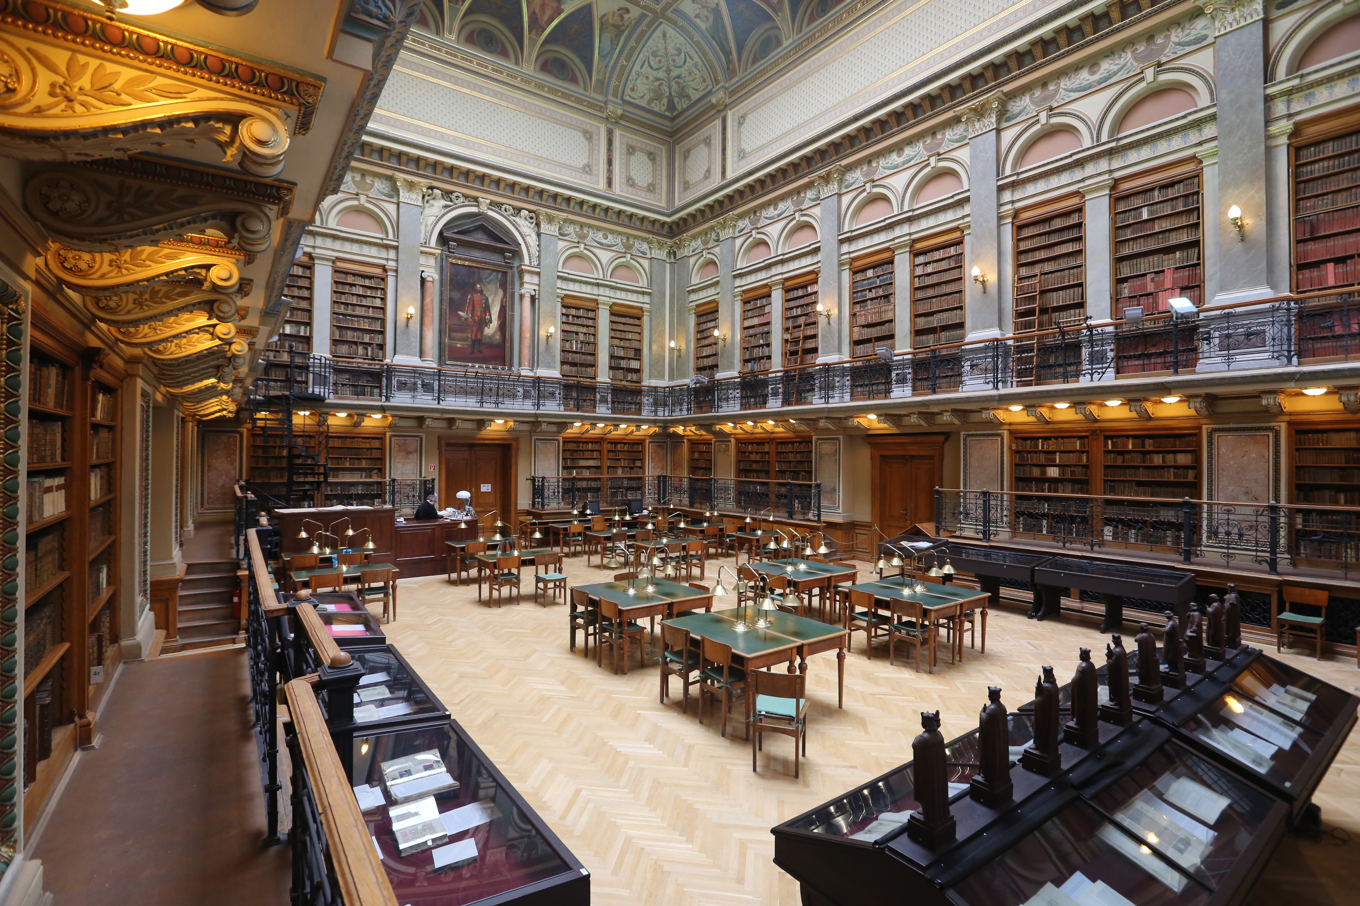
Resource
This Photo by Unknown Author is licensed under CC BY

Slide 3
Resources
Libraries
Databases (Jstor, Ebscohost, Ebrary, Proquest)
The Internet (Google Scholar)
Bibliographies

Slide 4
Sources
Journals
Academic articles
Academic books
Theses
Dictionaries
Encyclopedias

Slide 5
Evaluating your sources
Who wrote the text? Do you know anything about him/her?
Where was it published?
When was it written?
What is the overall tone of the writing?

Slide 6
Beware of
Student essays
Unreliable websites such as Wikipedia or free essay websites
Popular journals
Magazines

Slide 7
Plagiarism
The use of somebody else’s ideas, viewpoints, findings or works in a paper, project, report, or any similar document without proper acknowledgement of the source.
To avoid plagiarism, when you make use of a source you should acknowledge that source in your paper and list it in your bibliography using MLA style citation format.

Slide 8
Bibliography and Index
Learn how to make more effective use of the bibliography and index pages of your sources.

