Slide 1
Evrim, Kurumlar ve İktisat Kuramı So What?
Altug Yalcintas
Ankara University
altug.yalcintas@politics.ankara.edu.tr

Slide 2
So what – Ee N’olmuş?
Since we started:
We have made progress.
We have learned about different definitions of evolution.
We have moved toward upper levels of understanding.
And now:
We are at a further stage.
We are advanced economics students.

Slide 3
So what – Ee N’olmuş?
Since we started:
We have made progress.
We have learned about different definitions of evolution.
We have moved toward upper levels of understanding.
And now:
We are at a further stage.
We are advanced economics students.
What do we know about the underlined words (concepts) beyond commonsense?

Slide 4
So what – Ee N’olmuş?
Let’s try to think like an economist:
Properties of a graph like this:
Continuous
Progression, advancement, growth etc.
A single pathway
∑ K
Accumulation of knowledge
Direction of the process of knowledge production
Time

Slide 5
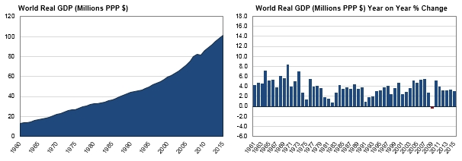
So What – Ee N’olmuş?
http://http://www.worldeconomics.com/papers/Global%20Growth%20Monitor_7c66ffca-ff86-4e4c-979d-7c5d7a22ef21.paper

Slide 6
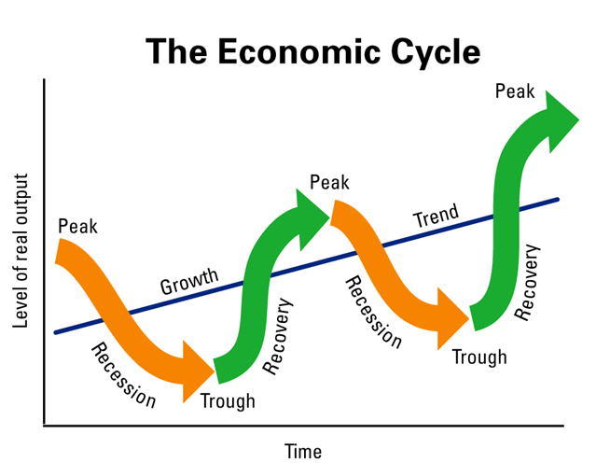
So What – Ee N’olmuş?
http://www.marketoracle.co.uk/images/2012/Aug/malaysia-income-inequality-5.gif

Slide 7
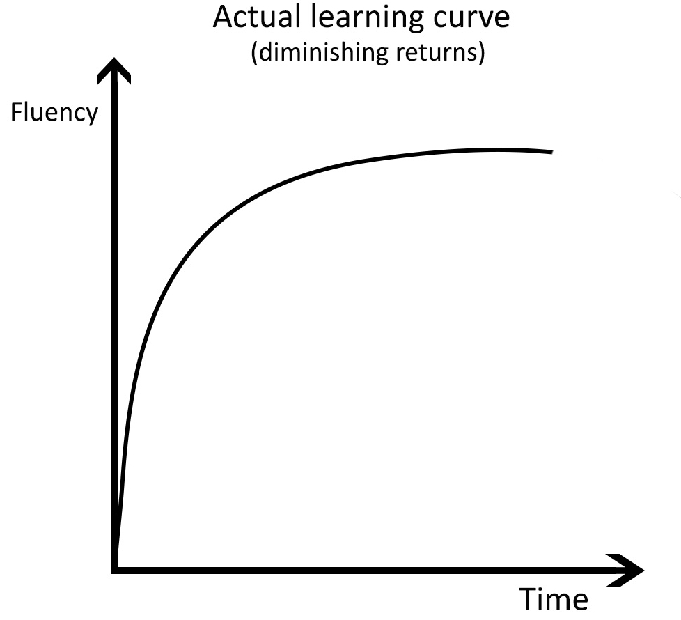
So What – Ee N’olmuş?
http://www.lingholic.com/wp-content/uploads/2013/05/actual-learning-curve1.jpg

Slide 8
So what – Ee N’olmuş?
Dialectics (Friedrich Hegel): Negation of ideas
Rational Choice Theory: Utility maximization
Critical Rationalism (Karl Popper): Trial and error

Slide 9
So what – Ee N’olmuş?
Now, let’s question the common sense of an economist!
Properties of a graph like this:
Progress, advancement, growth
BUT
Discontinous
Multiple pathways
Σ
i
i
B
i
ii
C
A
ii
i
ii
D
i
ii
E
ii
Time

Slide 10
So what – Ee N’olmuş?
Now, let’s question the common sense of an economist!
This graph may represent:
Social revolutions
15,000-10,000 BC The Neolithic Revolution
1789 The French Revolution
1917 The Russian Revolution
1923 The Turkish Revolution
1970s The Digital Revolution
Σ
i
i
B
i
ii
C
A
ii
i
ii
D
i
ii
E
ii
Time

Slide 11
Thomas Kuhn (1922-1996)
Philosopher of science
Best known for his work The Structure of Scientific Revolutions (1962)
In Turkish: Bilimsel Devrimlerin Yapısı (1982)
Paradigm

Slide 12
So what – Ee N’olmuş?
Now, let’s question the common sense of an economist!
This graph may represent:
Paradigm shifts
Coined by Thomas Kuhn
Newtonian Paradigm in Physics
Neoclassical Paradigm in Economics
Σ
i
i
B
i
ii
C
A
ii
i
ii
D
i
ii
E
ii
Time

Slide 13
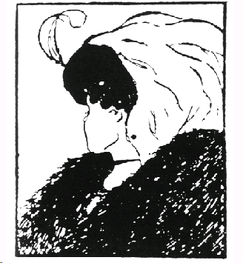
So what – Ee N’olmuş?
Now, let’s question the common sense of an economist!
This graph may represent:
Gestalt shifts
Σ
i
i
B
i
ii
C
A
ii
i
ii
D
i
ii
E
ii
Time

Slide 14
What if

Slide 15
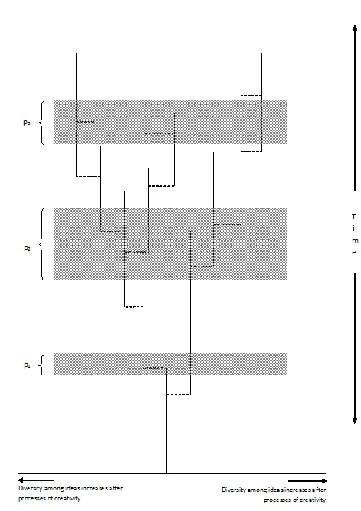
So what – Ee N’olmuş?
How about this?
Progress, advancement, growth → DIVERSITY
Discontinous or discreet
Multiple pathways

Slide 16
So what – Ee N’olmuş?
How about this?
Darwin’s «tree of life»
We forget things
We refuse to remember
Somethings do not change
People are stubborn, stupid, and lazy
People have habits
People behave instinctively
The Theory of Path Dependence

Slide 17
So what – Ee N’olmuş?
This graph may represent:
The history of economic thought
Emergence of nations
Evolution of any social institution:
Technologies
Universities
Habits
Customs
Languages
Religions

Slide 18
So what – Ee N’olmuş?
This graph can explain:
Why there are more than one specie
Why there are more than one theory
Why there are more than one language
Why there are more than one religion
In short:
Multitude and diversity in the society and economy!

Slide 19
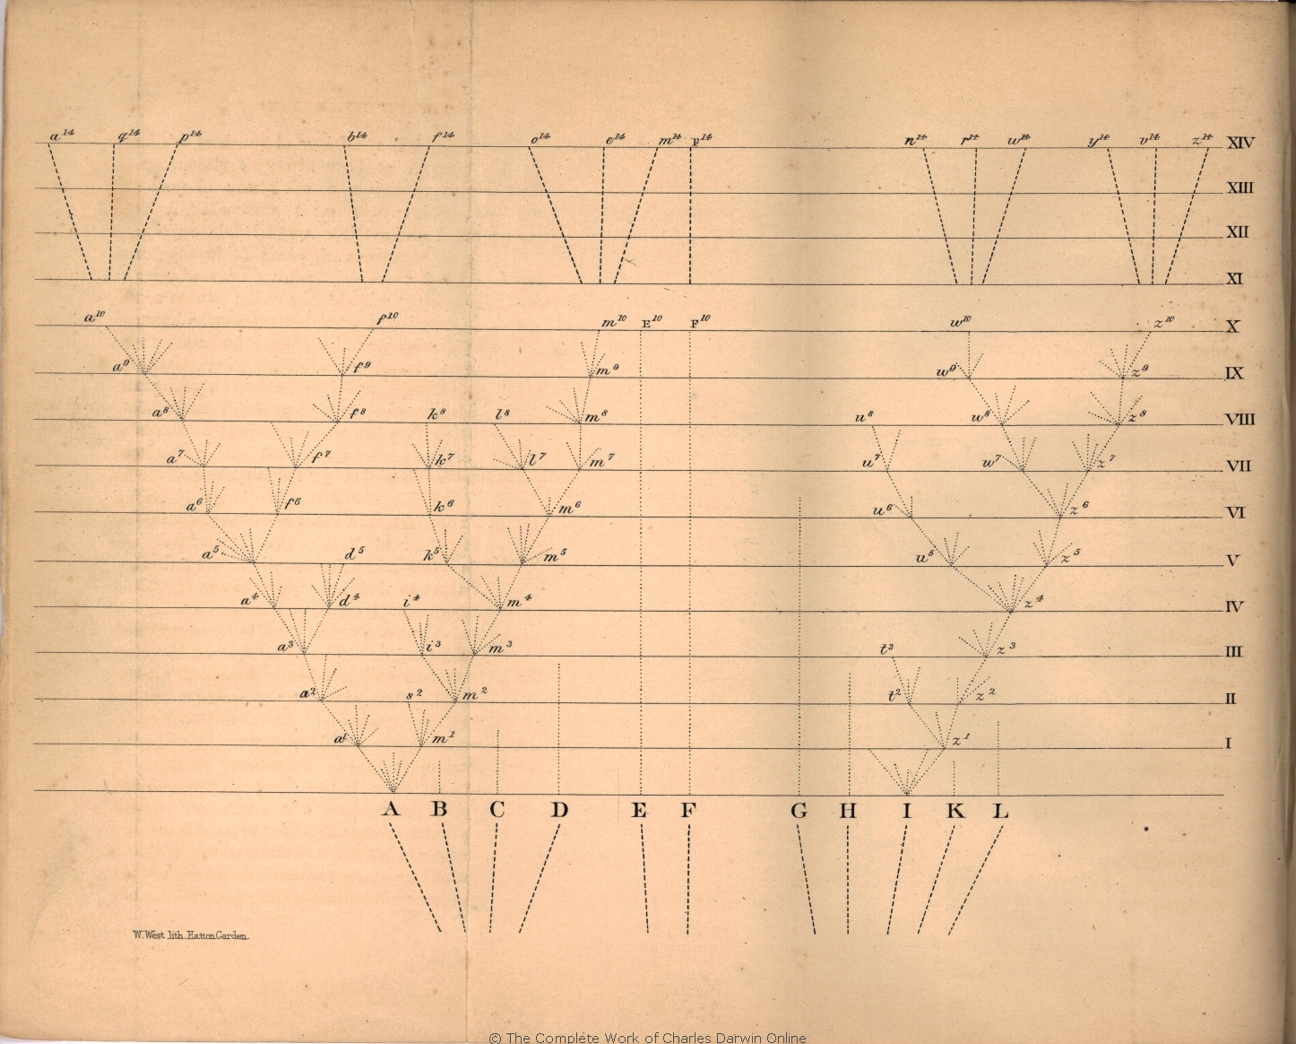
What is evolution?
Source: Charles Darwin. 1859 [2006] On the Origin of Species. In E. O. Wilson. From So Simple a Beginning. W. W. Norton: 525

Slide 20
So what – Ee N’olmuş?
What does evolution mean from an economist’s point of view?

Slide 21
So what – Ee N’olmuş?
What does evolution mean from a social scientist’s point of view?
Evolution is a process in which several mechanisms are simultaneously at play, causing institutions, instincts, and habits to change or resist to change.

