Slide 1
Third Definition
Popular culture is mass culture.
a commercial culture
mass-produced for mass consumption
its audience is a mass of non-discriminating consumers
formulaic and manipulative
public fantasy, a collective dreamworld, escapism

Slide 2
Fourth Definition
Culture that originates from ‘the people’.
an ‘authentic’ culture of ‘the people’.
folk culture: a culture of the people for the people
Who are ‘the people’?

Slide 3
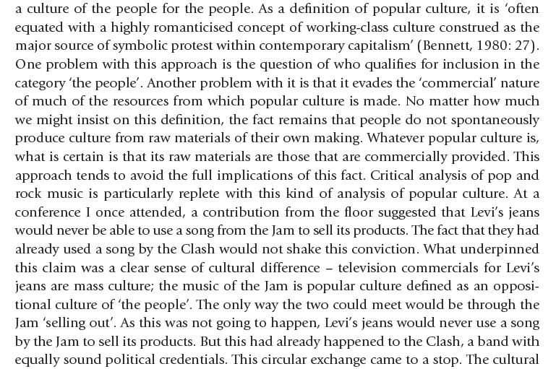
Notes:
Punk: mid-70s. anti-establishment. music of resistance, of protest. rebellion. A subculture.

Slide 4
“Toward a Definition of Popular Culture”, Holt N. Parker
Notes:
prole=working class imprimatur=license, accepting that it has good standards

Slide 5
Fifth Definition
A site of struggle between the ‘resistance’ of subordinate groups and the forces of ‘incorporation’ operating in the interests of dominant groups.
ex: using popular genres such as science-fiction for feminist politics
Notes:
feminists thus helped the political issues reach a much wider audience.

Slide 6
Postmodern View
Postmodern culture is a culture that no longer recognizes the distinction between high and popular culture.
Thus the distinction between ‘authentic’ and ‘commercial’ culture is blurred.

Slide 8
“Toward a Definition of Popular Culture”, Holt N. Parker

Slide 9
Examples of Popular Culture
pop music
comics
soap operas
TV programmes
films
clothes
computer games

