Slide 1
Ecology and Environmental Biology
Dr. Nüket BİLGEN

Slide 2
The Aquatic Environment
Environment? → first week’ class,
Everything that surrounds and influences an organism. Oceans, poddle, forest…
Environmental factors? →first week’ class,
Biotics and abiotics
Water…
What is WATER to us?

Slide 3
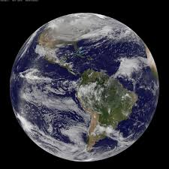
The Aquatic Environment
Water is the essential substance of life,
Dominant component of all living organisms
Dominant environment on earth

Slide 4
Major feature influencing the adaptations of organisms that inhibit aquatic environment is salinity.

Slide 5
The Aquatic Environment
Aquatic systems are those in which the primary medium inhabited by organisms is water.
2 groups:
Freshwater; limnology
Marine; oceanography

Slide 6
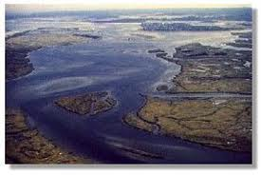
Some systems are transitional between the 2 types
Estuaries, salt marshes, saline lakes

Slide 7
Distribution
Majority of the Earth’s water is found in oceans
71% of worlds surface is covered with water
The hydrological cycle drives the movement of water throughout the Earth

Slide 8
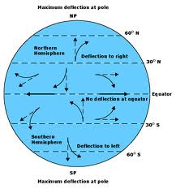
Oceans
Largest component is the water column itself or pelagic zone
Surface currents are generated by wind friction
Coriolis force causes the surface layer to move at 45º to wind direction

Slide 9
Deep currents are not effected by surface currents
Downwelling occurs because surface waters are cooled at high latitudes, increasing their density and sink
Upwelling occurs in areas where surface water circulation patterns diverge, leaving a gap, which is filled from beneath

Slide 10
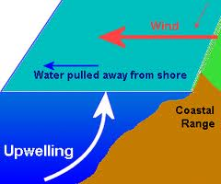
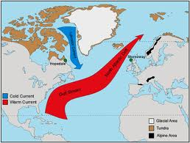

Slide 11
Benthic zone is the ocean bed
Divided into structures:
coastal zone where sea meets land
Continental shelf is part of the continental plate
Ocean ridges occupy 33% of sea floor; site of new seafloor
Deep sea floor covered in pelagic sediment

Slide 12
Inland waters
Glacial ice at high altitudes
Groundwater under most of the Earth’s surface
Rivers, lakes, and wetlands have a high turnover of water

Slide 13
Rivers are drainage channels for the excess of precipitation and the main conduit for the return of water from land to sea
Lakes require a basin within which to form
Wetlands occur where inputs of water exceed evaporation but outflow is impeded by flat topography

Slide 14
Chemistry of water
Dissolved substances determine the quality of water
Salinity is the total amount of dissolved material in a sample
Conductivity is a measure of the ability of water to conduct electricity

Slide 15
Source of salts for the sea is the weathering or rocks by rainwater
Calcium carbonate is used by many marine animals as a skeletal material

Slide 16
Dissolved gases
Oxygen and carbon dioxide are the most important
Physical mixing is required
Concentration is determined by temperature and pressure

Slide 17
Acidity is the measure of the concentration of hydrogen ions H⁺
Alkalinity is a measure of carbonates and bicarbonates in a solution because these substances act as buffers to the acidic rainwater
Sea water has a pH of 8 because it is well buffered with a high alkalinity

Slide 18
Energy inputs
Primary production is the creation of organix molecules from inorganic molecules
Photosynthesis in plants, algae and cyanobacteria
Light intensity decreases with depth called attenuation

Slide 19
There is a relationship between photosynthesis, respiration, and depth (see figure1.7)
Photic zone is the layer of water from the surface to the compensation point

Slide 20
Chemosynthesis produces organic matter without light by bacteria
most common around deep ocean vents
Detritus is the dominant source of energy for many organisms; it is dead primary producers

Slide 21
POM particulate organic matter
CPOM coarse particulate organic matter; diameter of at least 1mm
FPOM fine particulate organic matter

Slide 22
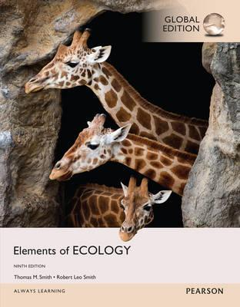
References
1- https://www.youtube.com/watch?v=ZouWWVyz9v8
2- http://www.climatedata.info/forcing/albedo/
3- http://astrocampschool.org/greenhouse-effect/
4- https://sites.google.com/a/gsbi.org/gvc1506/environment/greenhouse-effect
5- https://spaceplace.nasa.gov/seasons/en/
← Source material of this lecture
Further reading
McCarty, J. P., Wolfenbarger, L. L. and Wilson, J. A. 2017. Biological Impacts of Climate Change. eLS. 1–13.

