Slide 1
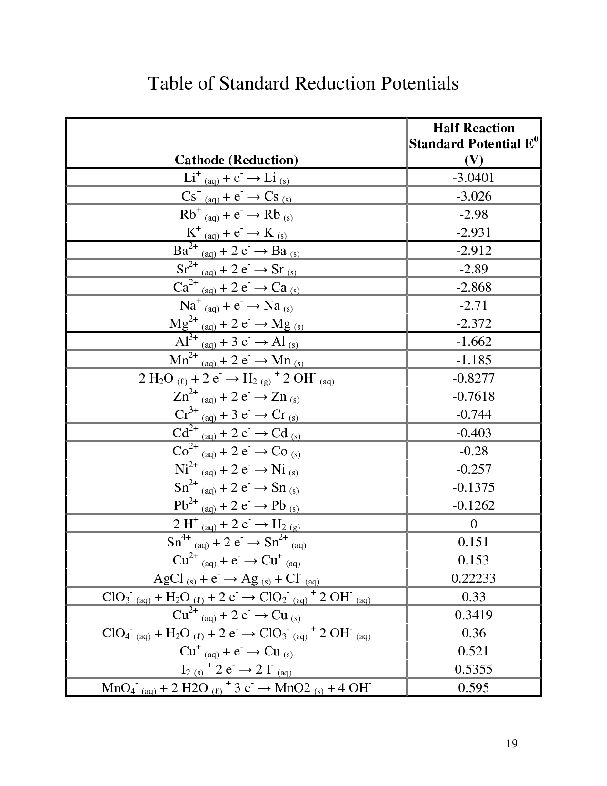

Slide 2
2H⁺ + 2e–  H₂
This reaction is two-way, that is, it can take both an electron and give an electron, which means it can be both reduced and oxidized so that it can reduce and oxidized opposite compound.
Standard states are;
Concentration in solution for a soluble substance 1M or activity is 1 (a = 1),
If gas is present at 0 oC and 1 atmosphere pressure,
The solubility of a slightly soluble solid in solution when it is equal, that is, when it forms a saturated solution,
A pure liquid or solid is standard.

Slide 3
Limits in standard electrode potential
Activity
Influence of other balances: solvolysis, dissociation, association and complex formation.
Signs of half-cell potentials
When connected with a standard hydrogen electrode, the oxidizers, ie the sign of the electron donors are "-", the signatures of the electron fields are "+".
Zn²⁺ + 2 e–  Znº eº = – 0.760 V
Cu²⁺ + 2 e–  Cuº eº = + 0.337 V
If the reaction reverses, the sign of the potential of the electrode is reversed

Slide 4
When the anode and the cathode come to a cell, a whole cell (battery) occurs. The potential of this cell c (or electromotor force
E_{batery or cell} = e_{cathode} – e_{anode}
If the conditions are standard
e_{pil} = eº _{katot} – eº _{anot}
Determination of anode and cathode if conditions are standard
When two semicells are brought side by side, the conditions for which to reduce and which to oxidize can be predicted by looking at the standard electrode potentials of the half cells. If the potential of the standard electrode is more positive, it tends to be reduced to get more electrons and this is cathode. The opposite will oxidized and this is anode.

Slide 5
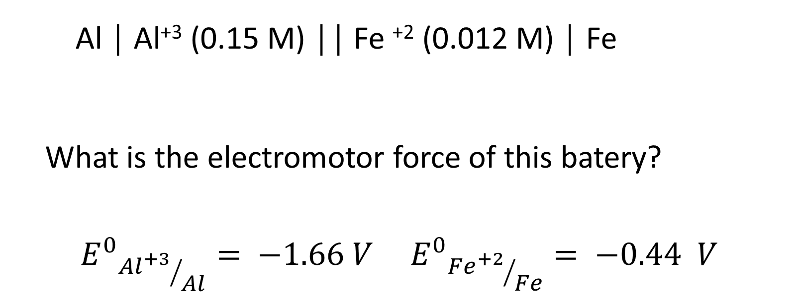
Al │ Al⁺³ (0.15 M) ││ Fe ⁺² (0.012 M) │ Fe
What is the electromotor force of this batery?
$${E^{0}}_{{{Al}^{+3}}/{Al}}= −1.66 V {E^{0}}_{{{Fe}^{+2}}/{Fe}}= −0.44 V$$

Slide 6
The positive electromotor force of a batery is shown that this reaction is occured by itself.
Potential calculations if conditions exceed standards
If there is deviation from the standard, the potencies of half cells and whole cells (pills) are calculated according to the Nernst equation
$$e= e^{o }– \frac{RT }{nF}\ln{K}$$
$$e= e^{o}+ \frac{RT }{nF}\ln{ \frac{1}{K}}$$
$$e= e^{o}+ \frac{0.0591 }{n}\log{ \frac{1}{K}}$$

