Slide 1
FIRST AID FOR MEDICAL CONDITIONS-I
Berna GUVEN, Phd

Slide 2
Medical Conditions
Asthma
Allergy
Angina
Stroke
Seizure
Faint

Slide 3
ASTHMA
Chronical inflammatory disease of the airways.
RECOGNITION
■ Difficulty in breathing, especially breathing out
There may be:
■ Wheezing
■ Difficulty speaking
■ Gray-blue coloring in skin, lips,
earlobes, and nailbeds
In a severe attack:
■ Exhaustion and possible loss
of consciousness
Notes:
People with asthma may be treated, depending on the severity
of their condition, with rescue inhalers or nebulizers on a regular
basis. They can usually deal with their own attacks by using their
inhaler at the first sign of an attack, but may need help and
encouragement.

Slide 4
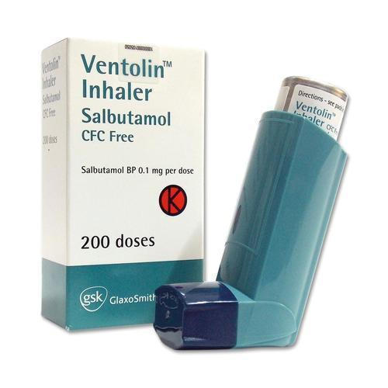
ASTHMA
What to do

Slide 5
ALLERGY
An allergy is an abnormal reaction of the body’s defense system to a normally harmless “trigger” substance (or allergen).
RECOGNITION:
Features of mild allergy vary depending on the trigger and the person. There may be:
■ Red, itchy rash or raised areas of skin (hives)
■ Red, itchy eyes
■ Wheezing and/or difficulty breathing
■ Swelling of hands, feet, and/or face
■ Abdominal pain, vomiting, and diarrhea

Slide 6
ALLERGY
WHAT TO DO
1.Assess the casualty’s signs and symptoms. Ask if she has any known allergy.
2. Remove the trigger if possible, or move the casualty from the trigger.
3. Treat any symptoms. Allow the casualty to take her own medication for a known allergy.
4. If you are at all concerned about the casualty’s condition, seek medical advice.

Slide 7
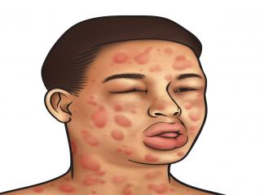
ANAPHYLACTIC SHOCK
Severe allergic reaction!!!
RECOGNITION:
■ Red, itchy rash or raised areas of skin (hives)
■ Red itchy, watery eyes
■ Swelling of hands, feet, and/or face
■ Abdominal pain, vomiting, and diarrhea
There may also be:
■ Difficulty breathing, ranging from a tight chest to severe difficulty, causing the casualty to wheeze and gasp for air
■ Pale or flushed skin
■ Visible swelling of tongue and throat with puffiness around the eyes
■ Feeling of terror
■ Confusion and agitation
■ Signs of shock, leading to collapse and loss of consciousness

Slide 8
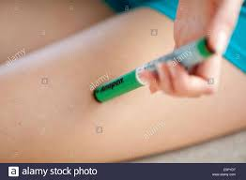
ANAPHYLACTIC SHOCK
3
Help the casualty sit up in
the position that best
relieves any breathing difficulty.
If she becomes pale with a weak
pulse, help her lie down with
legs raised and treat for shock
1
Call 112
2
If the casualty has an autoinjector
of epinephrine, help her use it. If she is unable to take the medication, administer it to her yourself. Pull off the safety cap and, holding the injector with your fist, push the tip firmly against the casualty's thigh until it clicks, releasing the medication (it can be delivered through clothing). Hold for ten seconds, remove the autoinjector, then massage the injection site for ten seconds.
4
Repeated doses of
epinephrine can be given at
five-minute intervals if there
is no improvement or the
symptoms return.

Slide 9
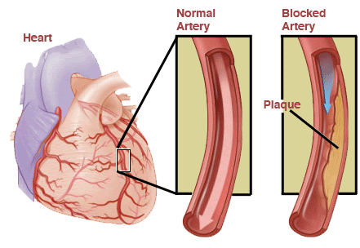
ANGINA
Coronary Arteries
■ Signs and symptoms: Chest pain or discomfort that comes and goes, with onset usually related to exertion
■ Shortness of breath
■ Fatigue, which is often sudden and extreme
■ Feeling of anxiety
Notes:
Angina occurs when coronary arteries that supply the heart
muscle with blood become narrowed and cannot carry sufficient
blood to meet increased demands during exertion or excitement.

Slide 10
ANGINA
What to do?
Help the casualty stop what he is doing and sit down. Make sure
that he is comfortable and reassure him; this should help the pain to ease.
2. If the casualty has angina medication, such as tablets or aerosol spray, let him administer it himself. If necessary, help him take it.
3. If the pain is not relieved five minutes after taking the angina medication, advise him to take a second dose.
4. If the casualty is still in pain five minutes after the second dose, or it returns, suspect a heart attack (opposite). Call 112 for emergency help.

Slide 11
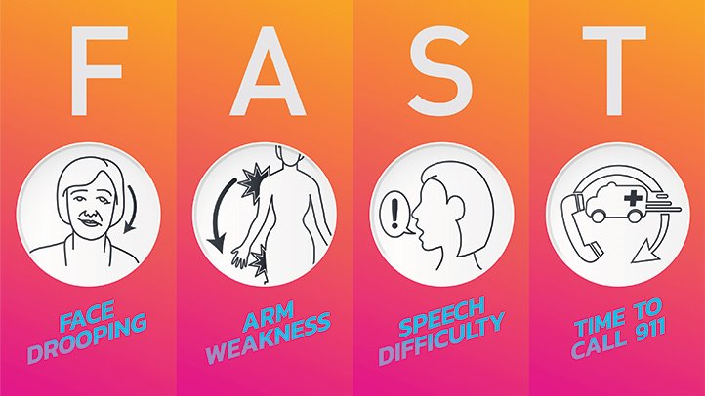
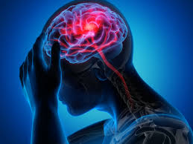
STROKE
Recognition
Use the FAST (Face—Arms—Speech—Time) guide to assess the casualty.
■ Facial weakness—casualty is unable to smile evenly
■ Arm weakness—casualty may only be able to move the arm on one side of his body
■ Speech problems
There may also be:
■ Weakness or numbness along one side of entire body
■ Sudden blurring or loss of vision
■ Difficulty understanding the spoken word
■ Sudden confusion
■ Dizziness, unsteadiness, or a sudden fall
Notes:
Stroke occurs when the blood supply to part of your brain is interrupted or reduced, preventing brain tissue from getting oxygen and nutrients. disorders of the circulatory system, such HBP.

Slide 12
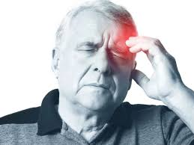
STROKE-What to do
1. CASUALTY’S FACE
CHECK
2. CASUALTY’S ARMS
3. CASUALTY’S SPEECH
5. CALL FOR EMERGENCY HELP
tell them suspection of stroke
6. KEEP HIM CONFORTABLE

Slide 13
SEIZURE (CONVULSION)-ADULTS
RECOGNITION:
■ Sudden loss of consciousness, often with a cry
■ Rigidity and arching of the back
■ Difficult breathing may become. The lips may show a gray-blue
■ Possible loss of bladder or bowel control---- Muscles relax
■ After the seizure the casualty may be dazed and unaware of what has happened
■ Casualty falls into a deep sleep
Notes:
Seizures usually result in loss or impairment of consciousness.
The most common cause is epilepsy. Other causes include head
injury, some brain-damaging diseases, shortage of oxygen or
glucose in the brain, and the intake of certain poisons, including
alcohol or drugs.

Slide 14
SEIZURE (CONVULSION)-CAUTION
■ Do not move the casualty unless he is in immediate danger or is vomiting.
■ Do not put anything in his mouth or attempt to restrain him during a seizure.
Call 112 for emergency help if:
■ The casualty is having repeated seizures or having his first seizure.
■ The casualty is not aware of any reason for the seizure.
■ The seizure continues for more than five minutes.
■ The casualty is unconscious for more than ten minutes.
■ The casualty has sustained an injury to another part of the body.
Notes:
Seizures usually result in loss or impairment of consciousness.
The most common cause is epilepsy. Other causes include head
injury, some brain-damaging diseases, shortage of oxygen or
glucose in the brain, and the intake of certain poisons, including
alcohol or drugs.

Slide 15
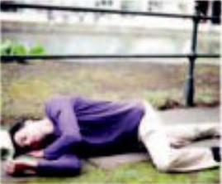
SEIZURE-What to do
1.PROTECT CASUALTY
Try to ease the casualty’s fall. Talk to him calmly and reassuringly. Clear away any potentially dangerous objects to prevent injury to the casualty. Ask bystanders to keep clear. Make a note of when the seizure began.
2. PROTECT HEAD AND LOOSEN TIGHT CLOTHING
If possible, cushion the casualty’s head with soft material until the seizure ceases. Place padding to protect him from objects that cannot be moved. Loosen any tight clothing around the casualty’s neck.
3. PLACE CASUALTY IN RECOVERY POSITION
Once the seizure has stopped

Slide 16
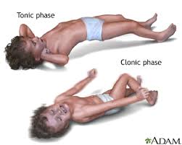
SEIZURE-CHILDREN
RECOGNITION:
■ Violent muscle twitching, arched back and clenched fists
■ Signs of fever, such as hot, flushed skin
■ A twitching face and squinting, fixed or upturned eyes
■ Breath-holding, with red, puffy face and neck
■ Drooling at the mouth
■ Loss of, or impaired, consciousness

Slide 17
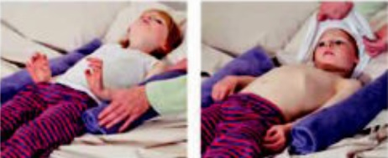
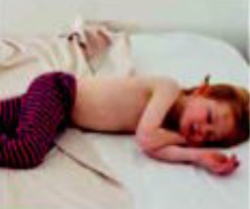
SEIZURE-What to do
1. PROTECT CHILD FROM INJURY.
2. HELP THE CHILD COOL DOWN
3. PLACE CHILD IN RECOVERY POSITION
Once the seizure has stopped
4. CALL FOR EMERGENCY HELP

Slide 18
FAINTING
brief loss of consciousness
temporary reduction of the blood flow to the brain.
RECOGNITION:
■ Brief loss of consciousness that causes the casualty to fall to the ground
■ A slow pulse
■ Pale, cold skin and sweating

Slide 19
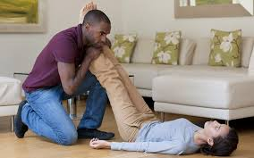
FAINTING-What to do
When a casualty feels faint, advise him to lie down. Kneel down, raise his legs, supporting his ankles on your shoulders to improve blood flow to the brain. Watch his face for signs of recovery.
Make sure that the casualty has plenty of fresh air; ask someone to open a window if you are indoors. In addition, ask any bystanders to stand clear. He may be more comfortable if his knees are bent.
As the casualty recovers, reassure him and help him sit up gradually. If he starts to feel faint again, advise him to lie down once again, and raise and support his legs until he recovers fully.

Slide 20
REFERENCES
The American College Of Emergency Physıcıans (Acep)-First Aid Manuel 5th Edition The Everything First Aid Book

