Slide 1
Mesleki Yabancı Dil 2

Slide 2
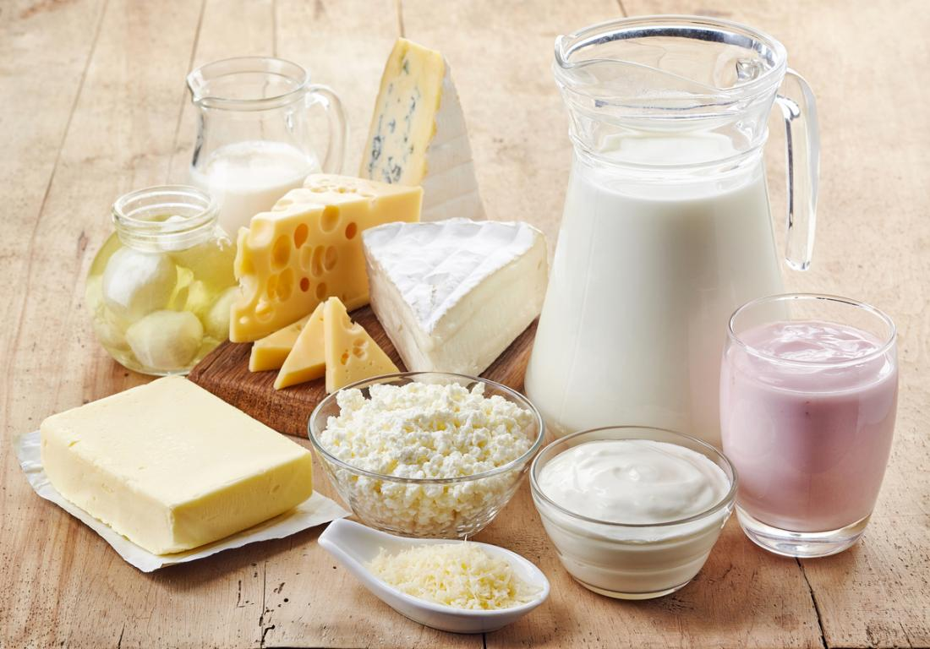
2. DAIRY PRODUCT
Dairy products are defined as foodstuffs generally produced from milk.
Clotted Cream/Heavy Cream
Ice Cream
Yogurt
Butter
Cheese
Sour Cream
Milk Powder
Kephir/Kefir
Milk puddings
Notes:
Süt ürünleri, mandıra ürünleri

Slide 3
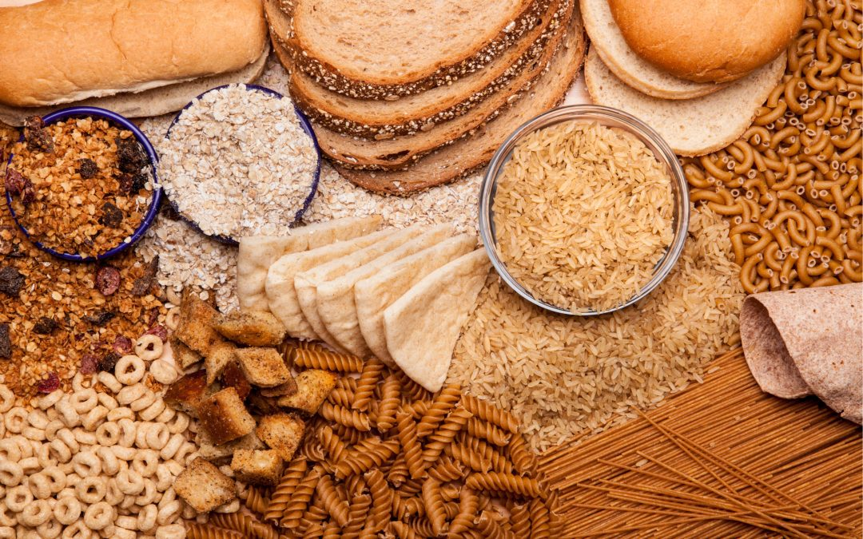
3. GRAINS
Wheat, barley and rye are used in bread making.
Wheat
Barley
Oat
Corn
Rye
Rice
All kinds of bread
Macaroni/Pasta
Cracked Wheat
Notes:
Hububat, tahıl

Slide 4
Grains are divided into 2 subgroups, Whole Grains and Refined Grains.
Whole grains contain the entire grain kernel (tüm tahıl tanesi) ― the bran (kepek), germ (rüşeym), and endosperm.
Examples of whole grains include whole-wheat flour, bulgur (cracked wheat), oatmeal (yulaf ezmesi), whole cornmeal (iri taneli mısır unu), and brown rice.
Refined grains have been milled (öğütülmüş), a process that removes the bran and germ. This is done to give grains a finer texture and improve their shelf life, but it also removes dietary fiber, iron, and many B vitamins.
Some examples of refined grain products are white flour, degermed cornmeal, white bread, and white rice.

Slide 5
4. VEGETABLE AND FRUITS
Okra / Gombo / Lady’s finger : Bamya
Zucchini / Marrow / Corugette : Sakız Kabağı /Yeşil Kabak
(Zukini/Merovv/Korjeet)
Eggplant/Aubergine (Abırciin) : Patlıcan
Cauliflower : Karnabahar (Kalığfılava)
Broccoli : Brokoli (Bırakıliiğğ/Brokliiy)

Slide 6
4. VEGETABLE (HERB) AND FRUITS
Cayenne Pepper (Keyeeğn) : Kırmızı Biber
Chili Pepper
Bell Pepper : Dolma Biber
Artichoke : Enginar (Artiçuğk)
Leek : Pırasa

Slide 7
Sorrel : Kuzukulağı
Lettuce : Marul
Iceberg Lettuce : Göbek (Letıss)
Arugula (İrügüla) Rocket : Roka Garden Rocket
Watercress : Tere/Su Teresi

Slide 8
Dill : Dereotu
Parsley : Maydanoz
Basil : Fesleğen
Purple Basil : Reyhan
Bunch: Demet

