Slide 1
Primary and Secondary Worlds
intrusive fantasies: the magic leaks into this world
portal fantasies: you enter the secondary world through a portal
immersive fantasies: an entirely alternative world is created

Slide 2
Clute and Grant

Slide 3
Reading the Fantastic
Samuel taylor coleridge
j. r. r. Tolkien
“the willing suspension of disbelief”
“secondary belief”
“enchantment”
* as part of the debate concerning fantasy or fantastic elements in literature being ”only suitable for children.”

Slide 4
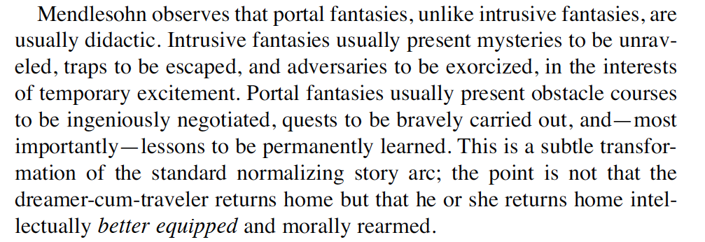

Slide 5
from Terry Pratchett
“Fantasy should present the familiar in a new light.”
“Fantasy is the Ur-literature, from which everything else sprang.”
“The point about escaping is that you should escape to, as well as from. You should go somewhere worthwhile, and come back the better for the experience.”
“The best stuff does take you somewhere. It takes you to a new place from which to see the world.”
“The fantasy books led me on to mythology, the mythology led painlessly to ancient history … and I quietly got an education, courtesy of the public library.”

Slide 6
Pratchett on LOTR
“I can’t remember where I was when JFK was shot, but I can remember exactly where and when I was when I first read J. R. R. Tolkien … Boys at school had told me about it. It had maps in it, they said. This struck me at the time as a pretty good indicator of quality … Enthralled I was. To the library I went back, and spake thusly: ‘Have you got any more books like these? Maybe with maps in? And runes?”

Slide 7
