Slide 1
MEDEA by SENECA
AKE 114/ING 118/DING 118
Dr. Gamze Kati Gumus

Slide 2
Senecan Tragedy
Seneca’s plays were mainly the rewritings of the plays of Euripides, Aeschylus and Sophocles
His plays were meant to be read and not performed
Detailed accounts of horrible actions
Violence on stage
Bloodthirsty revenge
Long reflective soliloquies
Morally judgmental
Substitutes speech for action
Uses a confidante (usually a servant)
Division into five acts with the use of choruses

Slide 3
Stichomythia
A dispute delivered in alternating lines
It is used as a means to show characters in contention or rivalry and/or to heighten the emotional intensity

Slide 4
Repartee
Interchanging quick witty replies
These two are stylistic features of Senecan tragedy
Playwrights such as Shakespeare were influenced by them

Slide 5
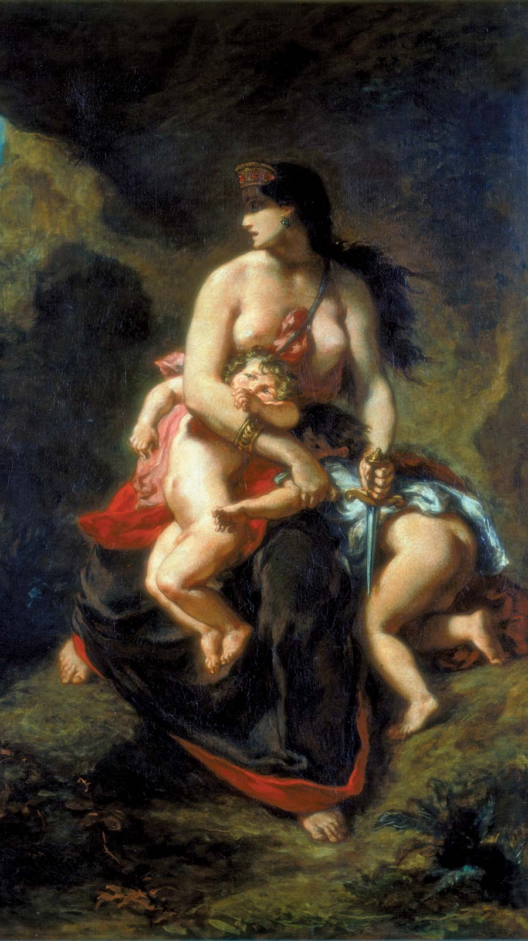
A comparison…
Euripides does not disregard the process up until the Medea’s murder of her children
Seneca disregards what happened before

Slide 6
A comparison…
Euripides
seneca
He is more humanist
Medea is portrayed as a human being
Gray
He is more strict
Medea is portrayed as a filicide
Black

Slide 7
A comparison…
Euripides
seneca
The chorus understands the outcast status of Medea
They sympathize with her
All women
The chorus views Medea as someone full of passion
They judge her
Corinthians

Slide 8
The Opening Scene
Euripides
seneca
Nurse explaining Medea’s suffering
Medea with her desire for vengeance

Slide 9
Medea’s first words?
Euripides
seneca
Ah, wretch! Ah, lost in my sufferings,
I wish, I wish I might die.
O Gods! Vengeance! Come to me now, I beg,
And help me, you who protect the nuptial bed.

Slide 10
Medea’s Depiction
euripides
seneca
Social, interacts with others
In solitary

