Slide 1
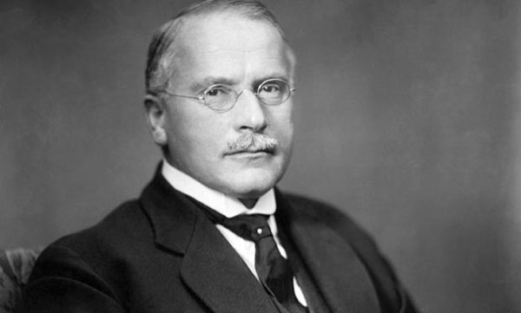
Carl Gustav Jung (1875- 1961)
* Swiss psychologist
* Sigmund Freud’s student and close friend
* In Freud’s words, his «adopted son, his crown
prince and successor»
* Influenced philosophy, anthropology,
literature, religious studies

Slide 2
Jung vs. Freud
*Although Carl Jung was Freud’s student, he developed his own way of analyzing human psyche.
*His observations on human psychology were sometimes a break from Freudian psychology and sometimes a modification of it.

Slide 3
Jung vs. Freud
*One of the points in which Jung opposed Freud is the idea of libido which is a sexual instict.
* Jung thinks that Freud puts too much emphasis on sexuality and tries to de-center it with a new term.
*What may be resembled to libido in Jungian psychology is psychic energy or life force.
*However, Jung uses it as a broader term which refer to needs of thinking, walking, eating and sexuality.

Slide 4
The Models of Human Psyche
Sigmund Freud | Carl Jung
Superego | Persona
Ego | Ego
Id | Shadow
 | Anima / Animus
 | Self

Slide 5
Components of Human Psyche
* Persona is the mask we wear according to the expectations of society.
*Freud’s «Ego» remians «Ego». It forms our personal idenitity.
* Shadow is the unconscious aspect of personality which is irrational and repressed.
*Anima refers to feminine traits in the personality of men. The oversensitive reactions and irrational behaviors of men are associated with this component
*Animus refers to the masculine traits in the personality of woman. It is the source of the rational and reasonable behaviors of women.
* Self is the totality of personality and the center around which all the components above are organized.

Slide 6
The Levels of Consciousness
Sigmund Freud | Carl Jung
Conscious Subconscious (Preconscious) Unconscious | Conscious (Ego) Personal Unconsciousness Collective Unconscious

Slide 7
The Levels of Consciousness
As the name itself suggests, Conscious (Ego) is the conscious mind. It is the level of consciousness in which individual make decisions, learns, obtains wisdom.
Personal Unconscious can be considered as a combination of Freud’s preconscious and unconscious. It includes the memories that can be brought back to conscious and those cannot be retrived back to conscious.

Slide 8
The Collective Unconscious
Jung does not believe that human mind is blank (tabula rasa) when s/he is born.
Collective unconscious is the part of the human consciousness in which collective experiences of humankind from their early ancestors on have been stored and shared universally.
It has contents and modes of behavior that are more or the less the same everywhere and in all individuals. These contents are called archetypes.
In Psychological Reflections, Carl Jung states that these archetypes “are older than historical man, have been ingrained in him from earliest times, and eternally living, outlasting all generations.

Slide 9
The Collective Unconscious
There is a close relationship between archetypes and myths.
Archetypes are essentially unconscious forms. (Like Plato’s Forms)
Myths are the means by which archetypes become manifest to the conscious mind.
THAT’S WHY the myths are not mere stories or allegories of real events but they are the mirrors by which the collective unconscious of the people is reflected.

Slide 10
The Collective Unconscious
For example, «Rebirth» is an archetypal topic.
CHRIST
TAMMUZ
DIONYSUS
REBIRTH

Slide 11
ARCHETYPES AND MYTHOLOGY IN LITERATURE
*The myth critic is concerned to seek out those mysterious elements that inform certain literary works and shows dramatic and universal human reactions.
*The literary works which gives better insight for the myth critic are usually classic and canonized ones.
*The archetype may be an image, a theme, a symbol, an idea, a character type or a plot pattern.

Slide 12
ARCHETYPES AND MYTHOLOGY IN LITERATURE
For example, the image of «water»
In many cultures, it is associated with purification, redemption, fertility.
For example, the image of «river»
In many cultures, it is associated with death&rebirth, flow of time, transitional phases of life cycle.

Slide 13
ARCHETYPES AND MYTHOLOGY IN LITERATURE
The Archetypal Woman:
Freudian view of woman tends to regard the mother in a single model in which she is the source of affection.
However, Jung creates a model in which the mother figure appears in different roles and depictions.
For instance, the mother archetype can appear either as the Good Mother or the Terrible Mother.
The Good Mother: birth, warmth, protection, nourishment
The Terrible Mother: the witch, castration,fear, death, dismemberment

Slide 14
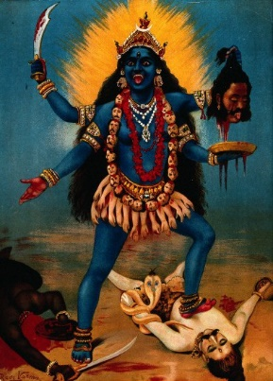
Lakshmi Kali
HINDU
MYTHOLOGY

Slide 15
ARCHETYPES AND MYTHOLOGY IN LITERATURE
The Archetypal Woman (Gertrude Morel):
The mother figure in D. H Lawrence’s Sons and Lovers demonstrates Jung’s assumptions.
After her husband Walter Morel (coal miner) dies, Gertrude Morel becomes overtly attached to her sons William and Paul.
Having been born into a wealthy family, she wants her sons to be successful in their business.
After William’s death, she focuses all her affection on Paul.

Slide 16
ARCHETYPES AND MYTHOLOGY IN LITERATURE
The Archetypal Woman (Gertrude Morel):
BUT….
She considers Paul’s achievements to be her own. She does not regard Paul as an independent personality but just an instrument of her intentions. It can be said that she uses her son to gain her social position which she had before marriage.
A similar control mechanism she has over Paul is effective in Paul’s love affairs, as well. She constantly tries to keep women away from her son. For instance, for Miriam whom Paul falls in love, she comments that «she is not like an ordinary woman who can leave me my share in him. She just wants to draw him out and absorb him till there is nothing left of him» (1995:238)
Lawrence, D. H. Sons and Lovers. New York: Oxford UP, 1995

Slide 17
ARCHETYPES AND MYTHOLOGY IN LITERATURE
The Archetypal Woman (Gertrude Morel):
Mrs. Morel’s affection for Paul is beyond question. In this respect she has the characteristics of the Good Mother in Jungian terms.
However, the results of her over affection proves that she is the Terrible Mother, as well.
Regarding him as an inseperable part of herself is metaphorically killing Paul-as-an-individual.
Keeping the other women away from him results in his inability to act like an grown up man and thus, again on metaphorical level, she castrates him.

Slide 18
An Example of Plot Pattern: Hero’s Journey Archetype
1. The hero is forced into an advanture, although he is not willing to do it, at first. (Departure)
2. The hero crosses a treshold into a new, dangerous and strange world and becomes more mature. (Initiation)
3. The hero passes through impediments, has to endure physical and psychological difficulties and he receives supernatural aid. (The road of trials)
4. The hero enters into an innermost cave, underworld or some other place of great trial. (It may be a physical or psychological.) This experience changes the hero. (The Innermost Cave)
5 . The hero gains wisdom and provides with the order that is absent or under threat.

Slide 19
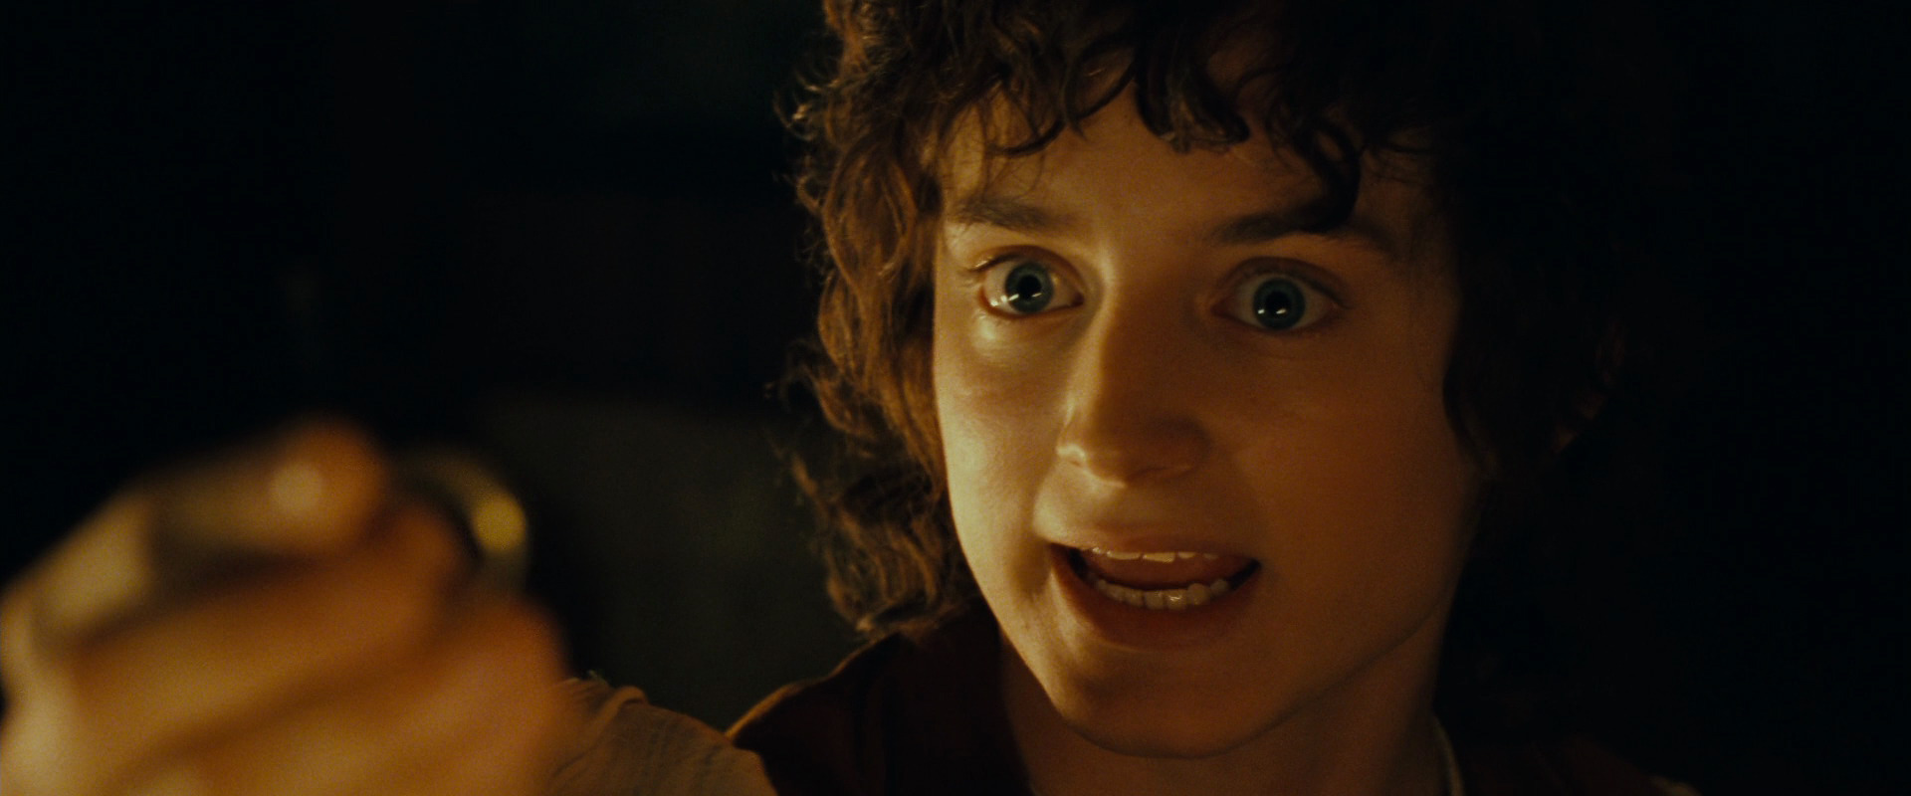
Hero’s Journey Archetype: The Lord of the Rings Example
The hero is forced into an adventure though
he is unwilling.
When Frodo learns the secret about the ring,
he tries to give it to Gandalf (a wizard).
However, Gandalf who is afraid of the ring’s
possible power on himself refuses and convinces
Frodo to keep it and to bring it to a rendezvous
place.

Slide 20
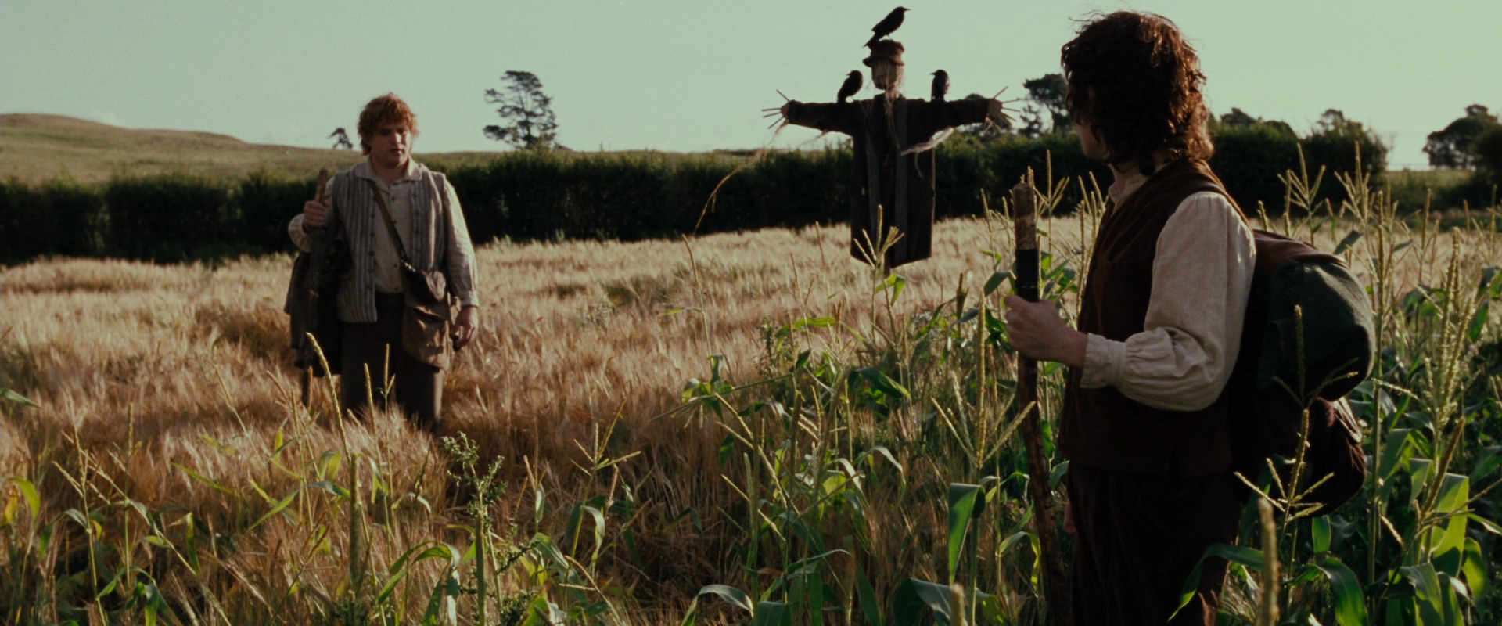
Hero’s Journey Archetype: The Lord of the Rings Example
The hero crosses a treshold into a new world.
The hobbits, who have led a life away from the
chaos of the rest of the world, enter into a new
space.
SAM: If I take one more step, it’ll be the farthest way from home
I’ve ever been.

Slide 21
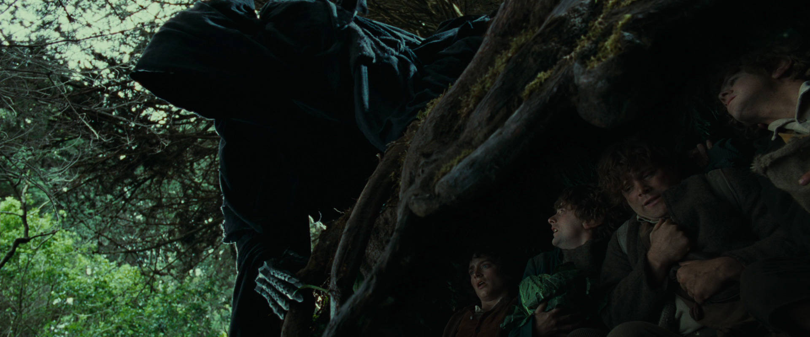
Hero’s Journey Archetype: The Lord of the Rings Example
This is also a dangerous one.
The hobbits are chased by the servants
of Sauron as soon as they leave
Shire where they inhabit.

Slide 22
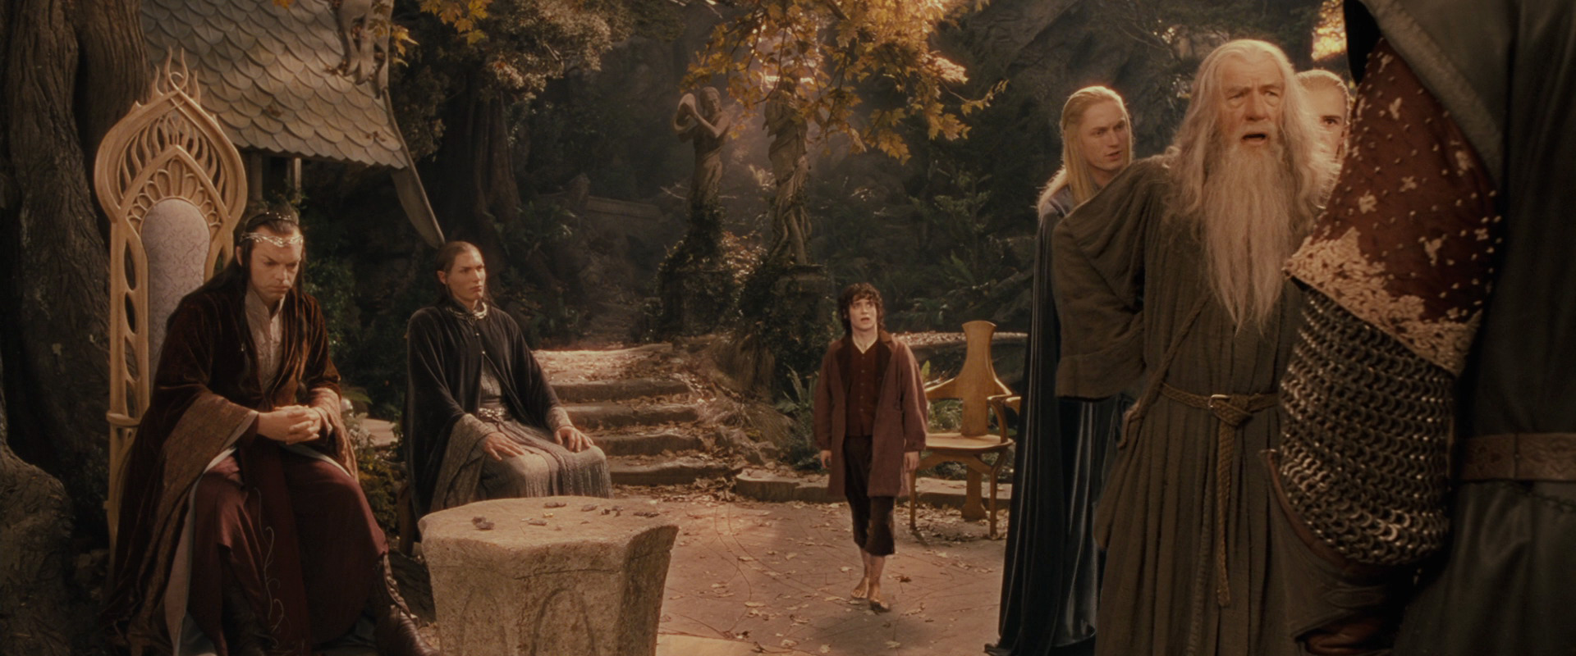
Hero’s Journey Archetype: The Lord of the Rings Example
The hero becomes more mature.
The leaders of Middle-Earth
quarrel over what to do with the
ring and who would carry it.
Frodo volunteers to bear it.
It shows the maturity he has
reached, for the hobbits are
known for their addiction to
comfort.

Slide 23
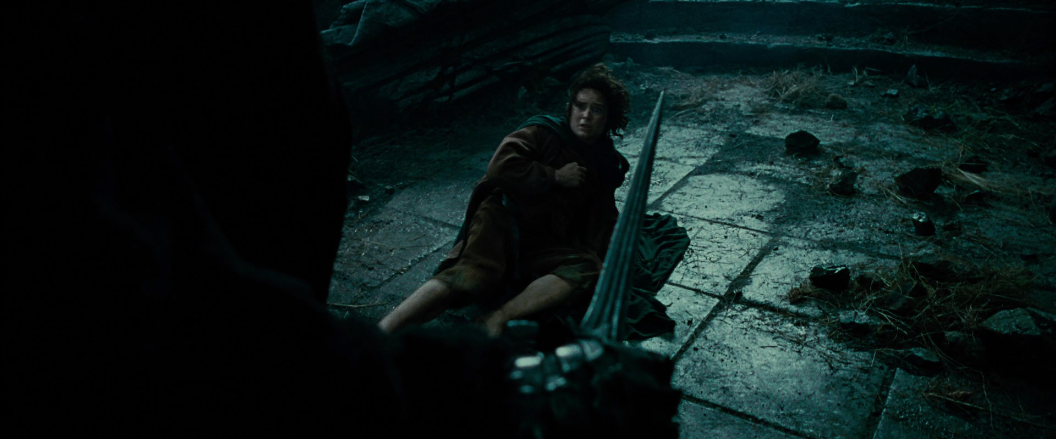
Hero’s Journey Archetype: The Lord of the Rings Example
The hero passes through impediments,
has to endure physical and psychological
difficulties and he receives supernatural aid.

Slide 24
Hero’s Journey Archetype: The Lord of the Rings Example
The hero passes through impediments,
has to endure physical and psychological
difficulties and he receves supernatural aid.
Frodo being attacked by the servants
of Sauron.

Slide 25
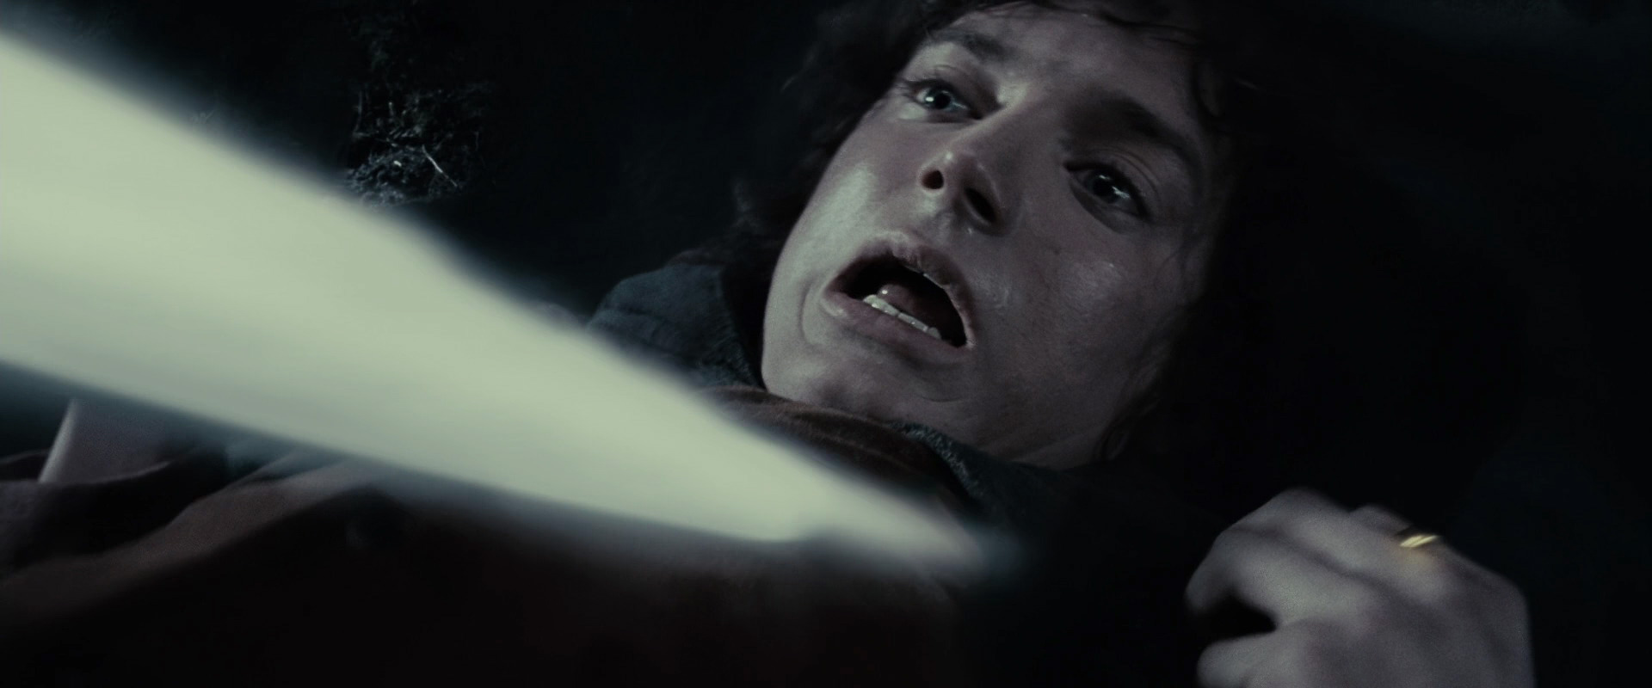
Hero’s Journey Archetype: The Lord of the Rings Example
The hero passes through impediments,
has to endure physical and psychological
difficulties and he receves supernatural aid.
Frodo being stabbed by the servant
of Sauron with a poisonous sword.

Slide 26
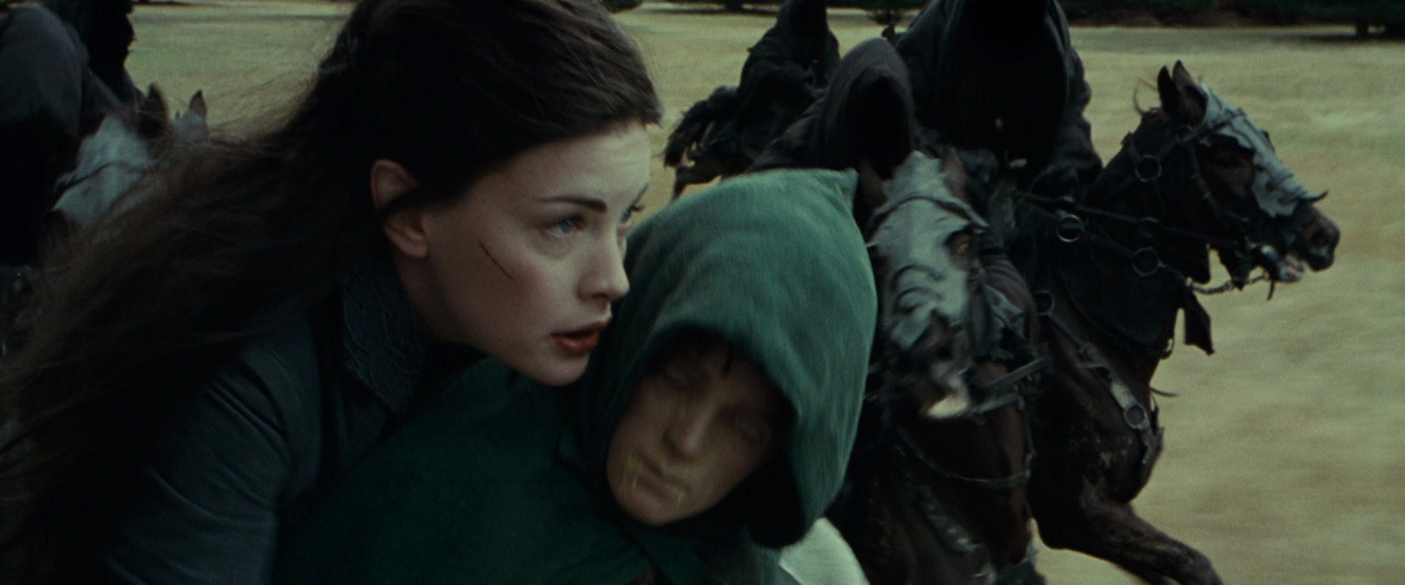
Hero’s Journey Archetype: The Lord of the Rings Example
The hero passes through impediments,
has to endure physical and psychological
difficulties and he receves supernatural aid.
Arwen taking Frodo away for medical help.

Slide 27
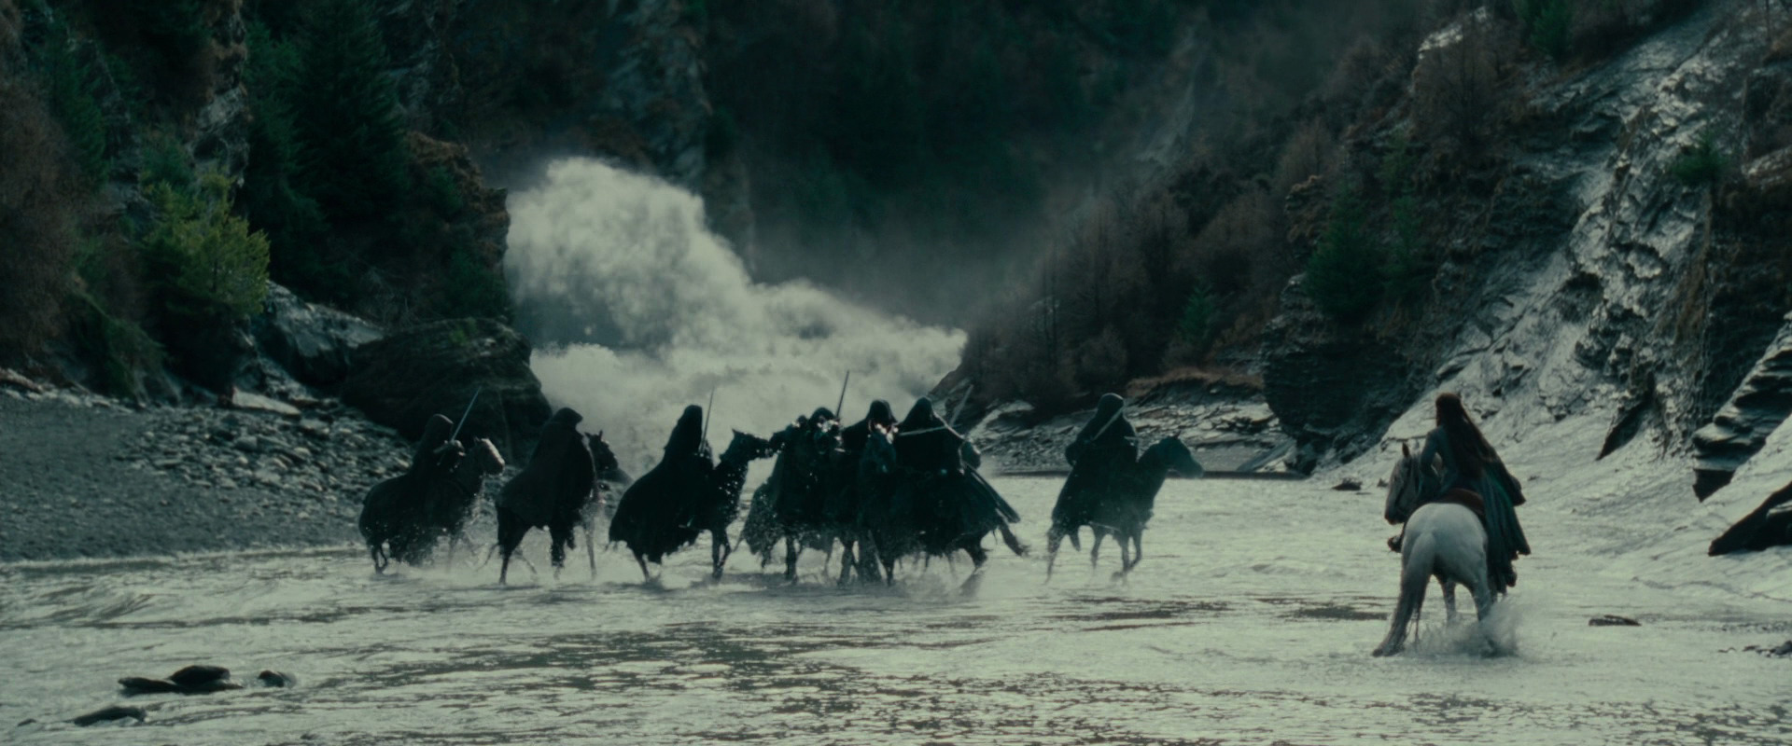
Hero’s Journey Archetype: The Lord of the Rings Example
The hero passes through impediments,
has to endure physical and psychological
difficulties and he receves supernatural aid.
Arwen’s spell to suffocate those pursuing
them.

Slide 28
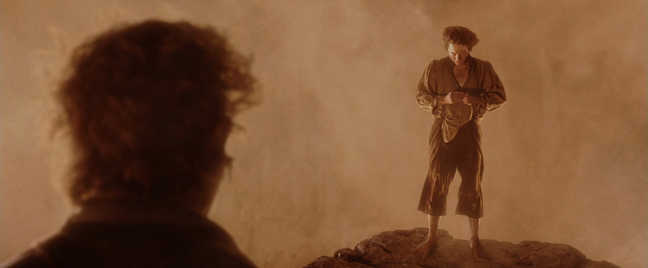
Hero’s Journey Archetype: The Lord of the Rings Example
The hero enters into an innermost cave,
underworld or some other place
of great trial.
(It may be a physical or psychological.)
This experience changes the hero.
Frodo is attracted to the power of the
ring though he has reached to the place
where he can destroy it and for the sake
of which he endured many evils.
Frodo: The ring is mine

Slide 29
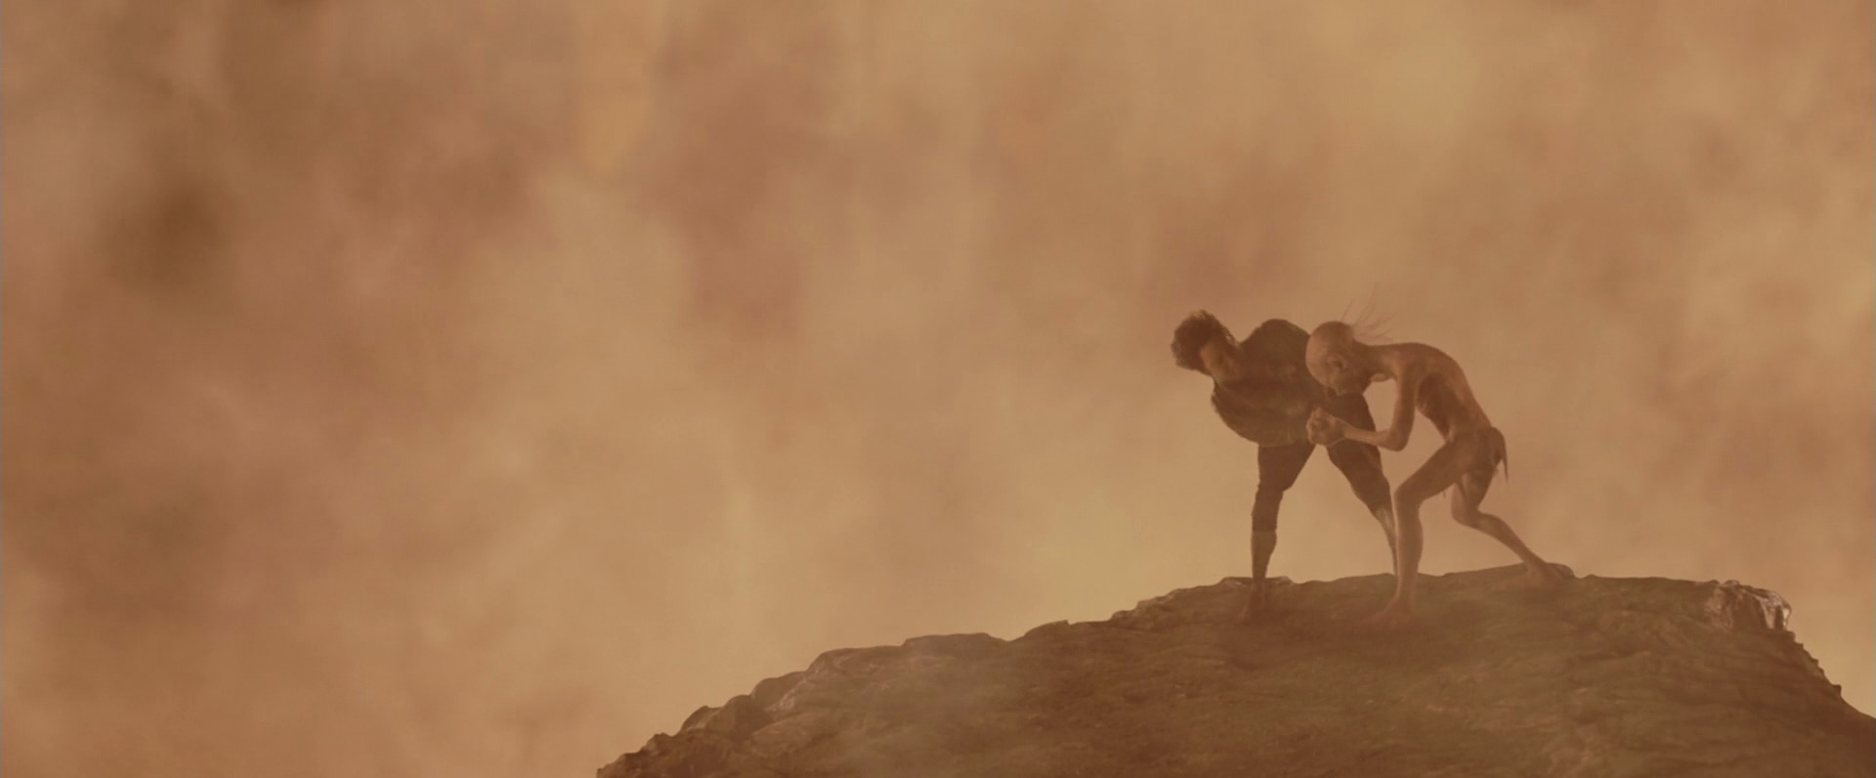
Hero’s Journey Archetype: The Lord of the Rings Example
The hero enters into an innermost cave,
underworld or some other place
of great trial.
(It may be a physical or psychological.)
This experience changes the hero.
Gollum, who has been enchanted by
the ring, captures it from Frodo and
from that point on Frodo realizes why
he was there and attempts to capture it
to destroy, which eventually leads to….

Slide 30
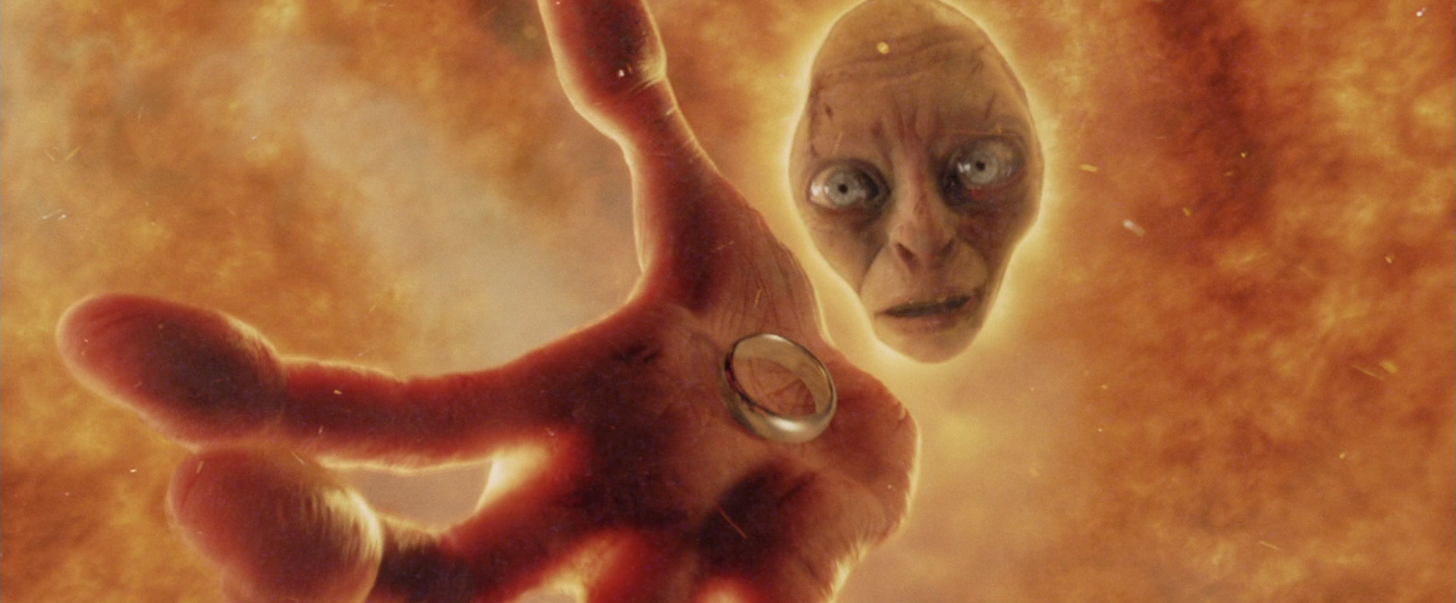
Hero’s Journey Archetype: The Lord of the Rings Example
The hero gains wisdom and
provides with the order
that is absent or under threat
…destruction of the ring and…

Slide 31
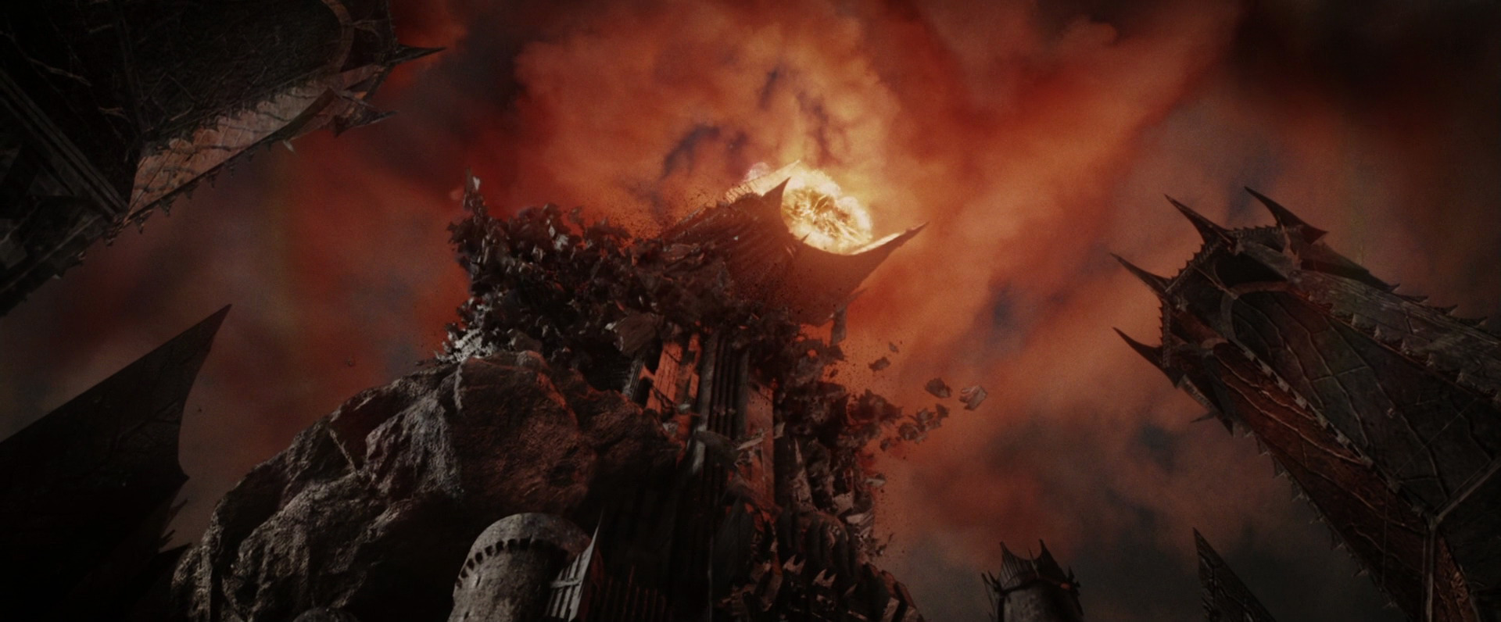
Hero’s Journey Archetype: The Lord of the Rings Example
The hero gains wisdom and
provides with the order that
is absent or under threat
….destruction of Sauron, as well.

Slide 32
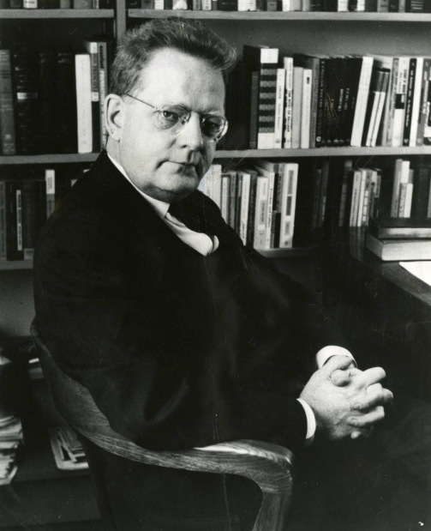
NORTHROP FRYE
* Canadian literary critic and theorist
*Believed in the influence of archetypes on literature
*The first person to theorize archetypal criticism in
literary terms
*Ignored the psychological aspect of archetypes, the
collective unconscious
*Focused on the function and the effects of the
archetypes

Slide 33
NORTHROP FRYE
Northrop Frye is best known for his work Anatomy of Criticism.
In this work, he states that myth is a structural organizing principle for literature and indicates correspondent genres for four seasons:
The mythos of fall: tragedy
The mythos of winter: irony/satire
The mythos of spring: comedy
The mythos of summer: romance

Slide 34
NORTHROP FRYE
He elaborates this classification with the phases which he determines for each of them. For the
tragedy he forms the list below:
Complete innocence: The stage in which Oedipus was born and sent away from the palace of Thebes to be killed.
Youthful innocence of experience: Years later, Oedipius suspects of being an adopted and leaves Corith for Delphi where he is informed of his adultery with his mother in the future.
Completion of an Ideal: Oedipus returns to Thebes and on his way he kills the Sphinx which has troubled the city and marries the newly widowed queen.

Slide 35
NORTHROP FRYE
4) Individual’s faults (hamartia): Oedipus’s obsession with justice and truth about finding the killer of the previous king.
5) Natural Law: Revelation of the unnatural relationship between Oedipus and his mother at the end of the investigation he carries out.
6) World of shock and horror: Oedipus’ self excecation

