Slide 1
EEE322 COMMUNICATION THEORY – I
ANKARA UNIVERSITY
FACULTY OF ENGINEERING
ELECTRICAL AND ELECTRONICS ENGINEERING DEPARTMENT

Slide 2
EEE322 COMMUNICATION THEORY - I
LECTURE 8
CONTINUOUS WAVE MODULATION:
QUADRATURE AMPLITUDE MODULATION (QAM)

Slide 3
QUADRATURE AMPLITUDE MODULATION (QAM)
Quadrature amplitude modulation, also known as quadrature-carrier multiplexing (QAM), utilizes carrier phase shifting and synchronous detection to permit two DSB signals to occupy the same frequency band.
Quadrature-carrier multiplexer is therefore a bandwidth-conservation system.

Slide 4
QUADRATURE AMPLITUDE MODULATION (QAM)
A block diagram of this system is shown in Fig. 3.17 (Haykin, page 121)
The transmitter part of the system, shown in Fig. 3.17(a), involves the use of two separate product modulators that are supplied with two carrier waves of the same frequency but differing in phase by 90 degrees.

Slide 5
QUADRATURE AMPLITUDE MODULATION (QAM)
The transmitted signal s(t) consists of the sum of these two product modulator outputs, as shown by
$s\left(t\right)=A_{c}$ $m_{1}(t)$ cos(2$πf_{c}t)+$ $A_{c}$ $m_{2}(t)$ sin(2$πf_{c}t)$
where $m_{1}(t)$ and $m_{2}(t)$ denote the two different message signals applied to the product modulators.

Slide 6
QUADRATURE AMPLITUDE MODULATION (QAM)
the in-phase component
of the multiplexed band-pass signal $s(t)$
the quadrature component
of the multiplexed band-pass signal $s(t)$

Slide 7
QUADRATURE AMPLITUDE MODULATION (QAM)
The multiplexed signal $s\left(t\right)$ occupies a channel bandwidth of 2W centered on the carrier frequency $f_{c},$ where W is the message bandwidth, assumed to be common to both $m_{1}(t)$ and $m_{2}\left(t\right).$

Slide 8
QUADRATURE AMPLITUDE MODULATION (QAM)
The receiver part of the system is shown in Fig. 3.17(b) (Haykin, page 122).
Specifically, the multiplexed signal is applied simultaneously to two separate coherent detectors that are supplied with two local carriers of the same frequency, but differing in phase by -90 degrees.

Slide 9
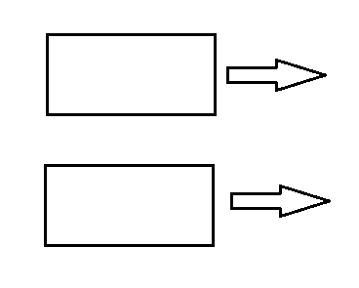
QUADRATURE AMPLITUDE MODULATION (QAM)
The output of the top detector is $\frac{1}{2}A_{c}A_{c}^{′}m_{1}(t)$
whereas the output of the bottom detector is $\frac{1}{2}A_{c}A_{c}^{′}m_{2}(t)$
$$\frac{1}{2}A_{c}A_{c}^{′}m_{1}(t)$$
$$\frac{1}{2}A_{c}A_{c}^{′}m_{2}(t)$$

Slide 10
References
Communication Systems, An Introduction to Signal and Noise in Electrical Communication, 5th edition, A.B. Carlson, P.B. Crilly, J.C. Rutledge, Mc Graw Hill.
An Introduction to Analog and Digital Communications, 2nd edition, S. Haykin, M. Moher, Wiley.

