Slide 1
Connective Tissue
Part3

Slide 2
Cells, extracellular matrixs and fibrils in the connective tissue vary from one region to another in the body.
These units can be more or less.
Various types can be transformed into intermediate forms, or a type of connective tissue can be transformed into another type by changing conditions.
Classification is generally dependent on loose or dense arrangements of fibrils.

Slide 3
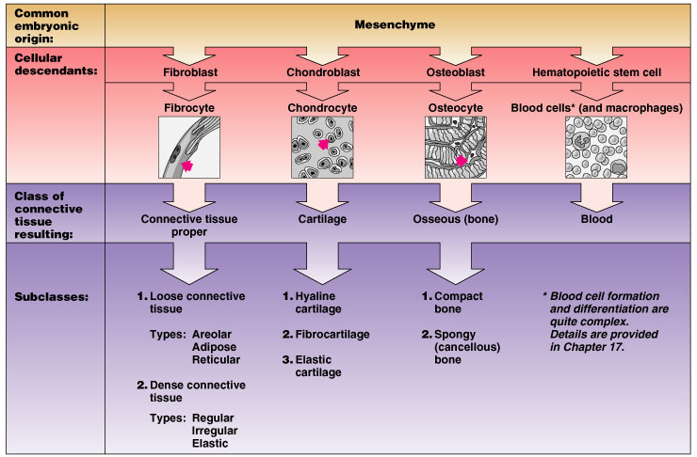
Classes of Connective Tissue

Slide 4
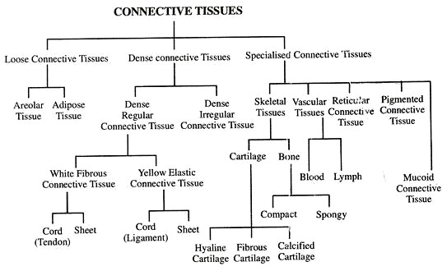

Slide 5
Two types of connective tissue proper are mentioned. 1. Loose connective tissue, 2. Dense connective tissue
Regular and irregular placement of the fibrils in the dense connective tissue reveals two different types of connective tissue. a. Dense Regular CT b. Dense Irregular CT

Slide 6
Loose Connective Tissue
Occurs after other tissues of the embryo have been formed, from mesenchyme.
Mesenchymal cells transforms into fibroblasts by altering their properties, forming extensions on collagen fiber bundles.
Fibroblast is the most common cell on this tissue.
Macrophages,
adipocytes,
plasmatocytes are other cells that differentiate or migrate from mesenchyme.
Like a sponge that shrinks, there are a lot of gap normally filled with a small amount of matrix.

Slide 7
These gaps may occasionally expand and contract depending on the amount of liquid in them.
This tissue is also called areolar tissue (areola = small space).
Loose connective tissue fills the spaces between the tissues and the muscles.
It lies under the epithelium layer and feeds it with blood vessels

Slide 8
It forms the structure of serous membranes such as peritoneum, pleura and pericardium.
They fill the spaces between the veins and the nerves.
Collagen, elastic, and reticular fibrils are present in the extra cellular area.
It is not resistant to stretching and drawing.
In general, it supports the tissues and organs and is responsible for feeding, repairing and protecting them.
It is useful for regeneration and repair of tissues such as inflammation and injury.

Slide 9
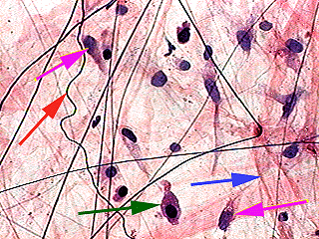
Fibroblast
Elastik teller
Kollagen
Makrofaj
Fibroblast
Loose CT fibers and cells

Slide 10
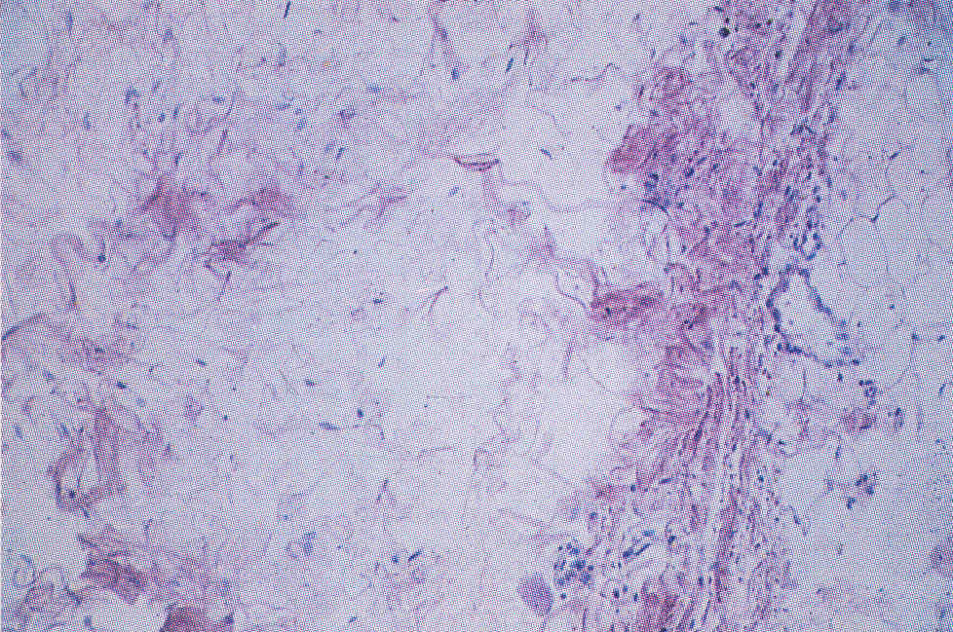
Loose CT rich in fibers and cells (H&E; x100).

Slide 11
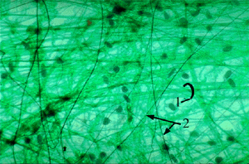
3
3
Loose CT 1.collagen fibers, 2.Elastik fibers, 3.Dark stained fibroblast nucleus

Slide 12
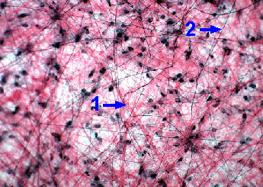
Areolar CT1.Kollagen teller, 2.Elastik teller

Slide 13
Dense Connective Tissue
Separated from the loose connective tissue by containing too much fibrils
The most common cell is fibroblast.
The free connective tissue cells are minimal or absent.
If the fibrils show irregular distribution Dense Irregular Connective tissue;
If the fibril distribution forms regular and parallel bundles, then dense regular connective tissue is formed.

Slide 14
Dense Irregular CT
It is found in the
dermis,
organ capsules,
the sheath of the nerves,
in the urinary tract under the epithelium and
in many other parts...
In Dermis, all cells and fibrils in loose CT are found.
Collagen creates thicker bundles of fibers.
Elastic strands also support this structure by making a dense network.

Slide 15
The ground substance is less.
Between dense fibrils it is more difficult to distinguish cells compaired to loose connective tissue.
Macrophages can be recognized by vital dye.
There are undifferentiated mesenchymal cells around small blood vessels.

Slide 16
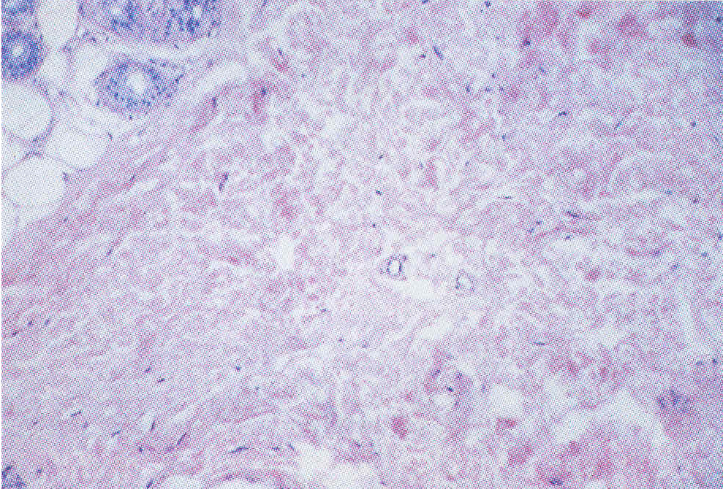
Dense Irregular CT, collagen fiber in every direction (H&E; x100).

Slide 17
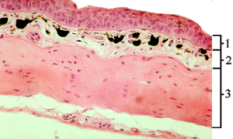
1
2
3
Dense Irregular CT(Frog dermis) (1.Epidermis, 2. ve 3. Dermis)

Slide 18
Dense Regular CT
Collagen fiber bundles are dense and in a regular manner that will give mechanical strength to the tissues.
The tendons which the muscles are attached to the bones are made of dense regular CT.
In white fibrous tendon most common collagen is type I.
The collagen fibril bundles, which are thick and tightly packed together, are parallel to the long axis of the tendon.

Slide 19
The collagen can be seen in the space between the fibril bundles.
Narrow elastic fiber nets are sometimes located between collagen bundles.
The only cell found in this tissue is fibroblast.
Tendon fibers can be bent and twisted, also resistant to pulling.

Slide 20
The ligament structure that connects the bones to bones and allows some organs to hang in the air is similar to the tendons; but the elastic fibrils are too much and more irregular.
Fibers pass from one layer to another.
In Periosteum, sclera (eyeball) the tissues form dense regular patterns showing less regular placement.

Slide 21
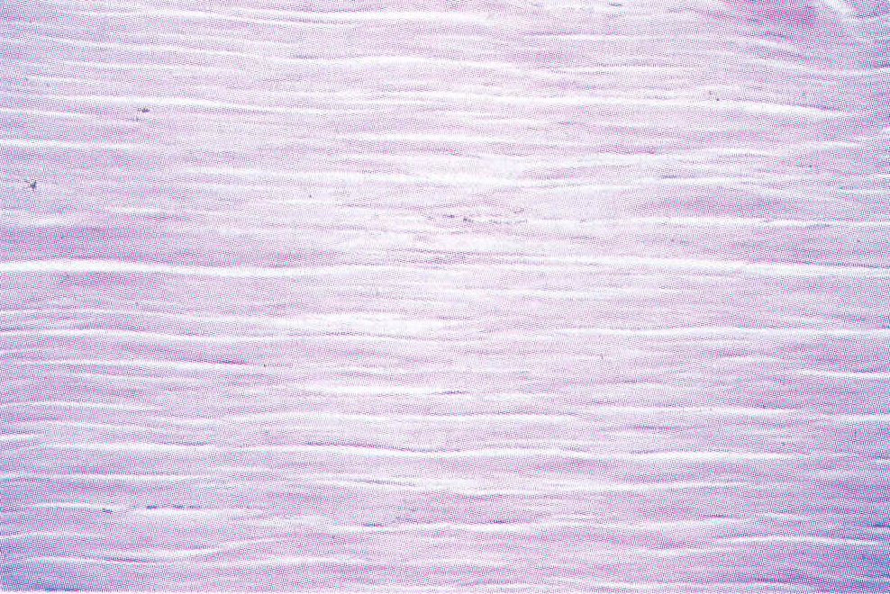
Kollagen teler
Fibroblastlar
Dense regular CT, collagen fibers in same direction and few fibroblastlar (Tendon) (H&E; x100)

Slide 22
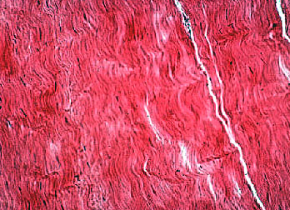
Dense regular CT, longitudinally collagen fibers (Tendon)

Slide 23
The connective tissues are divided into two according to the life status:
A-Embryonic connective tissue 1. Mesenchymal connective tissue, 2. Mucoid CT
B- The connective tissue in the adult tissue (specialized connective tissue): 1. Elastic connective tissue, 2. Reticular connective tissue 3. Pigment CT 4. Adipose CT.

Slide 24
A- Embryonic connective tissue 1- MESENSCHYMAL CT
It is the first connective tissue seen in the developing embryo.
The connective tissue is called embryonic connective tissue
Cell cytoplasm appears as a star with very thin cytoplasmic extensions.
These extensions can sometimes combine with each other.

Slide 25
Cells are found in a sticky ground substance containing very fine protein filaments.
Blood cells, blood vessels and other supporting tissues (connective, cartilage and bone tissue) are formed by their strong, rapid cleavage and differentiation potentials.
Adults do not have this tissue; but the mesenchymal cells, which are scattered around the adult support tissue, perform post-injury tissue repair.

Slide 26
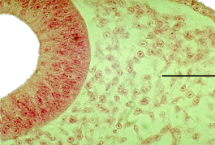
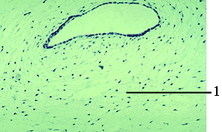
Embryonic connective tissue
Mesenchymal connective tissue
Mucoid CT

Slide 27
2-MUCOID CT
is very similar to Mesenchymal connective tissue.
It is found in many parts of the embryo.
There are more soft, peltier and homogeneous exracellular matrixs.
Granular and wired structures can be seen after preparation in the intermediate material.
The amount of fine collagen fibril is related with the age of the fetus.

Slide 28
The main cells are fibroblasts whose extensions have been mutually synergized.
A small number of cells of the macrophage and lymph system are found.
Mucoid connective tissue is known as Wharton paste in the umbilical cord.
It is also found in adult and child dental pulp.

Slide 29
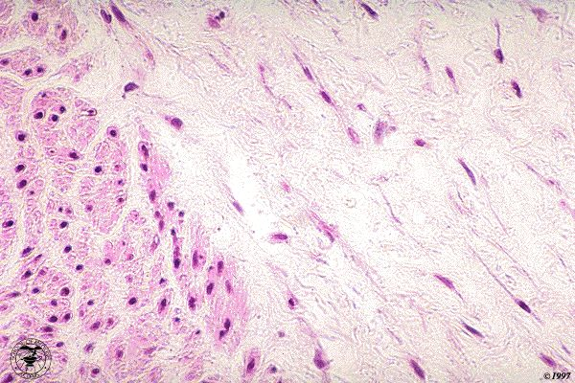
Fibroblast
Fibroblast
Mükoz bağ dokusu ve fibroblastlar (Ok) (Göbek bağı)

Slide 30
B- The connective tissue in the adult 1-ELASTIC CT
It is visible with the naked eye.
There are plenty of elastic wire bundles.
These fibrils are arranged parallel to each other or form interconnected structures in relation to each other.
The areas between the fibrils contain fibroblasts and occasionally collagen fibers.
Ligamenta flava is found on the walls of hollow organs (stomach and large vessels), some parts of the heart, and some parts of the respiratory tract.

Slide 31
2-Reticular Connective Tissue
Around the liver sinusoids, most of the wires in the thymus, lymph and hemopoietic organs of the spleen and the spleen are composed of reticular wires.
Between Reticular wires there are cells that synthesize them and very fine collagen wire nets exist.
This tissue supports the organs

Slide 32
3-PIGMENT CT
It is called the connective tissue where the pigment cells (melanocytes) are concentrated.
Found in certain places in the body.
In the retina and iris of the eye it is very dense , but it is more diffuse in the skin
The cold-blooded animals show intense settlement in places.
Ectodermal pigment CT protect organs against extreme UV

Slide 33
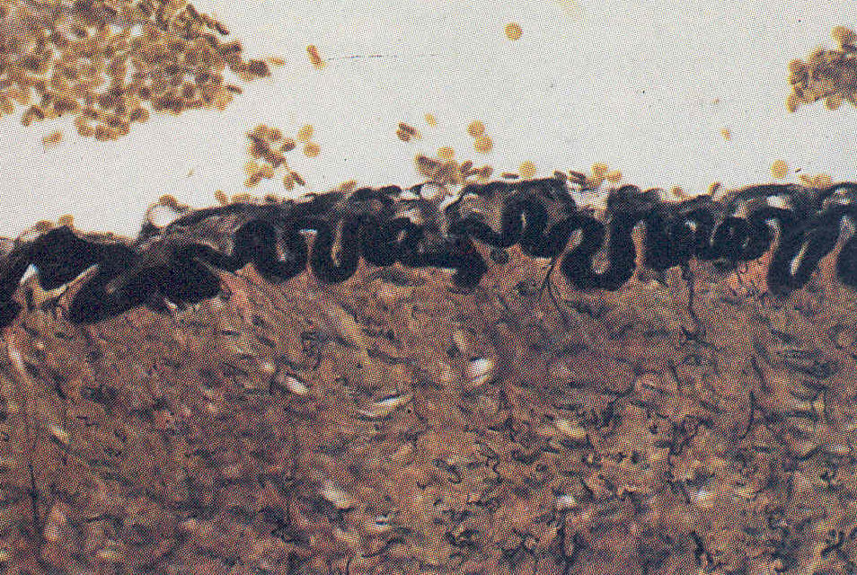
Arter duvarında siyah boyanmış elastik tellerden oluşan elastik lamina (Verhoeff boyası, x 250)

Slide 34
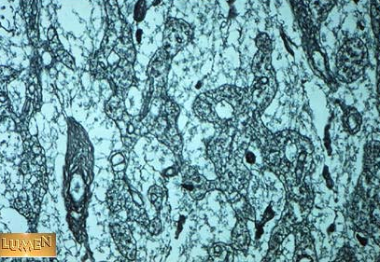
RETİKÜLER
TELLER

Slide 35
4-Adipose Tissue
Adipocytes
Immobilized cells of connective tissue
Specialized to synthesize and store lipids.
Fat accumulates in small cytoplasm of cells in small droplets.
Then the droplets join together to form a large oil droplet
The nucleus is flattened and pushed to one side, surrounds a thin ring-shaped cytoplasmic oil droplet

Slide 36
Golgi complex and filamentous mitochondria are distributed in the thin cytoplasmic region
Each fat cell is surrounded by a web of fine reticular fibrils.
Fat cells can be found all over the body.
They are either found individually or in groups.
As a result of accumulation in groups, they become a dominant volume and volume of the tissue they themselves form a tissue.
This is called adipose tissue or fat tissue
When creating groups, the corners are not sharp polygonal or rounded

Slide 37
They are active cells, uses fats according to the need and synthesize it again.
In the preparation, oil and fat such as alcohol and xylol used during dehydration dissolve, so the oil droplets remain empty in the cytoplasm of fat cells.
Adipocytes develop from the mesenchymal cell.
During early development, fat droplets begin to accumulate in the cell.
A fully formed fat cell can not be divided by mitosis.
In adolescents, new fat cells take root from undifferentiated mesenchymal cells.

Slide 38
Functions
Store fat,
Provides a protective layer against heat loss
Provides mechanical support to some parts of the body
It is an effective tissue in metabolism.
Most animals are fed occasionally; but it consumes constant energy.
We need to store an energizing substance.
Fat is much lighter than carbohydrates and proteins and gives much more energy.
Fat tissue forms the most efficient energy store of the body.
About 10-15% of the total body weight of a normal weight person is fat, which constitutes a 40-day energy density.
The fat rate increases when you are overweight.

Slide 39
Fat tissue in humans
50% hypodermis,
15% omentum and mesentery,
15-20% around the reproductive organs,
12% in the kidneys and
5-8% in the muscles.

Slide 40
White adipose tissue in paraffin section

Slide 41
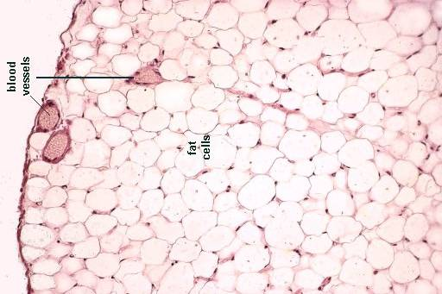
Kan
damarları
Yağ
hücreleri
Yağ Dokusu ve hücreleri http://neuromedia.neurobio.ucla.edu/campbell/connective_tissue/wp_images/2_adipose_cells.gif

Slide 42
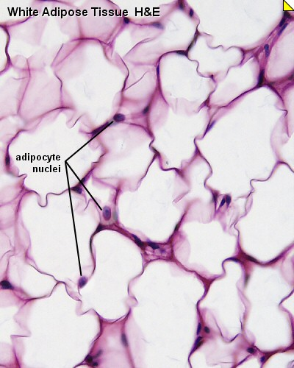

Slide 43
Mühür yüzük modeli(yağ doku)

Slide 44
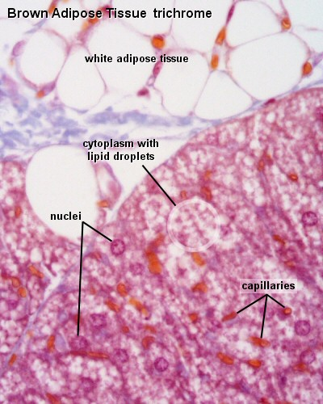

Slide 45
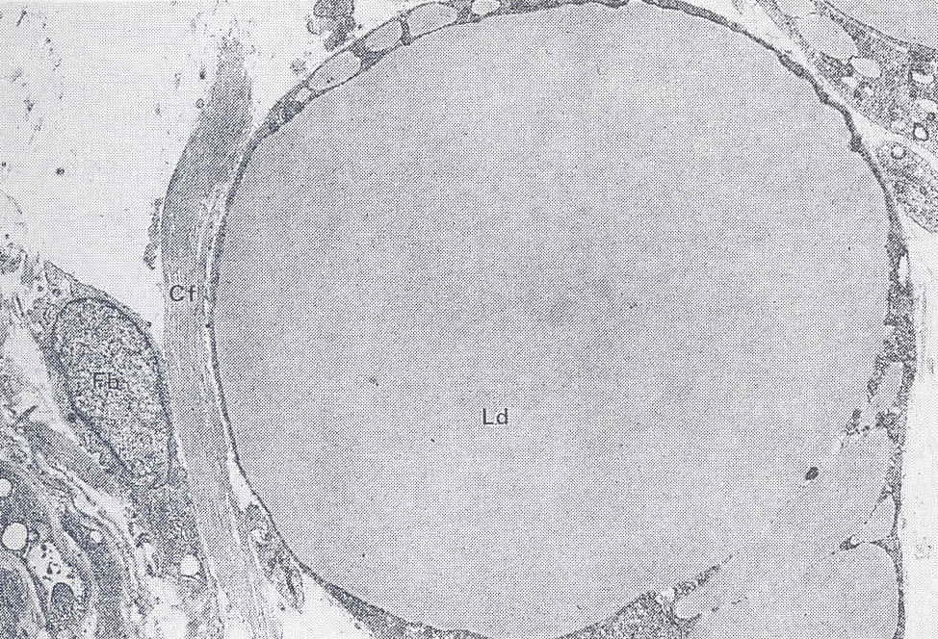
Kollagen
teller
Fibroblast
Lipit damlası
Altı aylık fetüsten alınan bir yağ hücresi (Adiposit) (TEM, x1.600)

Slide 46
HISTOLOGICAL CHARACTERISTICS OF ADIPOSE TISSUE
In most of the mammals, there are two different fatty tissues that differ from each other in terms of color, distribution, vascularity and metabolic efficiency.
Yellow or white fat tissue, which forms a large part of body fat
Brown fat, found less only very specific regions.
The distribution of these two types of fat varies in different species.
The brown fat tissue is found a lot in the wintering species.

Slide 47
White Adipose Tissue (Single Drop Oil Tissue)
In young people and children there is a continuous fat layer that surrounds the whole body called the panniculus adiposus.
In adults, this layer is thin in some parts of the body and thick in some parts.
Thickening is different in two sexes.
A single oil drop fills most of the cell volume.
The fat droplets found in the cytoplasm of the fat cells are free of grease; but fine filaments of 100 A surround this drop.

Slide 48
White fat tissue accumulates around the internal organs of the body, in the mesentery and omentum, and can immediately turn into energy.
However, the palm, the foot, and the joint fat tissue do not interfere with metabolism.
The fat here serves as a pillow, providing mechanical support.
There may be a decrease in the amount of starvation that lasts too long.

Slide 49
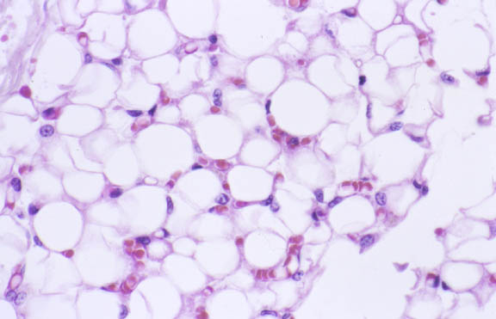
Periadrenal bölgede beyaz yağ dokusu, H&E, x132
http://pathology.mc.duke.edu/ research/PTH225.html

Slide 50
Brown adipose tissue (Multi Drop Oil Tissue)
May vary from dark yellow to reddish brown
Cells are smaller than those found in WAT and appear polygonal on sections.
The cytoplasm is biggger from cells in the WAT and contains many fat droplets in various sizes.
This tissue arises in embryonic life and does not occour after birth.
However, white fat cells may recur in the connective tissue.
Brown fat is found a lot in wintering species and newborn individuals.

Slide 51
This tissue, which is well defined in the 7th month of the human fetus, occupies 2-5% of the body weight of the newborn individual.
In old ages it is all white fat.
However, in chronic weight loose, similar fat clusters to newborns are seen .
The conversion of a fat tissue to another fat tissue ‘brown fat tissue’.

Slide 52
The brown color is a result of excess blood vessels, cytochromes and the mitochondria
The oxidative capacity of brown fat tissue is bounded by the cytochrome oxidase, which is larger than in the heart muscle.

Slide 53
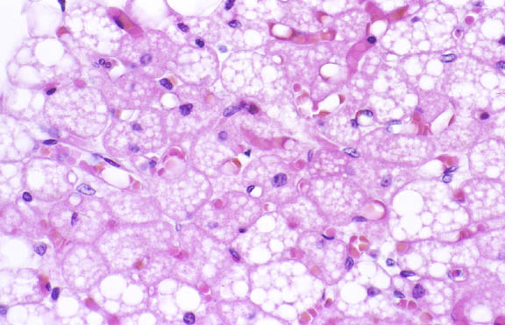
Periadrenal bölgede kahverengi yağ dokusu, H&E x132
http://pathology.mc.duke.edu/ research/PTH225.html

Slide 54
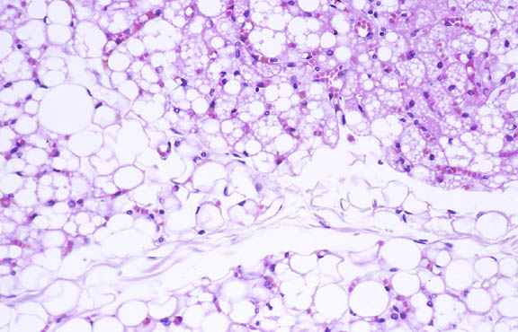
K
B
Periadrenal bölgede beyaz ve kahverengi yağ dokusu, H&E, x66
http://pathology.mc.duke.edu/ research/PTH225.html

Slide 55
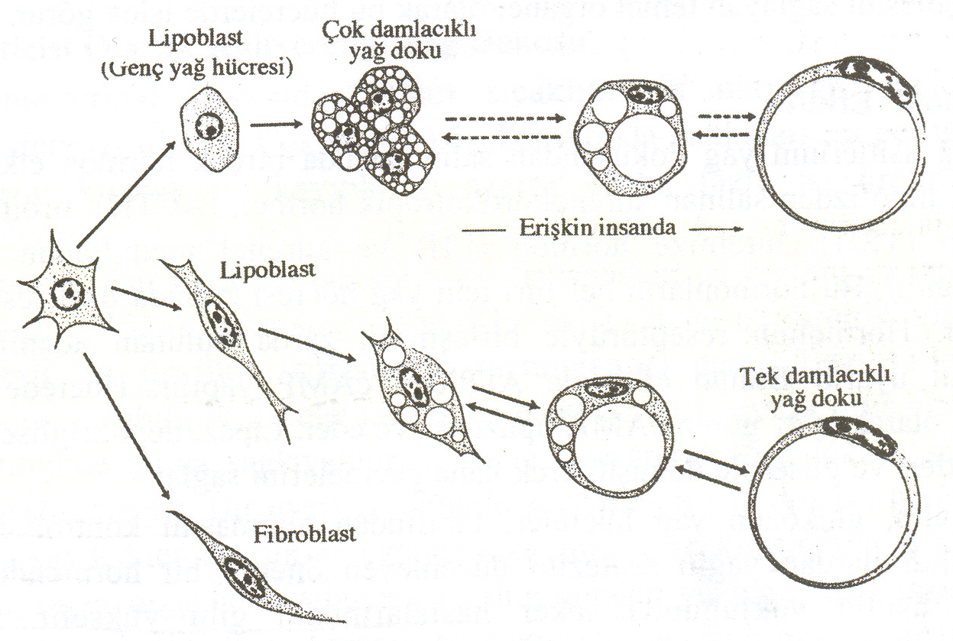
Yağ dokusunun meydana gelişi

Slide 56
HISTOPHYSIOLOGY OF ADIPOSE TİSSUE
Reservoir LİPİD is constantly burned and stored again
The half life of the fat is 8 days in rats.
10% of the fatty acids are stored in the fat tissue and replaced with new ones every day.
Depo fats are fed from the following sources: 1) Fatty acids from chylomicrons composed of oil from foods, 2) Fatty acids synthesized from glucose in liver and sent to adipose tissue in the form of serum lipoprotein, 3) triglycerides synthesized from carbohydrates in fat cells
The balance of fat in the body is under hormonal and neural control.

Slide 57
Cholesterol and other lipids are transported in the form of lipoproteins to specific targets
Plasma lipoproteins are synthesized and released by the liver and intestine.
The largest lipoprotein, chylomicrons, is also expressed in the small intestinal epithelium.
Then it enters the lymph system, which is in the blood through the subclavian artery.
The lipoprotein lipase in the fatty tissue, the heart, the skeletal muscle and the capillary endothelium of the mammary gland allows the tahen chylomicrons to turn into fatty acids, allowing them to enter fat cells, muscle cells and mammary gland cells.
For the formation of triglycerides, it is the sER which enables re-esterification of the fatty acid

Slide 58
Hormonal Effects
Many hormones are involved in the release of fatty acids from adiposa tissue.
These are; Adrenocorticotropic hormone (ACTH) released from the hypophysis, Thyroid stimulating hormone (TSH), Luteinize hormone (LH) The epinephrine released from the adrenal medulla.
For each of these hormones there are specific receptors in the adiposa cell membrane.
The association of the hormone receptor stimulates adenyl cyclase enzyme in the zygote.
With this effect, cAMP is made from ATP.
The cAMP that acts as a secondary messenger in the cell activates the lipase.
Lipase allows the triglycerides to be converted into fatty acids and glycerol to go into the blood.

Slide 59
Insulin is the hormone that regulates glucose uptake by adiposa cells and the synthesis of lipid from carbohydrates.
Blood sugar is elevated in the absence of insulin, like in diabetes.
In addition, the amount of non-esterified fatty acids and lipoproteins increases.
Energy is normally derived from carbohydrates in the cell.
In diabetics, in the absence of insulin, fat is used as a source for the desired energy.
Brown Oil act as Heat Generator
Animals adjust their body temperature within narrow limits.
In very cold conditions, they reduce peripheral blood flows, reducing heat losses and increasing metabolism to produce more heat.

Slide 60
The basal metabolic rate is the rate of heat production or oxygen use in a resting or non-fed animal at normal temperature.
More heat can be produced by flickering in a cold environment.
This is called thermogenesis with flicker (flicker thermogenesis).
Some species can do this without shaking.
They can increase the heat production without increasing the electrical activity of skeletal muscles.
They do this in the form of brown fat.
When a warning comes in, brown fat tissue can consume the highest oxygen consumption recorded in any organ.
At the same time, there is a seven fold increase in blood volume entering this tissue.
When a wintering animal awakens, there is an increase in heat production and oxygen consumption.
By neural stimuli, norepinephrine is released from the nerve endings to the brown fat tissue.

Slide 61
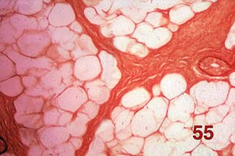
Yağ
Dokusu

Slide 62
Yağ hücresi
Yağ hücresi
Ç
Yağ Dokusu

Slide 63
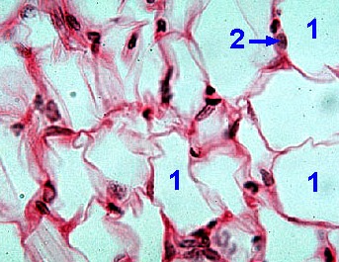
Yağ dokusu. 1.Yağ hücresi, 2.Hücre çekirdeği (x400)

Slide 64
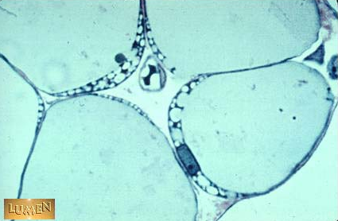
Lipit
Ç
YAĞ
DOKUSU
Yağ hücreleri içine lipit toplanması sebebiyle ince bir sitoplazma kitlesi tarafından çevrelenen çekirdek Ç) bir tarafa itilmiştir. Resmin ortasında dört yağ hücresinin arasında içinde bir eritrosit bulunan küçük bir kılcal damar kesiti görülmektedir.

Slide 65
HISTOPHYSIOLOGY OF THE CT
Functions of connective tissue
1)Provides mechanical support
2)Performs metabolite exchange between tissues and blood
3)Energy deposits in fat tissue
4)Protect your body against infections
5)After the injuries, the area will be repaired

Slide 66
Connective tissue plays a very important role in inflammation.
The inflammation usually develops in the connective tissue and includes all elements of the circulatory system.
When a bacterium or foreign chemical enters the wounded area of the body, and the epithelial layer, which acts as a protective barrier, is also overcome, it reaches the connective tissue,
There, redness, swelling, temperature elevation and pain develop after a series of events.

Slide 67
These events begin as follows: Histamine is released from mast cells as a result of tissue damage.
This enlarges the small vessels, increasing the blood flow rate, causing the area to blossom and increase the regional tissue temperature.
It also increases vascular permeability, causing fluid, fibrinogen and immunoglobulins to escape from the vein.
They form an edema in the tissue, it makes pain by putting pressure on the regional nerves.

Slide 68
The fluid that flows into the tissue quickly blocks the tissue spaces and lymph vessels, preventing the bacteria from spreading through the body.
Leukocyte stimulating factor released from the inflamatuar area detected by leukocytes and then with other blood cells.
After about a day, the monocytes migrating to these tissues are transformed into macrophages and phagocytes, bacteria are killed and digested
As a result, the product of the battle between blood cells and bacteria, accumulates in the tissue.
Tissue fluid, bacteria, dead or dying leukocytes, or pustules of macrophages are excreted out of the body or via the mucous membranes to the the digestive tract

Slide 69
Repair Function of Connective Tissue
The damaged area is repaired shortly with the ability of repair in fibroblasts cells
The heart is repaired by connective tissue after a heart attack.
There is no renewal after cell death in highly differentiated muscle and nerve cells;
The region of the dead nerve cells are filled with exracellular matrıxs by connective tissues cells

Slide 70
Although detailed information on collagen fibril formation has been learned, there are also mechanisms for removing collagen when necessary.
The collagen fibrils are removed by the collagenase enzyme during the dejeneration of the bone.

