Slide 1
COM 412
Information Technology and Security Governance
Week 13
Cloud Computing Security
Industrial Control Systems

Slide 2
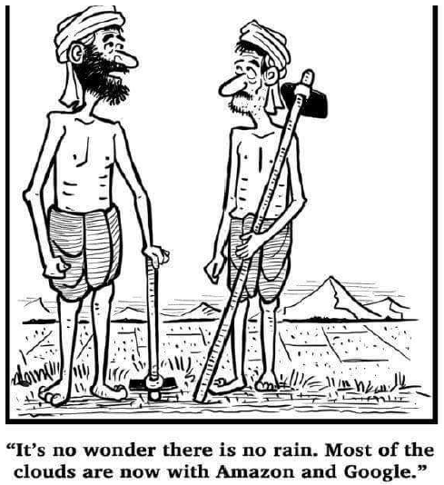
Cloud Computing Security
* Cloud Computing
- provides the ability to scale to tens of thousands of systems
- largely eliminates operational responsibilities
- five essential characteristics
- three service models
- four deployment models

Slide 3
Cloud Computing Security
* Cloud Computing - five essential characteristics:
- On-demand self-service
- Broad network access
- Resource pooling
- Rapid elasticity
- Measured service

Slide 4
Cloud Computing Security
* Cloud Computing - three service models:
- Infrastructure as a Service (IaaS)
- Platform as a Service (PaaS)
- Software as a Service (SaaS)
Notes:
Infrastructure as a Service (IaaS): It provides computing infrastructure, physical or virtual machines and other resources,
like virtual-machine disk image library, block and file-based storage, firewalls, load balancers, IP addresses, virtual local area networks etc..
e.g.: Windows Azure and Google Compute Engine
Platform as a Service (PaaS): It provides computing platforms including operating system, programming language execution environment,
database, web server etc.
e.g.: Windows Azure and Google App Engine
Software as a Service (SaaS): It provides access to application software called "on-demand software".
Customers don't have to worry about the installation, setup and running of the application.
Service provider will do that for customers and customers just have to pay.
e.g.: Google Apps and Microsoft Office 365

Slide 5
Cloud Computing Security
* Cloud Computing – Some sub services
- IaaS: DBaaS (database-as-a-service)
- IaaS: CCaaS (compute capacity-as-a-service)
- PaaS: STaaS (storage-as-a-service)
- PaaS: DTaaS (desktop-as-a-service)
- SaaS: CaaS (communications-as-a-service)
- SaaS: SECaaS (security-as-a-service)
- SaaS: MaaS (monitoring-as-a-service)
Notes:
A few subservice examples and their service models.

Slide 6
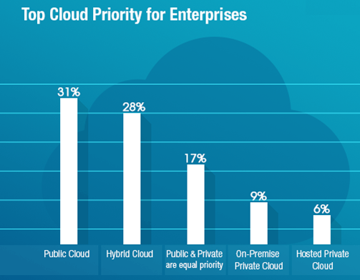
Cloud Computing Security
* Cloud Computing - four deployment models:
- Public
- Private
- Hybrid
- Community
Notes:
• Public: Cloud infrastructure is available to the general public and owned by an organization that sells cloud services.
Most common uses are for application development and testing, non-mission-critical tasks such as file-sharing, and e-mail service.
• Private: Cloud infrastructure for single organization only, may be managed by this organization or a 3rd party, maybe premise or not.
They are more expensive than public clouds because of acquiring and maintaining capital expenditure.
But they are better to address the security and privacy concerns.
• Hybrid: It is a computing environment that connects a company’s on-premises private cloud services
and third-party public cloud into a single, flexible infrastructure.
• Community: it is combinations of clouds types, multiple organizations that are part of a community share computing resources.

Slide 7
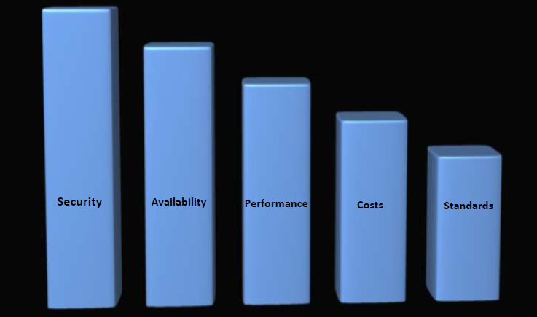
Cloud Computing Security
CIOs’ Cloud Concerns

Slide 8
Cloud Computing Security
What is Cloud computing Security?
In Some Ways, "Cloud Computing Security" Is No Different Than "Regular Security"
Notes:
unlike information technology systems in a traditional data center, in cloud computing,
responsibility for mitigating the risks is shared between the provider and the consumer.

Slide 9
Cloud Computing Security
Cloud-Unique Threats and Risks
- Consumers Have Reduced Visibility and Control
- On-Demand Self Service Simplifies Unauthorized Use
- Internet-Accessible Management APIs can be Compromised
- Separation Among Multiple Tenants Fails
- Data Deletion is Incomplete

Slide 10
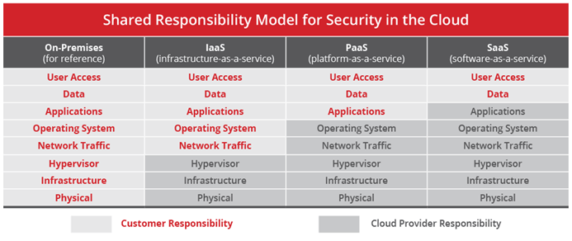
Cloud Computing Security
Shared Security Responsibility Model

Slide 11
Cloud Computing Security
* Top 10 cloud application security issues experienced with SaaS:
- Lack of visibility into what data is within cloud applications
- Theft of data from a cloud application by malicious actor
- Incomplete control over who can access sensitive data
- Inability to monitor data in transit to and from cloud applications
- Cloud applications being provisioned outside of IT visibility (e.g., shadow IT)
- Lack of staff with the skills to manage security for cloud applications
- Inability to prevent malicious insider theft or misuse of data
- Advanced threats and attacks against the cloud application provider
- Inability to assess the security of the cloud application provider’s operations
- Inability to maintain regulatory compliance
Notes:
Issues experienced with SaaS cloud application security are naturally centered around data and access,
because, most of the shared security responsibility models leave those two, as the sole responsibility for SaaS customers.

Slide 12
Cloud Computing Security
* Top 10 cloud application security issues experienced with IaaS:
- Cloud workloads and accounts being created outside of IT visibility (e.g., shadow IT)
- Incomplete control over who can access sensitive data
- Theft of data hosted in cloud infrastructure by malicious actor
- Lack of staff with the skills to secure cloud infrastructure
- Lack of visibility into what data is in the cloud
- Inability to prevent malicious insider theft or misuse of data
- Lack of consistent security controls over cloud and on-premises environments
- Advanced threats and attacks against cloud infrastructure
- Inability to monitor cloud workload systems and applications for vulnerabilities
- Lateral spread of an attack from one cloud workload to another
Notes:
According to the Shared Security Responsibility model, for IaaS,
customer responsibility extends to applications, network traffic, and operating systems, and so, additional threats are introduced for customers.

Slide 13
Cloud Computing Security
* Top 5 cloud security issues experienced with private cloud:
- Lack of consistent security controls spanning over traditional server and virtualized private cloud infrastructures
- Increasing complexity of infrastructure resulting in more time/effort for implementation and maintenance
- Lack of staff with skills to manage security for a software-defined data center (e.g., virtual compute, network, storage)
- Incomplete visibility over security for a software-defined data center (e.g., virtual compute, network, storage)
- Advanced threats and attacks
Notes:
In private clouds, additional levels of control and supplemental protection can compensate for other limitations of private cloud deployments,
and they may contribute to a practical transition from monolithic server-based data centers.

Slide 14
Cloud Computing Security
* Recommendations for mitigating the top security issues in cloud computing
- DevSecOps processes
- Automated application deployment and management tools
- Unified security with centralized management across all services and providers

Slide 15
Cloud Computing Security
* Step-by-step cloud security guide
- “Understand cloud usage and risk” phase
-- Identify sensitive or regulated data
-- Understand how sensitive data is being accessed and shared
-- Discover shadow IT (unknown cloud use)
-- Uncover malicious user behavior

Slide 16
Cloud Computing Security
* Step-by-step cloud security guide
- “Protect your cloud” phase
-- Apply data protection policies
-- Encrypt sensitive data with your own keys
-- Set limitations on how data is shared
-- Stop data from moving to unmanaged devices you don’t know about
-- Apply advanced malware protection to IaaS

Slide 17
Cloud Computing Security
* Step-by-step cloud security guide
- “Respond to cloud security issues” phase
-- Require additional verification for high-risk access scenarios
-- Adjust cloud access policies as new services come up
-- Remove malware from a cloud service

Slide 18
Cloud Computing Security
* IaaS security in detail
- Mistakes
-- Unencrypted data
-- Configuration mistakes: Improperly configured inbound or outbound ports, Multi-factor authentication not activated, Data encryption turned off, Storage access open to the internet
-- Shadow services
-- Excessive user permissions

Slide 19
Cloud Computing Security
* Solutions for IaaS security
- Cloud access security broker (CASB)
- Cloud workload protection platforms
- Virtual network security platforms
- Cloud security posture management
Notes:
Traditional enterprise security solutions aren't built for cloud services, which are outside the organization's firewall.
Virtual infrastructure services (like virtual machines, virtual storage, and virtual networks) require security solutions specifically designed for a cloud environment.
Four important solutions for IaaS security are: cloud access security brokers, cloud workload protection platforms, virtual network security platforms, and cloud security posture management.

Slide 20
Cloud Computing Security
* IaaS provider considerations
- Physical access permissions
- Compliance audits
- Monitoring and logging tools
- Hardware specifications and maintenance
Notes:
IT managers can evaluate providers based on:
Physical access permissions
Compliance audits
Monitoring and logging tools
Hardware specifications and maintenance

Slide 21
Cloud Computing Security
* PaaS security in detail
- Best practices
-- Research the provider's security
-- Use threat modeling
-- Check for inherited software vulnerabilities
-- Implement role-based access controls
-- Manage inactive accounts
-- Take advantage of provider resources

Slide 22
Cloud Computing Security
* SaaS security in detail
- Best practices
-- Detect rogue services and compromised accounts
-- Apply identity and access management
-- Encrypt cloud data
-- Enforce data loss prevention
-- Monitor collaborative sharing of data
-- Check provider's security

Slide 23
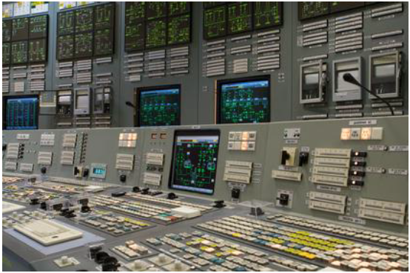
Industrial Control Systems (ICS)
* Industrial processes
- Manufacturing
- Smart Grid
- Utilities
- Oil & Gas
- Transport
- Telecommunication
- Chemicals

Slide 24
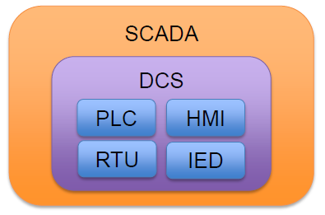
Industrial Control Systems (ICS)
* ICS components
•IED –Intelligent Electronic Device
•RTU –Remote Terminal Units
•PLC –Programmable Logic Controllers
•DCS –Distributed Control Systems
•HMI –Human-Machine Interfaces
•SCADA–Supervisory Control and Data Acquisition

Slide 25
Industrial Control Systems (ICS)
* Security Concerns
•Weak communication protocols
•Weak passwords
•Poor QoS
•Internet connected web servers without protection
•Difficult or nonexistent patching

Slide 26
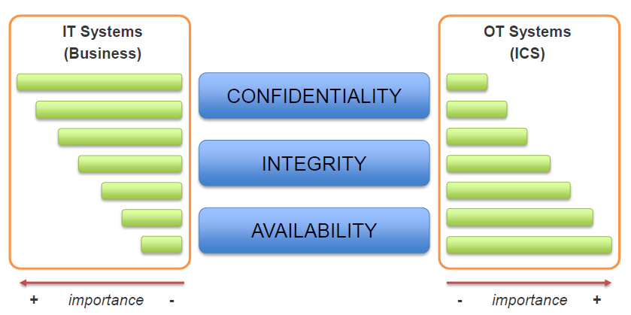
Industrial Control Systems (ICS)

Slide 27
Industrial Control Systems (ICS)
* Some countermeasures
- Assess existing systems
- Document policies and procedures
- Train personnel and contractors
- Segment the control system network
- Control access to the system
- Harden the components of the system
- Monitor and maintain the system

