Slide 1
Connective Tissue
Part2

Slide 2
Main classes
Connective tissue proper
Blood – Fluid connective tissue
Cartilage
Bone tissue
Supporting connective tissues

Slide 3
Components of connective tissue
Cells (varies according to tissue)
Matrix
Ground substance (varies according to tissue)
Protein fibers (varies according to tissue)

Slide 4
Connective Tissue Proper - Structures
Variety of cells, fibers & grounds substances
Types of depend on use
Cells found in connective tissue proper
Fibroblasts
Macrophages, lymphocytes (antibody producing cells)
Adipocytes (fat cells)
Mast cells
Stem cells
Ground substance:
Along with fibers, fills the extracellular space
Ground substance helps determine functionality of tissue
Fibers:
Collagen – very strong & abundant, long & straight
Elastic – branching fibers with a wavy appearance (when relaxed)
Reticular – form a network of fibers that form a supportive framwork in soft organs (i.e. Spleen & liver)

Slide 5
Fibers.
Not all types of CT are fibrous.
adipose tissue and blood are examples of non-fibrous CT
Adipose tissue gives "mechanical cushioning" to the body, among other functions.
Although there is no dense collagen network in adipose tissue, groups of adipose cells are kept together by collagen fibers and collagen sheets in order to keep fat tissue under compression in place
The matrix of blood is plasma.
Both the ground substance and proteins (fibers) create the matrix for CT.

Slide 6
FİBERS of CT
There are three types of fibers in connective and supporting tissues of the body (connective tissue, blood, cartilage and bone tissue)
Collagen
Elastic
Reticular

Slide 7
COLLAGEN FIBERS
The name collagen comes from the Greek meaning "glue", and suffix -γέν, -gen, denoting "producing".
They are present in varying amounts in all varieties of connective tissue.
In unstained preparations of loose connective tissue they appear as colorless strands 0.5-20 microns in diameter.
They are well painted with acidic dyes.
They have no obvious lengths.
They are scattered in every direction within the tissue.
They show a slightly wavy structure when they are not under pressure
The tendons and ligaments are visible in a silver-white color when viewed through the naked eye.

Slide 8
Collagen is the main structural protein in the extracellular space in the various connective tissues in animals
As the main component of connective tissue, it is the most abundant protein in mammals, making up from 25% to 35% of the whole-body protein content.
Collagen consists of amino acids wound together to form triple-helices to form of elongated fibrils.
Mostly found in fibrous tissues such as tendons, ligaments and skin

Slide 9
Depending upon the degree of mineralization, collagen tissues may be rigid (bone), compliant (tendon), or have a gradient from rigid to compliant (cartilage).
It is also abundant in corneas, cartilage, bones, blood vessels, intervertebral discs, and the dentin in teeth.
In muscle tissue, it serves as a major component of the endomysium.

Slide 10
Collagen constitutes one to two percent of muscle tissue, and accounts for 6% of the weight of strong, tendinous muscles.
The fibroblast is the most common cell that creates collagen.
In addition,
osteoblast (bone cell),
odondoblast (dental cell),
chondroblast (cartilage cell) also synthesize.
Smooth muscle cells, reticular cells, Schwann cells, hepatocytes, endothelial cells and epithelial cells also synthesize collagen.

Slide 11
When tissues containing collagen fibers are boiled, they melt to gelatin, which is a sticky substance.
Gelatin, which is used in food and industry, is collagen that has been irreversibly hydrolyzed.
Collagen also has many medical uses for treatment of complications in bones and skin.

Slide 12
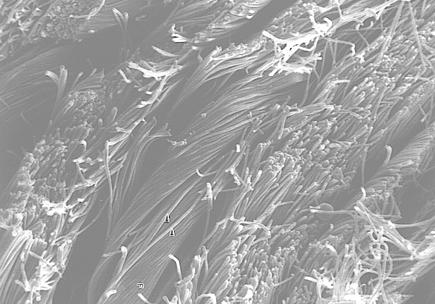
Collagen fibers

Slide 13
Many types of collagen fibers have been defined
The collagen diversity results from the difference in the molecular structure.
However, thise differences are well conserved in the amino acid content within the evolutionary process, and does not show much variation.
Collagen fibers are formed from collagen protein.
This protein comes from three polypeptide chains that are wrapped around one another.

Slide 14
These chains are known by names such as alpha 1, alpha 2.
For example, Type I collagen has two alpha 1 and one alpha 2 chains.
However, the type and number of alpha chains in the collagen structure of the same type differ in different organisms.
The collagen fiber structure contains
glycine (33.5%),
proline (12%),
hydroxyproline (10%) and
Lysine amino acids .

Slide 16
Collagen fibers gives a homogeneous appearance in normal light microscope, in a polarization microscope,it breaks light to 2 parts
When viewed with an electron microscope, they show transverse lines along their length.
Collagen fibers are very flexible; but the greatest feature is that it is very durable against pulling.
When hundred kilograms of force applied to a centimeter square in the human tendon it causes collagen fibers breakage.
The application of such force results in very little extension in their dimensions.

Slide 17
The synthesis of collagen occurs inside and outside of the cell.
Most common form of collagen is fibrillary collagen
Meshwork collagen, which is often involved in the formation of filtration systems, is the other form of collagen.
All types of collagens are triple helices, and the differences lie in the alpha

Slide 18
Collagen I formation
Most collagen forms in a similar manner, but the following process is typical for type I:
Inside the cell
Two types of alpha chains are formed during translation on ribosomes along the rough endoplasmic reticulum (RER):
alpha-1 and
alpha-2 chains.

Slide 19
Transcription of mRNA:
About 34 genes are associated with collagen formation, each coding for a specific mRNA sequence, and typically have the "COL" prefix.
The beginning of collagen synthesis begins with turning on genes which are associated with the formation of a particular alpha peptide (typically alpha 1, 2 or 3).

Slide 20
Pre-pro-peptide formation:
Once the final mRNA exits from the cell nucleus and enters into the cytoplasm, it links with the ribosomal subunits and the process of translation occurs.
The early/first part of the new peptide is known as the signal sequence.
The signal sequence on the N-terminal of the peptide is recognized by a signal recognition particle on the ER, which will be responsible for directing the pre-pro-peptide into the ER.
Therefore, once the synthesis of new peptide is finished, it goes directly into the ER for post-translational processing.
It is now known as pre-pro-collagen.

Slide 21
Pre-pro-peptide to pro-collagen:
Three modifications of the pre-pro-peptide occur leading to the formation of the alpha peptide:
The signal peptide on the N-terminal is dissolved, and the molecule is now known as propeptide
Hydroxylation of lysines and prolines on propeptide by the enzymes 'prolyl hydroxylase' and 'lysyl hydroxylase' (to produce hydroxyproline and hydroxylysine) occurs to aid cross-linking of the alpha peptides.
This enzymatic step requires vitamin C as a cofactor.
In scurvy disease, the lack of hydroxylation of prolines and lysines causes a looser triple helix

Slide 22
Glycosylation occurs by adding either glucose or galactose monomers onto the hydroxyl groups on lysines, but not on prolines.
Once these modifications have taken place, three of the hydroxylated and glycosylated propeptides twist into a triple helix forming procollagen.
Procollagen still has unwound ends, which will be later trimmed.
At this point, the procollagen is packaged into a transfer vesicle destined for the Golgi apparatus.

Slide 23
Golgi apparatus modification:
In the Golgi, the procollagen goes through one last post-translational modification before being secreted out of the cell.
In this step, oligosaccharides are added, and then the procollagen is packaged into a secretory vesicle destined for the extracellular space.

Slide 24
Formation of tropocollagen:
Once outside the cell, membrane bound enzymes known as 'collagen peptidases', remove the "loose ends" of the procollagen molecule.
What is left is known as tropocollagen.
Defects in this step produce one of the many collagenopathies known as Ehlers-Danlos syndrome.
This step is absent when synthesizing type III, a type of fibrilar collagen.
.

Slide 25
Formation of the collagen fibril:
lysyl oxidase, an extracellular copper-dependent enzyme, produces the final step in the collagen synthesis pathway.
This enzyme acts on lysines and hydroxylysines producing aldehyde groups, which will eventually undergo covalent bonding between tropocollagen molecules.
This polymer of tropocollogen is known as a collagen fibril

Slide 26
Amino acids
Collagen has an unusual amino acid composition and sequence:
Glycine is found at almost every third residue.
Proline makes up about 17% of collagen.
Collagen contains two uncommon derivative amino acids not directly inserted during translation.

Slide 27
These amino acids are found at specific locations relative to glycine and are modified post-translationally by different enzymes, both of which require vitamin C as a cofactor.
Hydroxyproline derived from proline
Hydroxylysine derived from lysine - depending on the type of collagen, varying numbers of hydroxylysines are glycosylated (mostly having disaccharides attached).

Slide 28
Long-term deficiency of vitamin C results in impaired collagen synthesis and scurvy disease.
These hydroxylation reactions are catalyzed by two different enzymes:
prolyl-4-hydroxylase and
lysyl-hydroxylase.
Vitamin C involves in these reactions.
One molecule of vitamin C is destroyed for each H replaced by OH
Cortisol stimulates degradation of (skin) collagen into amino acids.

Slide 29
Collagen occurs in many places throughout the body.
Over 90% of the collagen in the human body is type I
The five most common types are:
Type I: skin, tendon, vasculature, organs, bone (main component of the organic part of bone)
Type II: cartilage (main collagenous component of cartilage)
Type III: reticulate (main component of reticular fibers), commonly found alongside type I.
Type IV: forms basal lamina, the epithelium-secreted layer of the basement membrane.
Type V: cell surfaces, hair and placenta

Slide 30
Collagen may be attached to cell membranes via several types of protein, including
fibronectin,
laminin,
fibulin and
integrin

Slide 31
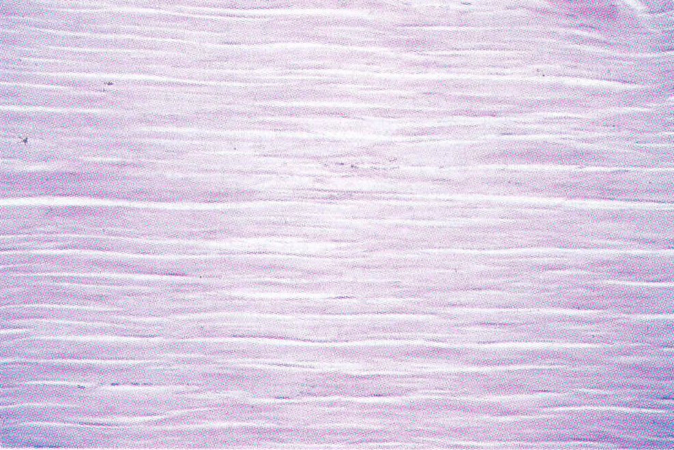
Collagen fibers
Fibroblast
Dense regular CT. Collagen fiber in the same direction and few fibroblasts (Tendon) (H&E; x100)

Slide 32
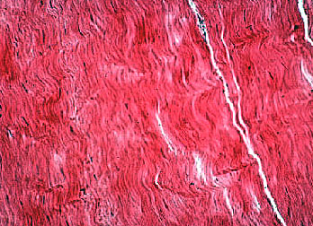
Dense regular CT, collagen fibers (Tendon)

Slide 33
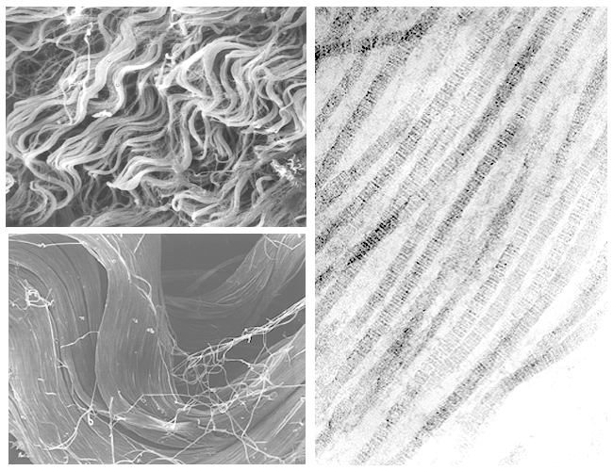
CT fibers

Slide 34
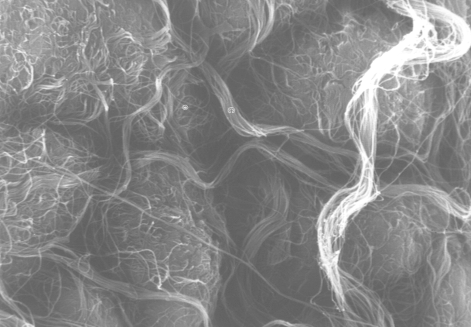
Collagen fibers EM

Slide 35
Reticular fibers
Reticular fibres or reticulin is a type of fiber in connective tissue composed of type III collagen secreted by reticular cells.
Reticular fibers crosslink to form a fine meshwork (reticulin).
This network acts as a supporting mesh in soft tissues such as liver, bone marrow, and the tissues and organs of the lymphatic system.

Slide 36
Reticular fiber is composed of one or more types of very thin and delicately woven strands of type III collagen.
These strands build a highly ordered cellular network and provide a supporting network.
Many of these types of collagen have been combined with carbohydrate.
Thus, they react with silver stains and with periodic acid-Schiff reagent but are not demonstrated with ordinary histological stains such as hematoxylin.
Reticular and regular collagenous materials contains the same four sugars – galactose, glucose, mannose, and fucose – but in a much greater concentration in the reticular than in the collagenous material.

Slide 37
The cof the capillary sheath and splenic cord were studied and compared in the pig spleen by transmission electron microscopy.
Their components and the presence of sialic acid in the amorphous ground substance were revealed.
Collagen fibrils, elastic fibers, microfibrils, nerve fibers, and smooth muscle cells were observed in the reticular fibers of the splenic cord.
On the other hand, only microfibrils were recognized in the reticular fibers of the capillary sheath.

Slide 38
The binding of LFA lectin to the splenic cord was stronger than the capillary sheath.
These findings suggested that the reticular fibers of the splenic cord include multiple functional elements and might perform an important role during contraction or dilation of the spleen.
On the other hand, the reticular fiber of the capillary sheath resembled the basement membrane of the capillary in its components.
Because of their affinity for silver salts, these fibers are called argyrophilic

Slide 39
EM image of the adipocyte cluster. Threadlike appearance of the supportive reticular fiber mesh.x150

Slide 40
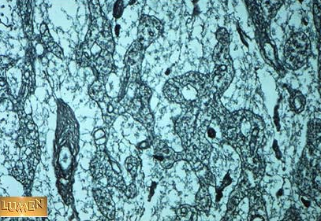
Reticular fibers

Slide 41
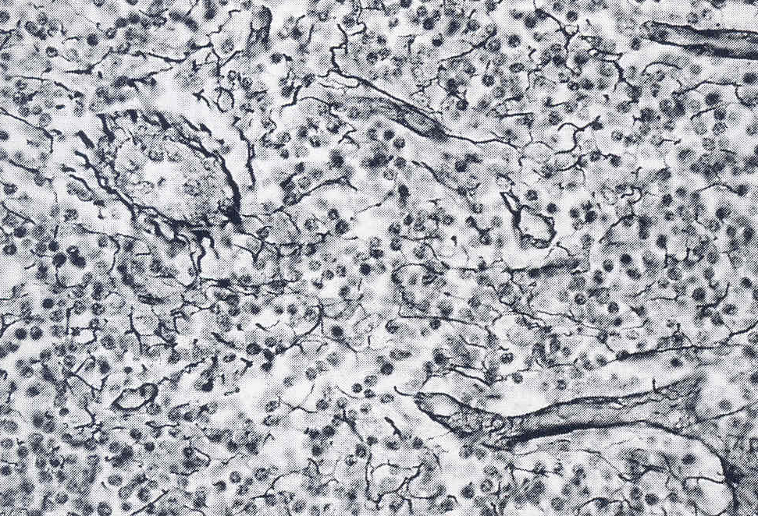
Reticular fibers, Lymph node (Silver staining; x 250)

Slide 42
Elastic fibers (or yellow fibers)
Are bundles of proteins (elastin) found in extracellular matrix of connective tissue and produced by fibroblasts and smooth muscle cells in arteries.
These fibers can stretch up to 1.5 times their length, and snap back to their original length when relaxed.
Elastic fibers include
elastin,
elaunin and
oxytalan.

Slide 43
Some organs increase their volume as a result of external or internal force during their normal functioning, and then return to their original state.
Elastic fibers are found in the areas with such stresses.
They are found in the lungs, stomach, veins, ligaments, vocal cords, mesentery, bladder, etc.
The diameter of the aorta increases with every pumping of blood
The lungs also expand in every breath, and return to the old volume in exhalation.

Slide 44
The urinary bladder (urinary bladder) may expand and contract according to the presence or absence of urine.
All these organs extend their volumes when a force or pressure is applied, the structures that allow these organs to take back their old dimensions are essentially elastic fibers.
These organs contain plenty of elastic fibers.
Elastic fibrils of the connective tissue give the ability to stretch to the tissues

Slide 45
Elastic tissue is classified as "connective tissue proper".
Elastic fibrils do not consist of fibril subunits.
Therefore, there are homogeneous images.
In electron microscope, elastic strands consisted of two parts.
Formed from the elastic microfibril (consisting of numerous proteins such as microfibrillar-associated glycoproteins, fibrillin, fibullin, and the elastin receptor) and amorphous elastin.
The microfibril scaffolds and organizes the deposition of amorphous elastin.

Slide 46
1-Elastin: It is an amorphous middle part.
Elastin is resistant to weak acid and alkaline solutions which can break down other elements of connective tissue and to boiling.
Can be easily disrupted by the action of the elastase enzyme of the pancreas
30% of the amino acids are glycine,
11% are proline.
There are also hydroxyproline and hydroxylysine.
Elastin contains non-collagen hydrophobic amino acids.
Furthermore, the amino acids desmosine and isodesmosine, which cross-link with the polypeptide chain, are involved in the elastin structure.

Slide 47
2-Fibrillin: It is glycoprotein and makes the filaments embedded in elastine or surrounding it.
The diameters of microfibrils embedded in the elastin vary between 100-120.
The microfibrils stand parallel to each other to form the microfibril bundle.

Slide 48
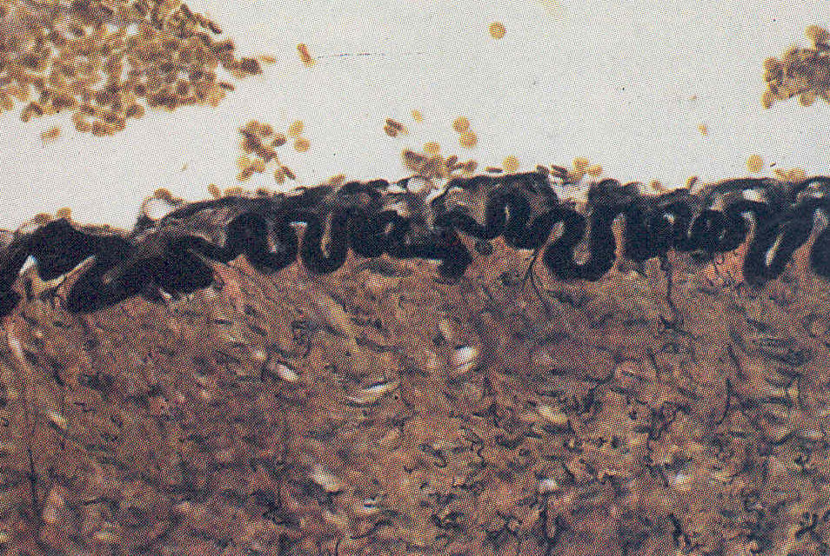
Elastic lamina consisting of black stained elastic fibers on the arterial wall (Verhoeff dye, x 250)

Slide 49
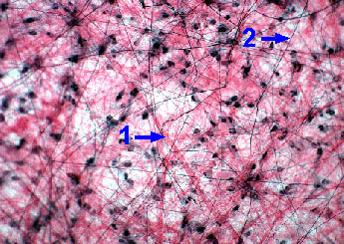
Areolar CT, 1.Collagen fibers, 2.Elastic fibers

Slide 50
Other fibrous structural proteins of connective tissue
In addition to collagen, reticular and elastic fibrils there are various chemical and molecular structures in connective tissue
Fibronectin
Laminins
Vitronectin
Tenascins
Nidogens
Glycoproteins are distinctive molecules that differ from proteoglycans of the extracellular matrix by their high protein content and polysaccharide side chain properties

Slide 51
Fibronectin
Is a high-molecular weight (~440kDa) glycoprotein of the extracellular matrix that binds to membrane-spanning receptor proteins called integrins.
Similar to integrins, fibronectin binds extracellular matrix components such as collagen, fibrin, and heparan sulfate proteoglycans.
Fibronectin exists as a protein dimer, consisting of two nearly identical monomers linked by a pair of disulfide bonds.
The fibronectin protein is produced from a single gene, but alternative splicing of its pre-mRNA leads to the creation of several isoforms.

Slide 52
Two types of fibronectin are present in vertebrates:
soluble plasma fibronectin (cold-insoluble globulin or CIg) is a major protein component of blood plasma (300 μg/ml) and is produced in the liver by hepatocytes.
insoluble cellular fibronectin is a major component of the extracellular matrix.
It is secreted by various cells, primarily fibroblasts, as a soluble protein dimer and is then assembled into an insoluble matrix in a complex cell-mediated process.

Slide 53
Fibronectin plays a major role in
cell adhesion,
growth,
migration,
differentiation,
it is important for processes such as wound healing and embryonic development
Altered fibronectin expression, degradation, and organization has been associated with a number of pathologies, including cancer and fibrosis

Slide 54
Laminins
Are high-molecular weight (~400 to ~900 kDa) proteins of the extracellular matrix.
They are a major component of the basal lamina, a protein network foundation for most cells and organs.
The laminins are an important and biologically active part of the basal lamina, influencing cell
differentiation, migration, and adhesion.
They are heterotrimeric proteins that contain an α-chain, a β-chain, and a γ-chain, found in five, four, and three genetic variants, respectively.

Slide 55
The laminin molecules are named according to their chain composition; laminin-511 contains α5, β1, and γ1 chains.
Fourteen other chain combinations have been identified in vivo.
The trimeric proteins intersect to form a cross-like structure that can bind to other cell membrane and extracellular matrix molecules.
The three shorter arms are particularly good at binding to other laminin molecules, which allows them to form sheets.
The long arm is capable of binding to cells, which helps anchor organized tissue cells to the membrane.
The laminin family of glycoproteins are an integral part of the structural scaffolding in almost every tissue of an organism.
They are secreted and incorporated into cell-associated extracellular matrices.

Slide 56
Laminin is vital for the maintenance and survival of tissues.
Laminins form independent networks and are associated with type IV collagen networks via entactin, fibronectin, and perlecan.
With interactions, laminins critically contribute to
cell attachment and differentiation,
cell shape and movement,
maintenance of tissue phenotype, and
promotion of tissue survival.
Defective laminins can cause muscles to form improperly, leading to a form of muscular dystrophy, lethal skin blistering disease (junctional epidermolysis bullosa) and defects of the kidney filter (nephrotic syndrome).

Slide 57
Tenascins
It is a large and complex glycoprotein of extracellular matrix.
It is synthesized tissue and time-specific during embryonic development.
It plays an important role especially in the development of epithelial-mesenchymal spaces and morphogenetic movements.
During the development of the placenta, it is particularly expressed in mesenchymal villi
In addition it’s expression increase in the healing of wounds, tumorogenesis and epithelial morphogenesis.

Slide 58
Vitronectin
It plays a role in the regulation of thrombin activity and proteolysis on the cell surface.
Intrinsic protein of human sperm.
It is found as a adhesion protein in tissue and plasma.
They are expressed in various amounts in cell differentiation and neoplastic changes (tumor formation)

Slide 59
Nidogens,
Formerly known as entactins, are a family of sulfated monomeric glycoproteins located in the basal lamina.
Two nidogens have been identified in humans: nidogen-1 (NID1) and nidogen-2 (NID2).
It plays an important role in the formation of the extracellular matrix (ECM) and in the regulation of the activities of other ECM components
Nidogens have been shown to play a crucial role during organogenesis in late embryonic development, particularly in cardiac and lung development.

Slide 60
Nidogen-1 (NID-1), is encoded by the NID1 gene.
Both nidogen-1 and nidogen-2 are essential components of the basement membrane alongside other components such as type IV collagen, proteoglycans (heparan sulfate and glycosaminoglycans), laminin and fibronectin.

