Slide 1
EME 201 Materials Science
Atomic Structure and Interatomic Bonding

Slide 2
The Periodic Table
The periodic table is a valuable tool to make comment on materials.
The periodic table includes valuable information about certain elements and can also help determine the tendency of atomic size, melting point and other properties.
The periodic table was designed in accordance with the electronic structure of the elements.
The order in the periodic table corresponds to the quantum shells or the basic quantum numbers.
The columns typically correspond to the number of electrons in the outermost s and p energy levels.

Slide 3
The Periodic Table
The elements in Group 0 are inert gases filling the electron shells and stable electron configurations.
Group 6A and 7A elements, respectively, have two electrons and one electron deficient.
Group 7 elements are known as halogens.
Flourine, Chlorine, Bromine can be shown as examles for halogens.
Alkaline and alkaline earth metals have been labeled as Groups 1A and 2A with one and two electrons in excess.
The elements in the three long periods from Group 3B to 2B, are called as transition metals that partially fill the d electron states and, in some cases, one or two electrons in the next higher energy level.

Slide 4
The Periodic Table
Most of the elements in the periodic table fall into the metal classification.
These are sometimes called electropositive elements; which indicates that a small number of electrons can turn the material into positively charged ions.
In addition, the elements on the right side of the periodic table are electronegative.
Atoms of the elements accept electrons easily to form negatively charged ions, or these atoms share electrons with other atoms.
Electronegativity increases when you move from left to right and from bottom to top on the periodic table.
Atoms can gain electrons if their outer energy levels are nearly full and closer to the nucleus.

Slide 5
Atomic Bonding
In engineering materials there are four important mechanisms by which atoms are bonded with each other:
1. Metallic bond
2. Covalent bond
3. Ionic bond
4. van der Waals bond
In the metallic, covalent and ionic bonding mechanisms, bonding is achieved when the atoms fill their outer s and p levels.
Metallic, covalent and ionic bonds are relatively strong compared to van der Waals bond and metallic, covalent and ionic bonds are known as primary bonds
Van der Waals bonds are secondary bonds and results from a different bonding mechanism .

Slide 6
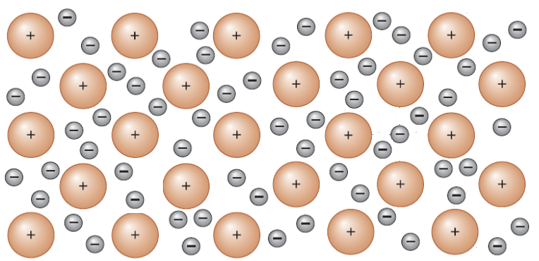
The Metallic Bond
Figure 1. Bonding structure whithin metallic materials

Slide 7
The Metallic Bond
Valence electrons move freely in the electron cloud, which is also known as electron sea, and are associated with several atomic nuclei.
Positively charged ion nuclei are held together within the crystal structure by attraction to the electron, which results in a strong metallic bond among metallic atoms.
Since the valence electrons are not constant in any position, most of the pure metals are good electrical conductors at relatively low temperatures.
The valence electrons of metals move and results in a current flow after the circuit is completed.
Materials possessing metallic bonds illustrate relatively high elastic modulus because of strong bonds.
Metals exhibit good ductility owing to the metallic bonds.

Slide 8
The Covalent Bond
Each hydrogen atom has one 1s electron.
Each of the hydrogen atoms can acquire the stable electron configuration when two hydrogen atoms share their single electrons.
In addition, there is an overlapping of 1s orbitals in the region between the two hydrogen atoms.
Figure 2. Schematic illustration of covalent bonding for hydrogen gas.

Slide 9
The Covalent Bond
Covalent bonds are among strong bonding types.
But it is not easy to predict the mechanical properties of covalently bonded materials based on the bonding properties.
The mechanical behaviors of covalently bonded materials are very diverse.
Certain types of covalently bonded materials are relatively strong, some are weak.
Certain types of covalently bonded materials fail fragile, while some experience significant amounts of deformation before failure.
For example, diamond, boron nitride and silicon carbide illustrate covalent type of boding.
States covalently bonded materials also illustrate very high melting points.

Slide 10
The Ionic Bond
When a material has more than one atom type, an atom can donate its valence electrons to a different atom that fills the outer energy level of the second atom.
Both atoms now fill or emptied external energy shells, but both have gained an electric charge and behave as ions.
Ionic binding is also known as non-directional type of bonding, which means that the magnitude of the bond is equal in every direction of an ion.
In order for ionic materials to be balanced, all positive ions must have their nearest neighbors negatively charged in a three dimensional structure.
Bonding energies ranging from 600 to 1500 kJ/mol are relatively large, which gives rise to high melting temperatures.

Slide 11
REFERENCES
William D. Callister, ‘Materials Science and Engineering: An Introduction’, Seventh edition, John Wiley & Sons, Inc., U.S.A.
Brian S. Mitchell, ‘AN INTRODUCTION TO MATERIALS ENGINEERING AND SCIENCE FOR CHEMICAL AND MATERIALS ENGINEERS’, John Wiley & Sons, Inc., U.S.A, 2004.
J. W. Martin, ‘Materials for Engineering’, Third Edition, WOODHEAD PUBLISHING LIMITED, Cambridge, England.
Donald R. Askeland & Pradeep P. Fulay, ‘Essentials of Materials Science and Engineering’, Second Edition, Cengage Learning, Toronto, Canada.
G. S. Brady, H. R. Clauser, J. A. Vaccari, ‘Materials Handbook’, Fifteenth Edition, McGraw-Hill Handbooks.

