Slide 1
Hardware Description Languages (HDLs) Verilog
Material from Mano & Ciletti book
By Kurtulus KULLU Ankara University

Slide 2
What are HDLs?
A Hardware Description Language
resembles a programming language
specifically oriented to describe hardware
HDL model can be simulated to check and verify a circuit’s functionality
Also, automatic tools can optimally synthesize the logic described by an HDL model
2 HDLs (Verilog and VHDL) are approved as standards by IEEE and widely used.

Slide 3
Verilog

Slide 4
Verilog
A module is the fundamental descriptive unit in Verilog
Name and list of ports

Slide 5
Verilog
Internal connections
Primitive gate instantiations:
Keyword name(output and inputs)

Slide 6
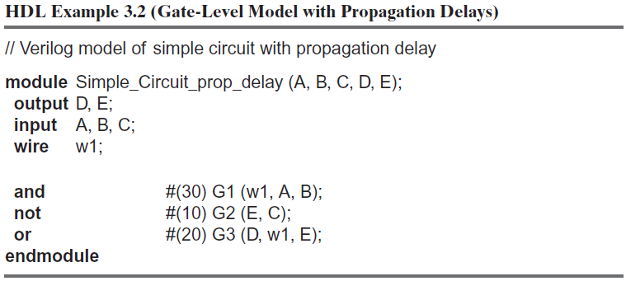
Delays in Verilog

Slide 7
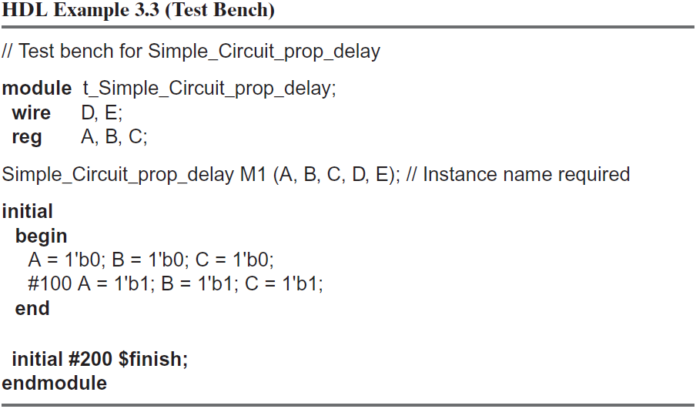
Test Bench

Slide 8
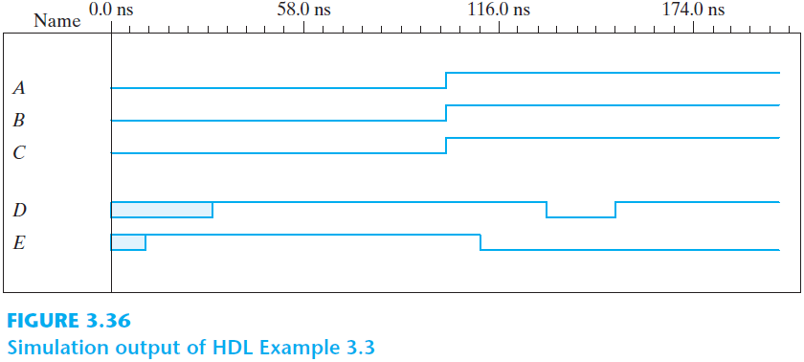
Verilog Simulation Results

Slide 9
Boolean Expressions
keyword assign
symbols &, |, and ! for AND, OR, and NOT
The previous example circuit could be defined with the statement
assign D = (A && B)||(!C);

Slide 10
Modeling with Expressions
Description below specifies a circuit with the following two Boolean expressions
$$E=A+BC+B^{′}D$$
$$F=B^{′}C+BC^{′}D′$$

Slide 11
User-defined Primitives and Truth Tables
Users can create their own primitives (with keyword primitive)
There can only be one output which is written first
A truth table can be given between table and endtable

Slide 12
Instantiating User-Defined Primitives

Slide 13
HDL Models
Logic of a module can be described in different ways
Gate-level modeling
Gates and how they are connected together
Dataflow modeling
Operators that act on binary operands and produce a binary result
Behavioral modeling
Circuits at a functional and algorithmic level (mostly used for sequential circuits)

Slide 14
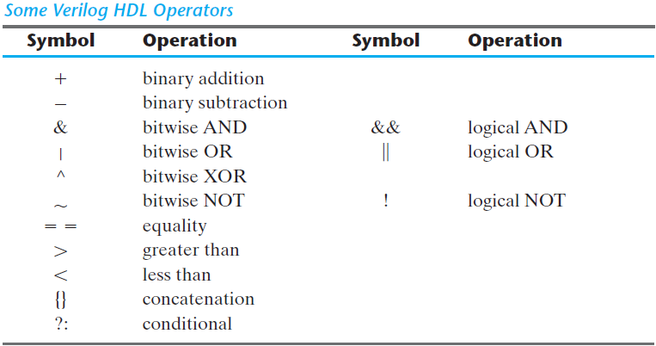
Some Verilog Operators

Slide 15
Summary
We only looked at a summary of HDLs
There are many other capabilities
State diagram-based models
Structural description of sequential circuits
Registers
Counters
…
The primary aim is to make circuit design and testing (simulating) easy and automatic synthesis possible

