Slide 1
European Union 2009
27 Members
480 million population (more than the total population of the USA and Russia)
21.6 billion Euros spent for new members in 2004-2006
80,000-page acquis
New neighbors: Russia, Ukraine, Belarus, Moldova and the Mediterranean world

Slide 2
EUROPEAN CONSTITUTION
In the new structure of the EU, whose number of members increased from 15 to 25 in May 2004, it was necessary to rearrange the system so that the management mechanisms of the EU were not obstructed.
Heads of State and Government agreed on a larger and deeper debate on the future of the Union at the Nice Summit and more serious revision of the founding treaties.

Slide 3
The Assembly, which convened on February 8, 2002, completed its work on June 13, 2003, after 15 months of work.
The European Constitution, prepared by the European Convention created within this framework, was signed in Rome on October 29, 2004 and later submitted to the approval of the member states.

Slide 4
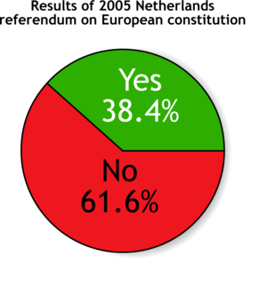
France and Netherlands Referendums
The EU Constitution was not accepted by referendums held in France on 29 May 2005 and then in Holland on 1 June 2005.
France: 55% “no”
Netherlands

Slide 5
21 - 22 June 2007 EU Leaders Summit
After two years of uncertainty following its rejection in 2005 in the Netherlands and France, European leaders agreed on a Reform Agreement to replace the EU Constitution.
According to the agreement reached, an intergovernmental conference will be held by the end of July 2007, this conference will be completed by the end of the year, and the agreed text will be submitted for the approval of the member states until the 2009 European Parliament elections.

Slide 6
THE NO OF IRELAND!
This time the Reform Agreement was put on a referendum in Ireland on 12 June 2008.
% 53,7 NO
% 46,3 YES

Slide 7
In the second referendum held on 2 October 2009 in Ireland, the Lisbon Treaty was approved. Thus, the ratification process of the Treaty was completed.

Slide 8
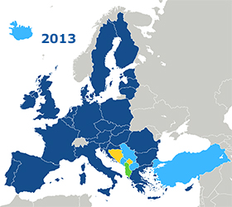
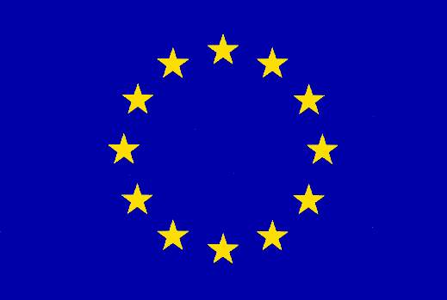
The Last Expansion Wave and Potential Members
Finally, Croatia became the 28th member of the EU on 1 July 2013. As of 2013, Iceland, Macedonia, Montenegro and Serbia have “candidate countries” status as well as our country; Albania, Bosnia and Herzegovina and Kosovo are also “potential candidate countries”.
As a result; There are 27 EU member countries. These are Germany, Austria, Belgium, England (Left) Denmark, Finland, France, Netherlands, Ireland, Spain, Sweden, Italy, Luxembourg, Portugal, Greece, Czech Republic, Estonia, Cyprus, Latvia, Lithuania, Hungary, Malta, Poland Slovakia, Slovenia, Bulgaria and Romania are Croatia. Countries in the EU candidate status: Turkey, Republic of Macedonia, Iceland, Montenegro, Serbia. Potential Candidate countries: Albania, Bosnia and Herzegovina are Kosovo.
https://ab.ibb.gov.tr/avrupa-birligi/abnin-tarihcesi/

Slide 9
SUMMARY OF EUROPEAN UNION HISTORY
1950 : Schuman ;Plan
1951 : European Coal and Steel Community
1957 : ROMA ➔ EEC
➔ EUROATOM 1965 Fusion European Community
1993 : Maastritcht European Union
1. Wave: ENGLAND, IRELAND, DENMARK (1973)
2. Wave: GREECE (1981)
3. Wave: SPAIN, PORTUGAL (1986)
4. Wave: AUSTRIA, SWEDEN, FINLAND (1995)
5. Wave: ESTONIA, LATVIA, LITHUANIA, POLAND, HUNGARY, CZECH REPUBLIC, SLOVENIA, SLOVAKIA, MALTA, CYPRUS (2004)
6. Wave: BULGARIA, ROMANIA (2007)
7. Wave: CROATIA (2013)
BREXİT (2016)

Slide 10
Infographic : Summary of EU History
https://infograph.venngage.com/ps/OQ6IVpyOcc/eu-history-timeline

Slide 11
Any Questions!?

