Slide 1
LABORATORY SAFETY

Slide 2
Laboratory Safety
Excessive amounts of the materials which are flammable, combustible, explosive, etc. are located in laboratory.
To establish specific rules and practices to protect the working people and their working areas and chemicals

Slide 3
Laboratory Safety
The safeguards and safety rules are set out to remove the hazards altogether or to reduce the most.
Basic precautions: The laboratory apron, eyeglasses, gloves and mask should be used while working in the laboratory.

Slide 4
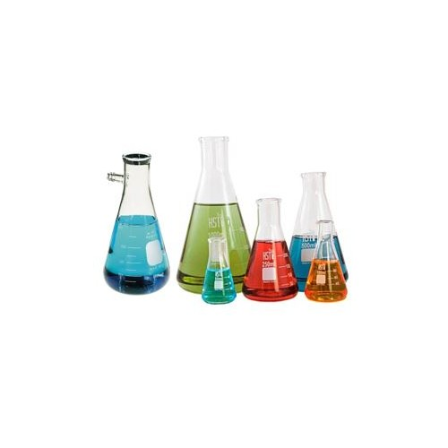
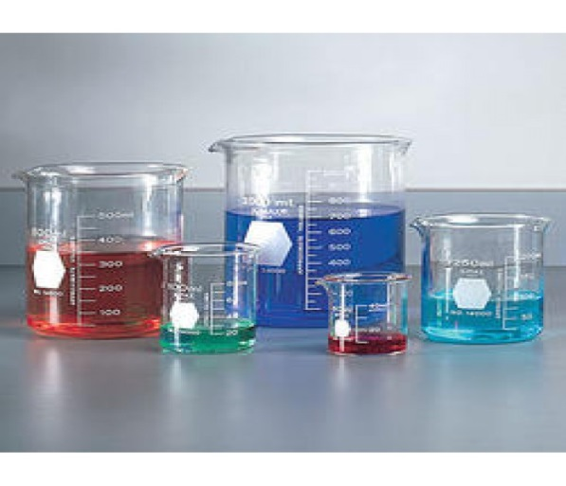
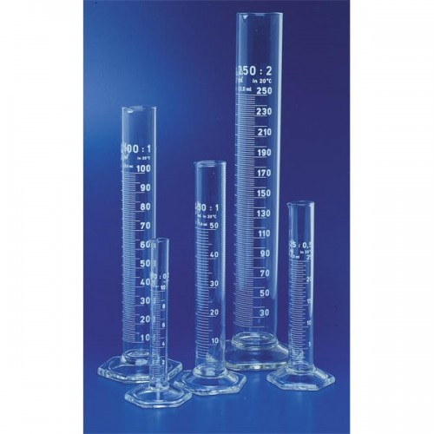
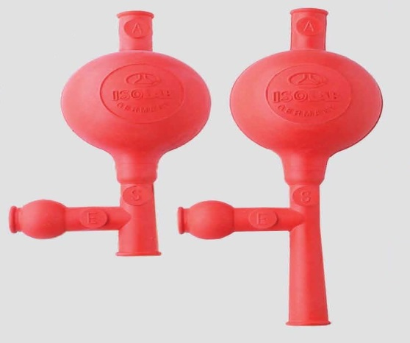
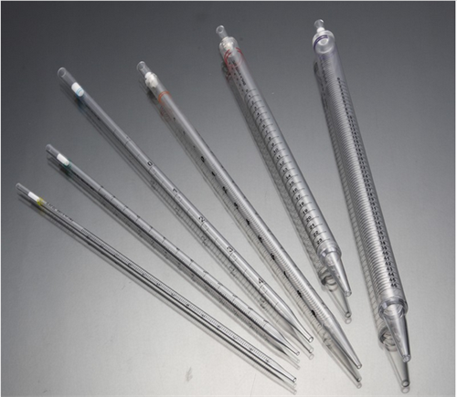
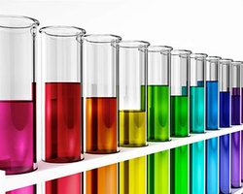
Laboratory Equipments-1
Measuring cylinder
Erlenmeyer
beaker
Pipette bulb
pipette
test tube

Slide 5
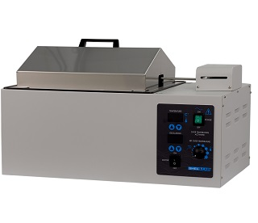
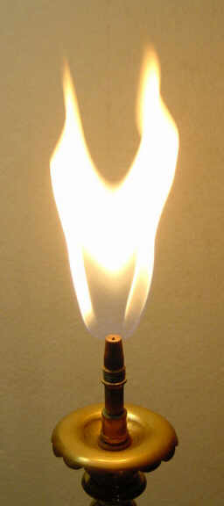
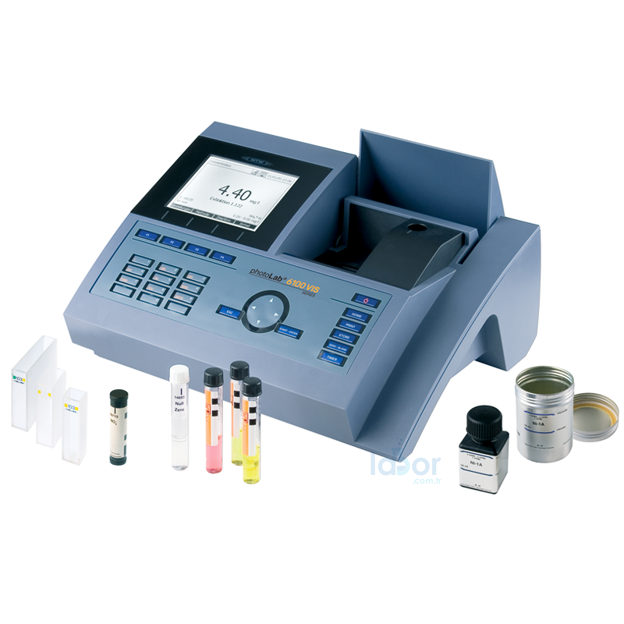
Laboratory Equipments-2
Laboratory
water bath
bunsen flame
Spectrophotometer

Slide 6
Accidents-1
Danger in the use of glassware:
When the glass material breaks, the spikes may cause cuts.
1) In small incisions; The pieces of glass are cleared, if any, inside the wounds.
the wound is cleaned with water, the wound is wrapped.
2) Deep cuts; The pieces of glass are cleared, if any, inside the wounds. Buffer with a clean cloth or similar material and go to the nearest health facility

Slide 7
Accidents-2
When working with a burning flame
Long hair is flammable if not attached,
It may catch fire when we approach it with a flammable substance (alcohol).
!!! In the event of a fire caused by a burning; The resulting fire should be removed with the help of a fire extinguisher and gas valves should be closed at the same time.

Slide 8
The Toxic Chemicals
Toxic chemicals can get into the body through ingestion, inhalation and skin. Toxic chemicals can cause undesirable reactions in the body when they participate in circulation.

Slide 9
Precautions for Toxic Substances
Not bringing and consuming food and beverages in the laboratory,
Liquids are drawn with pipette with the help of a pump (puar, etc.),
After use of liquid and powdered chemical substances, their bottles / packages should be closed,
Gloves should be worn especially when working with burning substances such as acid-base,
During the work we should not touch with the gloves to eyeglasses, face and hair.

Slide 10
Eye Injuries
Washed with 1% NaHCO₃ solution if contact with dilute acid, contact with concentrated acid, first with plenty of water and then with NaHCO₃.
If the base is diluted, the eye is washed with 1% boric acid solution, while contact with concentrated acid is first washed with plenty of water followed by washing with boric acid.

Slide 11
Burns
Organic matter burns: the wound is washed first with alcohol and then with water.
Acidic burns: the area is washed first with plenty of water, then with saturated sodium carbonate and finally with water again.
Alkali burns: the region is washed first with plenty of water and then with 1% acetic acid solution.

Slide 12
Poisoning
Alcohol poisoning: the stomach is emptied first by induction, then coffee is given.
Acidic poisoning: it certainly does not vomit. Sufficient water is given, then carbonate is drunk with plenty of water.
Alkali poisoning: not infused. First, plenty of water is given, followed by vinegar or lemon juice.

Slide 13
References
S. Özden, R. Ertan, E. Akı-Şener, İ. Yalçın, D. Nebioğlu, E. Büyükbingöl, H. Göker, İ. Yıldız, T. G. Altuntaş-Dinlenç, G. Ayhan-Kılcıgil, S. Ölgen, S. Süzen, Ö. Temiz-Arpacı, C. Kuş, O. Bozdağ-Dündar, B. Tekiner-Gülbaş, Z. Ateş-Alagöz, “Farmasötik Kimya Pratikleri 3-4” ISBN 975-482-668-4, Ankara Üniversitesi Basımevi, Ankara, 2003.
Laboratuvar güvenliği (2016)., ONUR FEYYAZ, Ankara Üniversitesi basımevi, Editör:Feyyaz Onur, Basım sayısı:1, Sayfa Sayısı 135, ISBN:978-605-136-243-4, Türkçe(Ders Kitabı), (Yayın No: 2586635).

