Slide 1
Yapay Zeka 802600715151
Doç. Dr. Mehmet Serdar GÜZEL
Slides are mainly adapted from the following course page:
at http://ai.berkeley.edu created by Dan Klein and Pieter Abbeel for CS188

Slide 2
Lecturer
Instructor: Assoc. Prof Dr. Mehmet S Güzel
Office hours: Tuesday, 1:30-2:30pm
Open door policy – don’t hesitate to stop by!
Watch the course website
Assignments, lab tutorials, lecture notes

Slide 3
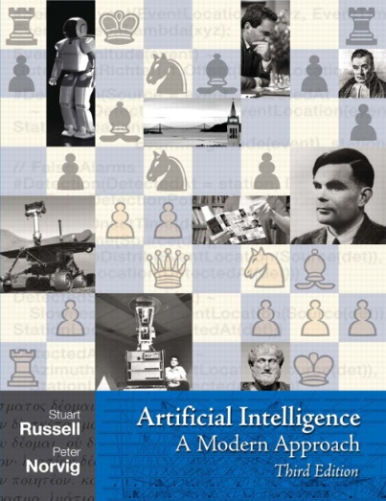
Textbook
Russell & Norvig, AI: A Modern Approach, 3rd Ed.
Warning: Not a course textbook, so our presentation does not necessarily follow the presentation in the book.

Slide 4
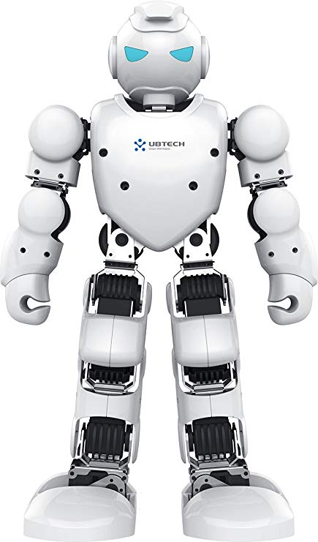
Today
What is artificial intelligence?
What can AI do?
What is this course?

Slide 5
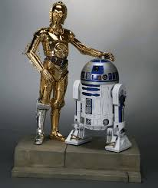
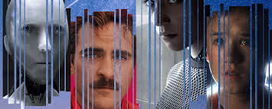
Sci-Fi AI?
Notes:
Who are these? C3PO, what does he do? Essentially google translate, (but with anxiety disorder!)
Smal guy? R2D2 – what does he do, yeah, not so sure
Things got darker: machines come back from the future – to kill us!
90’s : software is scary
Basic fear about what technology might do ?
What if we can’t even tell technology apart from ourselves?
OR maybe it’ll look really different and snarky
Some exceptions like wall-E, positive view of technology (but maybe not of us humans!)
But mostly a worry
[not very worried myself, at least at present]

Slide 6
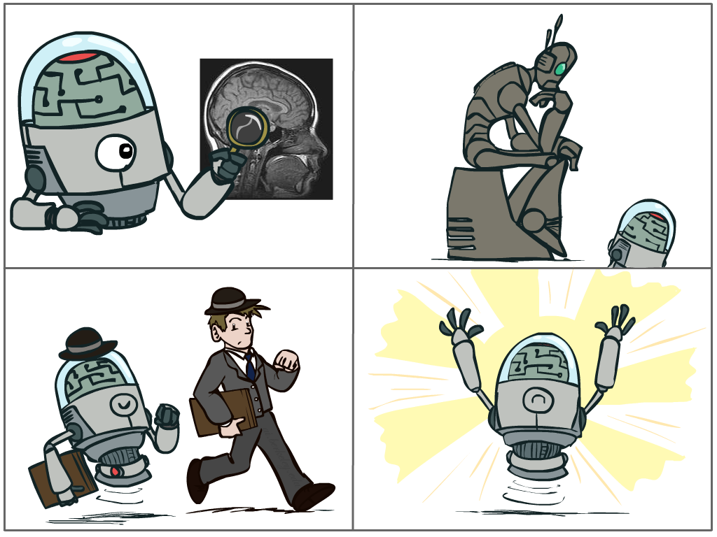
What is AI?
The science of making machines that:
Think like people
Think rationally
Act like people
Act rationally
Notes:
Top left: Think like people --- cognitive science, neuroscience
Bottom left: act like people --- actually very early definition, dating back to Alan Turing --- Turing test; problem to do really well you start focusing on things like don’t answer too quickly what the square root of 1412 is, don’t spell too well, and make sure you have a favorite movie etc. So it wasn’t really leading us to build intelligence
Think rationally – long tradition dating back to Aristotle --- but not a winner, because difficult to encode how to think, and in the end it’s not about how you think, it’s about how you end up acting

Slide 7
Rational Decisions
We’ll use the term rational in a very specific, technical way:
Rational: maximally achieving pre-defined goals
Rationality only concerns what decisions are made
(not the thought process behind them)
Goals are expressed in terms of the utility of outcomes
Being rational means maximizing your expected utility
A better title for this course would be:
Computational Rationality
Notes:
Example of utilities. 10 for A, 1 for each Friday with friends

Slide 8
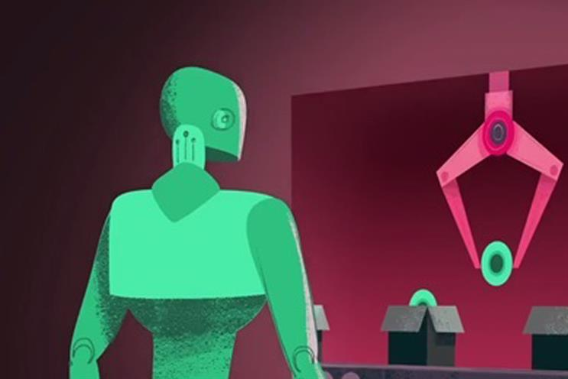
Maximize Your
Expected Gain

Slide 9
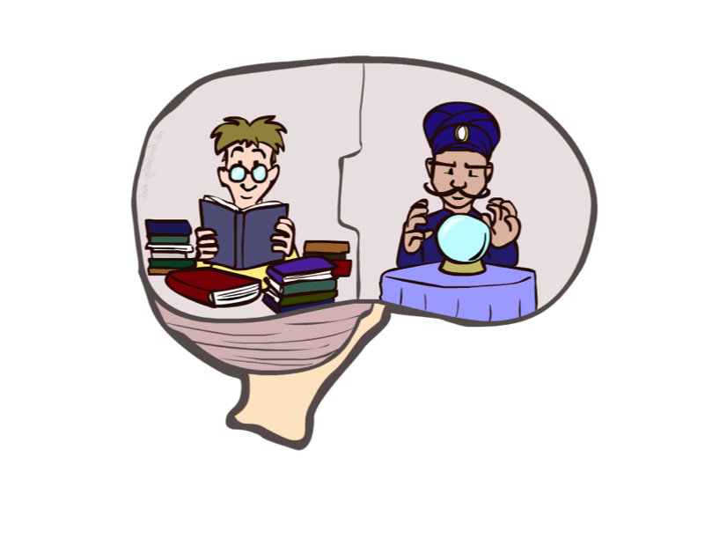
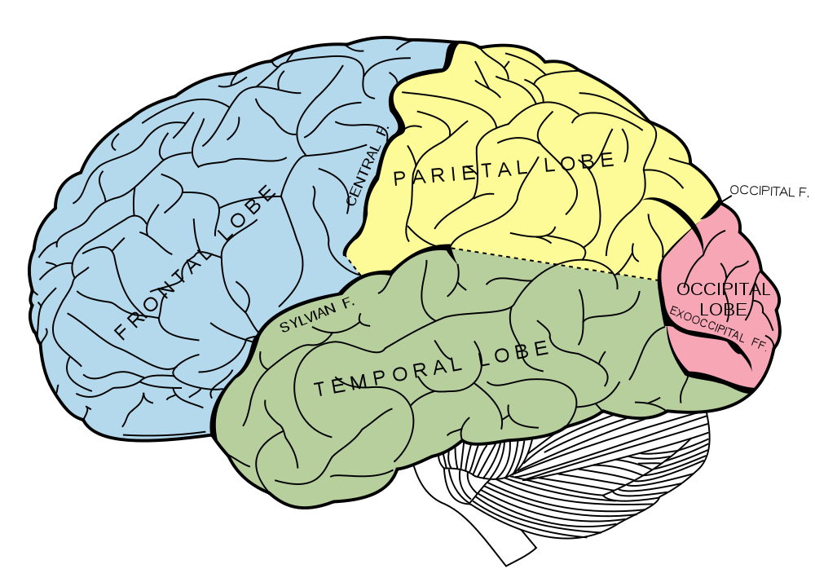
What About the Brain?
Brains (human minds) are very good at making rational decisions, but not perfect
Brains aren’t as modular as software, so hard to reverse engineer!
“Brains are to intelligence as wings are to flight”
Lessons learned from the brain: memory and simulation are key to decision making

Slide 10
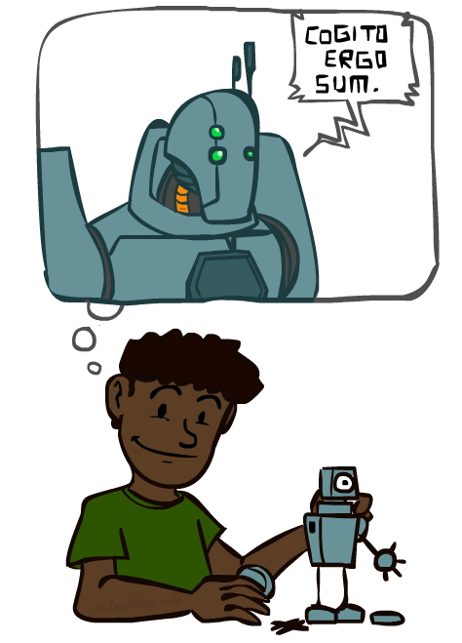
A (Short) History of AI
Demo: HISTORY – MT1950.wmv

Slide 11
A (Short) History of AI
1940-1950: Early days
1943: McCulloch & Pitts: Boolean circuit model of brain
1950: Turing's “Computing Machinery and Intelligence”
1950—70: Excitement: Look, Ma, no hands!
1950s: Early AI programs, including Samuel's checkers program, Newell & Simon's Logic Theorist, Gelernter's Geometry Engine
1956: Dartmouth meeting: “Artificial Intelligence” adopted
1965: Robinson's complete algorithm for logical reasoning
1970—90: Knowledge-based approaches
1969—79: Early development of knowledge-based systems
1980—88: Expert systems industry booms
1988—93: Expert systems industry busts: “AI Winter”
1990—: Statistical approaches
Resurgence of probability, focus on uncertainty
General increase in technical depth
Agents and learning systems… “AI Spring”?
2000—: Where are we now?
Notes:
Million dollar computer with less computation than your phone
MT was

Slide 12
What Can AI Do?
Quiz: Which of the following can be done at present?
Play a decent game of table tennis?
Play a decent game of Jeopardy?
Drive safely along a curving mountain road?
Drive safely along Telegraph Avenue?
Buy a week's worth of groceries on the web?
Buy a week's worth of groceries at Berkeley Bowl?
Discover and prove a new mathematical theorem?
Converse successfully with another person for an hour?
Perform a surgical operation?
Put away the dishes and fold the laundry?
Translate spoken Chinese into spoken English in real time?
Write an intentionally funny story?

