Slide 1
Diversity And Classification of Flowering Plants: Monocots

Slide 2
Monocotyledons (Monocotyledonae, Monocots)

Slide 3
Apomorphies of the Monocots

Slide 4
ALISMATALES Araceae - Arum family (Arum, a name used by Theophrastus). 111 genera / 2980 species

Slide 5
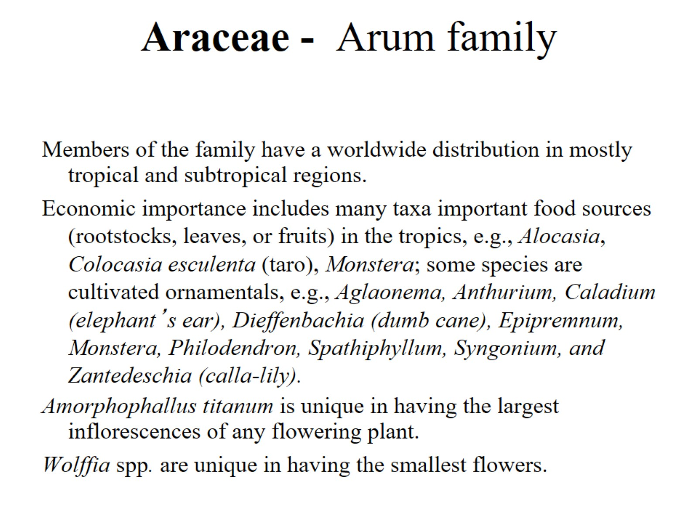
Araceae - Arum family

Slide 6
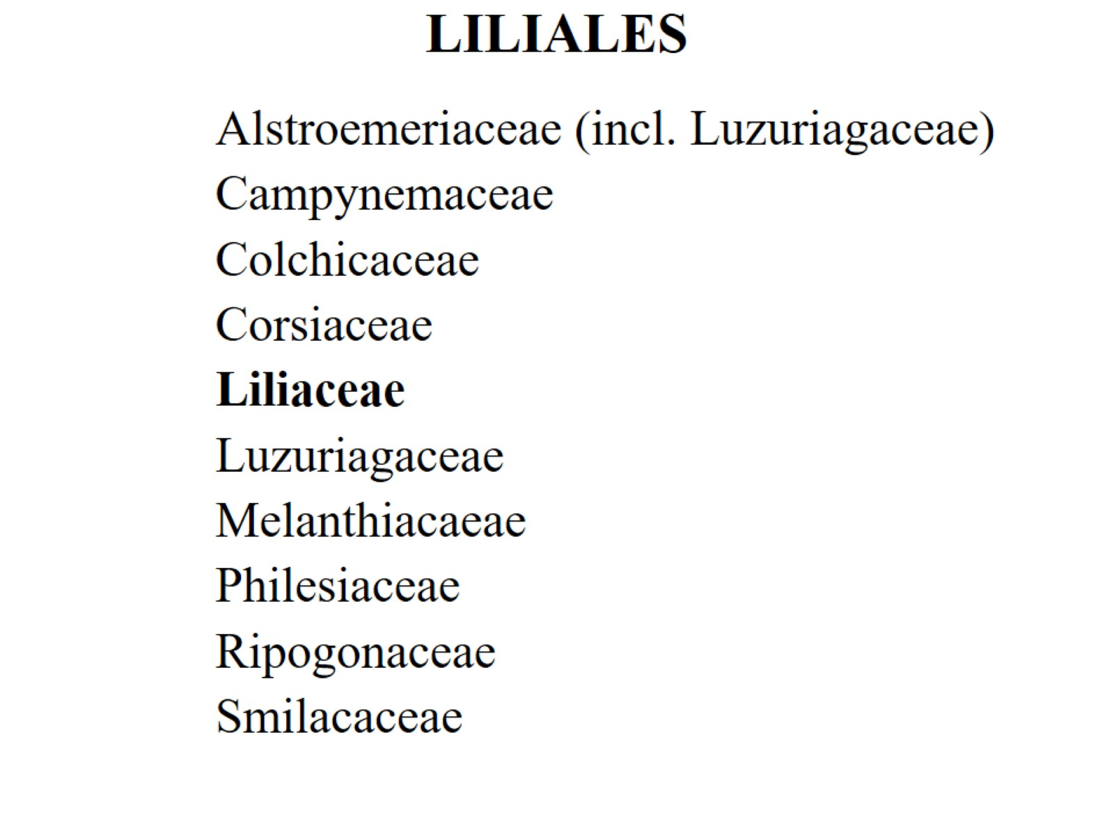
LILIALES

Slide 7
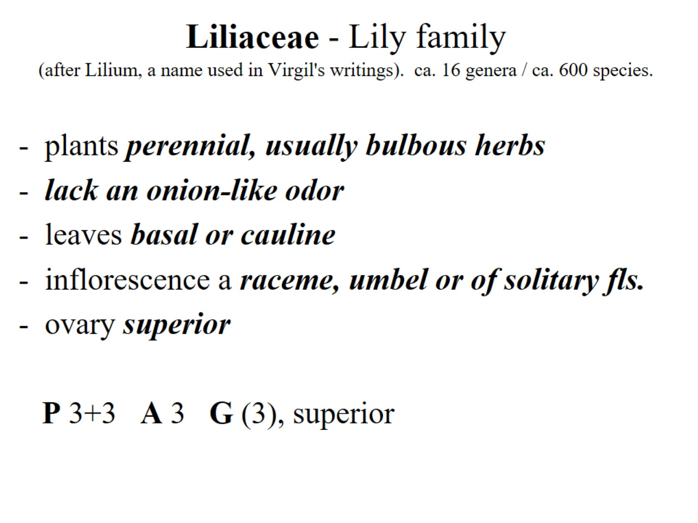
Liliaceae - Lily family (after Lilium, a name used in Virgil's writings). ca. 16 genera / ca. 600 species.

Slide 8
ASPARAGALES

Slide 9
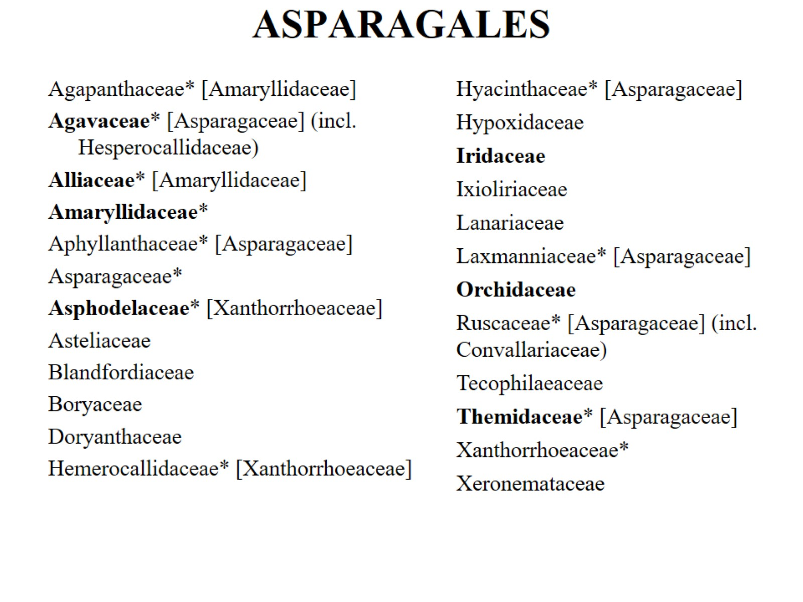
ASPARAGALES

Slide 10
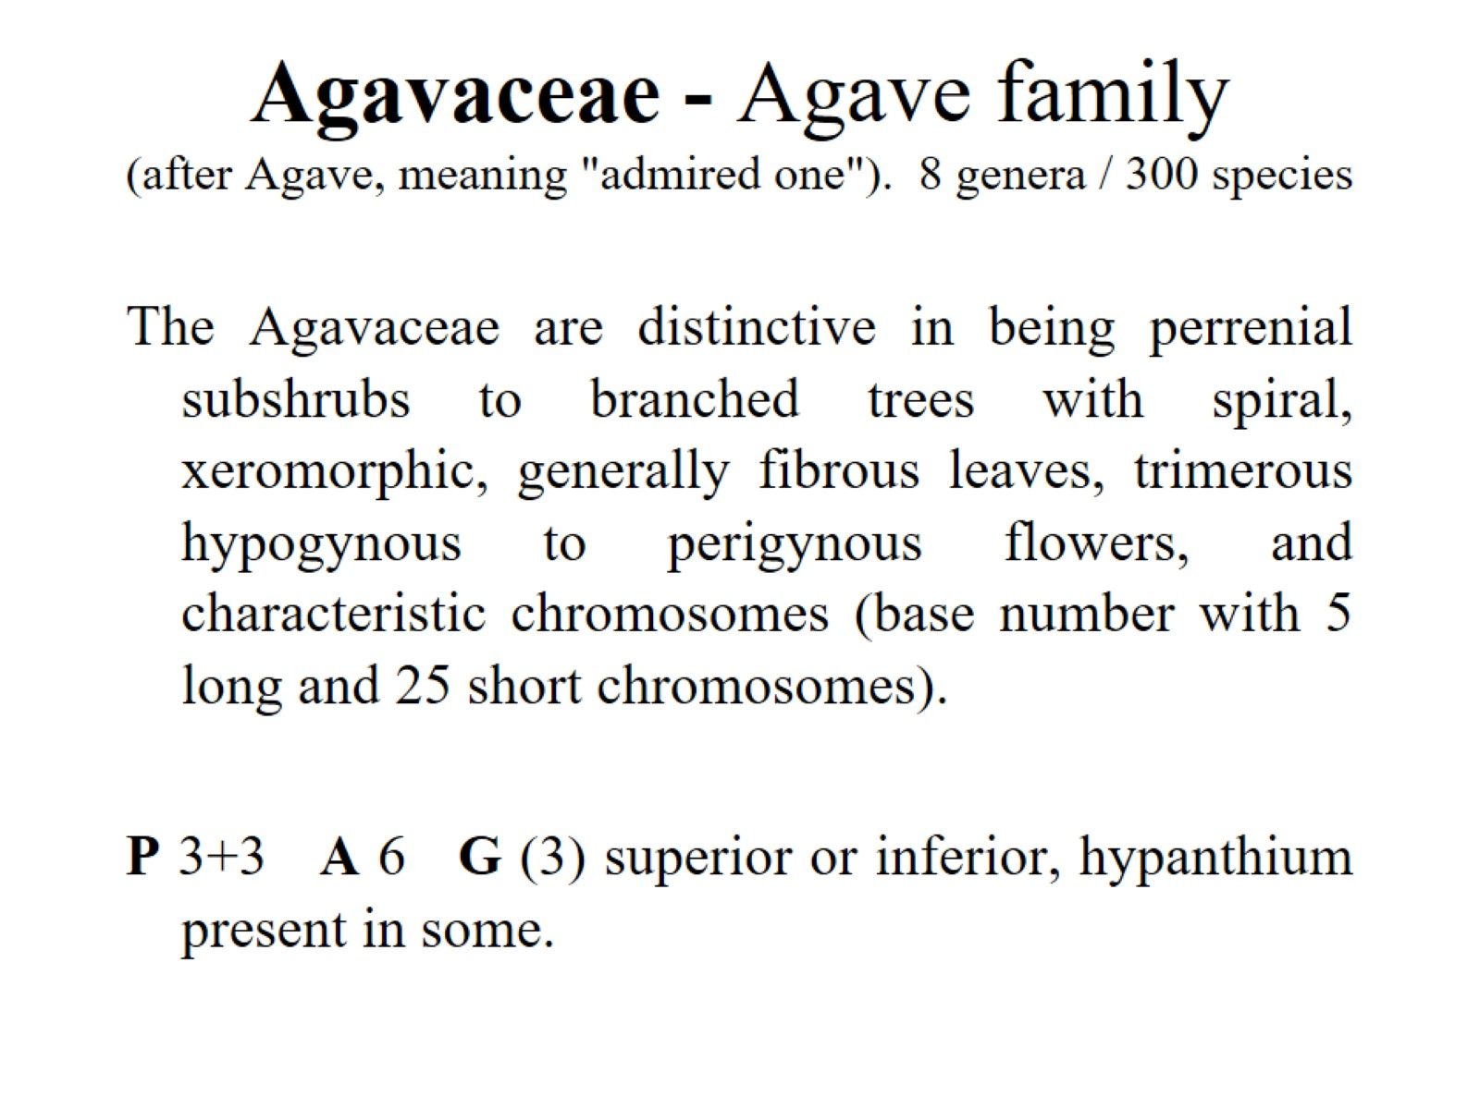
Agavaceae - Agave family (after Agave, meaning "admired one"). 8 genera / 300 species

Slide 11
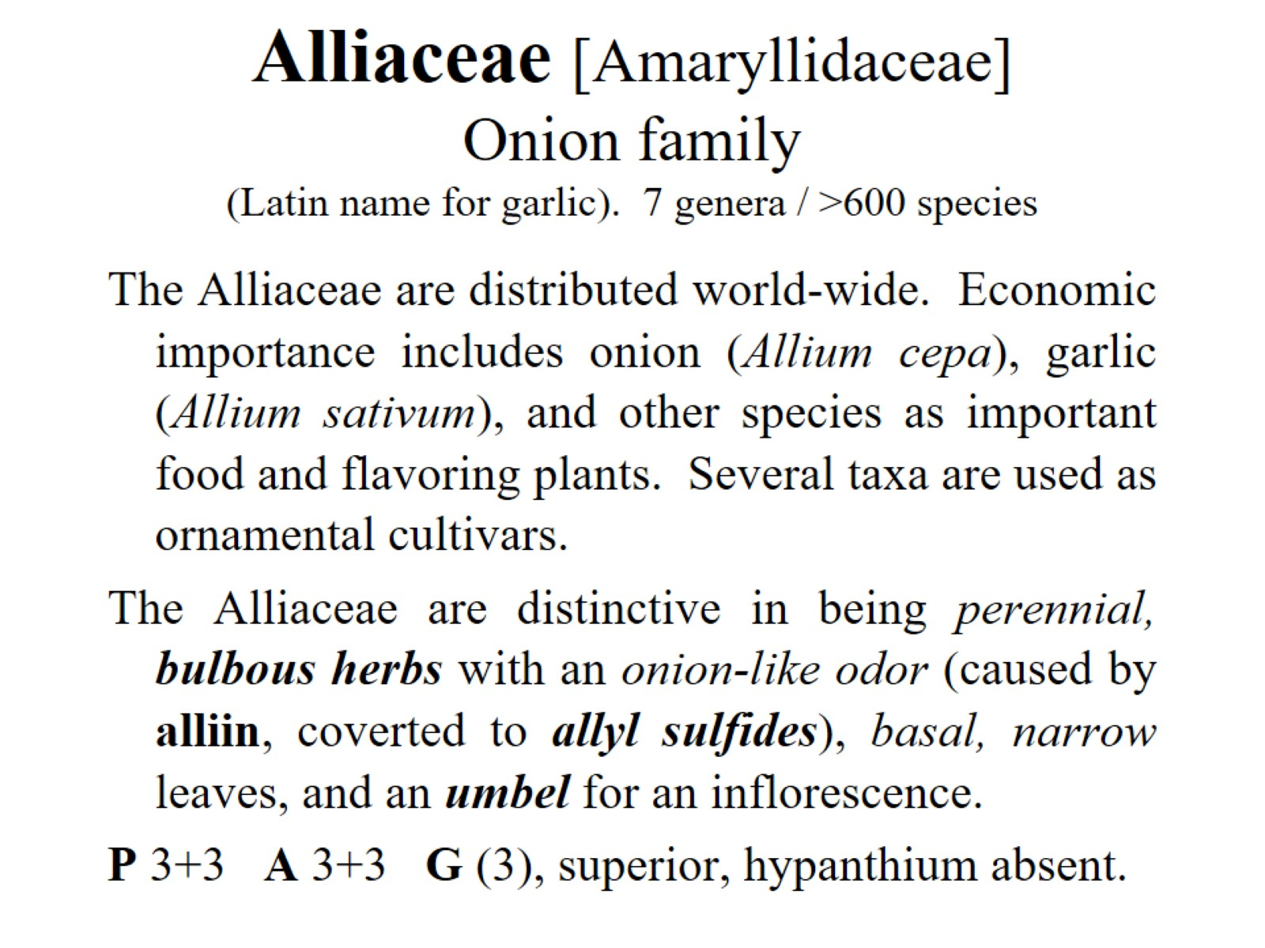
Alliaceae [Amaryllidaceae] Onion family (Latin name for garlic). 7 genera / >600 species

Slide 12
Asphodelaceae [Xanthorrhoeaceae s.l.] Asphodel or Alöe family 15 genera/780 species

Slide 13
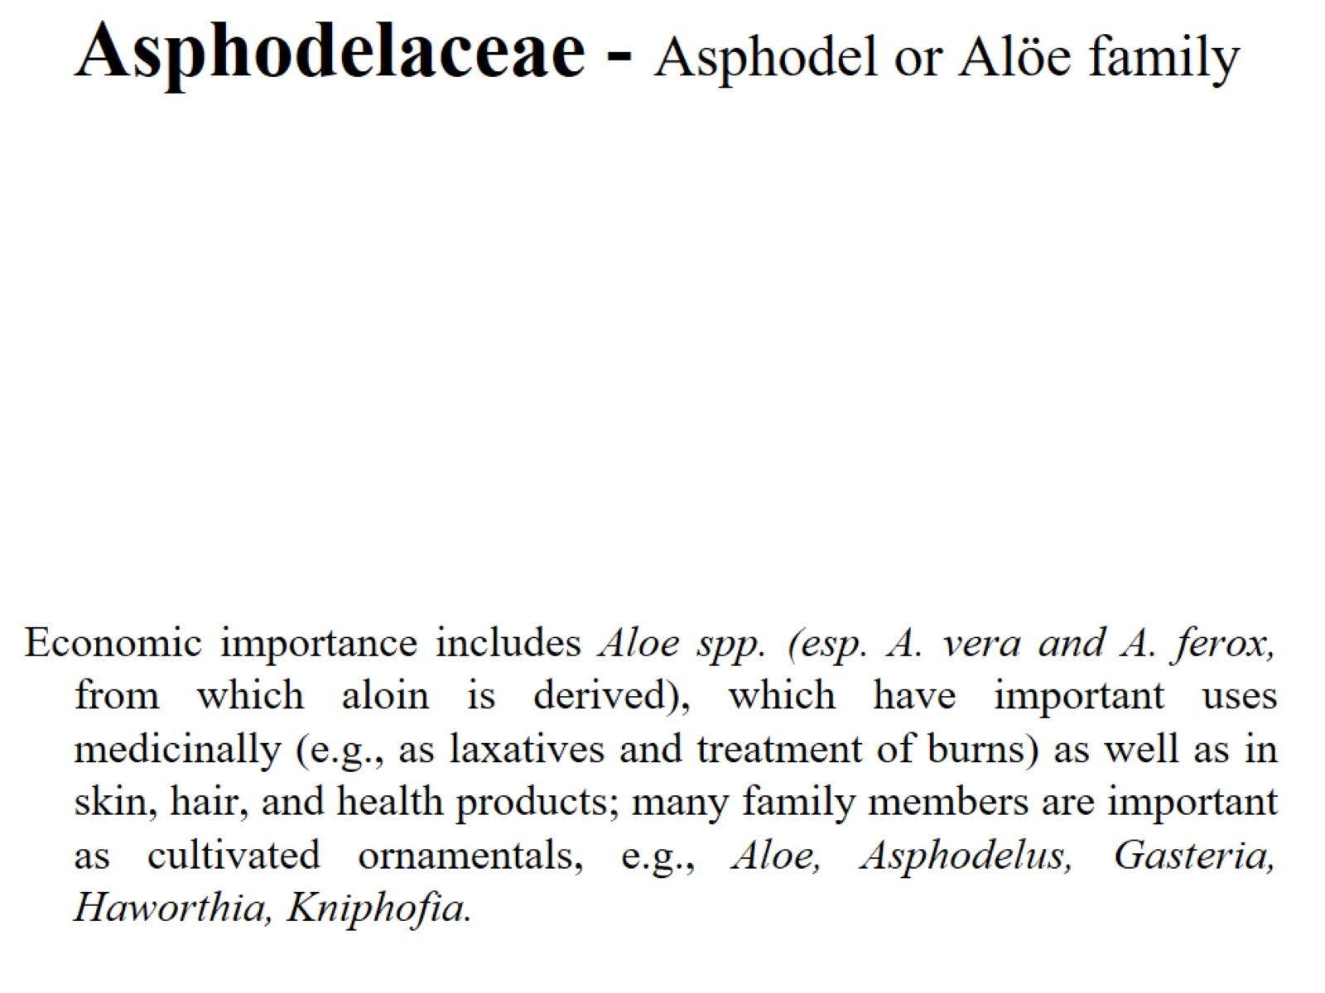
Asphodelaceae - Asphodel or Alöe family

Slide 14
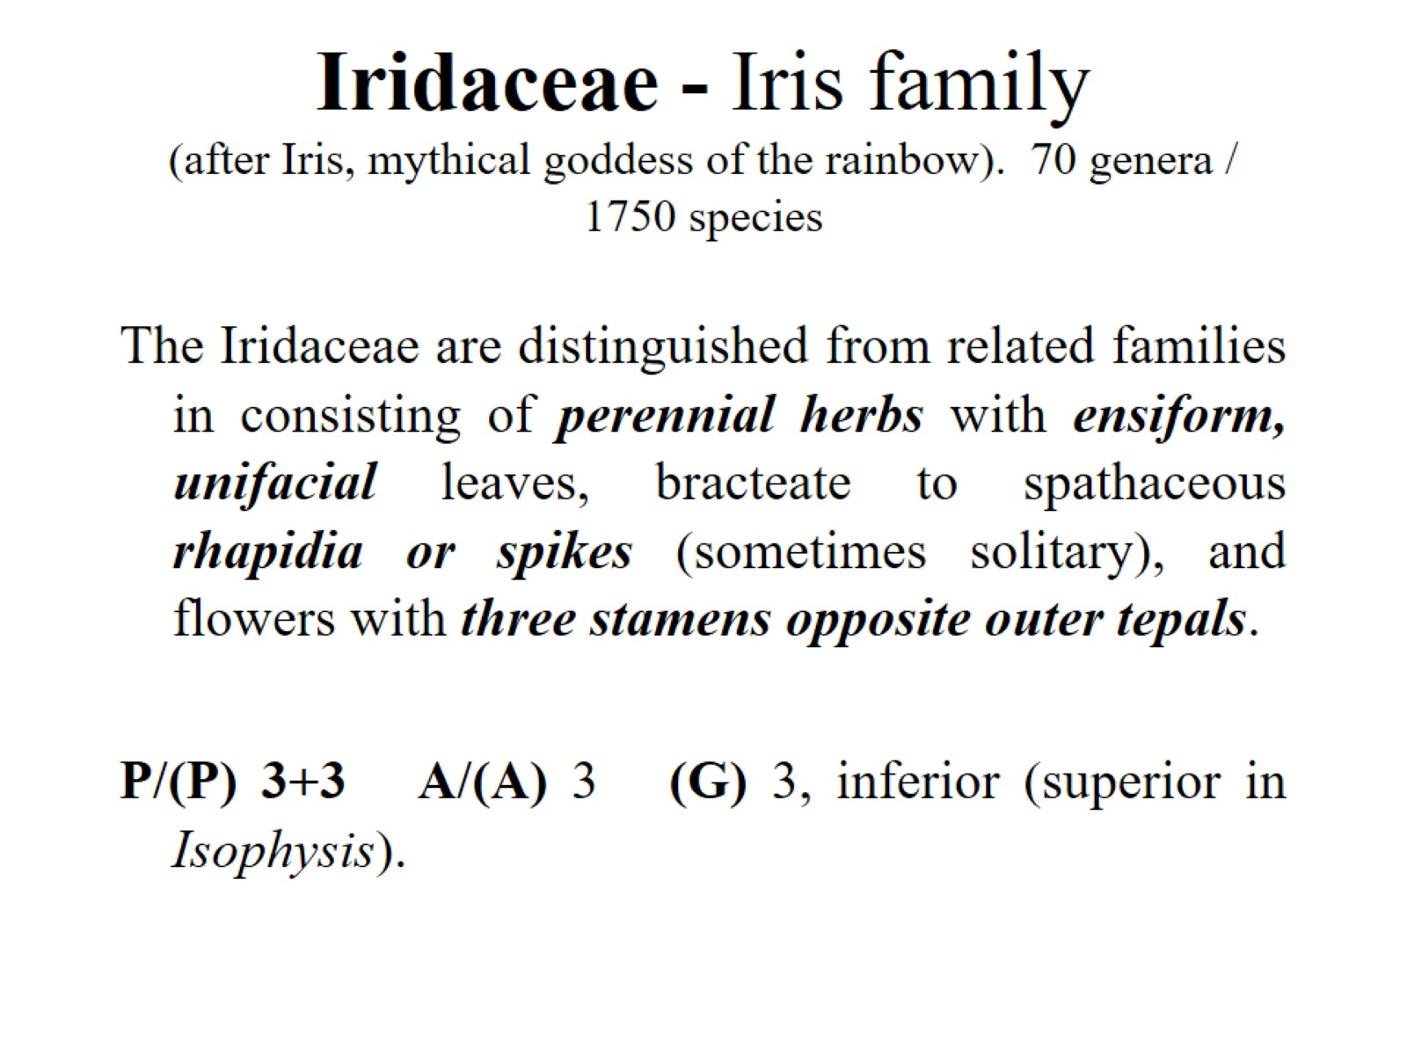
Iridaceae - Iris family (after Iris, mythical goddess of the rainbow). 70 genera / 1750 species

Slide 15
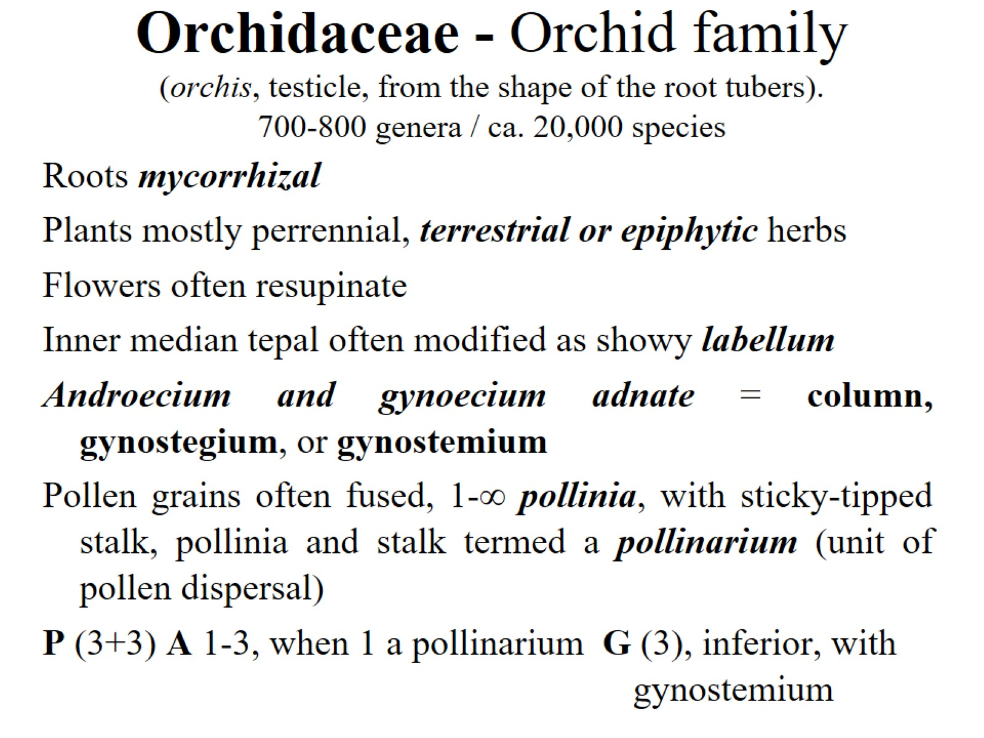
Orchidaceae - Orchid family (orchis, testicle, from the shape of the root tubers). 700-800 genera / ca. 20,000 species

Slide 16
Orchidaceae - Orchid family (orchis, testicle, from the shape of the root tubers). 700-800 genera / ca. 20,000 species

Slide 17
Vanilla: Vanilla planifolia

Slide 18
Orchidaceae - Orchid family (orchis, testicle, from the shape of the root tubers). 700-800 genera / ca. 20,000 species

