Slide 1
Color analysis
Assoc Prof. ÖZGE ŞAKIYAN DEMİRKOL
03.05.2021

Slide 2
Introduction
Color, flavor, and texture are the three principal quality attributes that determine food acceptance, and color has a far greater influence on our judgment than most of us appreciate.
Food scientists who establish quality control specifications are very aware of the importance of color and appearance. While subjective visual assessment and use of visual color standards are still used in the food industry, instrumental color measurements are extensively employed.

Slide 3
Definitions
Color:
It can be defined as the sensation that is experienced by an individual when radiant energy within the visible spectrum (380–770 nm) falls upon the retina of the eye
Colorant:
It is a pigment that is used to color a product.
Colorimetry:
It is the science of color measurement which makes it possible to define color in mathematical units.

Slide 4
Color specification systems:
There are verbal, visual matching, and instrumental methods for describing and specifying color.
Color is three-dimensional, and any color-order system will need to address hue, what we instinctively think of as color (e.g., red, blue, green); value, which represents lightness and darkness; and chroma or saturation which indicates intensity.

Slide 5
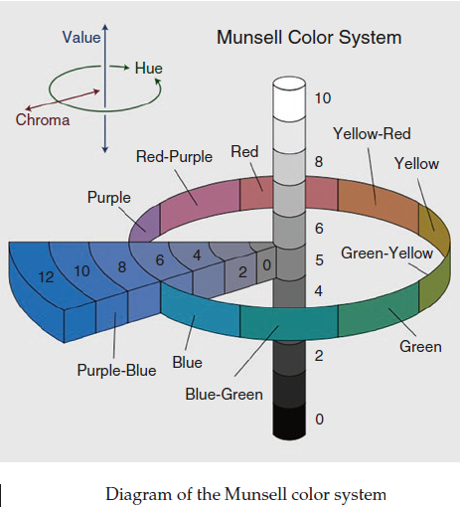
Visual matching systems:Munsell system
The Munsell system is probably the best known and most widely used visual color-ordering system.
It was developed by A.H. Munsell, a Boston art teacher, in 1905.
In this system red, yellow, green, blue, and purple plus five adjacent pairs, green yellow, yellow red, red purple, purple blue, and blue green, describe hue. Value is that quality of color described by lightness and darkness, from white to grey to black. Value is designated from 0 (absolute black) to 10 (absolute white). Chroma is the quality (change from pink to red is an example of an increase in chroma)

Slide 6
Instrumental measurement of color
The CIE (Commission Internationale de l’Eclairage, or the International Commission on Illumination) is the main international organization concerned with color and color measurement.
CIE tristimulus system is one of instrumental methods for color measurement. The calculation procedure is quite complicated.
Richard S. Hunter, Deane B. Judd, and Henry A. Gardner were among the pioneering scientists who in the 1940s were working to develop color-measuring instruments that would overcome the disadvantages of the CIE spectrophotometric tristimulus system

Slide 7
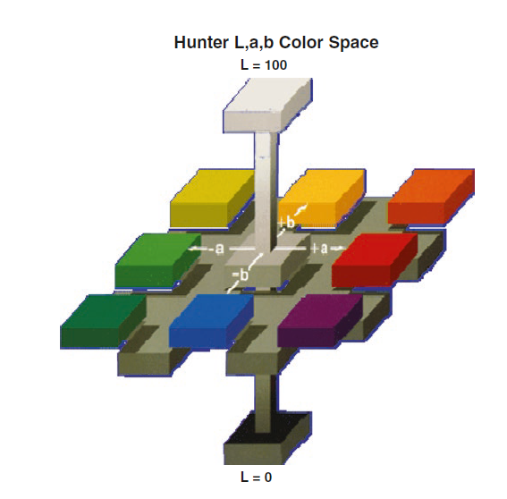
Hunter L, a, b color space
The Hunter color solid was first published in 1942 where L indicated lightness; a, the red (+) or green (−) coordinate; and b, the yellow (+) or blue (−) coordinate.
The Hunter L a b color space has been widely adopted by the food industry.

Slide 8
The Lab system was subsequently improved to give more uniform
color spacing.
In 1976, the CIE officially adopted the modified system as CIELAB with the parameters L*a*b*. L* indicates lightness (0–100) with 0 being black and 100 being white. The coordinate a* is for red (+) and green (−), and b* is for yellow (+) and blue (−). The limits for a* and b* are approximately + or -80.

Slide 9
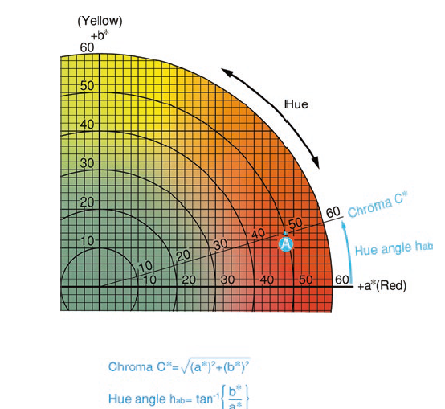
Hue angle and chroma are the further parameters which can be used for describing a color.

Slide 10
Thanks!!!!
osakiyan@ankara.edu.tr

