Slide 1
A Tour of C++

Slide 2
C++ is a general purpose programming language with a bias towards systems programming that
is a better C,
supports data abstraction,
supports object oriented programming, and
supports generic programming.

Slide 3
Object oriented programming is a technique for programming – a paradigm for writing ‘‘good’’ programs for a set of problems.
The term ‘‘object oriented programming language’’ means: a programming language that provides mechanisms that support the object oriented style of programming well.
There is an important distinction here. A language is said to support a style of programming if it provides facilities that make it convenient (reasonably easy, safe, and efficient) to use that style.
A language does not support a technique if it takes exceptional effort or skill to write such programs; it merely enables the technique to be used.
Support for a paradigm comes not only in the obvious form of language facilities that allow direct use of the paradigm, but also in the more subtle form of compile-time and/or runtime checks against unintentional deviation from the paradigm.

Slide 4
C++ was designed to support data abstraction, object oriented programming, and generic programming in addition to traditional C programming techniques under these constraints.
It was not meant to force one particular programming style upon all users.
Let see some programming styles and the key language mechanisms supporting them.. The emphasis will be on design approaches and ways of organizing programs rather than on language details.

Slide 5
Procedural Programming
Decide which procedures you want;
use the best algorithms you can find.
The focus is on the processing – the algorithm needed to perform the desired computation.
Languages support this paradigm by providing facilities for passing arguments to functions and returning values from functions.

Slide 6
Example:

Slide 7
C++’s most basic facilities for expressing computation:
Variables and Arithmetic
Tests and Loops
Pointers and Arrays

Slide 8
Variables and Arithmetic
Every name and every expression has a type that determines the operations that may be performed on it.
int inch
A declaration is a statement that introduces a name into the program. It specifies a type for that name. A type defines the proper use of a name or an expression.

Slide 11
Tests

Slide 13
Loops

Slide 14
Pointers and Arrays

Slide 15
Modular Programming
A set of related procedures with the data they manipulate is often called a module.
Decide which modules you want;
partition the program so that data is hidden within modules.
This paradigm is also known as the data-hiding principle

Slide 16
Example: definition of a Stack module
The main problems that have to be solved are:
[1] Provide a user interface for the stack
e.g., functions push() and pop()
[2] Ensure that the representation of the stack (e.g., an array of elements) can be accessed only through this user interface.
[3] Ensure that the stack is initialized before its first use.

Slide 17
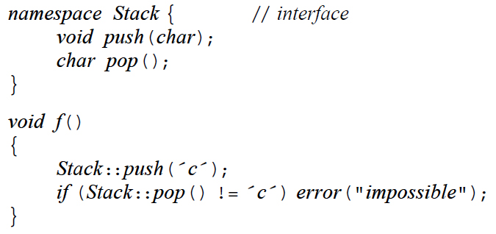
The user interface of a Stack module could be declared and used like this:

Slide 18
The definition of the Stack could be provided in a separately compiled part of the program:
the user code is insulated from the data representation of Stack by the code implementing
Stack::push() and Stack::pop(). The user doesn’t need to know that the Stack is implemented
using an array, and the implementation can be changed without affecting user code.

Slide 20
Exceptions

Slide 21
Exception Handling
The throw transfers control to a handler for exceptions of type Stack::Overflow
in some function that directly or indirectly called Stack::push().

Slide 22
Modules Defining Types
Programming with modules leads to the centralization of all data of a type under the control of a
type manager module. For example, if we wanted many stacks we could define a stack manager
with an interface :

Slide 23
This is less than ideal. Fundamentally, user-defined types implemented through a
module providing access to an implementation type don’t behave like built-in
types and receive less and different support than do built-in types.

Slide 24
User defined types
Decide which types you want;
provide a full set of operations for each type.
C++ allows a user to directly define types that behave in (nearly) the same way as builtin types.
Note: where there is no need for more than one object of a type, the data-hiding programming style using modules (prev. approach) suffices.

Slide 25
A user defined type
The declaration of class (that is, user-defined type) complex specifies the representation of a complex number and the set of operations on a complex number.

Slide 26
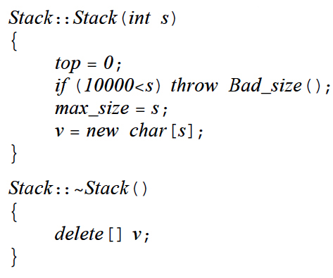
Concrete types

Slide 27
This Stack type obeys the same rules for naming, scope, allocation, lifetime, copying, etc.,
as does a built-in type such as int and char.

Slide 28
Abstract types
if we want to completely isolate users of a stack from changes to its implementation,
this last Stack is insufficient. Then, the solution is to decouple the interface from the
representation and give up genuine local variables (we cannot have genuine local variables
of a type without knowing the size of the type’s representation).

Slide 30
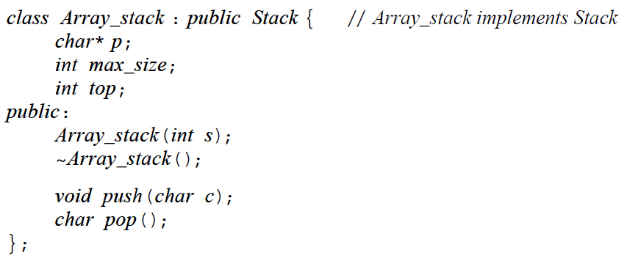
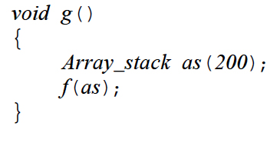

Slide 32
Object Oriented Programming
Decide which classes you want;
provide a full set of operations for each class; make commonality explicit by using inheritance.

Slide 33
Problems with concrete types

Slide 35
Solution

Slide 37
Generic Programming
Decide which algorithms you want;
parameterize them so that they work for a variety of suitable types and data structures.

Slide 38
Container class

Slide 40
Last words
Please remember that the real purpose of examining the details of C++ is to be able to use them in concert to support good programming style in the context of sound designs.

Slide 41
Advice from the creator of C++
Don’t panic! All will become clear in time;
You don’t have to know every detail of C++ to write good programs;
Focus on programming techniques, not on language features;

