Slide 1
Rheological properties of foods
Assoc Prof. ÖZGE ŞAKIYAN DEMİRKOL
17.05.2021

Slide 2
Definition of rheology
Rheology is the science of flow and deformation of matter and describes the interrelation between force, deformation and time.
It is the study of the manner in which materials respond to applied stress or strain.
The term comes from Greek ‘rheos’ meaning to flow.

Slide 3
The importance of rheology
It is important in food science due to its utility in food processing operations and sensory characteristics.
It gives information about the microstructure of a food.
Rheology properties are manifestation of the rate and nature of the deformation that occurs when a material is stressed. These parameters can be used to predict how the fluid will behave in a process and in determining the energy requirement for transporting the fluid from one point to another in processing plant.
Rheological parameters are also useful in defining the quality attribute of food products.

Slide 4
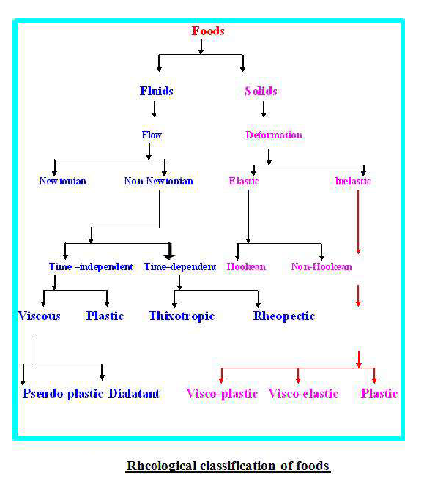

Slide 5
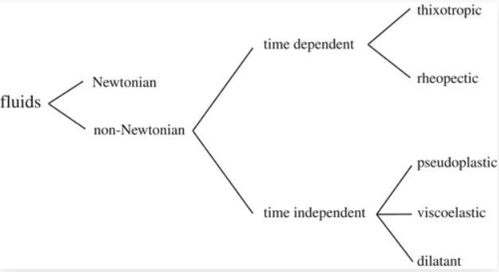
Rheological properties of fluids
Newtonian foods: Newtonian fluids are fluids which exhibit a linear increase in the shear stress with the rate of shear. These fluids exhibit a linear relationship between the shear stress and the rate of shear.
Non-newtonian foods: A non-Newtonian fluid is broadly defined as one for which the relationship between shear stress and shear rate is not a constant. When the shear rate is varied, the shear stress doesn't vary in the same proportion. These fluids exibit either shear thinning or shear thickening behaviour and some exhibit a yield stress. The two most commonly used equations for characterizing non-Newtonian fluids are the power law model and Herschel-Bulkley model for fluids.

Slide 6
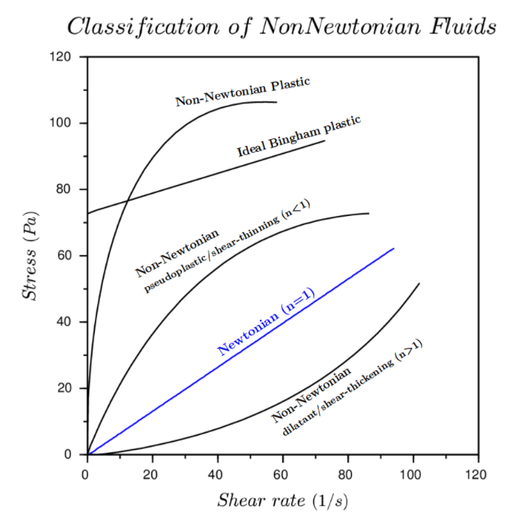
(A) Time-independent flow of non-Newtonian foods:
The fluid foods whose viscosity is not influenced by the shearing time at a constant shear rate show two distinct patterns of stress – shear rate relationship i.e shear-thinning and shear-thickening.
(i) Pseudoplastic/shear-thinning fluids: - This type of fluids will display a decreasing consistency with an increasing shear rate
E.g. fruit and vegetable purees and gum solutions are the examples of psedo-plastic fluid food products.
(ii) Dilatant/shear-thickening flow behaviour:- This type of fluid will display an increasing viscosity with increase in shear rate.
Dilatancy is frequently observed in fluids containing high level of deflocculated solids, such as candy compounds, cooked corn starch paste, certain types of honey etc. Dilatancy is also referred to as shear-thickening flow behaviour.

Slide 7
(B) Time-dependent flow of non-Newtonian foods:
Certain non-Newtonian fluids show a time-dependent stress-shear relationship.
(i) Thixotropy: - When at a constant shear rate, the stress decreases over a period of time due to structure breakdown until eventually it reaches a steady value, the product is said to be thixotropic. Aged condensed milk, cream and ice cream mix, egg white etc. revel thixotropy.
(ii) Rheopectic: - This essentially the opposite of thixotropic behaviour, in which the fluids viscosity increases with time as it is sheared at a constant rate. Rheopectic fluids are rarely encountered.

Slide 8
Measurement of rheological properties
Foods are diverse and complex materials which exhibit a wide range of different rheological properties, e.g., solids, liquids, plastics and viscoelastic behaviour.
Consequently, a variety of different instruments have been developed for characterizing their rheological properties.
Instruments vary according to the type of deformation they apply to the sample (shear, compression, elongation or some combination), the property measured, the cost, the ease of operation etc

Slide 9
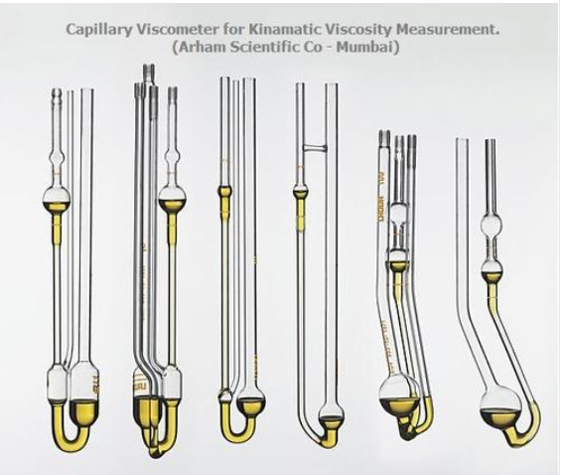
Instruments can be conveniently categorized according to whether they utilize simple compression (or elongation) or shear forces. We will focus on the second one.
Shear measurements:
1.Capillary viscometers
The simplest and most commonly used capillary viscometer is the Ostwald viscometer. This consists of a glass U-tube into which the sample to be analyzed is poured. The whole arrangement is placed in a thermostated water-bath to reach the measurement temperature. The viscosity of the liquid is measured by sucking up liquid into one of the arms of the tube using a slight vacuum and then measuring the time taken for it to flow back through a capillary of known radius and length. The time t taken to travel through the capillary is related to the viscosity

Slide 10
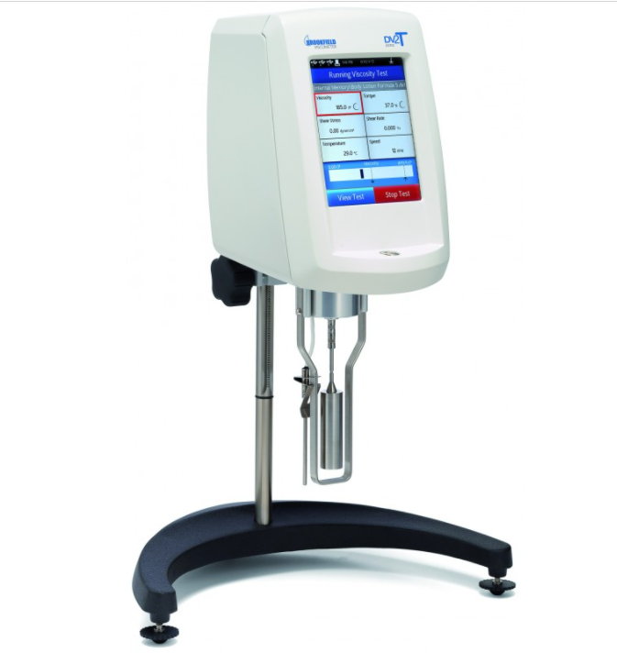
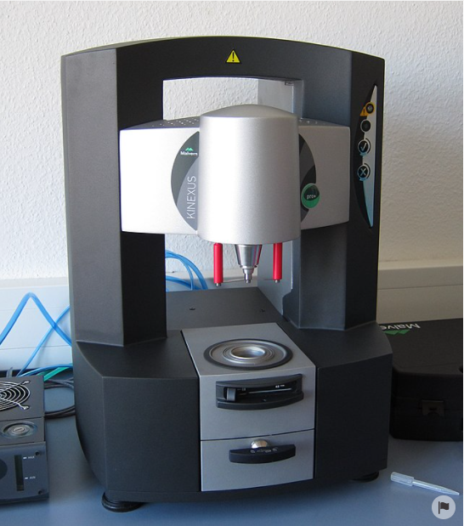
2.Mechanical Viscometers and Dynamic Rheometers
A number of analytical instruments have been designed that can measure the shear properties of liquids, viscoelastic materials, plastics and solids.
These instruments are usually computer controlled and can carry out sophisticated test procedures as a function of time, temperature, shear rate or frequency.
Most of these instruments can be adapted to carry out tests using either the concentric cylinder, cone-and-plate or parallel plate arrangements.

Slide 11
Thanks!!!!
osakiyan@ankara.edu.tr

