Slide 1
Religion & Democratization Week 8 Course Materials
By Asst. Prof. Dr. Selman Yılmaz

Slide 2
Religion and Democratization
Religion as an independent factor
Religion as a dependent factor

Slide 3
Tabula Rasa
Secular traditions
Religious traditions

Slide 4
The Clash of Civilizations
The clash of civilizations is a hypothesis that claims cultural and religious identities will be the primary conflict of the post-cold war world.
Civilizations will clash because they embody incompatible political and moral values.

Slide 5
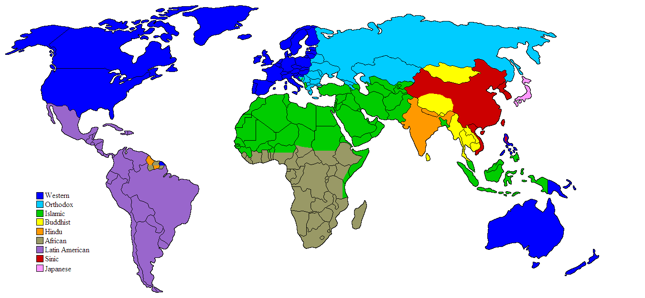
Crashing Civilizations

Slide 6
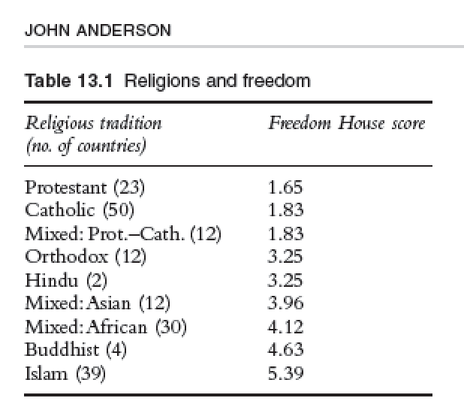
Anticipations

Slide 7
Review
Any further comments and questions?

Slide 8
References
Anderson, John (2009). Does God Matter, and If So Whose God? In Jeffrey Haynes (ed.). Routledge Handbook: Religion and Politics. New York: Routledge.
Huntington, Samuel P. (1996). Clash of Civilizations and the Remaking of World Order. New York: Simon & Schuster Paperbacks.

