Slide 1
«Race, Culture, and Communications»
STUART HALL
1989

Slide 2
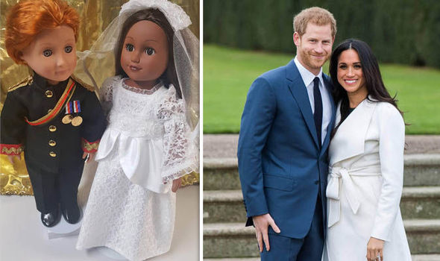
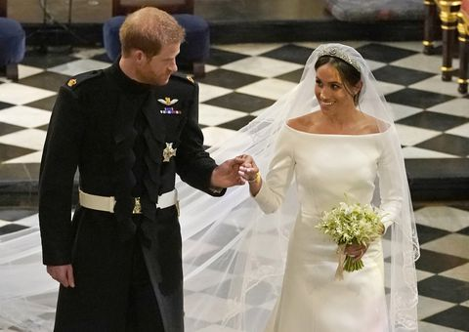
Prince Harry and Meghan- fairy tale wedding
Notes:
The very fact that she is referred to as black conveys a sense of racism in itself since she is paler than many Africans.

Slide 3
What is race?
What is ethnicity?
The film This is England presents a poignant portrayal of the issue of race. What led Combo to feel extreme anger towards Milky?
How did Britain experience “cultural trauma” during the decolonisation period?
When did the black communities begin to form in Britain?
What does Hall mean by stating that cultural studies has taught him to speak of “racisms” in the plural?
How does Hall explain “cultural racism”?
How are racial stereotypes formed?
According to Hall, what strategies have been employed to define certain groups of people as “the other”?

Slide 4
Ethnicity is about tradition, learned behaviour and customs. Ethnicity is a sociological or anthropological term to describe culture.
Race often refers to biologically engineered features, but this concept has been discredited because the divisions between races come from society not biology. The British Council points out that the human race is a single race so terms like ‘racial groups’ are misleading.
Note that Stuart Hall uses the term cultural racism(s) to refer to the discrimination against «different» ways of life.

Slide 5
Cultural studies deals with power relations.
The racial issues can be explained within the frame of power relations between dominant and sub-ordinate groups.
Cultural studies is interdisciplinary.

Slide 6
In his essay, Hall explains how they founded the Centre for Contemporary Cultural Studies (CCCS).
Then, he explains what cultural studies is:
it poses new questions
these questions are central, serious and disturbing

Slide 7
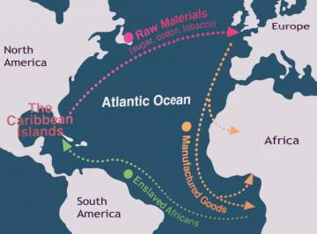

Slide 8
Slave triangle/the slave trade
GB – sailed down to West Africa, sold textiles, weapons and goods
West Africa – in return for the goods, they would get slaves
North and South America – They would take the slaves to the Americas and sell them to the plantation owners in return for sugar, tobacco and cotton which they would take to GB and sell to Europe

Slide 9
Harold Macmillan’s speech in South Africa in 1960 strengthened the decolonisation process which had begun during the Labour government between the years 1945 and 1951.
His "wind of change" speech became a historical landmark. Macmillan stated the following:
«The wind of change is blowing through this continent. Whether we like it or not, this growth of national consciousness is a political fact.»
Macmillan’s speech affirmed that the British government accepted that the days of the Empire were over, and it dramatically speeded up the process of African independence.

Slide 11
The great migrations of the 50s and 60s from the Caribbean and from the Asian continent led to the formation of black communities in the UK.
The negative representation of black people in the culture gave rise to a new form of racism – cultural racism.

Slide 12
The differences in culture, in ways of life, in systems of belief, in ethnic identity and tradition now matter more than anything that can be traced to specifically genetic or biological forms of racism.

Slide 13
Racial stereotyping – the negative imagery of race and ethnicity in the mass media, exclusion of the black experience from the «English» way of life, repetition in the mass media of a simplified history, life, and culture of black people.

Slide 14
The reality of race in any society is media-mediated.
Racism expresses itself through displacement, through denial, through the capacity to say two contradictory things at the same time, the surface imagery speaking of an unspeakable content, the repressed content of a culture.

Slide 15
Racism occupies a world of opposites: them and us, primitive and civilised, light and dark, a black and white symbolic universe.
Yet, these categories do not tend to consider the complexes of feelings and attitudes, beliefs and conceptions that refuse to be so neatly stabilised and fixed. (e.g. Resistance against restrictive stereotypes)

Slide 16
Cultural racism comprises the attempt to make what is different an object of the exercise of power, the attempt to expel it to the far side of the universe.
But, what is expelled keeps coming back home.

Slide 17
In Black Skin, White Masks, Franz Fanon engages with the psychological experience of Black people under the rule of the white – such as how Black people were made to feel if they did not learn the language of the white, or how, for instance, they began to dislike their own race and have a strong desire to be white.

Slide 18
«The Black Madonna»

Slide 19
Discussion questions
What is the reaction of the townspeople to the arrival of the Black Madonna?
How are the Parkers described early in the story?
What are the two Jamaicans called?
What is Tina Farell’s occupation?
What is Lou’s sister called?
What is it that Raymond thought he saw in Lou’s sister’s house?
What is Raymond’s reaction to the black baby?
Whose side has ‘the black blood’?
What did the Parkers decide to do with the baby?
Explain briefly the two examples of irony in the story.

Slide 20
«My Son the Fanatic»

Slide 21
Discussion questions
What is Parvez’s son called?
What is Parvez’s occupation?
What is the “eccentric” change in Parvez’s son?
What is it that Parvez’s son does early in the mornings?
What is Parvez’s lady friend called?
What is Parvez’s outlook on life?
What caused Parvez to avoid all religions?
What is it that Parvez’s son dislikes in his father’s attitude towards their life
in England?
What did Parvez do when they got home after the quarrel
(which happened towards the end of the story)?
Who is the ‘fanatic’ in the story?

