Slide 1
Diversity And Classification of Flowering Plants: Eudicots: Asterids

Slide 2
Asterids

Slide 3
Ovules unitegmic

Slide 4
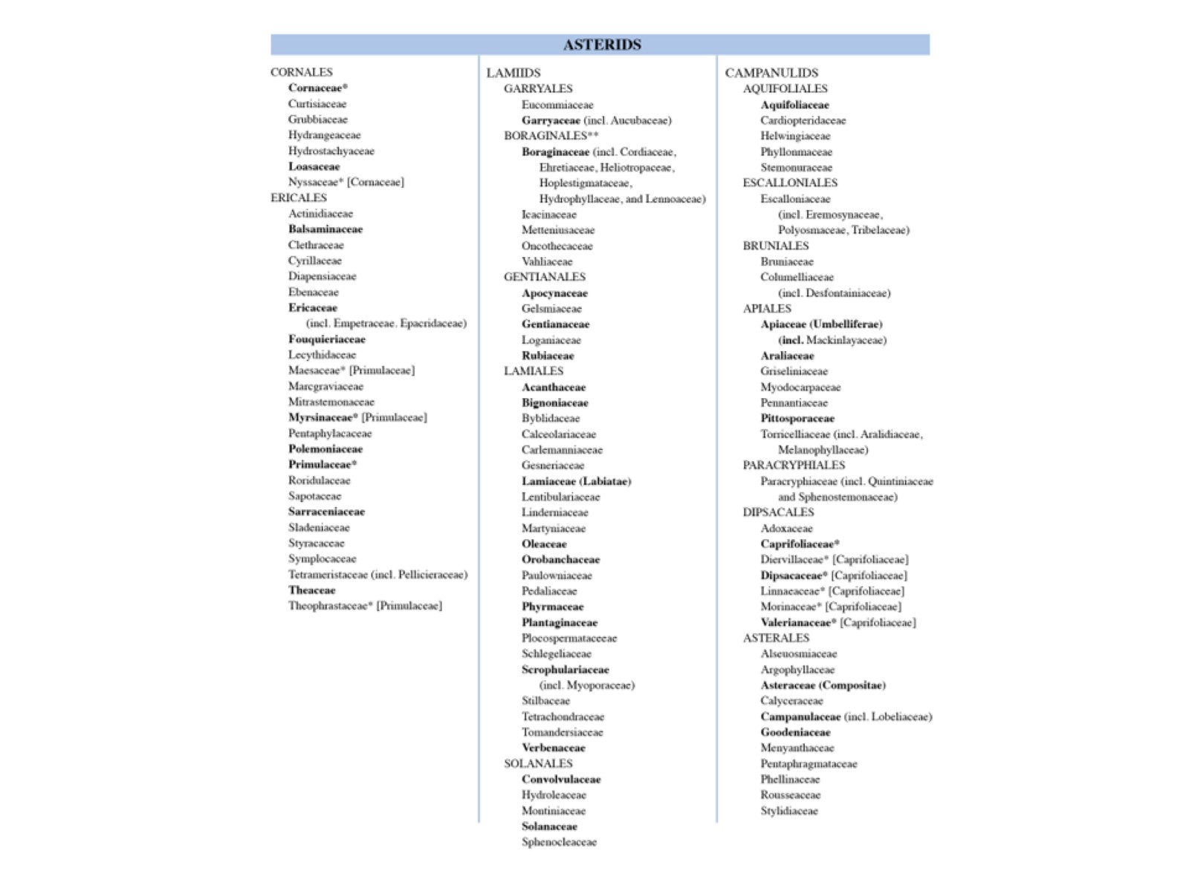

Slide 5
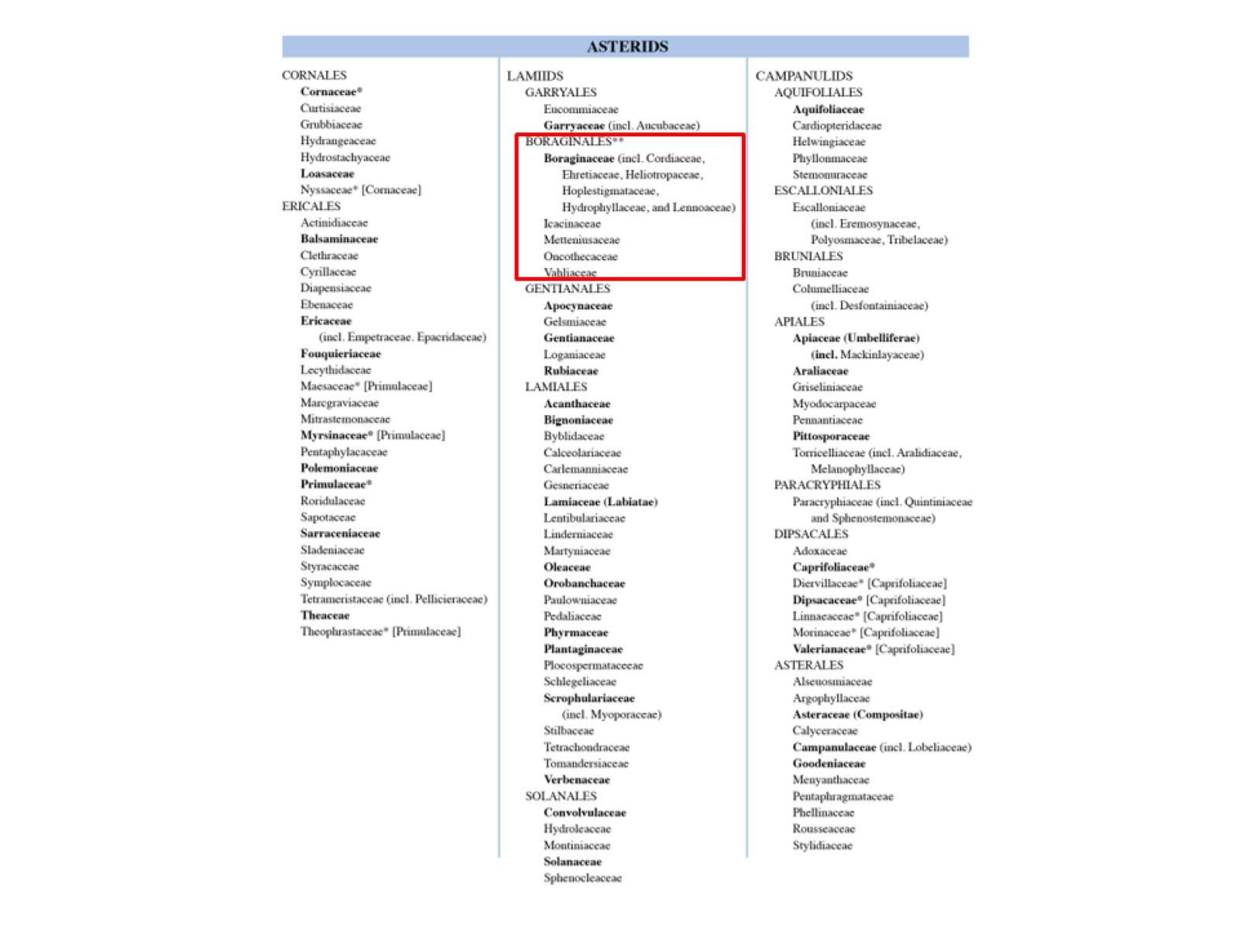

Slide 6
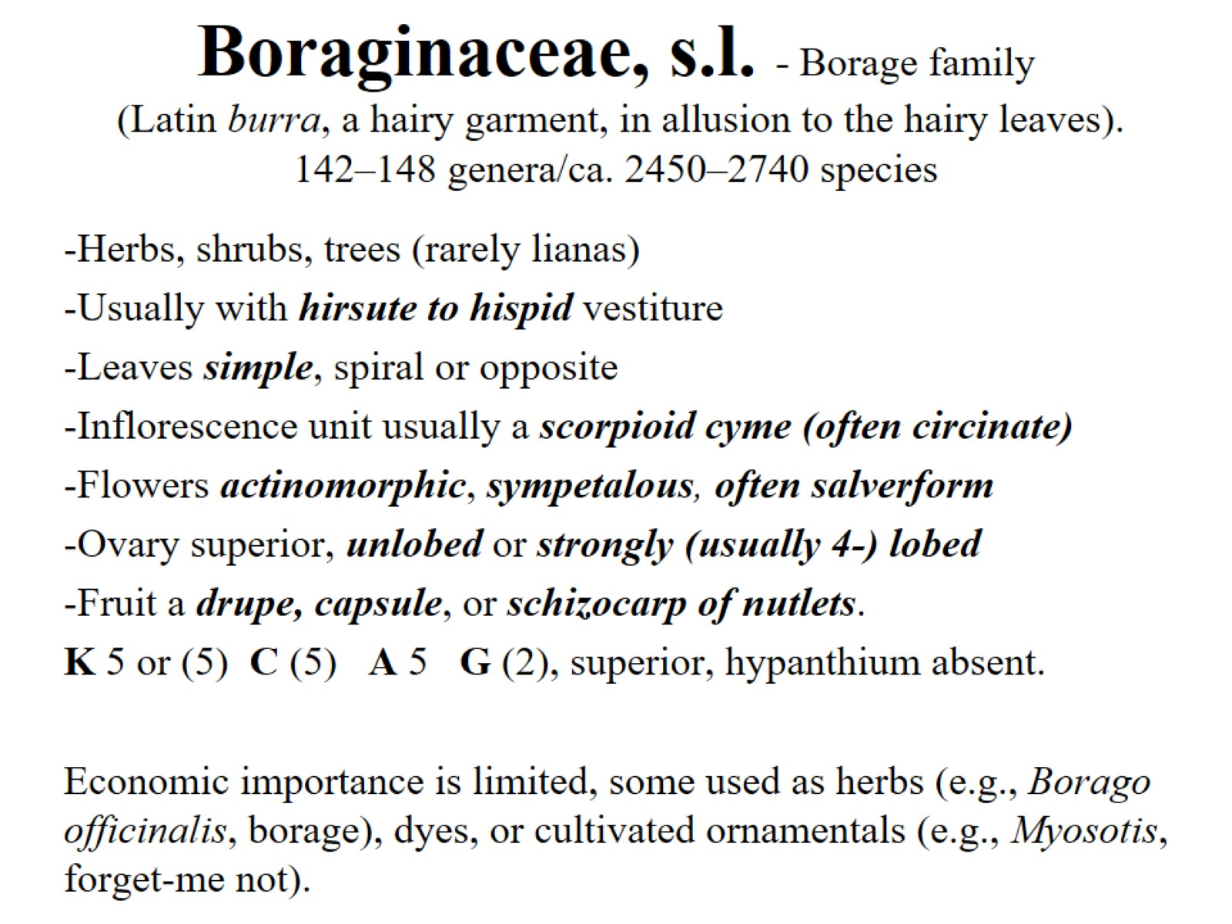
Boraginaceae, s.l. - Borage family (Latin burra, a hairy garment, in allusion to the hairy leaves). 142–148 genera/ca. 2450–2740 species

Slide 7
Boraginaceae, s.l. - Borage family

Slide 8
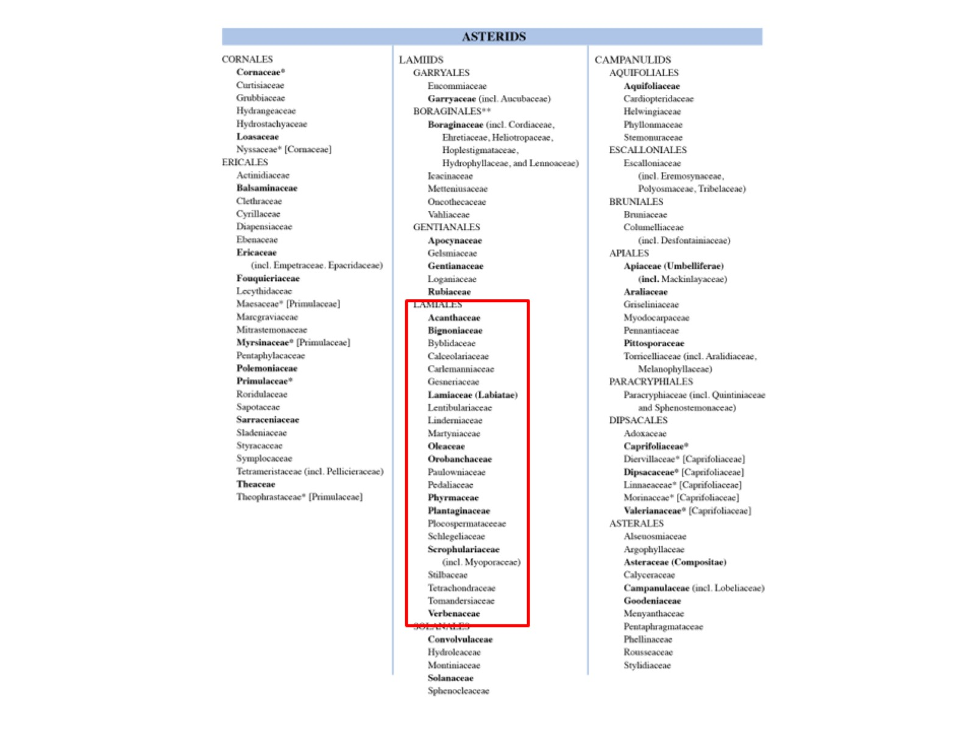

Slide 9
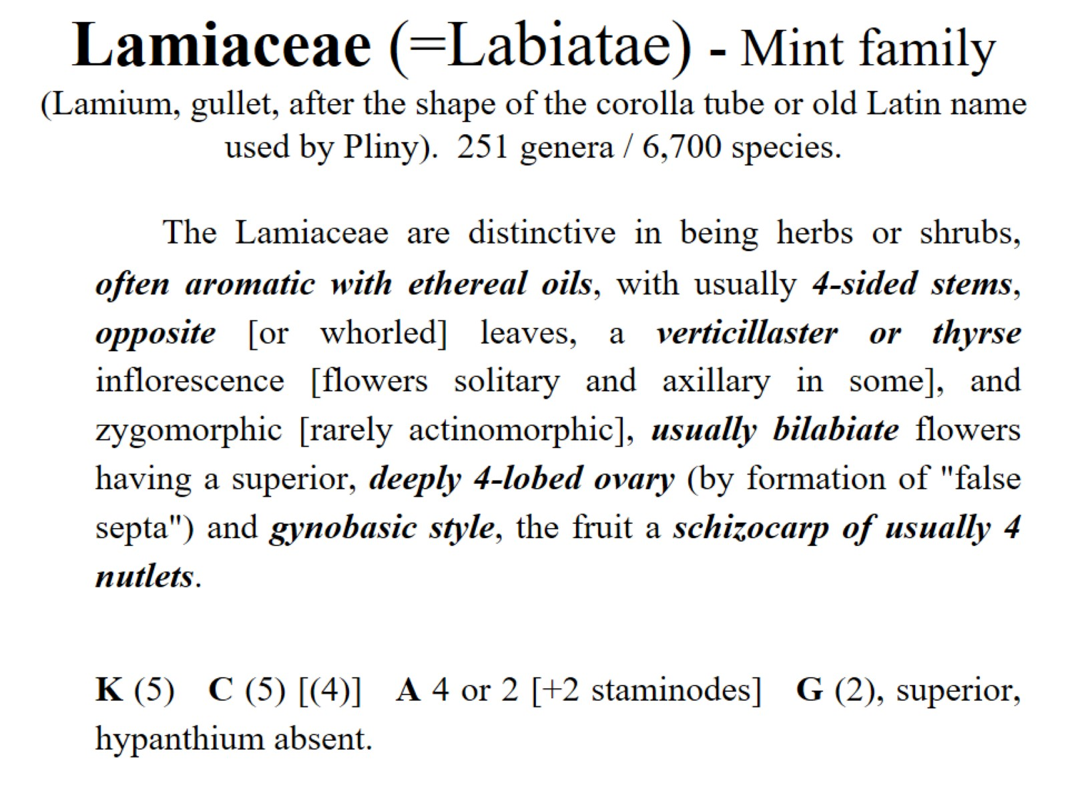
Lamiaceae (=Labiatae) - Mint family (Lamium, gullet, after the shape of the corolla tube or old Latin name used by Pliny). 251 genera / 6,700 species.

Slide 10
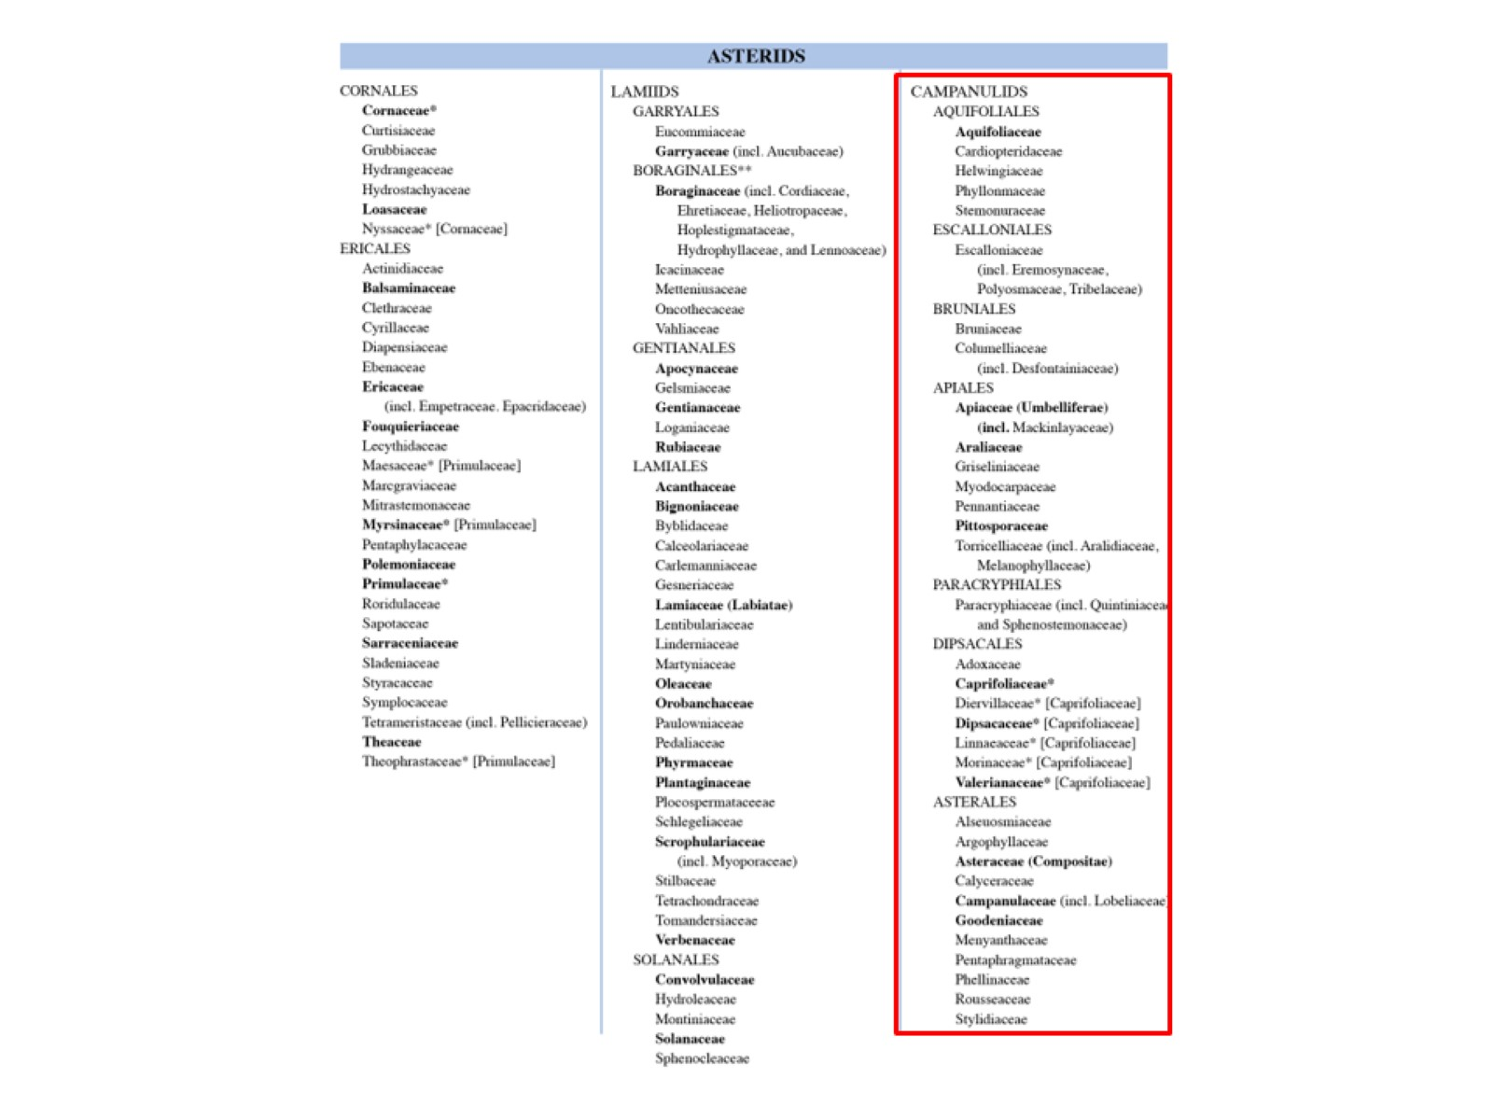

Slide 11
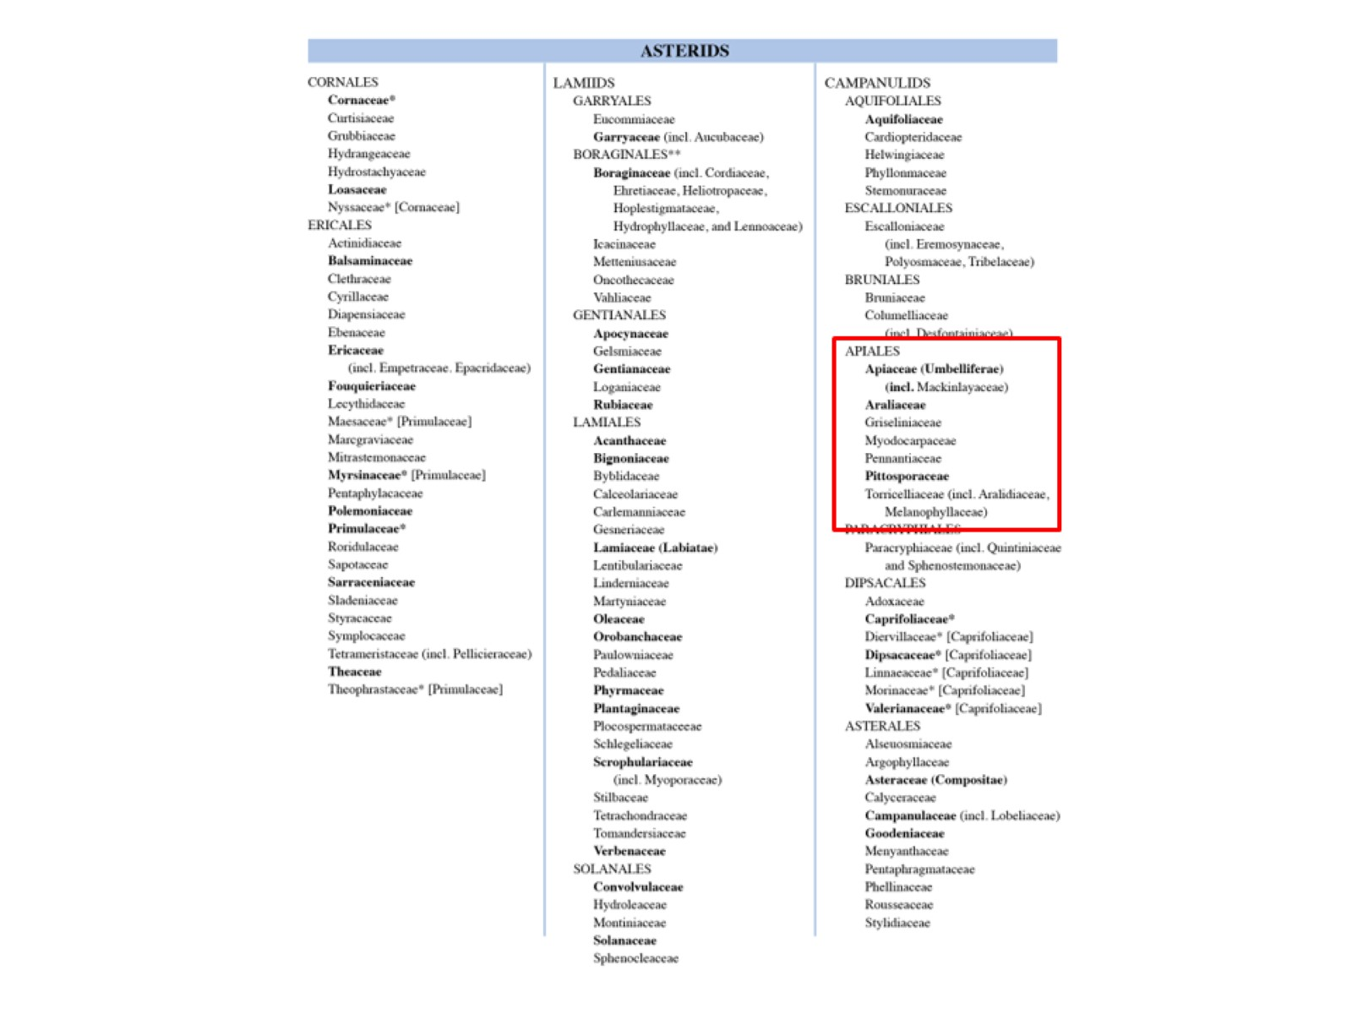

Slide 12
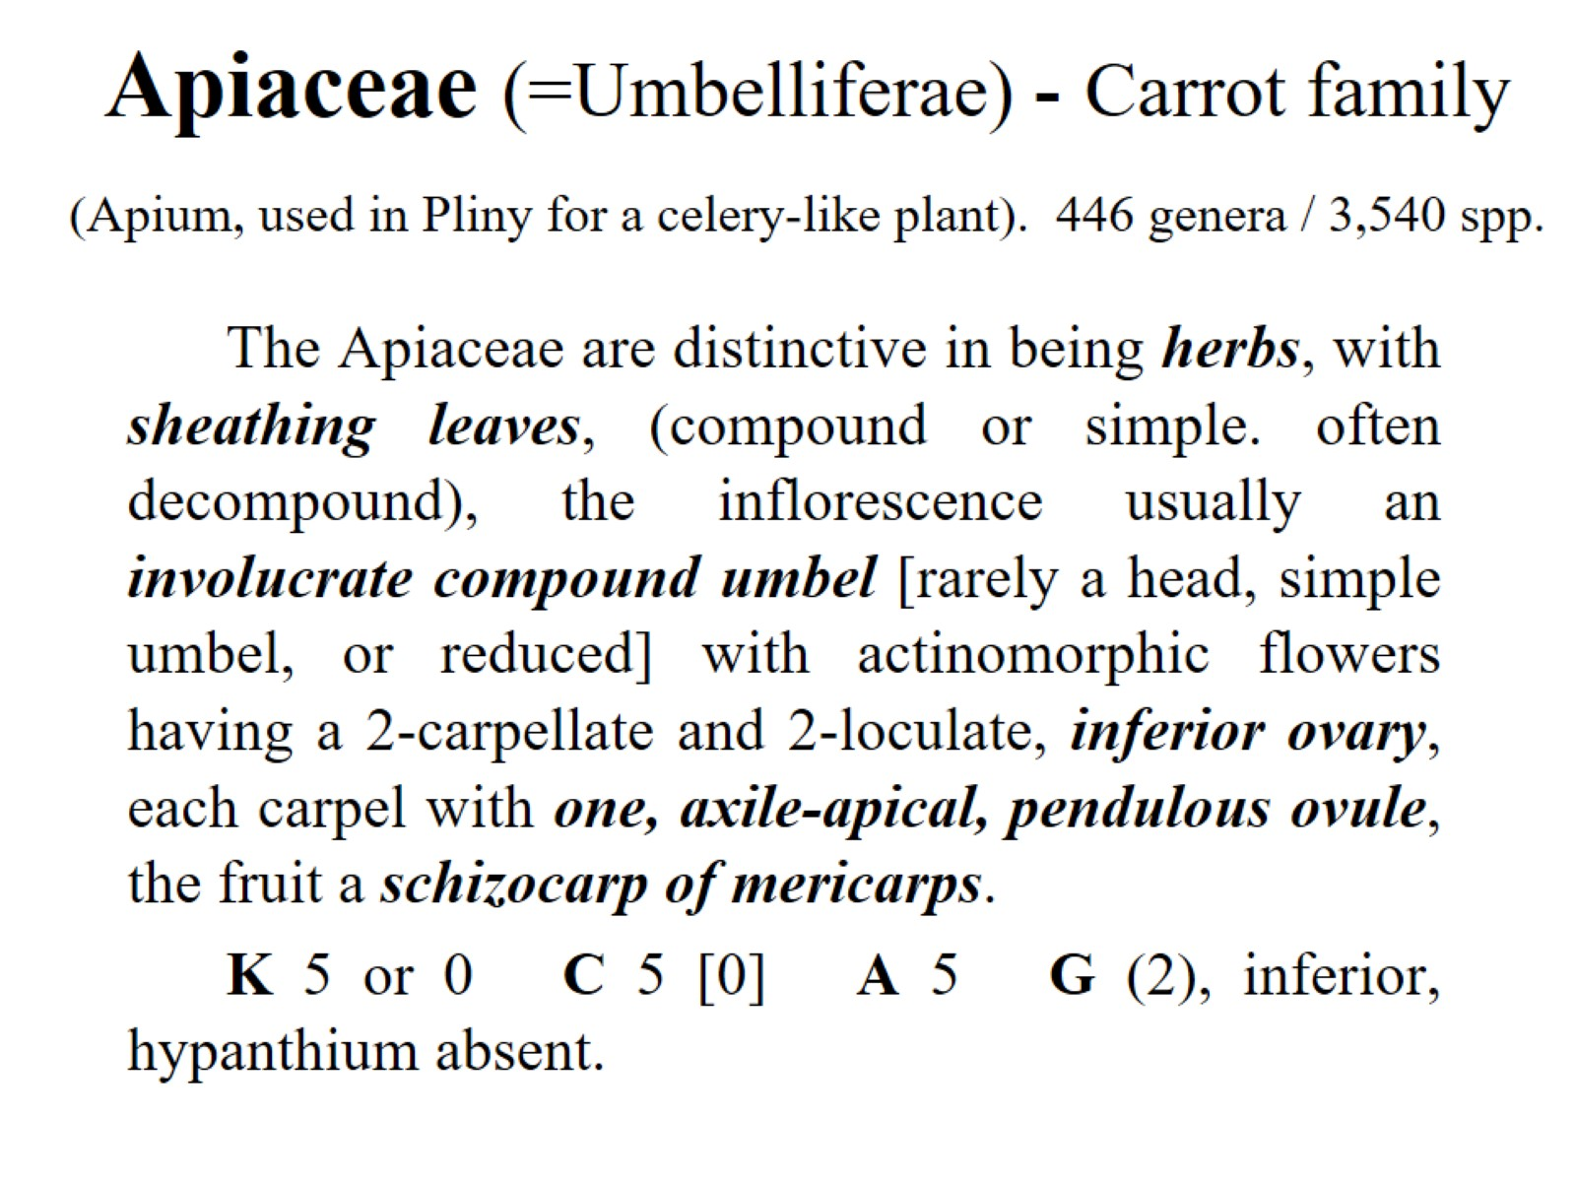
Apiaceae (=Umbelliferae) - Carrot family (Apium, used in Pliny for a celery-like plant). 446 genera / 3,540 spp.

Slide 13
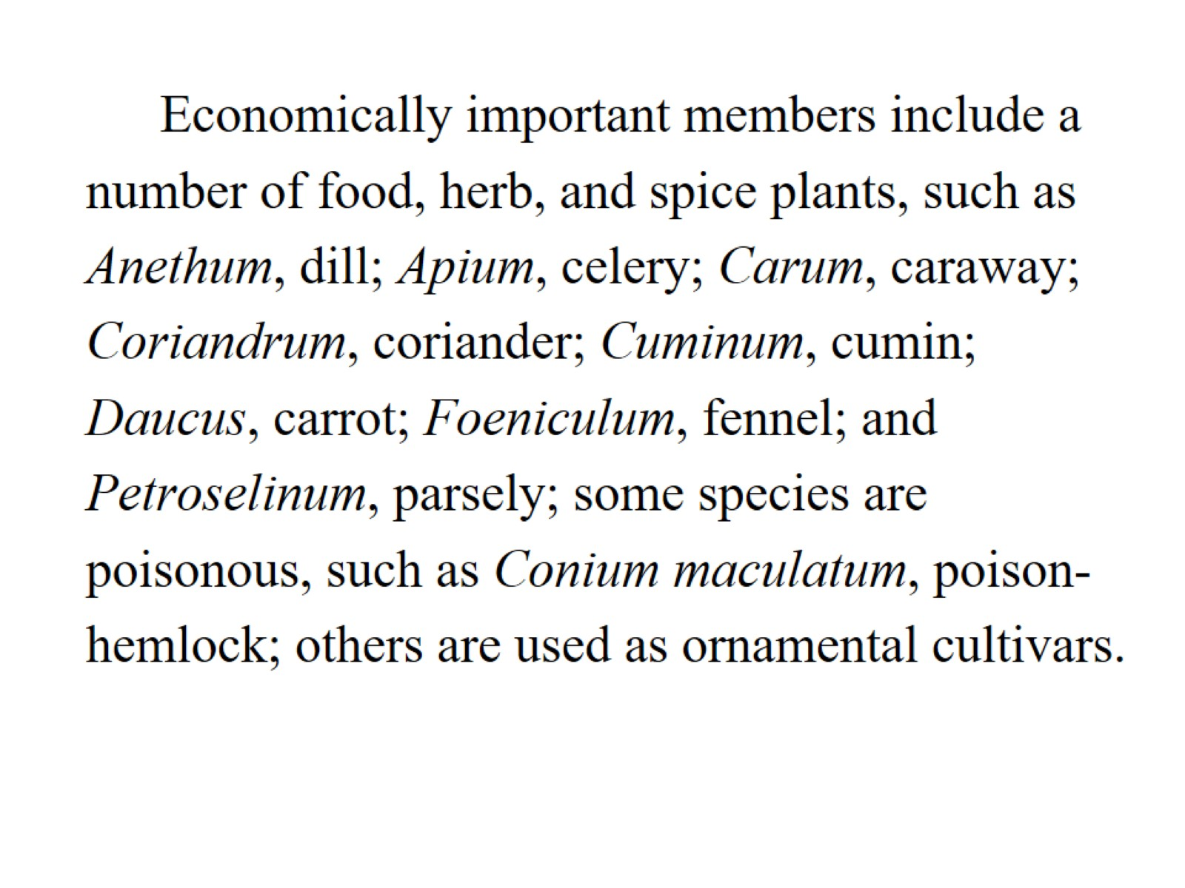

Slide 14
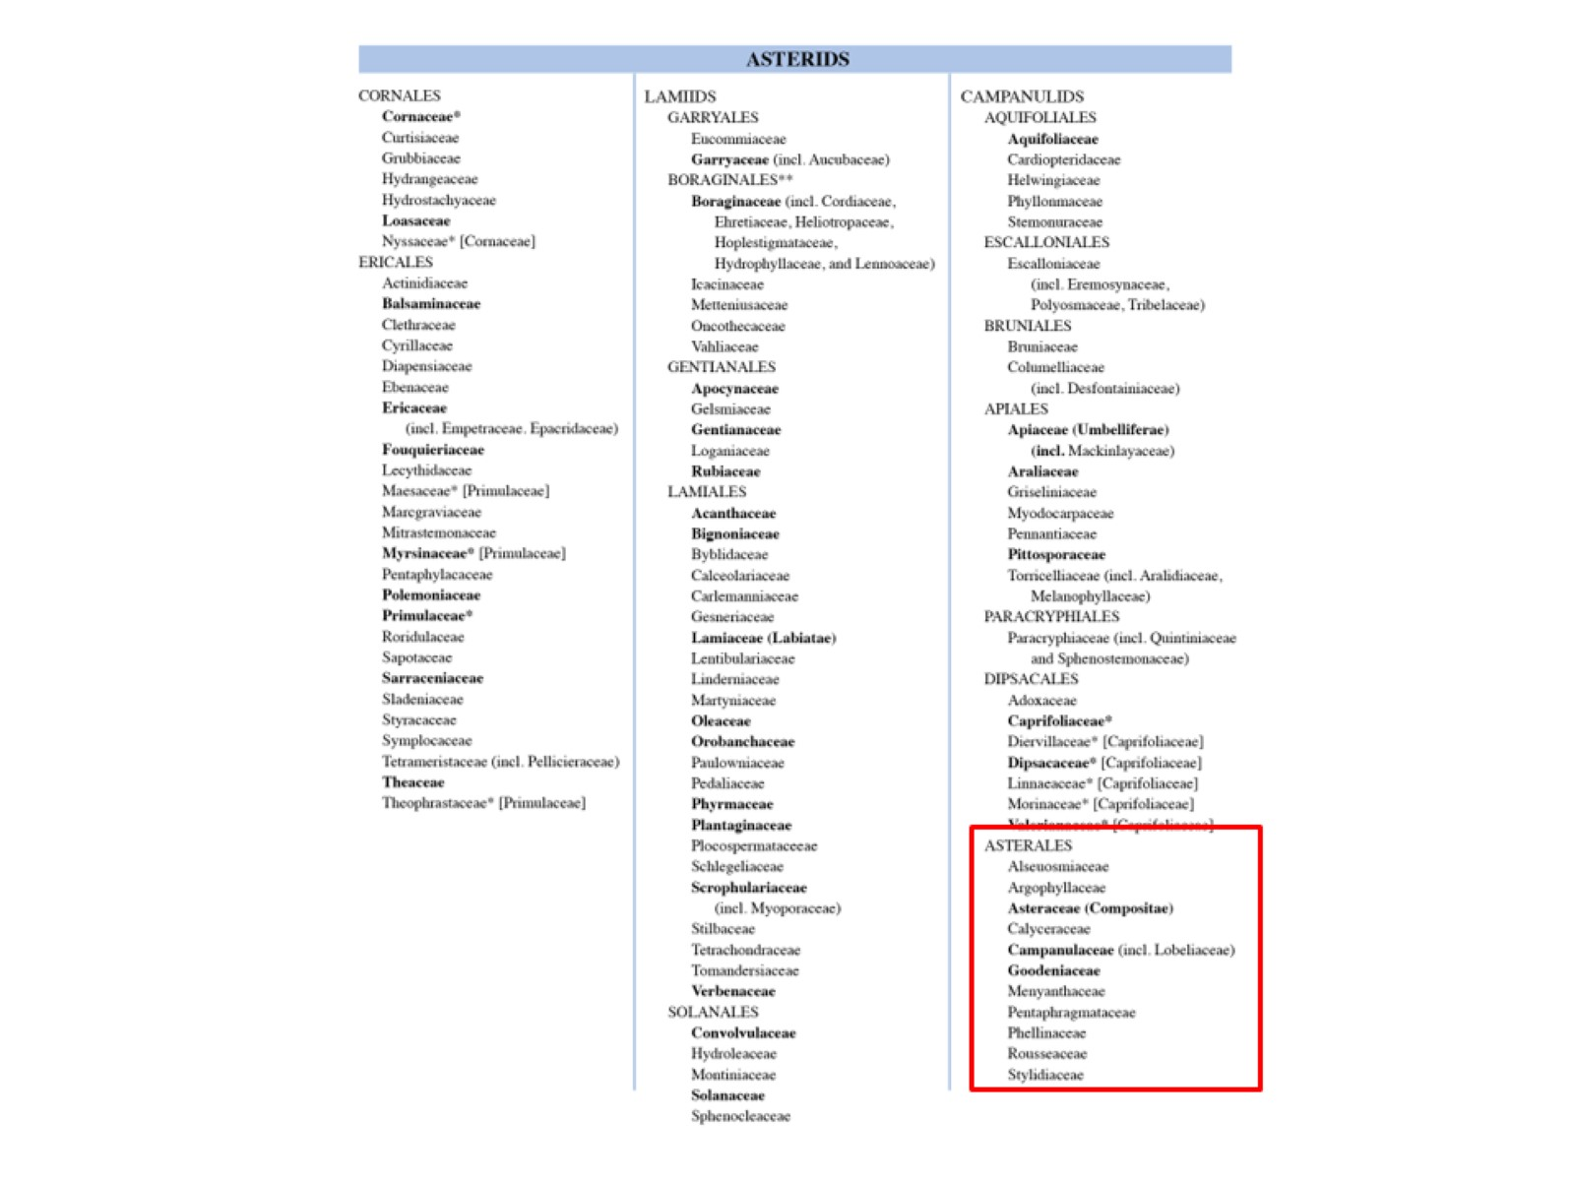

Slide 15
Asteraceae (Compositae)

Slide 16
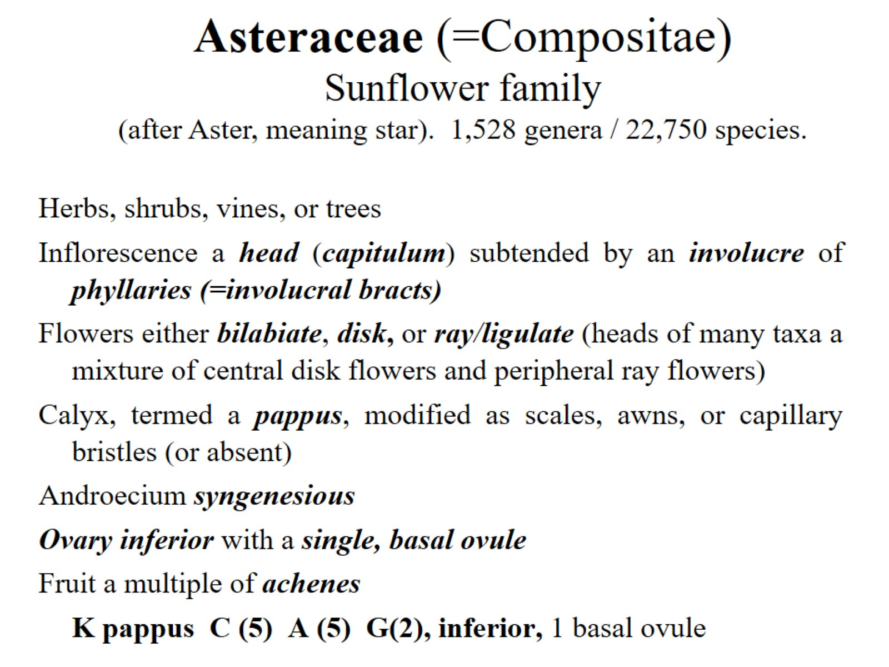

Slide 17
Asteraceae (=Compositae)

Slide 18
Asteraceae (=Compositae) - Sunflower family (after Aster, meaning star). 1,528 genera / 22,750 species.

Slide 19
Asteraceae: floral variation

Slide 20
Five types of heads:

