Slide 1
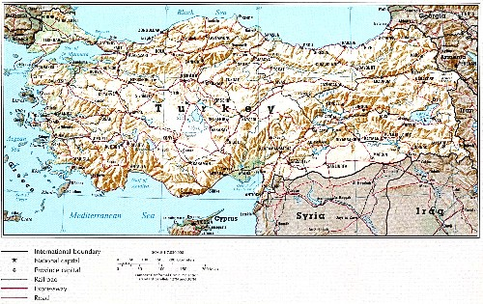
Epidemiological maps
1- point (settlement) maps

Slide 2
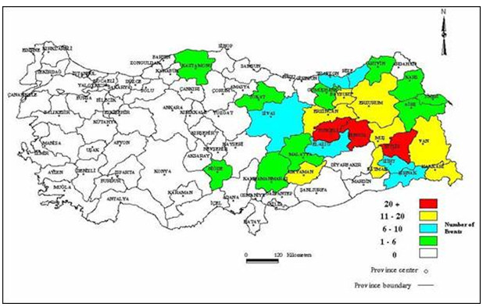
Epidemiological maps
2- distribution maps (Turkey Avalanche Distribution Map)

Slide 3
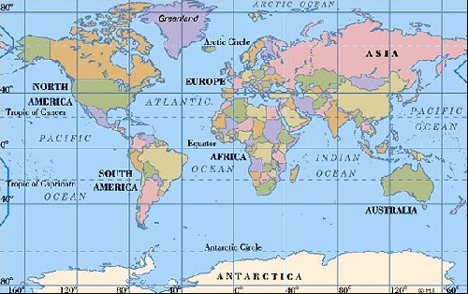
Epidemiological maps
3-collective maps

Slide 4
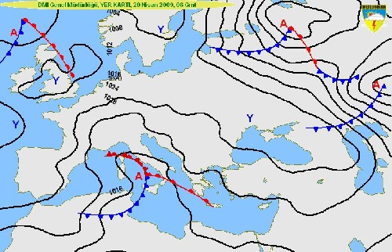
Epidemiological maps
4- isoplethic maps

Slide 5
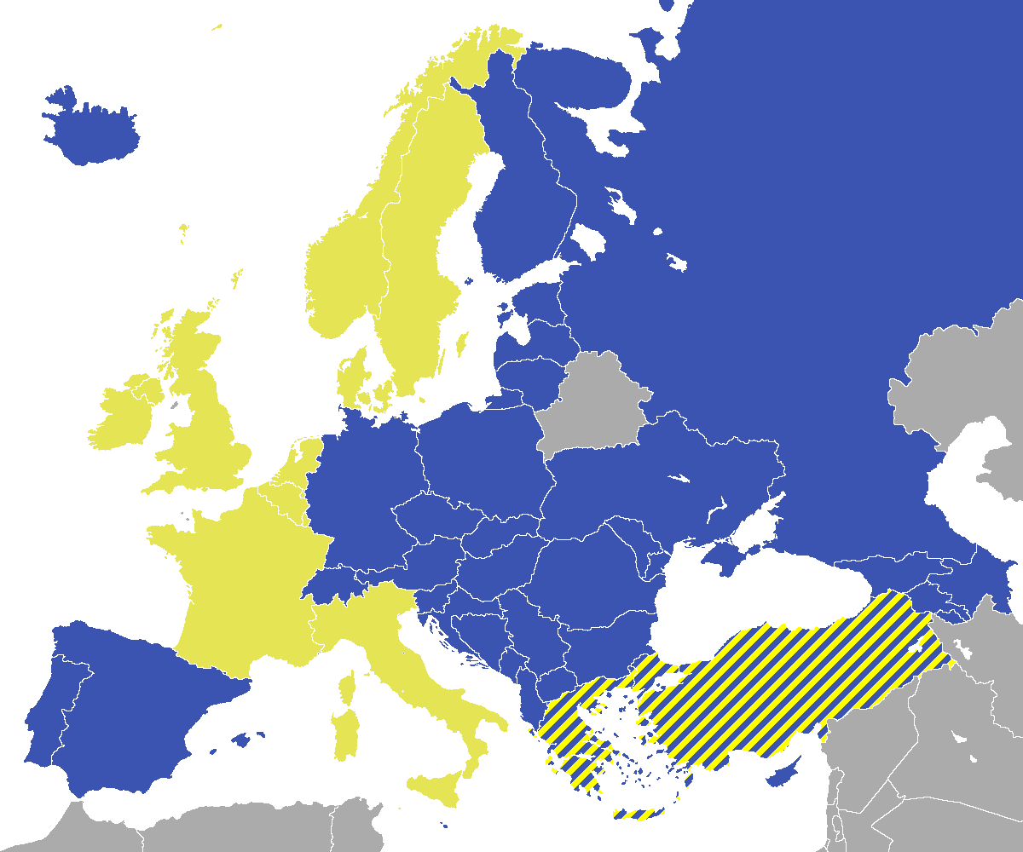
Epidemiological maps
5- demographic map

