Slide 1
KARDİYOVASKÜLER KLİNİK ANATOMİ
Prof. Dr. Ahmet Rüçhan Akar 2018-2019 Eğitim Yılı Ankara Üniversitesi Tıp Fakültesi
akarruchan@gmail.com
+90 533 646 06 84

Slide 2
“Understanding cardiac anatomy is
fundamental to success in cardiac surgery.”
Donald B. Doty, M.D.
John R. Doty, M.D.
CARDIAC SURGERY Operative Technique (2012)

Slide 3
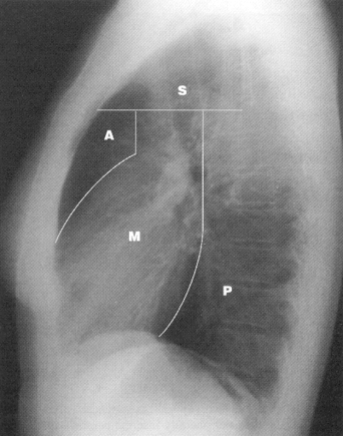
Mediastinal Compartments
Superior
Anterior
Middle
Posterior
line from the sterno-manubrial joint to the fourth thoracic vertebral body (T4)
Collins J, Stern EJ.
Chest Radiology- The Essentials (1999)

Slide 4
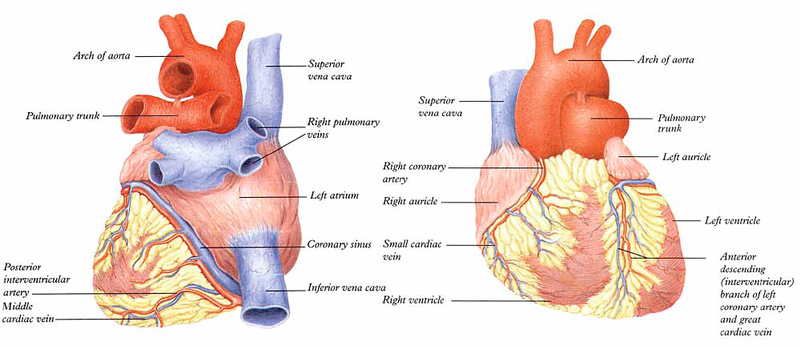

Slide 5
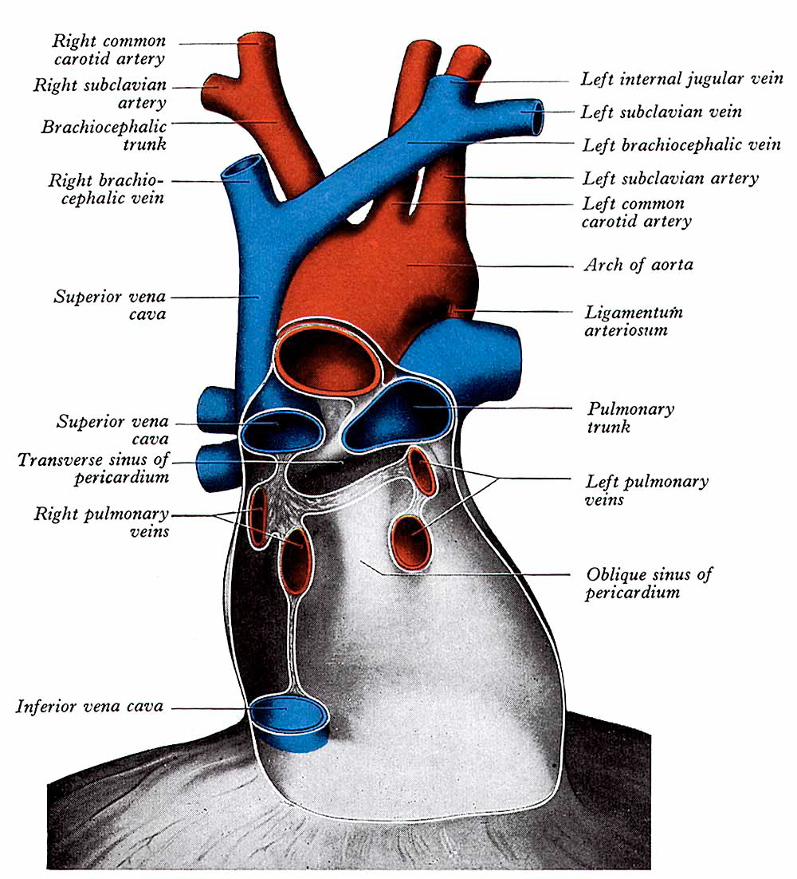
Perikardium
Transvers sinüs
Oblik sinüs

Slide 6
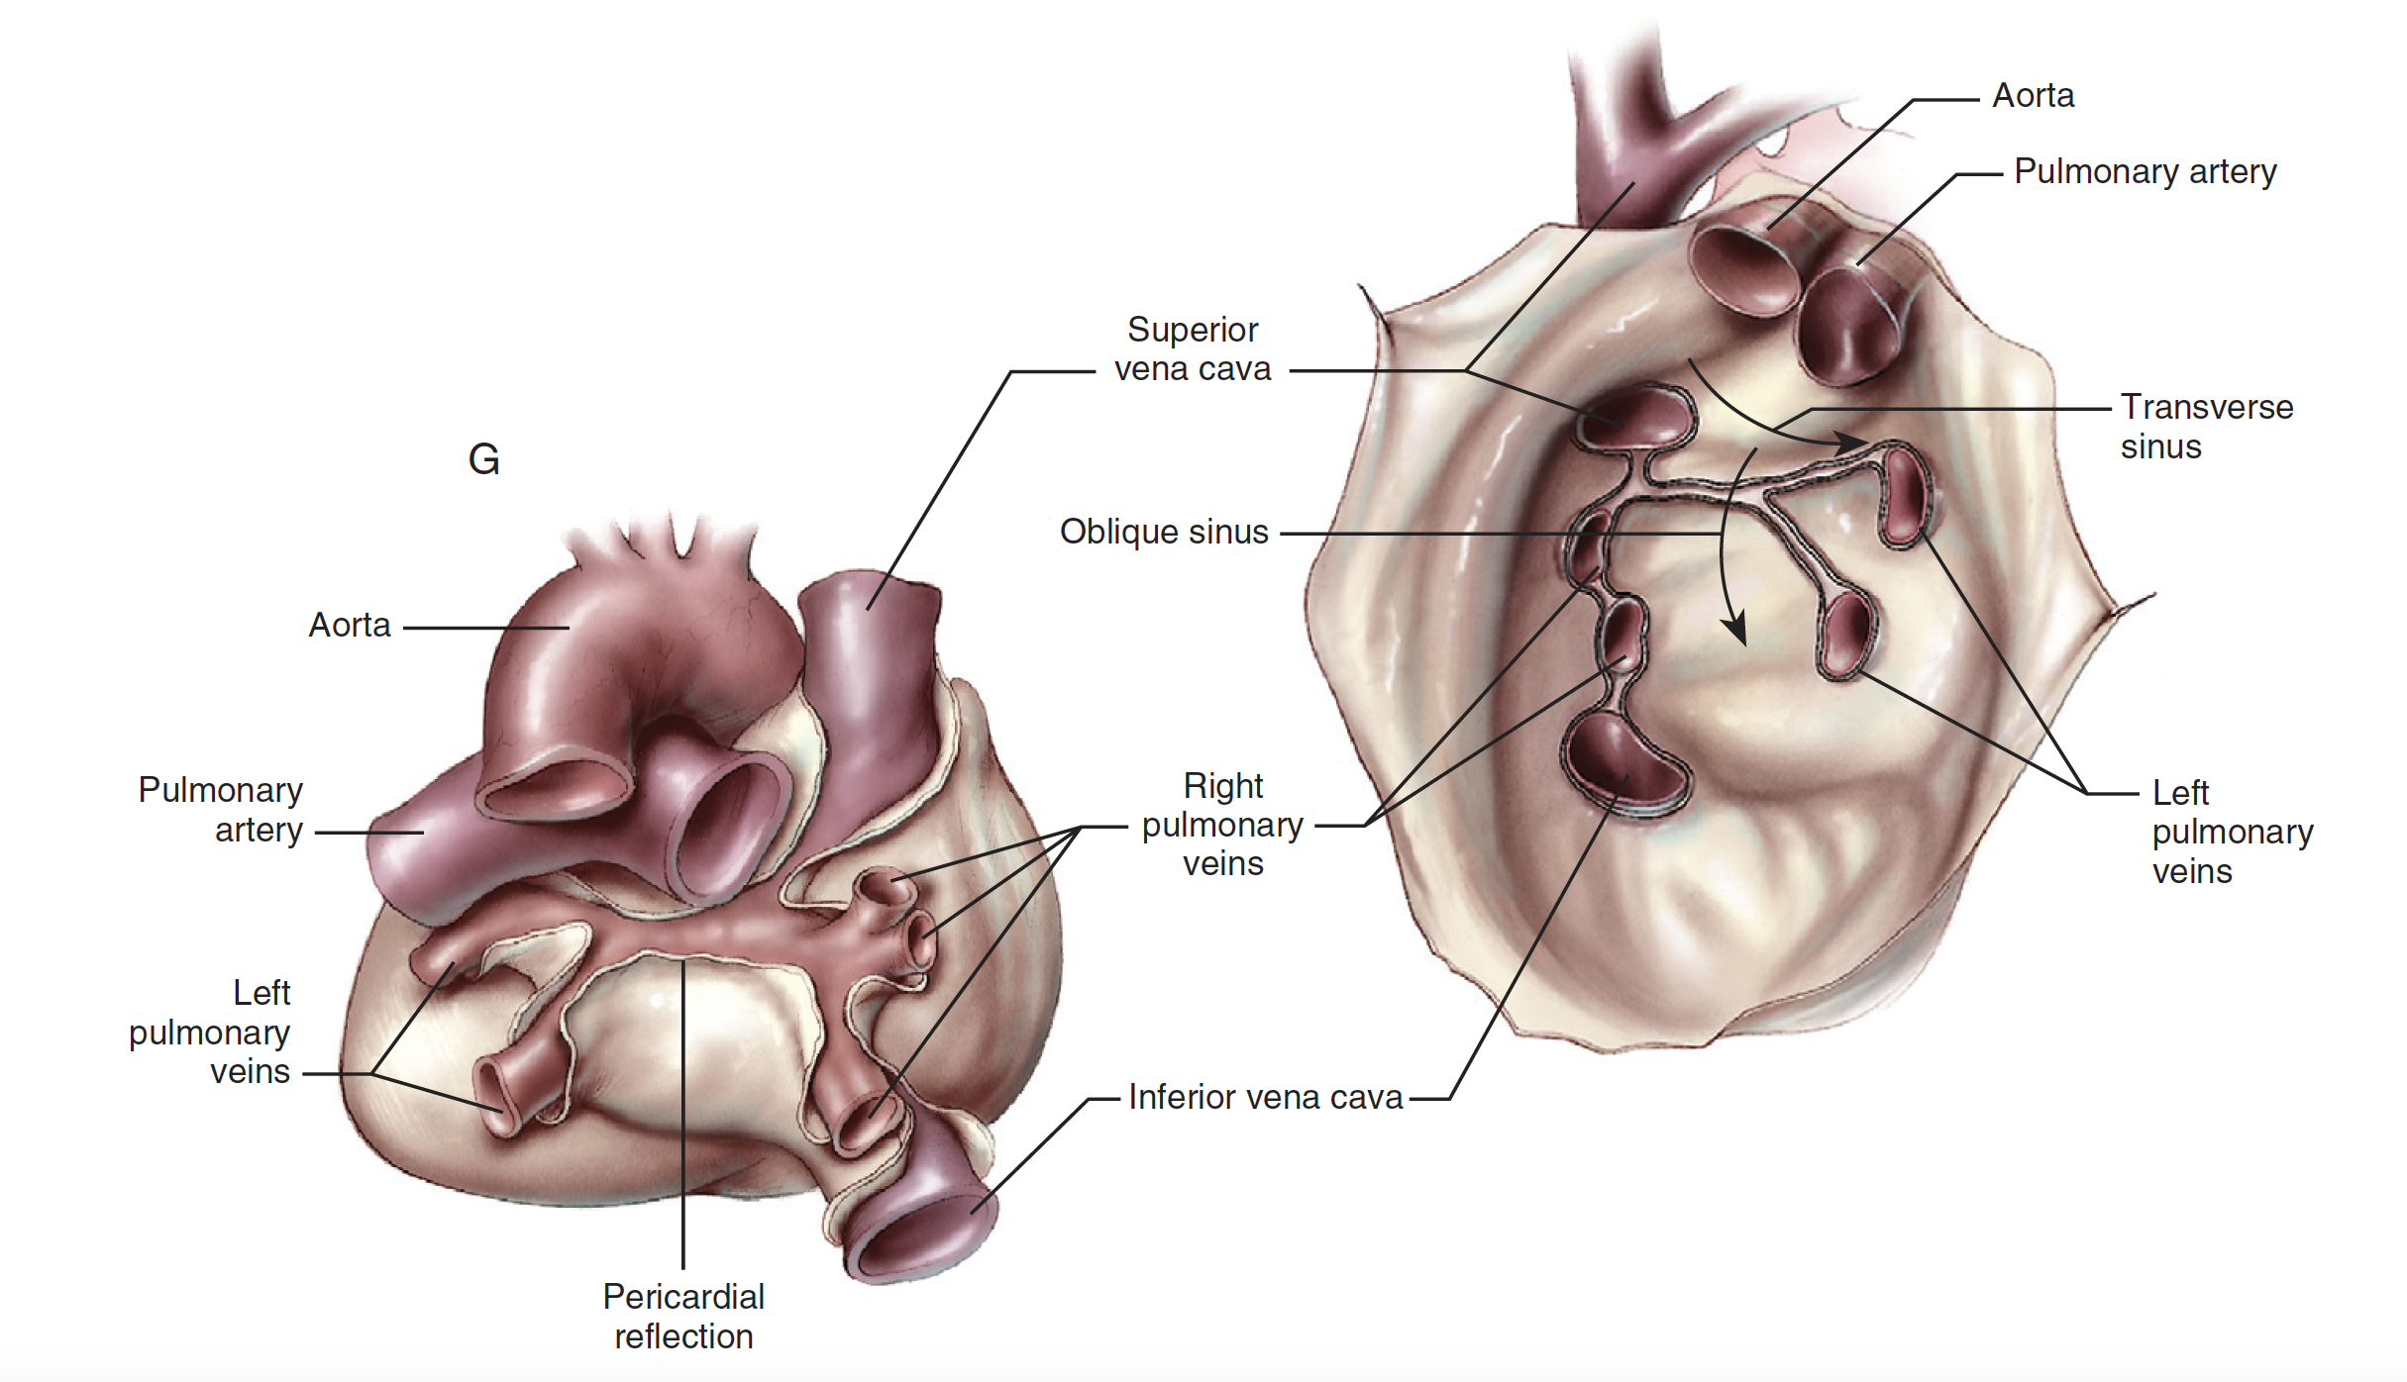

Slide 7
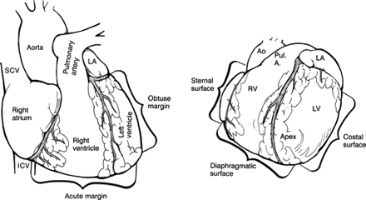
Kenar ve yüzeyler
Akut margin, Obtuz margin, Posterior margin

Slide 8
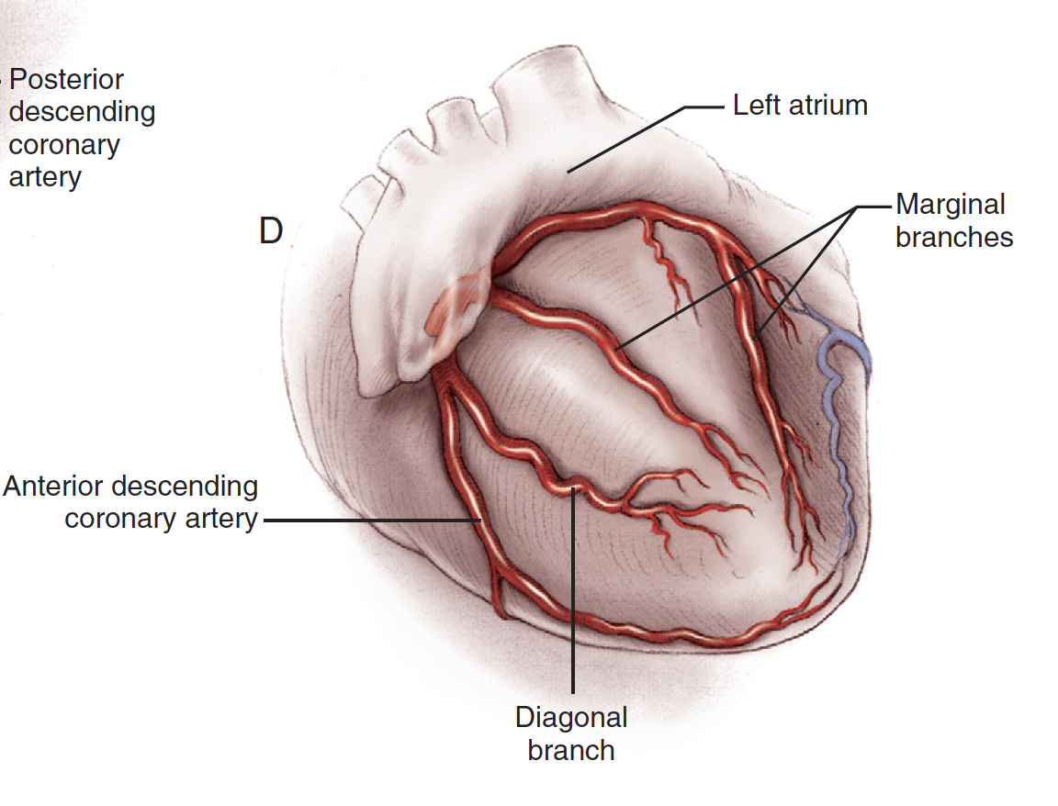

Slide 9
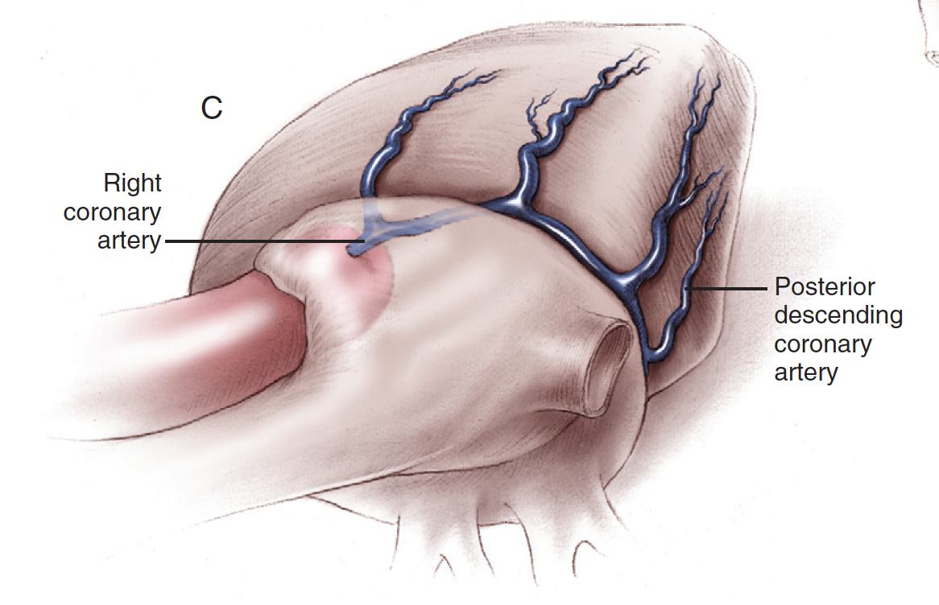

Slide 10
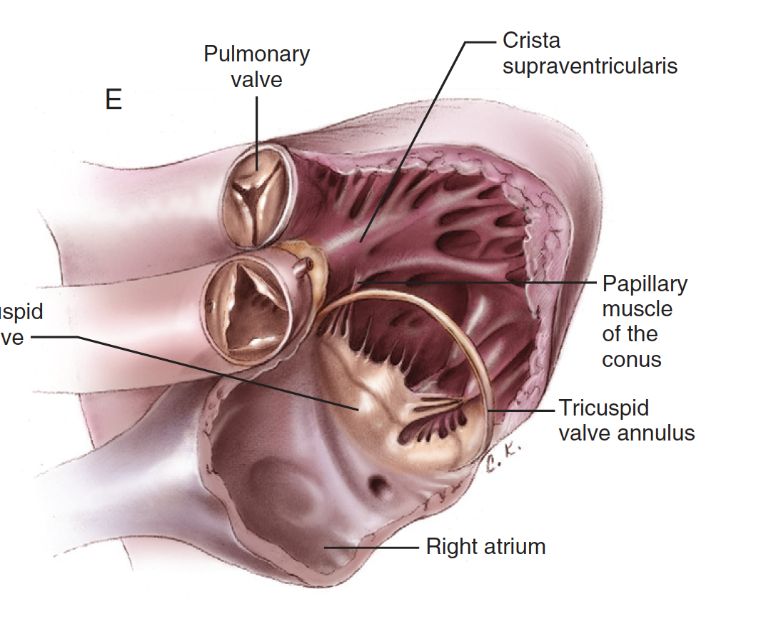

Slide 11
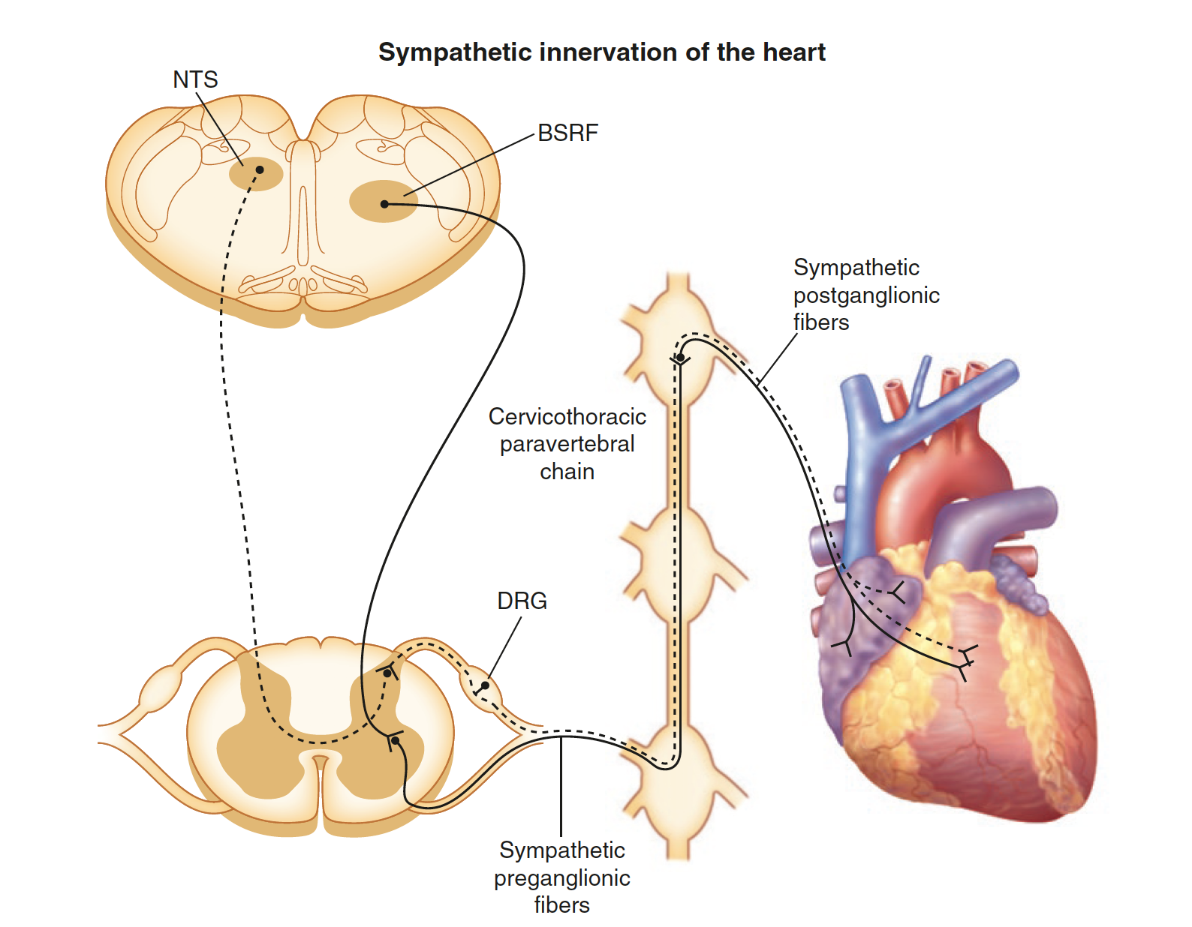
Notes:
Figure 2-3. Cardiac sympathetic innervation. The sympathetic nervous system is one of the two divisions of the autonomic nervous system that regulates cardiac function, the other being the parasympathetic nervous system. This diagram illustrates the path of sympathetic nerve fibers to the heart (solid line). Sympathetic preganglionic neurons innervating the heart originate in the intermediolateral cell column between the first and fourth thoracic segments of the spinal cord [13].
These preganglionic neurons receive inputs from glutamatergic neurons of the brainstem reticular formation (BSRF), which includes the rostral ventrolateral medulla [14]. Preganglionic neurons course through the ventral rami and synapse on postganglionic neurons contained primarily within extracardiac intrathoracic ganglia.
Traditionally, it was thought that cell bodies of cardiac sympathetic postganglionic neurons were restricted to the stellate ganglia [15]; however, more recent data demonstrate that they also are found in the superior, middle cervical [16], mediastinal [17], and even intrinsic cardiac ganglia [2]. Postganglionic neurons from these ganglia innervate the atrial and ventricular myocardium, as well as the coronary vasculature.
Preganglionic neurons release acetylcholine, which binds to nicotinic acetylcholine receptors on postganglionic neurons. Postganglionic neurons in turn
release norepinephrine, which binds to α- and β-adrenergic receptors on cardiac myocytes and the coronary vasculature.
This initiates a signal transduction cascade that involves G proteins, cyclic adenosine monophosphate,
and protein kinase A, resulting in changes in chronotropy, dromotropy, inotropy, and lusitropy [13]. Also depicted in
this schematic is one of the paths through which cardiac afferent signals are transmitted to the central nervous system
(dashed line). These bipolar neurons with cell bodies in the dorsal root ganglia (DRG) have peripheral axons projecting to the heart and central axons projecting to the dorsal horn of the spinal cord. Second-order afferent neurons from the dorsal horn project to the nucleus tractus solitarius (NTS) of the medulla [18].

Slide 12
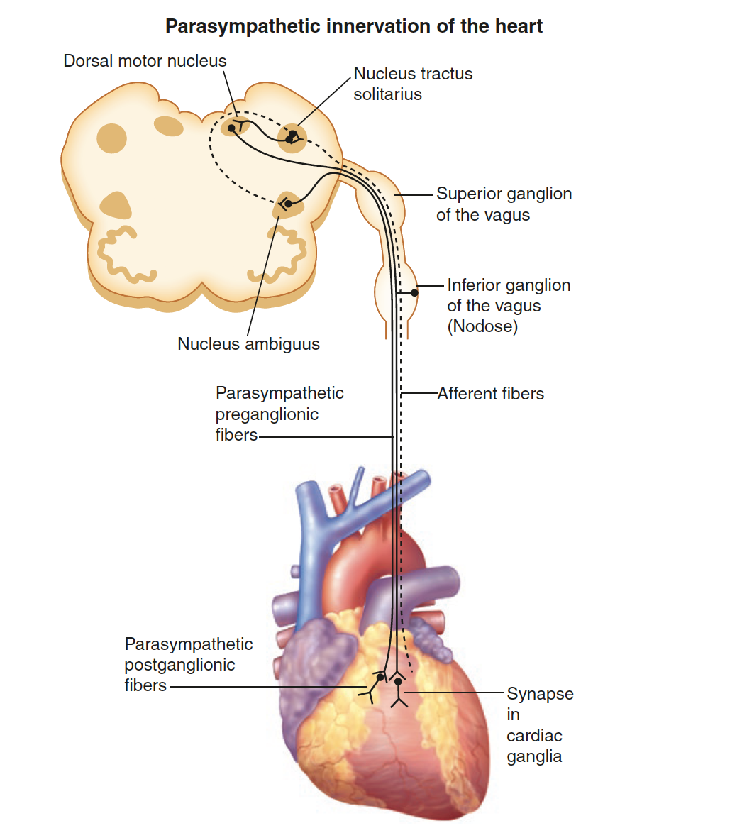
Notes:
Figure 2-4. Cardiac parasympathetic innervation. The parasympatheticnervous system is the other division of the autonomic nervous system that regulates cardiac function. This diagram illustrates the path of parasympathetic nerve fibers to the heart (solid line). Parasympathetic preganglionic neurons innervating the heart originate in the nucleus ambiguus and dorsal motor nucleus of the medulla oblongata in the brainstem [19].
In contrast to sympathetic preganglionicneurons, parasympathetic preganglionic neurons have long axons and synapse near the target organ. Cardiac parasympathetic preganglionic neurons synapse on postganglionic neurons contained within intrinsic cardiac ganglia [13]. Postganglionic neurons from these ganglia project axons to widespread regions of the heart [20]. Although most efferent nerve fibers contained within the vagus nerve are parasympathetic, sympathetic nerve fibers also have been reported
[21, 22].
Preganglionic neurons release acetylcholine, which binds to nicotinic acetylcholine receptors on postganglionic neurons. Postganglionic neurons in turn release acetylcholine, which binds to muscarinic receptors on cardiac myocytes and the coronary vasculature [19]. The vagus nerve is also an important path for sensory information from visceral organs, including the heart, to the central nervous system. In fact, approximately 80 % of the fibers contained within the vagus nerve are afferent, being made up of A, B, and C fibers [23–25]. Cardiac-related bipolar neurons with cell bodies in the nodose ganglia have peripheral axons projecting to the heart and central axons projecting to the nucleus tractus solitarius of the medulla (dashed line) [19]. Thus, the vagus nerve contains both ascending afferent and descending efferent nerve fibers. Furthermore, as vagus nerve stimulation is evaluated as a potential therapy for a variety of chronic disorders, it is critical to understand the type of axons being activated in order to maximize the efficacy of the therapy while minimizing off-target effects (Adapted from Huang
et al. [26]).

Slide 13
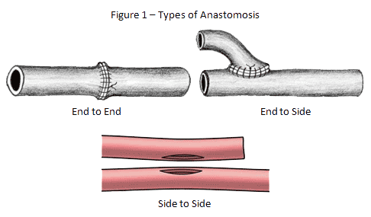
Anastamoz tipleri

Slide 14
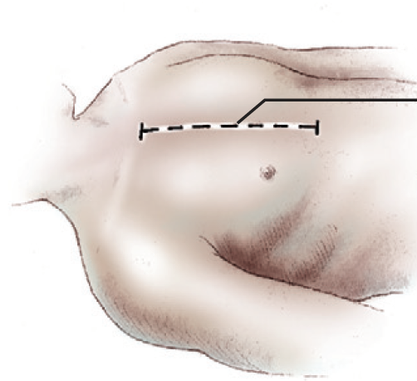
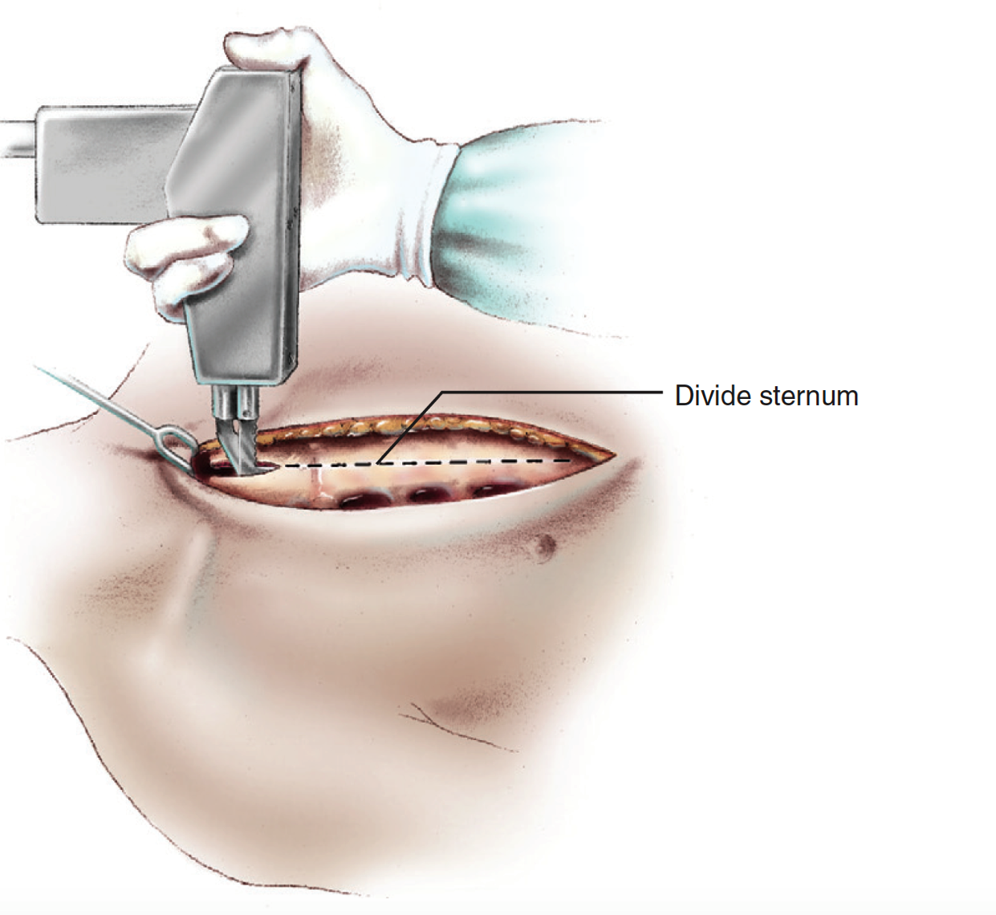

Slide 15
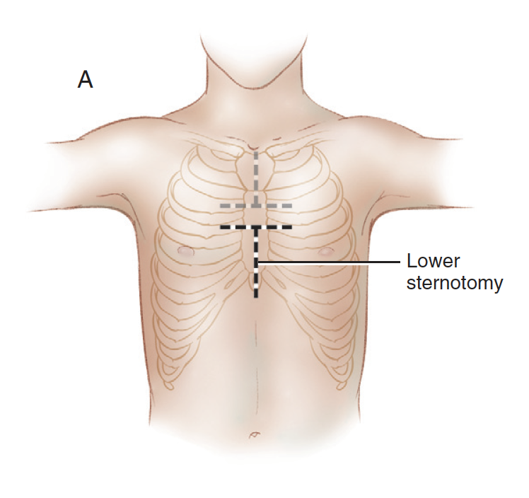
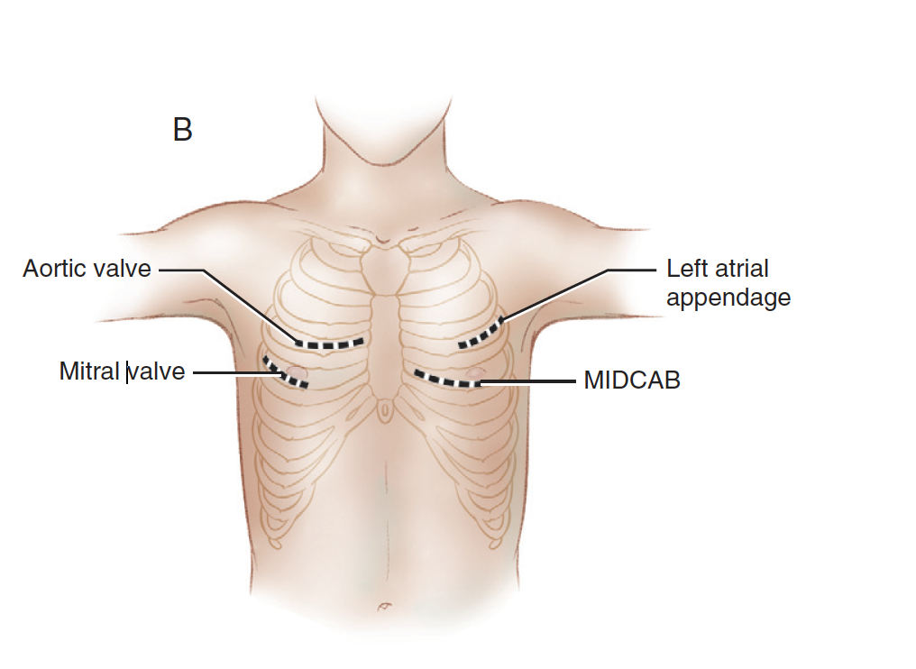

Slide 16
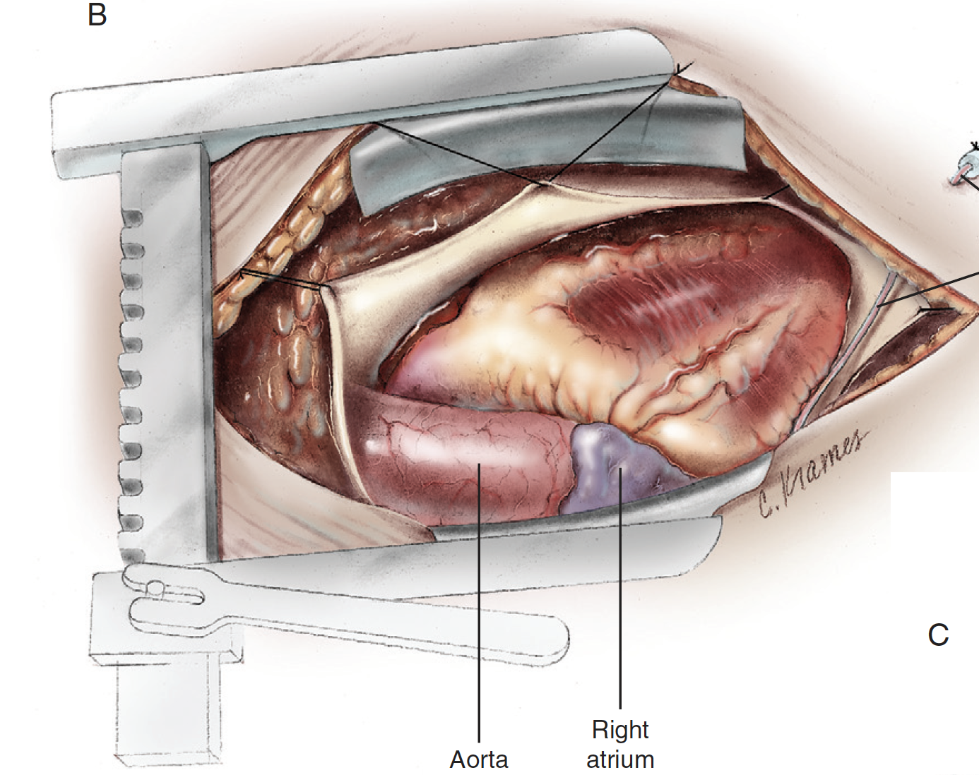

Slide 17
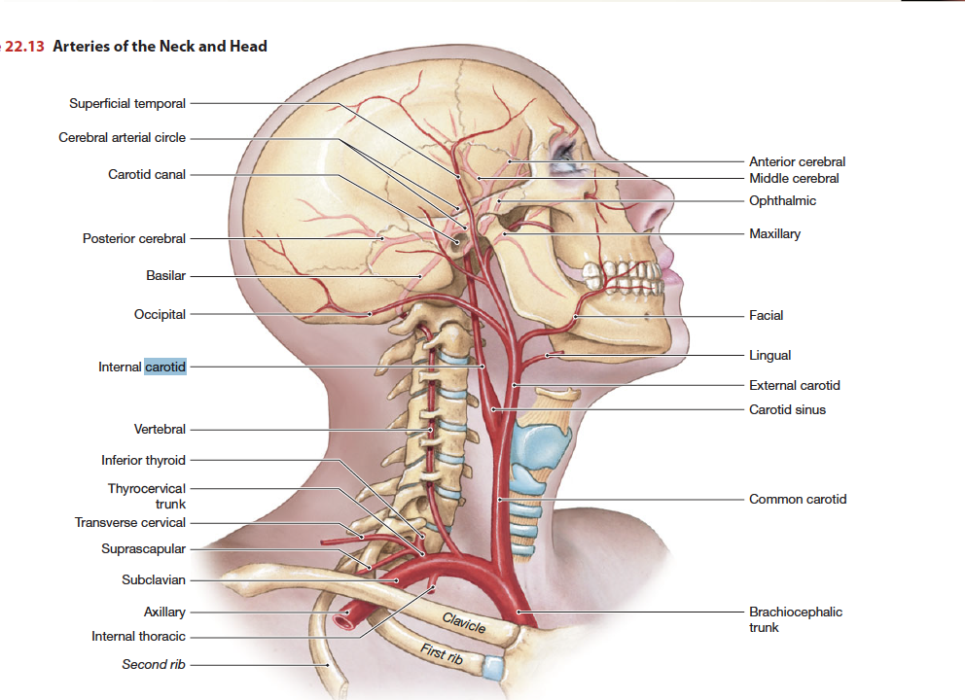

Slide 18
